Slide 1
Buffer Solutions “Sources of Alkalinity of Raise pH”
Los Angeles Regional Water Board
General WDR
Buffer solutions can create favorable groundwater pH conditions for aquifers less than pH of 6 to ensure favorable conditions (pH 5.5-6 to 8.1-8.5) for the degradation of groundwater pollutants during anaerobic reductive dechlorination and immobilization of metals
By Eliot Cooper
Vironex, Inc.

Slide 2
List of Proposed Buffers
Calcium Carbonate
Calcium Magnesium Carbonate
Calcum Oxide
Magnesium Hydroxide
Magnesium Oxide
Potassium Bicarbonate
Sodium Bicarbonate

Slide 3
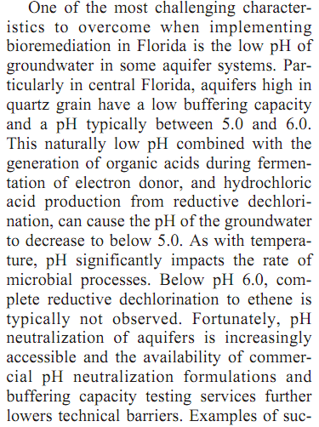
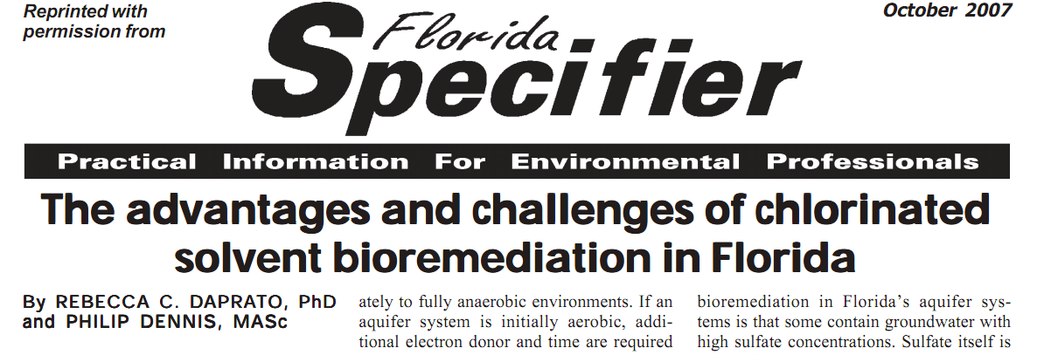
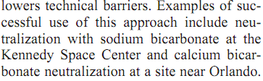
Kennedy Space Center

Slide 4
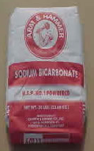
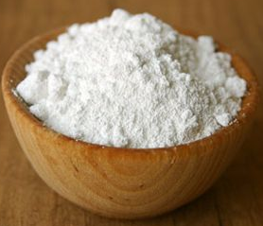
Sodium Bicarbonate
General Information: a white solid that is crystalline but often appears as a fine powder.
Chemical Formula: NaHCO3
Effectiveness: May have to be redosed
Adverse Impacts to GW Quality: , 1/3 volume precipitant but expected minimal impact on aquifer conductivity based on volumes utilized.
Human Health Impact: Slightly Hazardous, irritant (see MSDS for more information)
Time used in Industry: Most commonly applied by consultants rather than using commercial available buffering products from EVO vendors …

Slide 5
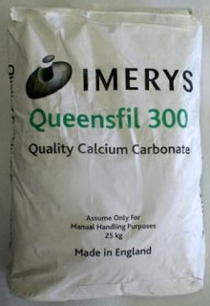
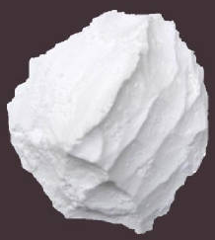
Calcium Carbonate
General Information: Limestone - Common substance found in rocks in all parts of the world, and is the main component of shells of marine, organisms, snails, coal balls, pearls, and eggshells.
Chemical Formula: CaCO₃
Effectiveness: May have to be redosed, typically grind to nano scale for sustainability and injectability.
Adverse Impacts to GW Quality: …
Human Health Impact: slightly hazardous, irritant (see MSDS for more information)
Time used in Industry: Newman Zone…

Slide 6
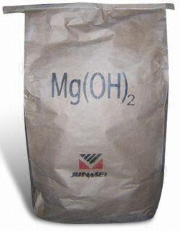
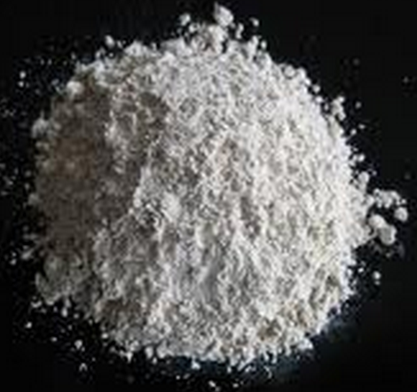
Magnesium Hydroxide
General Information: Magnesium hydroxide is a common component of antacids and laxatives. As a suspension in water, it is called milk of magnesia.
Chemical Formula: Mg(OH)₂ Also known as Milk of Magnesia.
Effectiveness: Lower cost than sodium, Insoluble in water, long reaction time.
Adverse Impacts to GW Quality : …
Human Health Impact: slightly hazardous, irritant (see MSDS for more information)
Time used in Industry: EOS, EHC

Slide 7
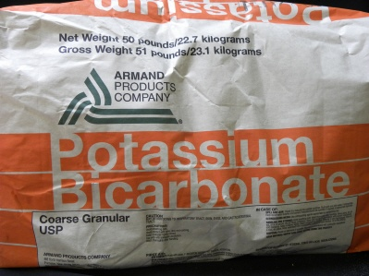
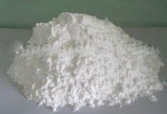
Potassium Bicarbonate
General Information: A colorless, odorless, slightly basic, salty substance.
Chemical Formula: KHCO₃
Effectiveness: Bacteria use ion effectively and creates more vigorous population. More expensive and less soluable than sodium.
Adverse Impacts to GW Quality: …
Human Health Impact: Hazardous, irritant (see MSDS for more information)
Time used in Industry: ABC+

Slide 8
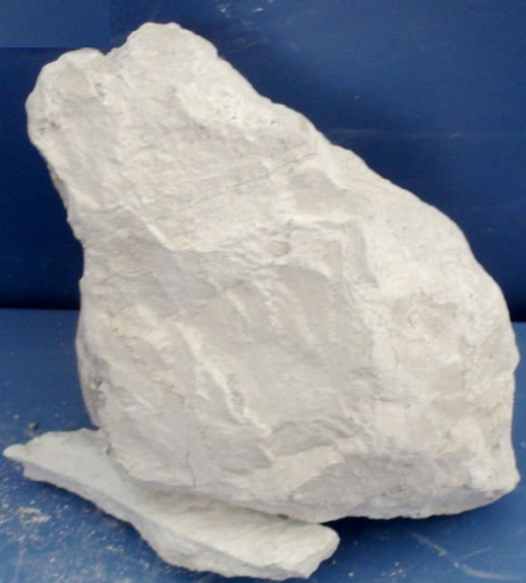
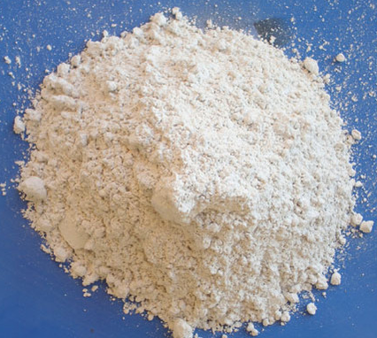
Calcium Oxide
General Information: Lime. Commonly known as quicklime. Produces heat energy by the formation of the hydrate calcium hydroxide
Chemical Formula: CaO
Effectiveness: …
Adverse Impacts to GW Quality: …
Human Health Impact: Very Hazardous, Corrosive, Irritant (see MSDS for more information)
Time used in Industry: …

Slide 9
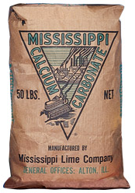
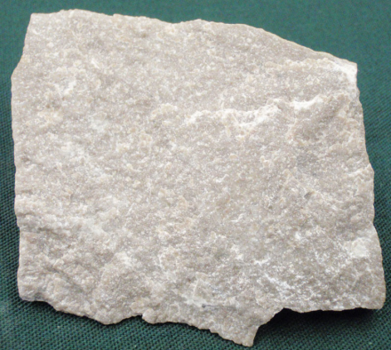
Calcium Magnesium Carbonate
General Information: White or light-colored mineral, it is used in fertilizer and in the manufacturing process of cement
Chemical Formula: CaMg(CO₃)₂
Effectiveness: …
Adverse Impacts to GW Quality: …
Human Health Impact: Irritant (see MSDS for more information)
Time used in Industry: …

Slide 10
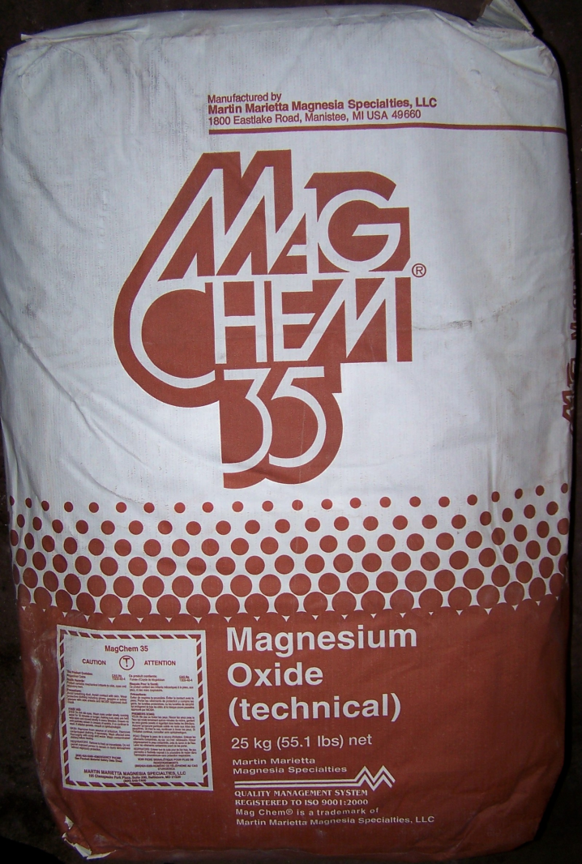
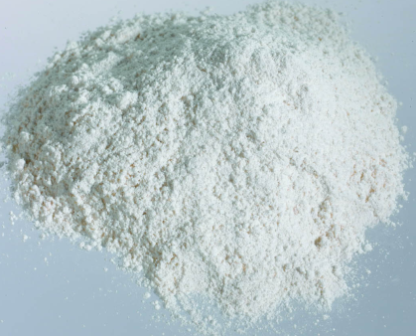
Magnesium Oxide
General Information: A white hygroscopic solid mineral that occurs naturally as Periclase.
Chemical Formula: MgO
Effectiveness: …
Adverse Impacts to GW Quality: …
Human Health Impact: Slightly Hazardous, irritant (see MSDS for more information)
Time used in Industry: …

