Slide 1

Resolution No. R1-2017-0012
Clarifying the North Coast Regional Water Board’s Position on the Public Nature of Documents Held or Maintained by Approved Third Party Programs Associated with Order No. R1-2015-0023
Item No. 3
March 8, 2017
Fortuna, California
Joshua Curtis and Kason Grady
North Coast Regional Water Quality Control Board

Slide 2
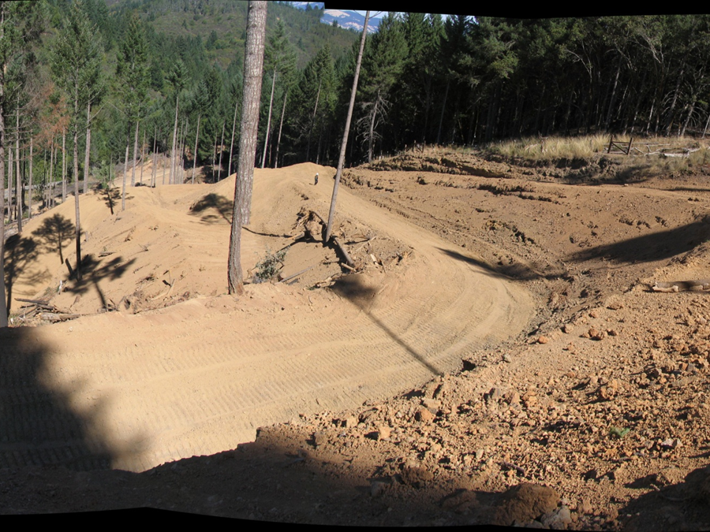
Regional Board Cannabis Order
Regional Board adopted Waiver of WDR, for discharges of waste from cannabis cultivation sites in August 2015
Order provided for the utilization of 3rd party programs for enrollment and compliance assistance
Currently have 4 approved 3rd parties in the Region for this Order
2

Slide 3
Third Party Program
Order allows for pertinent documents to be held by the 3rd party unless specifically requested by Regional Board staff.
Enrollment is documented at the Regional Board using a unique ID number instead of any personally identifying information.
3

Slide 4
Regulatory and Legal Changes
Medical Cannabis Regulation and Safety Act in 2015
Adult Use of Marijuana Act in 2016
Licensing requirements:
  Local Ordinances can be developed to require licensing
  Licensing of cultivators by CA Department of Food and Agriculture (CDFA)
Additionally, recent legal developments involving the State Water Board and other Regional Water Quality Control Boards supports the need to require public disclosure of third party program documents
4
Notes:
Mention Next Item in discussing local ordinances
Ongoing regulatory role out

Slide 5
Proposed Resolution
Does not change or alter the order or its implementation
Does not change or affect existing regulation or law
Does clarify the Regional Board’s processes in regards to documents required for program implementation
  Aligns those processes with requirements under the California Public Records Act
  Furthers Regional Water Board’s transparency and accountability to the public
5

Slide 6
Proposed Resolution
Pertinent Documents
Clarifies that all pertinent program documents held by 3rd parties are considered public records.
Examples include:
  Notice of Intent (NOI)
  Water Resource Protection Plans (WRPP)
  Monitoring and Reporting Plans (MRP)
  Tier 2 Surface Water Correction Workplans
  Annual and Inspection Reports
6
Notes:
Not included: contracts with dischargers, communication between 3rd party and discharger that are not required for program implementation, etc.

Slide 7
Proposed Resolution
NOI Submissions
Requires future approved third parties programs to submit the NOI to the Regional Board as part of enrollment
Current approved third party programs must modify their procedures to begin submitting the NOI to the Regional Board on or before June 1, 2017.
7

Slide 8
Staff Recommendation
Adoption of the proposed Resolution
No. R1-2017-0012
8

Slide 9
Board Questions and Comments
9

