Slide 1
Samoa Peninsula Development
Wastewater Need Assessment

Slide 2
Brief Samoa Peninsula
Development History
Development, mainly sawmills, in the late 1800’s, including company housing, a post office, and fire protection
Proximity to the bay allowed for easy exportation of goods
Sawmills, plywood, and pulp mills prospered in the mid-1900’s
Timber harvesting slowed and by 2000, most of mills had closed
2002 Samoa Pacific Group purchased the town of Samoa and began rebuilding the town.
2013 the HBRHCD bought the closed pulp mill, with the intention of improving the site for economic and coastal recreation purposes
2016 Samoa Fire Protection District applies to LAFCO to become a Community Services District (water, fire, recreation, streets, lighting, and wastewater)
2017 unified need - Wastewater System ties the above together

Slide 3
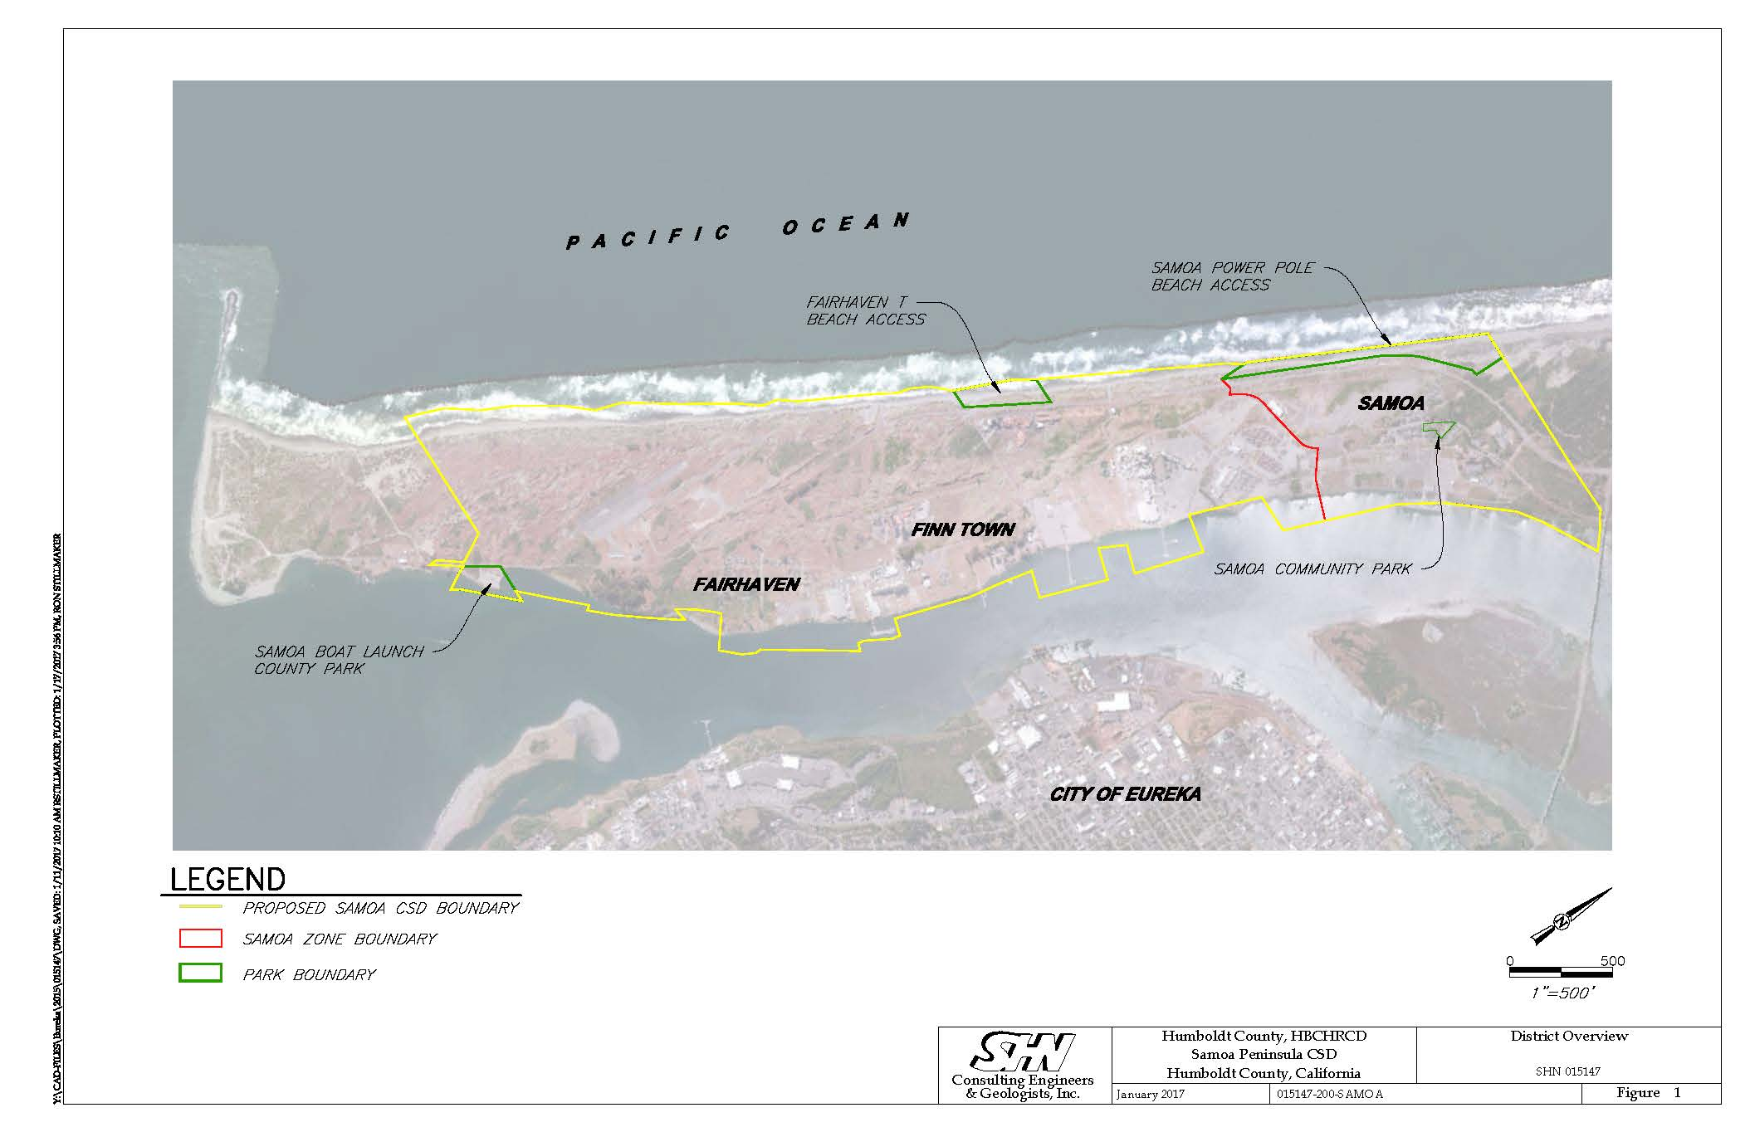

Slide 4
Samoa Town Master Plan
-A vision for redevelopment
Investors saw the town as an opportunity for redevelopment and began plans, studies and work to get entitlements in 2004, and they continue today
Plan is to subdivide: sell the existing homes and build additional homes
Town Maintenance – stop the deterioration
Town Improvement – begin to repair structures
Environmental clean-up – EPA grants and loans for clean-up
Affordable Housing development – HCD Infrastructure Infill grant
Requirement – wastewater improvement, plans approved and funding secured

Slide 5
HBHRCD –Former Samoa Pulp Mill
- Innovative view of peninsula reuse
Community meeting - 200 people envision how to reuse the 72 acre site – Economic Development and Recreation at the forefront
Improvements
  Dock upgraded, damaged building repaired, debris and trash from mill demolition removed
  New Market Tax Credits leveraged to improve existing buildings and surrounding land
  EPA clean-up of site
Coastal-dependent development (aquaculture) expanded
To make this profitable, more acres need to be productive
  Updated Humboldt Bay Area Plans
  Consideration of interim and permanent changes to coastal dependent uses
Expansion requires improvement of existing ocean outfall pipe

Slide 6
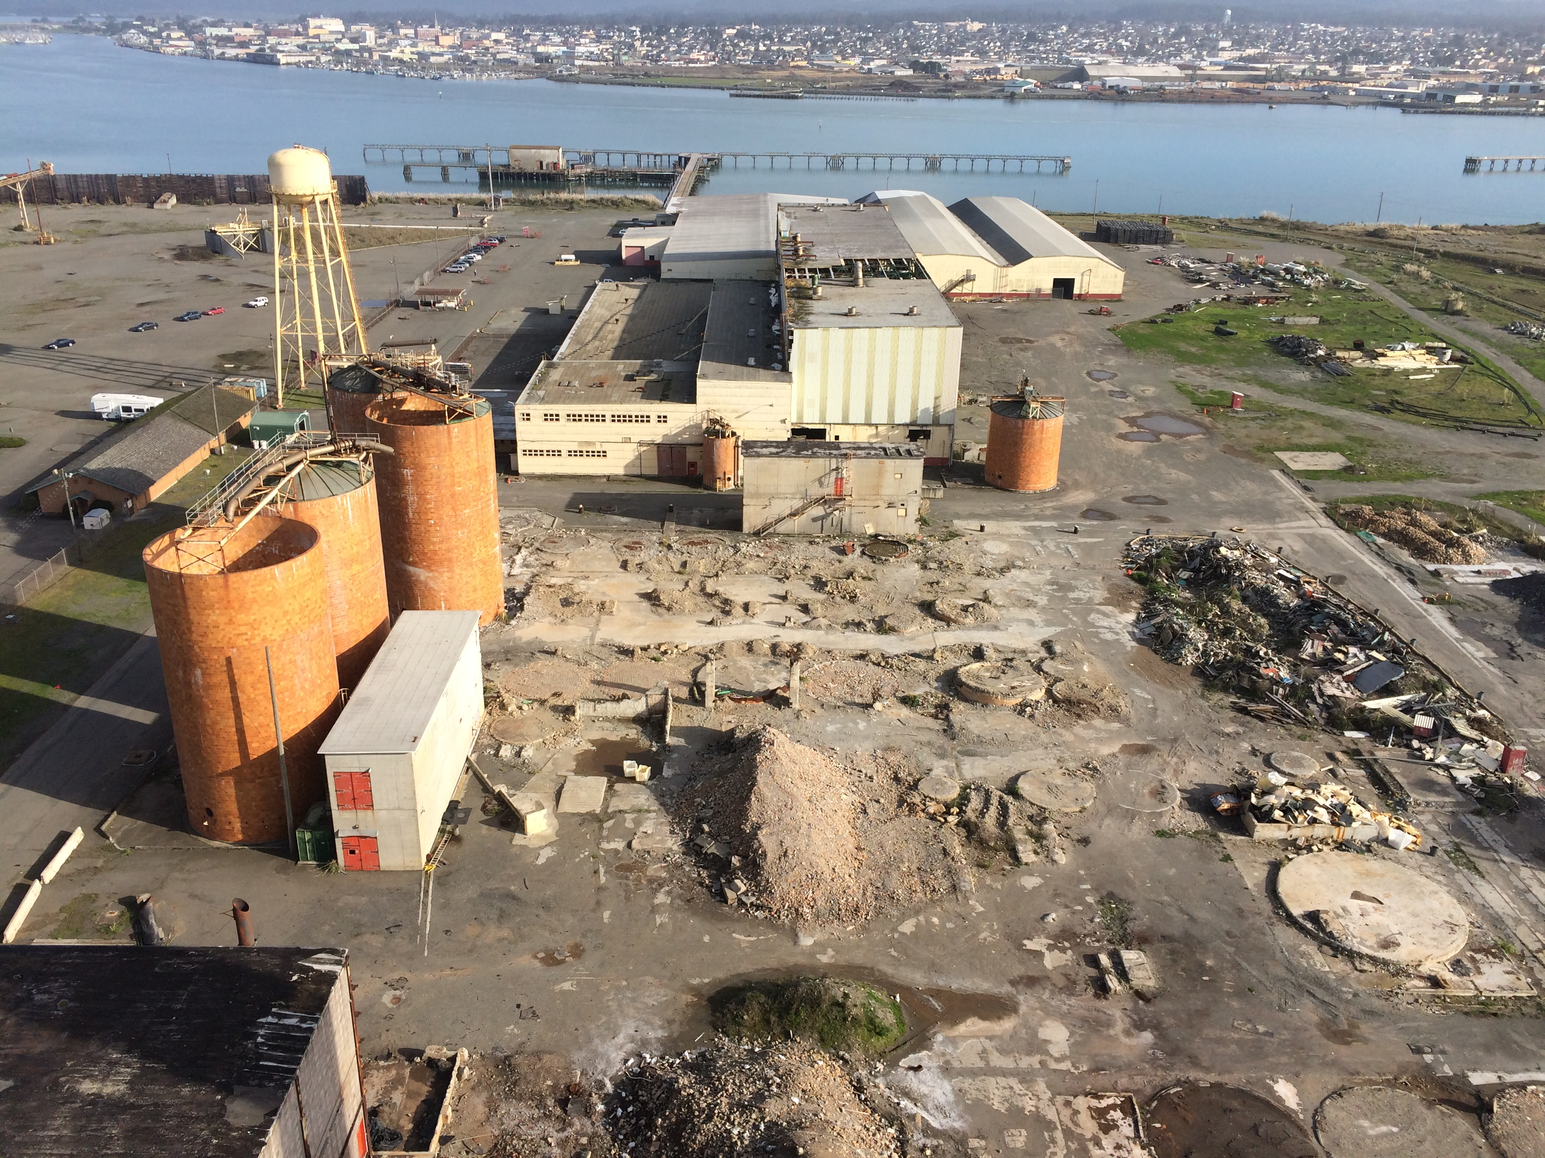

Slide 7
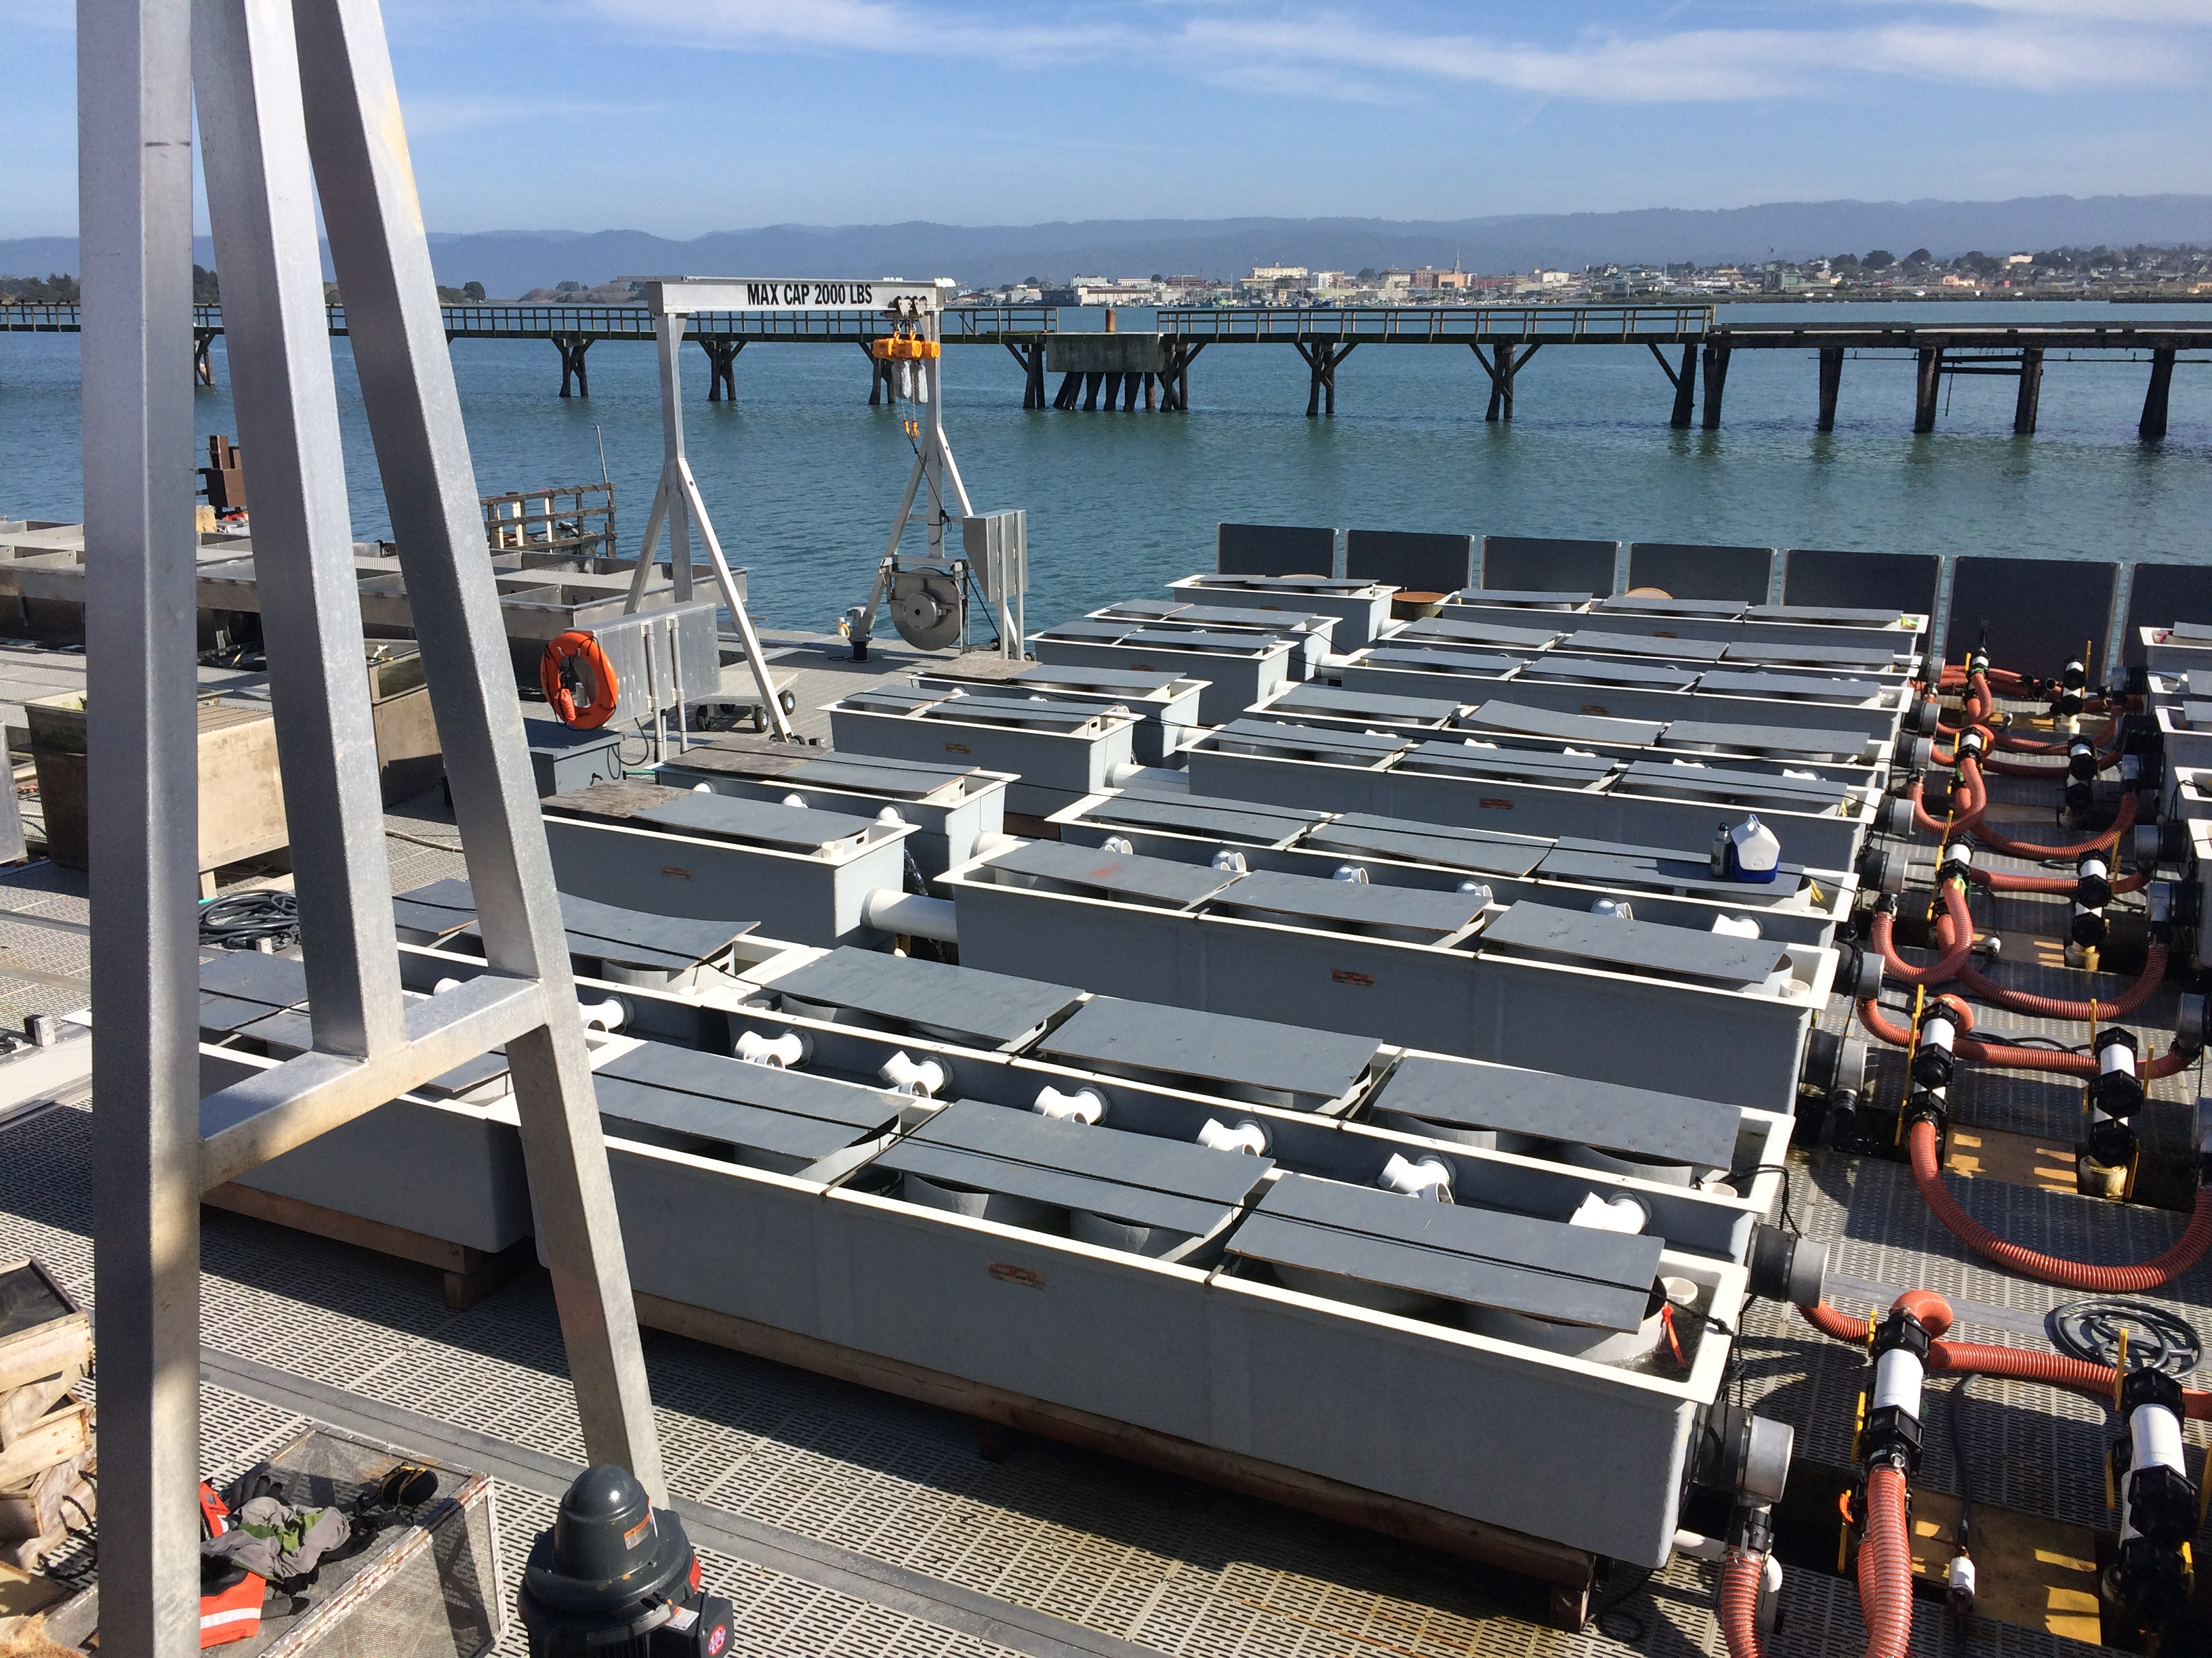

Slide 8
Fairhaven/Finntown
-constrained by topography
Fairhaven, south end of the peninsula, small community with older homes
Finntown, between Fairhaven and Harbor District, a few homes and industrial park
Oversight agencies concerned with tsunami dangers
  development not possible until fully evaluated and mitigated
  Studies underway
Oversight agencies concerned with failing septic systems
  Recent applications for septic systems have required costly mound systems
  Wastewater System would help

Slide 9
Wastewater Concept
-Is there a cost effective path forward?
Harbor District - ocean outfall pipe is under utilized
Samoa Pacific Group - installing a treatment facility for redevelopment
Finntown and Fairhaven - evaluating collection, improved environmental conditions
Samoa Fire District - community service district, including wastewater
Entities have received grant funding and looked separately at solutions
Can all entities work together SWRCB Grant:
  Environmental challenges
  Options for collection, transmission, treatment, and discharge
  Identify most cost effective option

Slide 10
Constraints
Topography
Environmentally sensitive habitat
Tsunami Hazards
Geographically large area to connect together
Relatively small user base to pay for a consolidated system
Underutilized coastal dependent industrial (connections)
Various entities in various stages of re-development
Individual interests, without a consolidated plan

Slide 11
Opportunities
Interest by separate entities to solve it the wastewater problem
Interest by funders to solve this problem
Outfall pipe has additional capacity
Samoa is pretty far along in their plans and could potentially by a centralized treatment system
Newly formed Service District, central point of planning
Business development, increased jobs and tax base, will likely follow improvements
Housing development, with a wastewater system, could help alleviate the current housing shortage

Slide 12
Next Steps
-Items currently under consideration
Provided there is a cost effective path forward
  Construction application to the SWRCB
  Economic Development Administration application for outfall pipe improvement
  Research other funding
Request Coastal Commission approval conversion of a portion of the coastal dependent industrial land
Tsunami Hazard plan in place for the peninsula
City of Eureka upgrade their collection and treatment system

