Slide 1
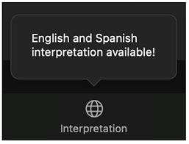
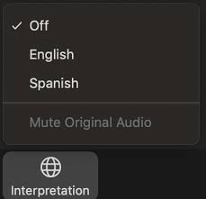
Language Interpretation through Zoom
Click the Interpretation icon in your meeting controls
  Navigate to Language Channels
  Select Spanish
  Mute Original Audio
For technical assistance, email: racialequity@waterboards.ca.gov

Slide 2
State Water Resources Control Board
Racial Equity​ Action Plan​
Celia Pazos, Santa Ana Regional Water Board
State Water Board Meeting | January 18, 2023
Notes:
Good morning, we are here today to present the 2023-2024 Racial Equity Action Plan. The Racial Equity Action Plan is a compilation of goals, actions, and metrics intended to advance the State Water Board’s racial equity efforts.
This is a major milestone for the Water Boards. We began developing the plan in early 2022 and we are excited to be sharing the final draft with everyone today

Slide 3

Thank You
Notes:
Before jumping into today's presentation, the racial equity team would like to start off with a HUGE thank you to everyone who shared their thoughts, time, resources, and effort to develop this plan. As we developed the racial equity resolution in 2020, we heard that this action plan should be developed in partnership with Black, Indigenous, and People of Color communities most impacted by racial inequities. It took many people to get us here today- THANK YOU to our community members- those of you who attended workshops or listening sessions, those of you who emailed us your thoughts and priorities, community leaders who shared their stories and experiences with us, folks who retweeted or shared our social media, folks who attended Board meetings, and submitted public comment, Our community partners who helped develop and host our public workshops. THANK YOU and of course thank you to Water Boards staff, who came together to ensure this plan matched the assets and opportunities in the communities we serve—water boards racial equity team, our executive team, Board members, Regional Board members, and executive management, the EJ roundtable, incredible staff from OPP, DIT, Comms and so many others!

Slide 4
Agenda
Background
Racial Equity Action Plan Development Process
Overview of the 2023-2024 Racial Equity Action Plan
Presentation of Actions from Each Division and Office
Discussion and Questions from the Board

Slide 5
Background
State Water Board Meeting | January 18, 2023

Slide 6

Water Boards’ Mission Statement​
6
Preserve, enhance, and restore the quality of California’s water resources and drinking water for the protection of the environment, public health, and all beneficial uses, and to ensure proper water resource allocation and efficient use, for the benefit of present and future generations.
Notes:
The State Water Board and the nine Regional Water Boards, collectively Water Boards, have a shared mission to preserve, enhance, and restore the quality of California’s water resources and drinking water. This mission is strengthened by a commitment to racial equity and environmental justice.
The Water Boards acknowledge and condemn inequities, past and present, in water quality, access, and affordability, and are proactively working to eliminate the structures and practices that perpetuate these inequities. The Water Boards has made racial equity a priority. We acknowledge our historic role in creating inequitable outcomes and we are committed to addressing and changing them. We also acknowledge the perpetuation of inequities in the workplace and are working to address them.

Slide 7

State Water Board’s Racial Equity Vision
The Water Boards envision a California where:
  Race no longer predicts the access to, or quality of, water resources;
  Water Boards employees at all organizational levels reflect the racial and ethnic diversity of California; and
  A racial equity lens is consistently applied to Water Boards’ decision- making processes.
Notes:
The State Water Board's Racial Equity Vision is:
The Water Boards envision a California where:
race no longer predicts a person’s access to, or quality of, water resources;
Water Board employees at all organizational levels reflect the racial and ethnic diversity of California; and
a racial equity lens is consistently applied to Water Boards’ decision-making processes.
Applying a “racial equity lens” means the Water Boards will conduct and incorporate racial equity analyses in their work statewide by considering questions like “How must California water laws, regulations, and policies by implemented and enforced to ensure that race no longer predicts access to, or quality of, water resources?”
As an example, this may include using demographic mapping tools to identify vulnerable communities most affected by pollution and to prioritize total maximum daily loads (TMDLs) and site clean-ups in those communities.
This vision was developed during the visioning workshop on May 3, 2022. The workshop included Waterboards staff, tribal representatives, and community representatives. The workshop and today's presentation of the action plan are one milestone along our Racial Equity Journey---

Slide 8
Our Racial Equity Journey
Human Right to Water
In 2016, the State Water Board adopted the Human Right to Water Resolution
Tribal Beneficial Uses
In 2017, Tribal Beneficial Use definitions were adopted by the State Water Board
In 2019, the State Water Board adopted the Tribal Consultation Policy )
Tribal Consultation Policy
Safe and Affordable Funding for Equity and Resilience (SAFER) Program
Established in 2019
Notes:
Beginning in 2016—and all of this work is ongoing--
2016- In 2016 the State Water Board adopted the Human Right to Water resolution and several Regional Water Boards adopted Human Right to Water resolutions afterwards. The human Right to Water recognizes that every person in the State has a right to safe, clean, and affordable water for human consumption, cooking, and sanitary purposes.
In 2017, the State Water Board adopted definitions for Tribal Beneficial Uses in Basin Plans,
2019- Water Boards adopted the Tribal Consultation Policy, strengthening the Water Boards commitment to meaningful tribal engagement
2019- SAFER program established. SAFER" is a set of tools, funding sources, and regulatory authorities designed to ensure that one million Californians who currently lack safe drinking water receive safe & affordable drinking water as quickly as possible. The SAFER program also aims to reach sustainable operations for all of the state’s drinking water systems and is a critical element for achieving the goals of safe, accessible, and affordable water for all Californians."

Slide 9
Our Racial Equity Journey
GARE and CalEPA Advancing Racial Equity Team
Water Boards’ Racial Equity Team
Racial Equity Resolution Development
The Water Boards’ Racial Equity Team was convened in 2020
Development included public listening sessions in November and December of 2020
In 2018, Water Boards join the Government Alliance on Race and Equity (GARE)
Notes:
In 2018 the Water Boards joined the Government Alliance on Race and Equity (GARE) and the CalEPA Advancing Racial Equity Team
In 2020- Water Boards staff presented a framework for addressing racial equity as an informational item to the State Water Board. The Board acknowledged the historic effects of institutional racism that must be confronted throughout government and directed staff to develop a priority plan of action.
In Fall of 2020, State Water Board Executive Director Eileen Sobeck established a Racial Equity Team to advance this work. The Water Boards Racial Equity Team is comprised of Water Boards staff representing all levels of the organization and includes support staff, engineers, scientists, technologists, and executives.
The Racial Equity Team was tasked with three major priorities:
(1) to establish a foundation of internal and external engagement that values listening and collaboration to drive action;
(2) to draft a resolution on racial equity to be considered for adoption by the State Water Board and leveraged by the nine Regional Water Quality Control Boards (Regional Water Boards) to adopt their own resolutions; and
(3) to develop racial equity strategies and action plans to drive efforts for the coming years
In November and December of 2020, the RET began developing the RE Resolution by hosting public listening sessions to inform the development of the resolution

Slide 10
Our Racial Equity Journey
State Water Board Resolution No. 2021-0050
Adopted November 16, 2021
Racial Equity Action Plan Development
Began in Spring 2022
Internal & External Workshops
Tribal Consultations
January 2023
Racial Equity Action Plan
Notes:
The State Water Board made a huge step by adopting the Racial Equity Resolution on November 16, 2021. The State Board resolution connects the dots between systemic racism and how we do our jobs everyday and lays a foundation of accountability moving forward.
The resolution acknowledges:
The existence of systemic racism and white supremacy across American institutions
American history and the colonization, slavery, displacement, and genocide of indigenous people contribute to racist precedents
Race as a predictor of access
Disproportionate distribution of adverse environmental impacts based on race
Disproportionate allocations of funding and services based on race
Remaining silent perpetuates the racial inequities and systems of oppression
The Resolution "Encourages the nine Regional Water Boards to adopt this resolution, or a similar resolution, that condemns racism, xenophobia, bigotry, and racial injustice; and that affirms a commitment to racial equity, diversity, inclusion, access, and anti-racism; and otherwise prioritizes this important work“
The three primary goals of the resolution are to 1) acknowledge and condemn systemic racism and its effects, 2)institutionalize racial equity, and 3) direct staff to act.
In 2022, the Water Boards began developing a Racial Equity Action Plan- that development extended through 2022 which brings us to January 2023- today- the presentation of the "2023 Racial Equity Action Plan"

Slide 11
Racial Equity Action Plan
State Water Board Meeting| January 18, 2023
Notes:
Which leads us to the Racial Equity Action Plan

Slide 12
Action Plan Development
Directives from the Resolution:
  Normalize conversations about racial equity
  Foster a workforce that integrates racial equity into its work
  Effectively reach and engage with Black, Indigenous, and people of color communities and tribes
  Be developed within one year of adoption of the Racial Equity Resolution
  Be metric-driven in order to evaluate progress
  Incorporate all State Water Board divisions, offices, and programs and address all aspects of our work
Notes:
The Action Plan must outline steps we will take to:
Normalize conversations about racial equity
Foster a workforce that competently integrates racial equity into its work
Effectively reach and engage with Black, Indigenous, and people of color communities to benefit those we serve
Additionally- it was the action plan:
Be developed within one year of adoption of the Racial Equity Resolution
Be metric-driven in order to evaluate progress
Incorporate all State Water Board divisions, offices, and programs and address all aspects of our work
Regional Boards are taking the lead to create their own action plan directives

Slide 13
Action Plan Development
April 2022
June 2022
Tribal Consultations began
Racial Equity Employee Support Lunch Session
May 2022
Visioning Workshop
Strategizing Workshop
Action Planning Workshops
Racial Equity Employee Support Lunch Session
Emails Sent to racialequity@waterboards.ca.gov (ongoing)
1:1 meetings with community partners
Notes:
The Racial Equity Team developed the draft Racial Equity Action Plan based on input from the Water Boards (which included board members, management, and staff), as well as tribal governments, and the general public:
In April, the Water Boards begin government to government tribal consultations on the REAP development
In May, we held visioning and strategizing workshops, where Water Boards staff and community leaders came together to develop our racial equity vision (earlier slide) and develop draft actions for the plan
We also held a series of action planning workshops where State Water Board staff and management and Regional Board executive management met to further develop draft action ideas
Office of Public Participation staff and RET members held 1:1 meetings with community partners to plan, develop and ultimately host the Action Plan public workshops. Many community partners also met with OPP staff and our diversity, inclusion consultants to discuss the plan's development
In June, we held an internal employee listening session where participants discussed "What actions should be included in the REAP?" And feedback was collected anonymously

Slide 14


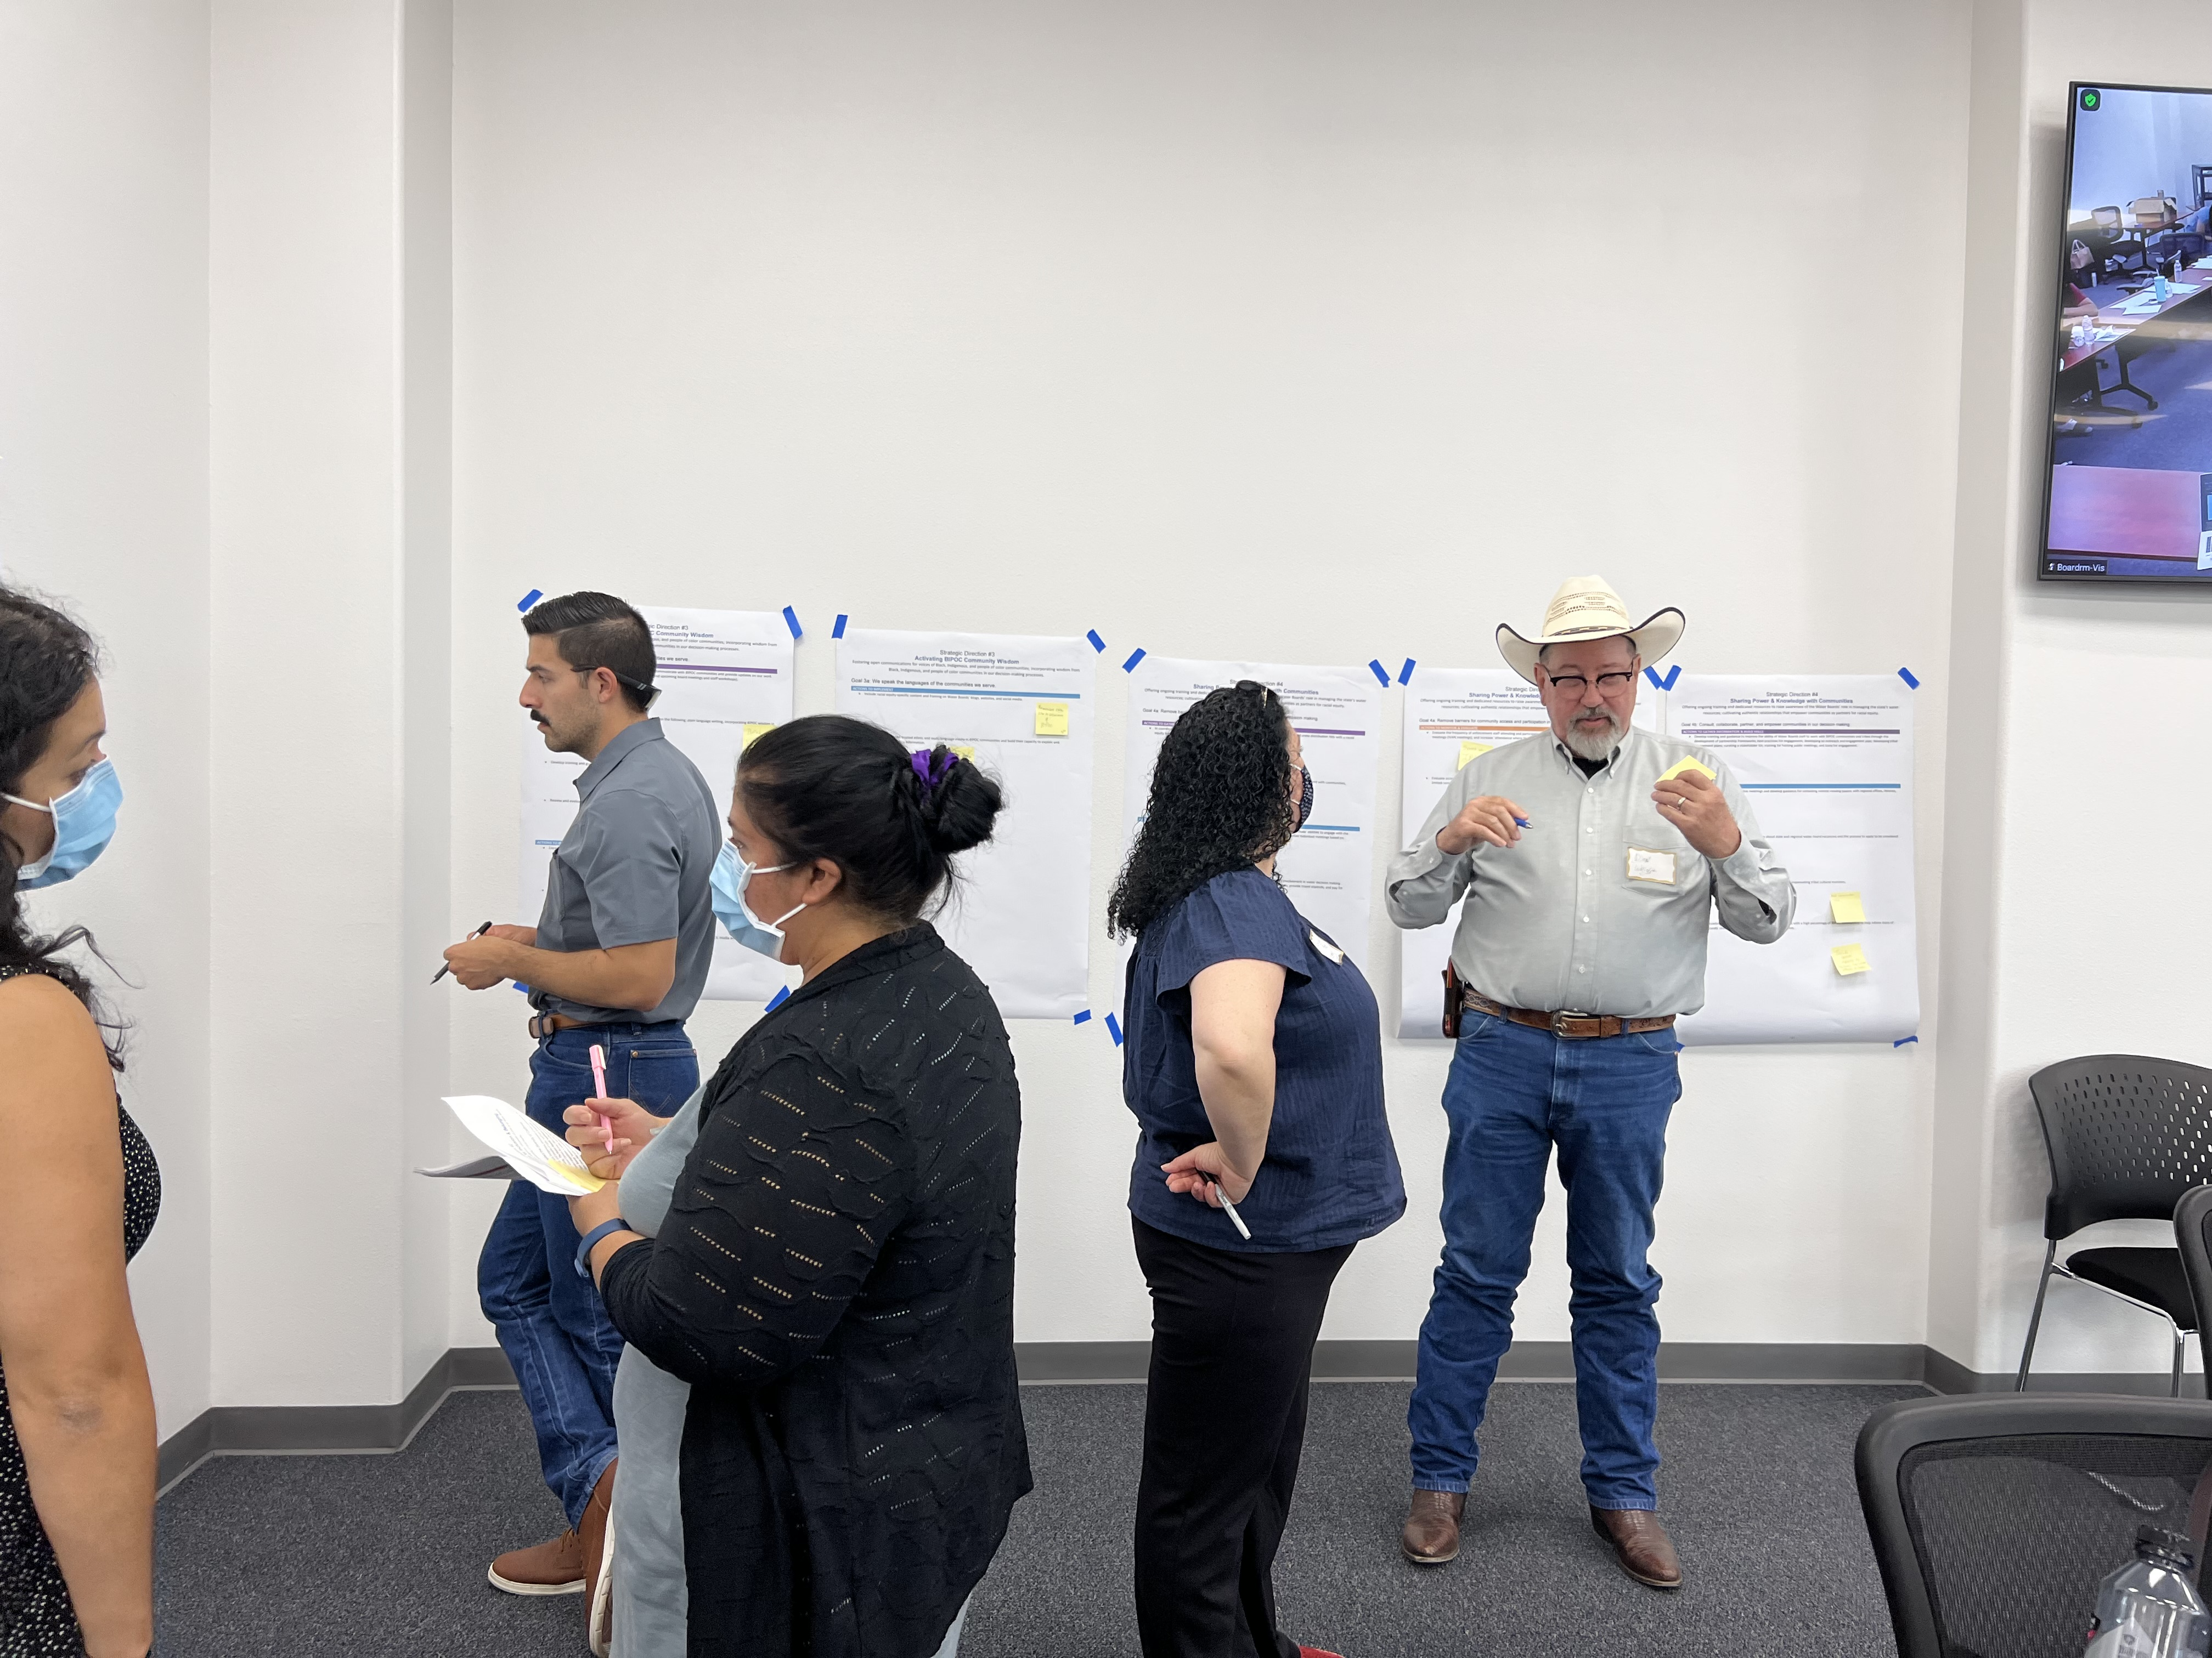





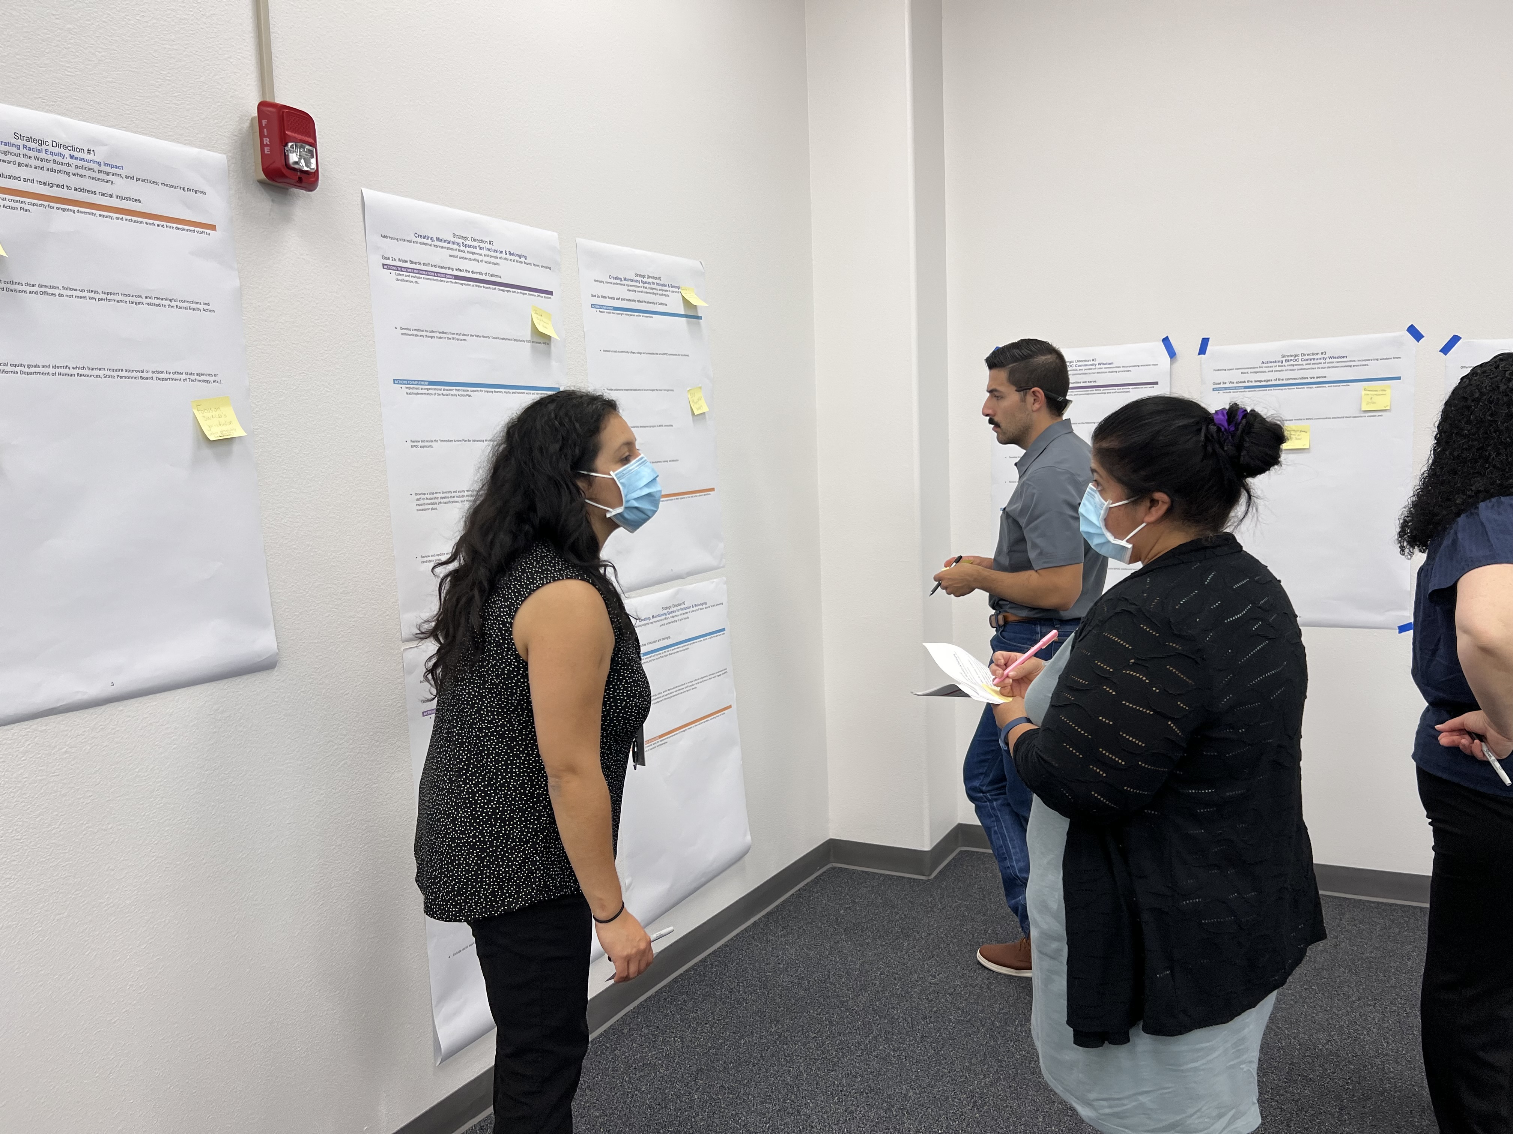
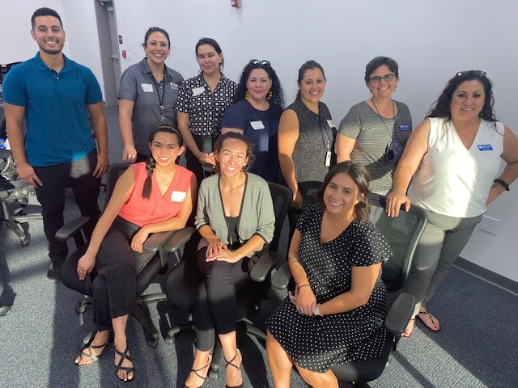
Public Workshops
Statewide (July 20)
Virtual
Northern California (July 21)
Hybrid/Redding
Southern California (July 25)
Hybrid/Mecca
Central California (July 27)
Hybrid/Visalia
Notes:
In July 2022,
The racial equity team partnered with the office of public participation and community leaders to host four public workshops in July 2022. The public workshops were held to ensure community priorities and strengths were incorporated into the action plan. The workshops began with Board member remarks, followed by community storytelling, and a staff presentation. Participants broke into small groups to review and discuss the actions and identify which most resonated with them.
a version of the draft action ideas document was shared with the public in mid-July, prior to the Public Workshops
the RET members in partnership with OPP and community partners facilitated 4 workshops: a statewide virtual workshop (July 20), and 3 hybrid regional workshops in Redding, Mecca, and Visalia (July 21-27)
NEXT SLIDE

Slide 15
Action Plan Development
July 2022
August 2022
Public workshops
Executive management review
Board workshop on 10/19/2022
October–December 2022
Public comment period closed
Executive review
Revisions and finalization of 2023-2024 Racial Equity Action Plan
Draft “action ideas” document posted to webpage
Racial Equity Team reviewed feedback and revised action plan
September 2022
Draft Racial Equity Action Plan open for 30-day public comment period
All-staff webinar on Racial Equity Action Plan
Notes:
In August, the RET categorized and sorted ideas from all of these workshops- the July public workshops, and May workshops to draft the Racial Equity Action Plan
During this process, we considered both public and internal employee feedback
Also, some comments from last year's Resolution were integrated into the draft Action Plan
So we sorted all of these comments and integrated them into a draft of our Goals and Actions
We released the draft for a 30-day public comment period on September 23, 2022
A Board workshop was held on October 19, 2022 where staff presented the draft REAP. Verbal comments on the REAP were also heard
In October we closed the public comment period
And workshopped, reviewed, and finalized the REAP through December of 2022

Slide 16
Summary of Comments
Received 47 sets of written comments from the public and 32 sets of comments from Water Boards employees.
Many comments received simply expressed support of or opposition to the Water Boards’ racial equity work.
Many requested clarification/details, and several suggested additional or revised language.

Slide 17
Summary of Predominant Comment Themes
Comment Theme | How it was addressed in the 2023-2025 Racial Equity Action Plan
Resources for new actions | Actions that require new personnel or resources are marked with (R) in the Stage column to identify where resources are needed Language added: “Many actions will be supported with existing program resources”… “Many actions build on each other as they are implemented” New actions, that may require additional resources to implement, are included in the plan under “Future Actions”
Accountability as Racial Equity Action Plan is implemented | Performance indicators developed for “2023 Actions” Racial Equity Action Plan will be assessed annually Annual update on the Racial Equity Action Plan to State Water Board New actions added
Notes:
Where will resources come from to support the work and ensure it is ongoing?
Actions requiring resources were still included in the plan- some added to the “Future Actions” section
The draft did not include metrics, so we heard many comments about accountability and how we will measure our success

Slide 18
Summary of Predominant Comment Themes
Comment Theme | How it was addressed in the 2023-2025 Racial Equity Action Plan
Tribal sovereignty, meaningful tribal engagement | Several actions revised or added under Strategic Direction 3
Prioritization of funds for community capacity building | Action under Goal 3b: “Develop a community capacity building pilot fund to: 1.) compensate tribal and BIPOC community partners for their time and expertise; and 2.) support tribal- and community-led projects that address environmental clean-up projects.”
Notes:
Tribes are sovereign nations that have used, and in some cases continue to use, water to support their cultural, spiritual, ceremonial, and/or traditional rights. Each tribe has unique water needs and perspectives, and engagement and consultation should be meaningful and in alignment with our Tribal Consultation Policy, not just a “check in the box” exercise. Several actions were added to SD 3 the actions will be presented in detail in a later portion of the presentaion
We heard that expanding/prioritizing funds for community capacity building was a major priority for BIPOC communities

Slide 19
Summary of Predominant Comment Themes
Comment Theme | How it was addressed in the 2023-2025 Racial Equity Action Plan
In-stream flow requirements can have negative impacts on BIPOC communities, including tribal beneficial uses and cultural resources, and related ecosystems, especially the Bay Delta Water Quality Control Plan and its potential impacts to San Joaquin Valley communities. | Modified action on instream flow requirements to include consideration of existing impacts to BIPOC communities (Goal 1b). Action added for tribal outreach for Bay-Delta Plan implementation
Notes:
We received many comments about instream flow requirements and how they may negatively impact BIPOC communities, tribal beneficial uses, and cultural resources, and related ecosystems- many specifying the Bay Delta Water Quality Control Plan Implementation. To address this, the Division of Water Rights modified their lead role action under Goal 1b and added a new action to address these concerns. Again, we will hear from the division on these actions in a later portion of the presentation.

Slide 20
Summary of Changes Made
Actions reviewed by Water Boards’ staff, revised to make actions specific and measurable
Action Types revised:
  Actions for 2023: actions that will start, continue, or be completed in 2023. Performance indicators have been developed for these actions and progress will be assessed during the annual board update.
  Future Actions: actions that will not start, continue, or be completed in 2023. These actions will be assessed during the annual board update and their priority may be modified as other actions are completed.
Notes:
After the close of public comment in October, Water Boards staff revised the action plan to make the actions, specific and measurable
The draft action plan included three action types, These previous action types from the draft helped WB staff prioritize actions based on public feedback, and all actions are now categorized into two types Actions for 2023 and Future Actions
(Action Types = Baseline status in 2022​
Type A = Existing program, existing resources​
Type B = New program, existing resources​
Type C = New or existing program, needs new resources​)

Slide 21
Summary of Changes Made
Stage Types revised:
  Stage 1: Preparation or scoping not yet started
  Stage 2: Preparation, scoping, data collection, securing funding and resources
  Stage 3: Work in progress
  Stage 4: Action complete and/or at least one cycle of continual action complete; monitoring and evaluation of action is complete or ongoing
  (R): Needs new personnel or new resources to start or complete action
“Challenge” statements updated to reflect ongoing racial equity work
“Performance Indicators” developed for each 2023 Action
  Quantitative performance measures and qualitative targets to assess progress and evaluate each action’s success
Notes:
Stages have been revised to reflect ongoing water boards actions, the Previous stages included zero
And as mentioned in prior slides “R” was added to identify actions that require resources
Challenge statements were updated to highlight where Water Boards have ongoing racial equity work
Due to the diversity of actions included in this plan, measurements of success include metrics, milestones, data, and other indicators that can be used to indicate successful completion of actions or to track progress toward actions over time. Performance indicators have been developed for each 2023 Action
Divisions and offices considered different metrics types including:
How much we will do/have done (quantity)
Examples: % staff trained, # of recruitment events, # of trainings offered, # of scoping meetings, # of meetings in BIPOC communities
How well we will do/have done it (quality)
Examples: % attendance at advisory meetings, response time, % recruitment events in BIPOC communities, % of funds allocated to BIPOC communities, % inspections in most-impacted BIPOC communities
Is anyone better off? (population accountability outcomes)
Examples: # of communities with safe water, # of tribes benefitting from TBU designations
Some actions require "performance measures" or counts such as the number of staff or the number of outreach events to establish a baseline to assess the action's progress

Slide 22
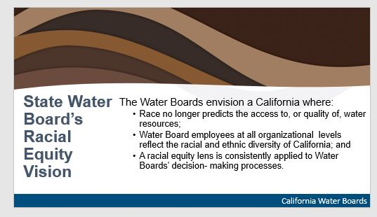
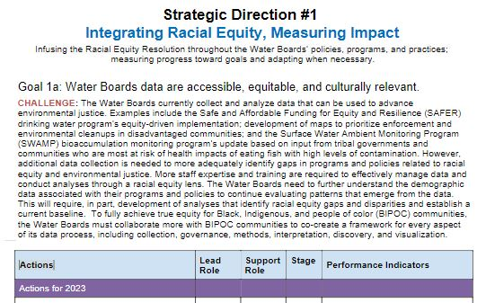
Action Plan
Structure
1
Vision =
Where we want to end up​
Strategic Directions =
How we will achieve our vision
Goals =
Outcomes we are working toward
Actions =
What we should do to achieve our goals
2
3
4
Notes:
The Action plan has 4 main parts: the Vision, Strategic Directions, Goals, and Actions.
(#1) The Vision, shared in a previous slide, is overarching. It let's us know WHERE we want to end up.
(#2) Strategic Directions clarify HOW we will achieve our Vision.
There are three big Strategic Directions or "HOWs" in the Action Plan.
For example, the first Strategic Direction is Integrating Racial Equity and Measuring Impact. So HOW will we achieve our vision? One way is by integrating racial equity and measuring impact.
(#3) Goals are broad OUTCOMES that should flow out of Strategic Directions.
Each Strategic Direction has 2 to 3 goals or "outcomes."
Then under each outcome goal is a list of (#4) Actions that are WHAT we should do to achieve our Goals.
Each Action is assigned to a lead Divisions or Office, who will take a lead or supporting role in implementing the Action. (as another layer of accountability)

Slide 23
Action Plan Structure
4
Actions | Lead Role | Support Role | Stage | Performance Indicators
Actions for 2023
Actions that will start, continue, or be completed in 2023 |  |  |  | Performance indicators have been developed for these actions and progress will be assessed during the annual board update.
Future Actions
Actions that will not start, continue, or be completed in 2023 |  |  |  | These actions will be assessed during the annual board update and their priority may be modified as other actions are completed.
Lead Role: Division or Office responsible for action implementation
Support Role: Divisions or Offices to support action implementation
Stage: The progress of each action is measured by project stages as of the end of 2022. Stages will be used to evaluate and monitor progress in the future.
Notes:
Some more details about the Actions- the actions are intended to be assessed annually in a Board update, similar to this forum
Each Action:
-is categorized either "Actions for 2023" those that will start, continue or be completed in 2023, or future action, those that will not start, continue, or be completed in 2023
- is assigned to Divisions, Offices, who will take a lead or supporting role in implementing the Action.
- is assigned a Stage as of the end of 2022, used to measure and evaluate progress in the future
- performance indicators have been developed for 2023 actions. Performance indicators are Quantitative performance measures and qualitative targets to assess progress and evaluate each action’s success
- future actions, and entire REAP, may be modified in annual assessment
That summarizes the action plan development process and structure, Divisions and Office representatives will be presenting their "lead role" actions ----pass it over to------

Slide 24
Division and Office
Racial Equity Actions
State Water Board Meeting | January 18, 2023

Slide 25
Communications Office
Nefretiri Cooley, Deputy Director
State Water Board Meeting | January 18, 2023
Notes:
Six action: four for 2023 and two for future

Slide 26
Lead Role: Comms
Strategic Direction #1: Integrating Racial Equity, Measuring Impact
Goal 1a: Water Boards data are accessible, equitable, and culturally relevant.
Action | Support | Stage | Performance Indicator
Update the State Water Board’s racial equity webpage to include a page for tracking and measuring progress on the Racial Equity Action Plan. | DIT | 1 | Webpage updated

Slide 27
Lead Role: Comms (cont’d)
Strategic Direction #3: Activating BIPOC Community Wisdom and Sharing Power
Goal 3a: Engage with BIPOC communities by providing effective language access services and accessible communications.
Action | Support | Stage | Performance Indicator
Revise Water Boards’ public comment webpages and instructions to better describe the process and improve access to participation. | OPP DIT | 1 | Webpage revisions completed

Slide 28
Office of Public Affairs
State Water Board Meeting | January 18, 2023
Notes:
Two action: both for 2023

Slide 29
Lead Role: OPA
Strategic Direction #3: Activating BIPOC Community Wisdom and Sharing Power
Goal 3a: Engage with BIPOC communities by providing effective language access services and accessible communications. processes.
Action | Support | Stage | Performance Indicators
Cultivate relationships with ethnic and multi-language media in BIPOC communities and build capacity to explain and contextualize water policy information. | Comms | 1(R) | # Direct conversations with ethnic and multi-language media professionals in BIPOC communities # Articles published in new multi-language media outlets

Slide 30
Lead Role: OPA (cont’d)
Strategic Direction #3: Activating BIPOC Community Wisdom and Sharing Power
Goal 3b: Remove barriers for community access and participation in water decision-making by providing resources for capacity building, including funding, training, and education.
Action | Support | Stage | Performance Indicators
In consultation with BIPOC communities, non-governmental organizations, and tribes, expand press distribution lists with a racial equity lens and add media contacts who represent and are connected with BIPOC communities | OPP | 1 | # New media contacts that represent and are connected with BIPOC communities

Slide 31
Office of Public Participation
State Water Board Meeting | January 18, 2023
Notes:
17 actions: 15 for 2023, 2 for the future

Slide 32
Lead Role: OPP
Strategic Direction #3: Activating BIPOC Community Wisdom and Sharing Power
Goal 3a: Engage with BIPOC communities by providing effective language access services and accessible communications. processes.
Action | Support | Stage | Performance Indicators
Finalize language access guidance document and deliver training to Water Boards staff on language access laws and best practices. | EEO OCC | 3 | Guidance completed

Slide 33
Lead Role: OPP (cont’d)
Strategic Direction #3: Activating BIPOC Community Wisdom and Sharing Power
Goal 3b: Remove barriers for community access and participation in water decision-making by providing resources for capacity building, including funding, training, and education.
Action | Support | Stage | Performance Indicators
Coordinate the second cohort of the Facilitation and Training Pool to train Water Boards staff on how to engage with communities effectively, how to design and manage engagement processes, how to navigate challenging conversations, and deliver racial equity trainings. | Racial Equity Training Cohort | 3 | # Staff members trained and certified as Water Boards facilitators # Meetings/workshops/trainings facilitated by Facilitation and Training pool members

Slide 34
Lead Role: OPP (cont’d)
Strategic Direction #3: Activating BIPOC Community Wisdom and Sharing Power
Goal 3b: Remove barriers for community access and participation in water decision-making by providing resources for capacity building, including funding, training, and education.
Action | Support | Stage | Performance Indicators
Develop guidance and templates for developing outreach and engagement plans that support equitable public participation, engagement, and community and tribal partnerships. | Comms | 2 | Completed best practices guidance document

Slide 35
Lead Role: OPP (cont’d)
Strategic Direction #3: Activating BIPOC Community Wisdom and Sharing Power
Goal 3b: Remove barriers for community access and participation in water decision-making by providing resources for capacity building, including funding, training, and education.
Action | Support | Stage | Performance Indicators
Develop a community capacity building pilot fund to: 1) compensate tribal and BIPOC community partners for their time and expertise; and 2) support tribal- and community-led projects that address environmental clean-up projects. | DFA OE Regions | 2 | Completed funding pilot charter presented to the Board

Slide 36
Lead Role: OPP (cont’d)
Strategic Direction #3: Activating BIPOC Community Wisdom and Sharing Power
Goal 3c: Consult, collaborate, and partner with BIPOC communities in decision-making processes.
Action | Support | Stage | Performance Indicators
Update Tribal Affairs webpage to include a table of current tribal consultation opportunities for all Water Boards projects subject to AB 52. | - | 1 | Webpage completed

Slide 37
Division of Administrative Services
Lucia Neri, Branch Chief
State Water Board Meeting | January 18, 2023
Notes:
Nine actions: seven for 2023 and two for future

Slide 38
Lead Role: DAS
Strategic Direction #2: Creating, Maintaining Spaces for Inclusion & Belonging
Goal 2a: Water Boards staff and leadership reflect the diversity of California.
Action | Support | Stage | Performance Indicators
Increase recruitment for job openings and internship opportunities at high schools, community colleges, colleges, universities, workforce development networks, and community-based groups that serve BIPOC communities in California. Collaborate with Regional Water Boards on future recruitment efforts. | ALL | 3 | Track the number and type of recruitments, such as in-person job fairs and visits.

Slide 39
Lead Role: DAS (cont’d)
Strategic Direction #2: Creating, Maintaining Spaces for Inclusion & Belonging
Goal 2a: Water Boards staff and leadership reflect the diversity of California.
Action | Support | Stage | Performance Indicators
Update the Water Boards’ website to include additional guidance for prospective applicants on how to navigate the state’s hiring process, with a focus on successfully applying for Water Board positions. | ALL | 2 | Employment assistance public webpages are revised and updated to provide additional resources for prospective applicants
Require implicit bias and racial equity training for all hiring panelists, supervisors, and State and Regional Board Members. | ORPP | 3 | Develop a plan to provide and require implicit bias and racial equity training for staff by January 2024
Notes:
Eight goals: six for 2023 and two for future

Slide 40
Lead Role: DAS (cont’d)
Strategic Direction #2: Creating, Maintaining Spaces for Inclusion & Belonging
Goal 2a: Water Boards staff and leadership reflect the diversity of California.
Action | Support | Stage | Performance Indicators
Develop a paid youth employment program for high school students to work in Water Board offices to help develop the high school to Water Board employment pipeline. | - | 1 | Develop the Water Board’s high school student employment program and have that ready for implementation in the Summer of 2024.
Notes:
Eight goals: six for 2023 and two for future

Slide 41
Division of Drinking Water
Darrin Polhemus, Deputy Director
State Water Board Meeting | January 18, 2023
Notes:
Two actions: both for 2023

Slide 42
Lead Role: DDW
Strategic Direction #1: Integrating Racial Equity, Measuring Impact
Goal 1a: Water Boards data are accessible, equitable, and culturally relevant.
Action | Support | Stage | Performance Indicators
Incorporate racial equity analysis into the annual Drinking Water Needs Assessment, including a measurement of the number of BIPOC communities impacted by primary and secondary contaminants in drinking water and water unaffordability. Work with U.S. EPA to implement a similar analysis to federally regulated tribal water systems. | DFA OPP | 3 | Each future Needs Assessment will include the evaluation. Types of data incorporated into the Needs Assessment.

Slide 43
Lead Role: DDW (cont’d)
Strategic Direction #1: Integrating Racial Equity, Measuring Impact
Goal 1b: Programs and policies are evaluated and realigned to address racial injustices.
Action | Support | Stage | Performance Indicator
Incorporate racial equity analysis when developing maximum contaminant levels using available data and as data and methods allow. | - | 2 | Each future maximum contaminant level will include a racial equity analysis when data and methods allow.

Slide 44
Division of Financial Assistance
Joe Karkoski, Deputy Director
State Water Board Meeting | January 18, 2023
Notes:
Two actions: one for 2023 and one for future

Slide 45
Lead Role: DFA
Strategic Direction #1: Integrating Racial Equity, Measuring Impact
Goal 1a: Water Boards data are accessible, equitable, and culturally relevant.
Action | Support | Stage | Performance Indicator
Assess race/ethnicity data and other relevant demographic data, associated with the communities that benefit from funding administered by DFA. Existing annual funding reports and plans will be the primary mechanism to report these data on a project specific basis, where appropriate. In addition, summaries for the funding program will be provided. | - | 3 | % Funding program reports/plans that include racial, ethnic, and other demographic information

Slide 46
Division of Water Quality
Karen Mogus, Deputy Director
State Water Board Meeting | January 18, 2023
Notes:
Six actions: all for 2023

Slide 47
Lead Role: DWQ
Strategic Direction #1: Integrating Racial Equity, Measuring Impact
Goal 1a: Water Boards data are accessible, equitable, and culturally relevant.
Action | Support | Stage | Performance Indicators
Identify and assess available data to identify racial equity data gaps related to water quality | - | 1 | # DWQ units/programs that have completed data needs assessments Types and # of datasets assessed Process for ground truthing data sets developed

Slide 48
Lead Role: DWQ (cont’d)
Strategic Direction #2: Creating, Maintaining Spaces for Inclusion & Belonging
Goal 2b: Foster a culture of inclusion and belonging.
Action | Support | Stage | Performance Indicators
Update roundtable charters or workplans to include racial equity and include racial equity discussions as a standing agenda item on roundtables. | Regions | 1 | # of roundtables with updated charters and/or workplans to include racial equity.

Slide 49
Lead Role: DWQ (cont’d)
Strategic Direction #3: Activating BIPOC Community Wisdom and Sharing Power
Goal 3c: Consult, collaborate, and partner with BIPOC communities in decision-making processes.
.
Action | Support | Stage | Performance Indicators
Implement Assembly Bill 2108 (2022) by developing guidance on using racial equity data to identify potential environmental justice water quality impacts, engage with communities potentially impacted, and develop findings based on data and outreach. | Regions OPP OCC | 2 | # New resources developed providing guidance on implementation of Assembly Bill 2108 Type and # of DWQ templates updated (e.g., project charters, outreach plans) to include racial equity and environmental justice data considerations

Slide 50
Division of Water Rights
Erik Ekdahl, Deputy Director
State Water Board Meeting | January 18, 2023
Notes:
Three actions: all for 2023

Slide 51
Lead Role: Rights
Strategic Direction #1: Integrating Racial Equity, Measuring Impact
Goal 1b: Programs and policies are evaluated and realigned to address racial injustices.
Action | Support | Stage | Performance Indicators
Consider impacts to BIPOC communities, tribal beneficial uses and cultural resources, and related ecosystems when developing, implementing, and enforcing instream flow requirements, consistent with all applicable laws and requirements, including those related to water rights, basin planning, public trust resources, and endangered species. | OCC OE | 3(R) | Develop and update webpage that identifies streams with ongoing instream flow development activities.

Slide 52
Lead Role: Rights (cont’d)
Strategic Direction #1: Integrating Racial Equity, Measuring Impact
Goal 1b: Programs and policies are evaluated and realigned to address racial injustices.
Action | Support | Stage | Performance Indicators
Establish a single point of contact in the Division of Water Rights to serve as a coordinator on Bay-Delta tribal and BIPOC engagement to improve communication and outreach, and conduct tribal outreach under AB 52 and B-10-11 for the Bay-Delta Plan implementation regulation for Lower San Joaquin River flows and Southern Delta Salinity. | - | - | Establishment of Division coordinator Number of consultation requests and engagements related to development of the Sacramento River watershed and interior Delta (Sac/Delta) Bay-Delta Plan Staff Report Include a chapter in the Sacramento/Delta Staff report focused on BIPOC and DAC issues.

Slide 53
Equal Employment Opportunity Office
Kyle Mossman, EEO Officer
State Water Board Meeting | January 18, 2023
Notes:
Two actions: one for 2023, one for future

Slide 54
Lead Role: EEO
Strategic Direction #2: Creating, Maintaining Spaces for Inclusion & Belonging
Goal 2b: Foster a culture of inclusion and belonging.
Action | Support | Stage | Performance Indicators
Develop educational materials for staff to improve understanding of the EEO processes for submitting racial discrimination/harassment complaints and following up after a complaint has been submitted. | - | 2 | Materials developed

Slide 55
Office of Enforcement
Yvonne West, Director
State Water Board Meeting | January 18, 2023
Notes:
Three actions: all for 2023

Slide 56
Lead Role: OE
Strategic Direction #1: Integrating Racial Equity, Measuring Impact
Goal 1b: Programs and policies are evaluated and realigned to address racial injustices.
Action | Support | Stage | Performance Indicators
Participate as partners in implementing the Environmental Justice Enforcement Action Plan with the U.S. Environmental Protection Agency and the California Environmental Protection Agency (bit.ly/EJ_enforcement_plan) | - | 2 | Staff participation in EJ community listening sessions Staff participation in EJ Enforcement Rapid Response Team Participation in community outreach training for enforcement staff # Multimedia inspections in overburdened communities

Slide 57
Lead Role: OE (cont’d)
Strategic Direction #3: Activating BIPOC Community Wisdom and Sharing Power
Goal 3b: Remove barriers for community access and participation in water decision-making by providing resources for capacity building, including funding, training, and education.
Action | Support | Stage | Performance Indicators
Improve Water Board participation in community-based environmental violations monitoring meetings (IVAN meetings). | - | 1 | Improve and track participation in IVAN meetings and training by Water Boards staff.
Develop guidance document for improving/streamlining enforcement complaint process to improve responsiveness to community complaints. | - | 1 | Duplicate complaint pathways eliminated, outdated complaint links removed, and email addresses from Water Board web pages are updated Guidance document disseminated and implemented

Slide 58
Office of Information Management and Analysis
Greg Gearhart, Deputy Director
State Water Board Meeting | January 18, 2023
Notes:
Three actions: all for 2023

Slide 59
Lead Role: OIMA
Strategic Direction #1: Integrating Racial Equity, Measuring Impact
Goal 1a: Water Boards data are accessible, equitable, and culturally relevant.
Action | Support | Stage | Performance Indicators
Develop and implement a Racial Equity Data Action Plan (REDAP). At a minimum the REDAP must do the following: (1) Develop training and best practices guidance for Water Boards staff on incorporating racial equity concepts into the planning and design of data collection methods and visualizations (e.g., maps, factsheets, etc.) projects. (2) Identify and expand existing opportunities for public participation in science and community data gathering programs to develop new data collection methods, support existing programs, and incorporate community datasets into the database. (3) Create a publicly accessible data catalog tool / interface that includes existing demographic data, Water Boards program data, and other available data (such as heat maps or flood hazard maps) to inform the implementation of the Racial Equity Action Plan. | Comms OPP ORPP | 1 | Circulate draft REDAP to Water Board organizations by January 2023. Develop REDAP best practices draft guidance by February 2023. Deliver beta version REDAP best practices training online by March 2023. Build online platform for public access to REDAP priority data catalog and visualization tools by February 2023.

Slide 60
Lead Role: OIMA (cont’d)
Strategic Direction #1: Integrating Racial Equity, Measuring Impact
Goal 1b: Programs and policies are evaluated and realigned to address racial injustices.
Action | Support | Stage | Performance Indicators
Develop a racial equity toolkit for all Water Boards staff to consider racial equity in their day-to-day work. | OPP | 2 | Toolkit developed
Strategic Direction #2: Creating, Maintaining Spaces for Inclusion & Belonging
Goal 2b: Foster a culture of inclusion and belonging.
Action | Support | Stage | Performance Indicators
Distribute the second, biannual racial equity survey to the Water Boards to measure staff understanding of racial equity. | - | 3 | Survey response rate above 60%

Slide 61
Office of Legislative Affairs
Ana Melendez, Deputy Director
State Water Board Meeting | January 18, 2023
Notes:
One action: for 2023

Slide 62
Lead Role: OLA
Strategic Direction #3: Activating BIPOC Community Wisdom and Sharing Power
Goal 3c: Consult, collaborate, and partner with BIPOC communities in decision-making processes.
Action | Support | Stage | Performance Indicators
Provide briefings for legislators who represent geographic areas with a high percentage of BIPOC communities to help inform them of Water Boards’ resources and community participation processes, and to better understand barriers to implementation and hear suggestions for how to overcome them. | ALL | 1 | # Briefings held Geographic diversity of participants' elective office included in briefings Diversity of type of elective offices contacted

Slide 63
Office of Research, Planning, and Performance
James Nachbaur, Director
State Water Board Meeting | January 18, 2023
Notes:
Six actions: five for 2023, one for the future

Slide 64
Lead Role: ORPP
Strategic Direction #1: Integrating Racial Equity, Measuring Impact
Goal 1b: Programs and policies are evaluated and realigned to address racial injustices.
Action | Support | Stage | Performance Indicator
Develop a racial equity training plan for staff that will guide efforts to develop and coordinate a racial equity curriculum through the Training Academy. Elements may include analysis of what trainings are effective; what trainings should be required; how often people should get training; which current courses could be modified to incorporate more content related to racial equity; how racial equity goals should inform the selection, onboarding, and evaluation of instructors and vendors providing materials or courses; and what educational content could be developed or made available. | Racial Equity Training Cohort | 2 | Plan developed

Slide 65
Lead Role: ORPP (cont’d)
Strategic Direction #1: Integrating Racial Equity, Measuring Impact
Goal 1b: Programs and policies are evaluated and realigned to address racial injustices.
Action | Support | Stage | Performance Indicators
As appropriate, ensure that priorities and actions within the State Water Board’s annual Strategic Work Plan reflect this action plan. | ALL | 2 | # Strategic Work Plan actions that reflect use of a racial equity lens
Develop a plan to identify climate change impacts (related to State Water Board authorities) and how they may potentially disproportionately impact BIPOC communities or interests. | ALL | 2(R) | Plan developed

Slide 66
Next Steps
State Water Board Meeting | January 18, 2023

Slide 67
Next Steps
Estimated timeline for Action Plan revision:
  January 2024, January 2025: Action Plan updates presented to the State Water Board
  Throughout 2025: Re-engage the public and tribes to reflect on accomplishments, hear feedback on emerging priorities, and prioritize actions
  January 2026: Revised Racial Equity Action Plan presented to the State Water Board as informational item
Actions outlined in this plan will be subject to the Board's standard decision-making and public engagement processes. The plan does not modify any existing policy, plan, permit, or regulation duly adopted by the State Water Board. Any proposed changes to State Water Board policy will be subject to State Water Board approval.
Notes:
Board members will not take action on the REAP today, with the intent that this document can be modified and adjusted as necessary – based on what we learn as we implement these first actions and as we further engage with BIPOC communities
Board members will be regularly updated on the plan's implementation.
There will also be an annual update presentation of this plan to the Board

Slide 68
Additional Information
California Native American tribes can continue to request government-to-government consultations on an ongoing basis.
General comments about racial equity work can be sent to: racialequity@waterboards.ca.gov.
The Racial Equity Action plan is posted online: bit.ly/SWRCB_REAP
Racial Equity Webpage: waterboards.ca.gov/racial_equity/

