Slide 1
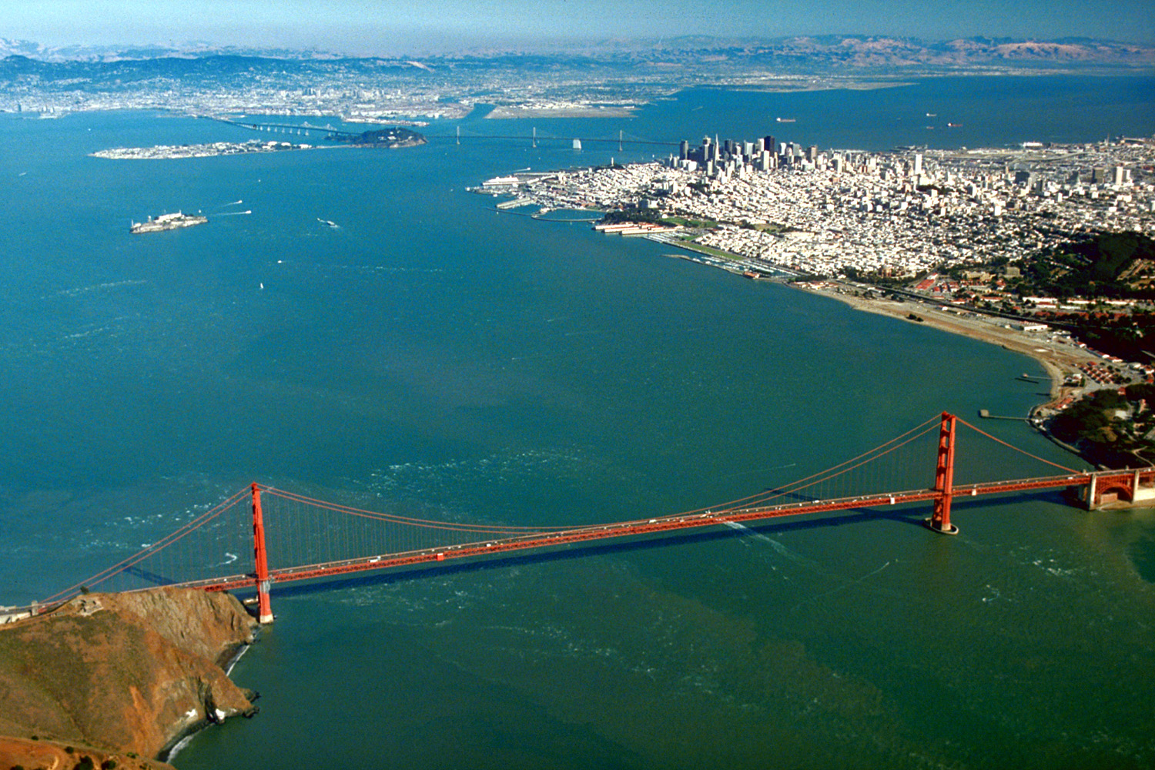
SF Bay Nutrient Assessment Framework Development
Nutrient Technical Workgroup Meeting
February 4, 2014

Slide 2
At Previous Stakeholder Meetings….
Discussed work plan to create assessment framework
Presented white paper summarizing existing approaches to creating assessment frameworks
Site-specific (Chesapeake Bay chlorophyll a criteria)
Regional (Florida, European Water Framework Directive)
Specific Feedback from SAG:
Opportunity to provide technical input in real time, not just comment on outcome

Slide 3
Progress Since Last Meeting
Completed preliminary analysis of existing data
Held 2nd conference call of expert team to discuss:
Proposed segmentation
Get consensus on indicators
Present analysis of existing data
First workshop is scheduled for February 11-12, 2014
Tech team is working on the charge

Slide 4
Goal and Roadmap for This Agenda Item
Goal: Provide opportunity for SAG technical input on approach prior to for technical team workshop
Road map:
Overview of process, approach and timeframe
Geographic scope, focal habitats, and proposed segmentation
Informing the process: analysis of existing data
Charge for February 11-12, 2014 workshop
Discussion (all)

Slide 5
Context for Assessment Framework
Conceptual Model
Assessment Framework
Modeling Strategy
SF Bay Monitoring Program
Core Monitoring and Special Studies
Nutrient-Response Model Development and Validation
Regulatory
Basin Plan Objectives
Waterbody Assessments
and 303(d) listing
NPDES Permit Limits
NPS
Control

Slide 6
What is An Assessment Framework?
Decision support
Transparent
Peer-reviewed
Capacity to evolve framework as science advances
Indicators, metrics & endpoints may differ by Bay segment or season
Key components
Supported by SF Bay conceptual models
Specifies what to measure, temporal and spatial frequency in which those indicators/metrics should be measured
Specifies how to use data to classify the Bay (or segments of the Bay) in “risk categories”
Assessment frameworks do not:
Specify regulatory thresholds – that is a policy decision

Slide 7
Process and Schedule to Develop Assessment Framework
Begin with conceptual models
Identify indicators, linkages to beneficial uses at relevant spatial and temporal scales
Review available assessment frameworks
White paper that synthesizes approaches, data required
Utilize those frameworks with existing SF Bay data (if available) to demonstrate applicability
Inform decision-making
Utilize demo results, in tandem with conceptual models, to craft strawman framework with experts
Demonstrate with existing data
Vete and refine assessment framework (…repeat)
Fall 2012
Spring 2013
Fall 2013
Spring 2014
Summer 2014

Slide 8
Who Are The Experts
International experts in assessment frameworks, criteria:
Suzanne Bricker (NOAA)
Larry Harding (University of Maryland/UCLA)
James Hagy (EPA ORD)
Local experts in SF Bay nutrient biogeochemistry and eutrophication, but not limited to:
Jim Cloern -- Wim Kimmerer
Anke Mueller-Solger
Dick Dugdale
Raphael Kudela

Slide 9
What’s Ahead: Three 2-Day Experts Workshops To Develop Draft Framework
Workshop 1 (January-February 2014)
Confirm indicators (and metrics) of interest
Agree on geographic scope, SF Bay “segments” and targeted habitats
Identify temporal elements of assessment framework
Identify spatial elements of assessment framework
Workshop 2 (March- April 2014)
Develop proto-monitoring program
Discussion of thresholds for classification scheme
Workshop 3 (May-June 2014)
Develop classification scheme by Bay segment
Discuss uncertainty associated with classification scheme
Conference calls (June – July 2014)
Comment on assessment framework document

Slide 10
Goal and Roadmap for This Agenda Item
Goal: Provide opportunity for SAG technical input on approach prior to for technical team workshop
Road map:
Overview of process, approach and timeframe
Geographic scope, focal habitats, and proposed segmentation
Informing the process: analysis of existing data
Charge for February 11-12, 2014 workshop
Discussion (all)

Slide 11
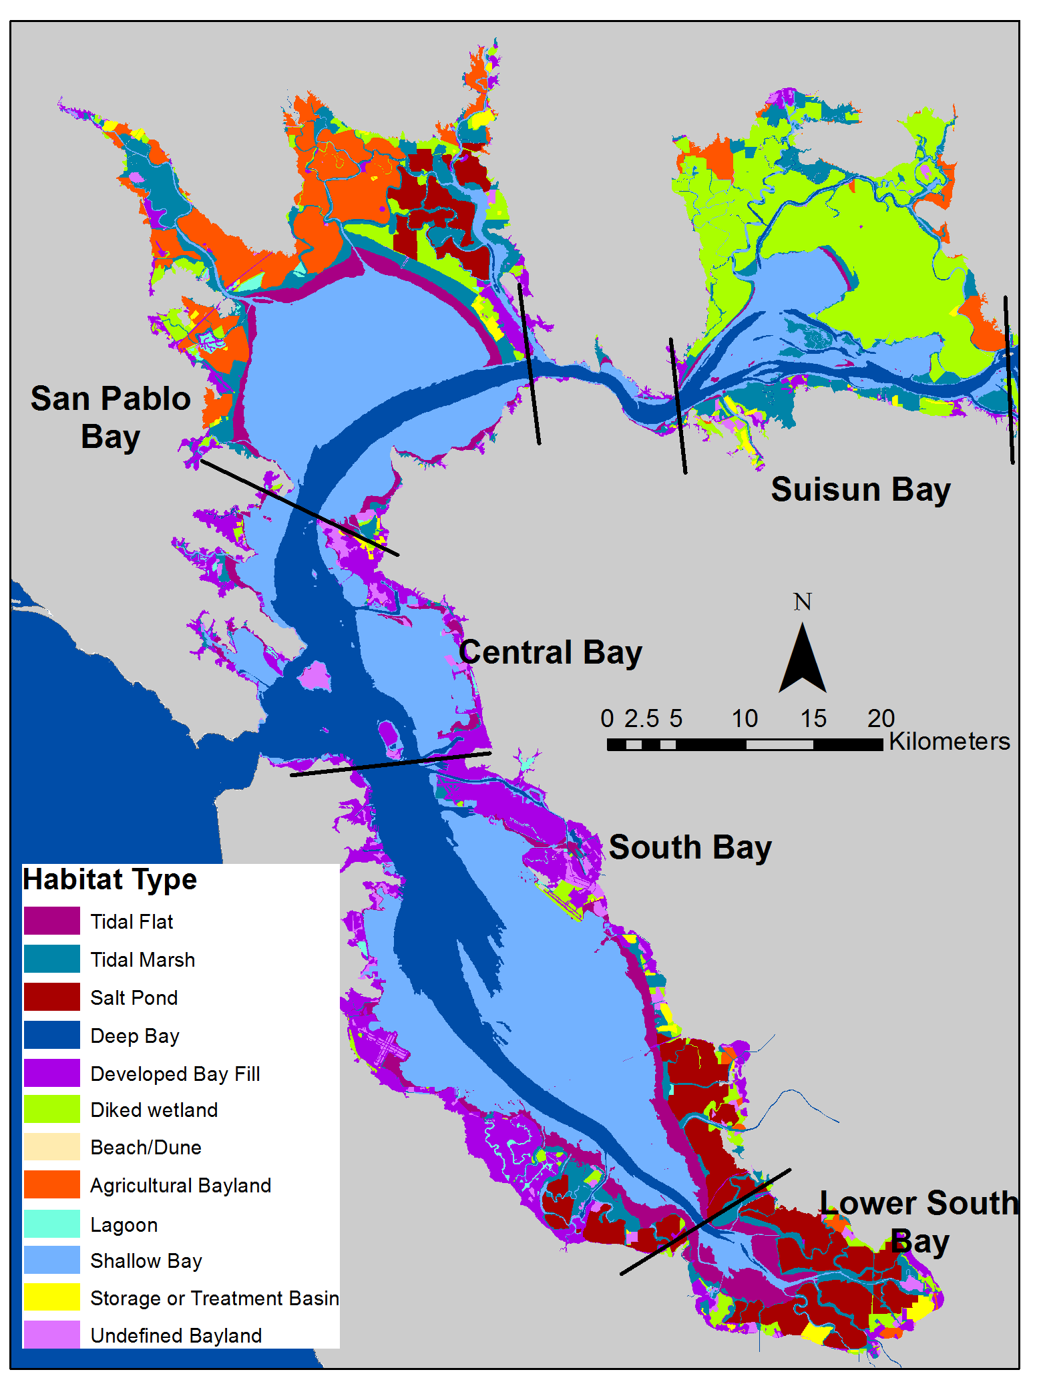
Geographic Scope and Applicable Habitats?
Geographic scope coincident with RB 2 boundaries
Shallow & deepwater subtidal
Excludes:
Diked baylands, restored salt ponds

Slide 12
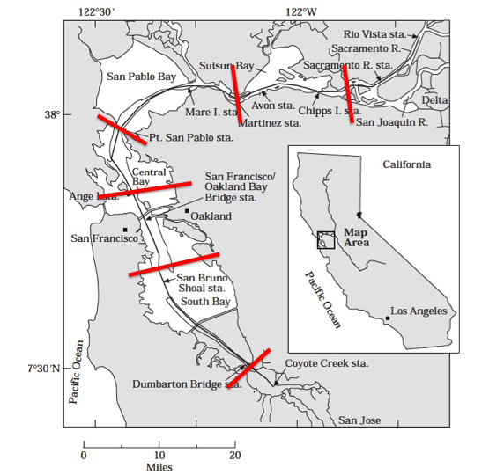
Proposed Preliminary Segmentation of SF Bay, Based on Jassby et al. 1997
Boundaries coincident with natural physical boundaries
Starting point for discussions now
Possibility to refine with new data

Slide 13
Analysis of Existing Monitoring Data: A Preview
From January 16, 2014 Tech Team Conference Call

Slide 14
Introduction
Many frameworks exist to assess effects of nutrient over-enrichment and/or eutrophication
Use of different assessment frameworks on same system can yield very different results
Different frameworks apply similar indicators, but small differences affect outcome
Data integration (seasonal, annual average, annual median, percentile)
Characteristics included in indicator metrics (concentration, spatial coverage, frequency of occurrence)
Combination of indicators into multiple lines of evidence

Slide 15
Purpose of Analysis of Existing Data
Inform the process of developing an appropriate assessment framework and monitoring program for SF Bay
Test out existing indicators and assessment frameworks using real data
Show you how the details of indicators, thresholds, and data integration affect the result
Generate discussion of what you like/don’t like about the frameworks
Solicit additional analysis that could be done to better inform this process
This is a jumping off point for discussion, so looking for a visceral reaction! Does not imply we are suggesting to use these approaches for SF Bay
Notes:
This is material for you to think about in advance of the workshop. We still have time to conduct more analysis if there is something you feel would be informative for discussion

Slide 16
Frameworks, Frameworks, Frameworks…
Method Name | Biological Indicators | Physico-Chemical Indicators | Load related to WQ | Integrated final rating
TRIX | CHL | DO, DIN, TP | No | Yes
EPA NCA Water Quality Index | CHL | DO, Water clarity, DIN, DIP | No | Yes
ASSETS | CHL, macroalgae, seagrass, HAB | DO | Yes | Yes
LWQI/TWQI | CHL, macroalgae, seagrass | DO, DIN, DIP | No | Yes
OSPAR COMPP | CHL, macroalgae, seagrass, PP indicator spp. | DO, DIN, DIP, TP, TN | Yes | Yes
WFD guidance | CHL, PP, macroalgae, benthic invertebrates, seagrass, | DO, Water clarity, DIN, DIP, TN, TP | No | Yes
HEAT | CHL, macroalgae, benthic invertebrates, seagrass, HAB | DO, Water clarity, DIN, DIP, TN, TP, C | No | Yes
IFREMER | CHL, seagrass, macrobenthos, HAB | DO, Water clarity, DIN, SRP, TN, TP, sediment organic matter, sediment TN, TP | No | Yes
Statistical Trophic Index | CHL, Primary Production | DIN, DIP | No | No
AMBI | Soft bottom macrobenthic community |  | No | Yes
BENTIX | Soft bottom macrobenthic community |  | No | Yes
ISD (lagoons) | Benthic community biomass size classes |  | No | Yes
B-IBI | Benthic community species diversity, productivity, indicator spp., trophic composition |  | No | Yes
Notes:
There are a lot of frameworks to choose from, but, for this exercise, we can only apply the frameworks for which we have existing data

Slide 17
Data Sets– Quarterly Sampling
USGS Water Quality Monitoring Surveys
Chlorophyll (1975-present)
Dissolved oxygen (1971-present)
Inorganic nutrients (1971-present)
Interagency Ecological Program (IEP) Bay –Delta monitoring program (CA Department of Water Resources)
Chlorophyll (1975-present)
Taxa (1975-present)
Dissolved oxygen (1971-present)
Inorganic nutrients (1971-present)
Total nutrients (1971-present)
Turbidity (1975-present)

Slide 18
Data Limits the Framework We Can Apply
Method Name | Biological Indicators | Physico-Chemical Indicators | Load related to WQ | Integrated final rating
TRIX | CHL | DO, DIN, TP | No | Yes
EPA NCA Water Quality Index | CHL | DO, Water clarity, DIN, DIP | No | Yes
ASSETS | CHL, macroalgae, seagrass, HAB | DO | Yes | Yes
LWQI/TWQI | CHL, macroalgae, seagrass | DO, DIN, DIP | No | Yes
OSPAR COMPP | CHL, macroalgae, seagrass, PP indicator spp. | DO, DIN, DIP, TN, TP | Yes | Yes
WFD guidance | CHL, PP, macroalgae, benthic invertebrates, seagrass, | DO, Water clarity, DIN, DIP, TN, TP | No | Yes
HEAT | CHL, macroalgae, benthic invertebrates, seagrass, HAB | DO, Water clarity, DIN, DIP, TN, TP, C | No | Yes
IFREMER | CHL, seagrass, macrobenthos, HAB | DO, Water clarity, DIN, SRP, TN, TP, sediment organic matter, sediment TN, TP | No | Yes
Statistical Trophic Index | CHL, Primary Production | DIN, DIP | No | No
AMBI | Soft bottom macrobenthic community |  | No | Yes
BENTIX | Soft bottom macrobenthic community |  | No | Yes
ISD (lagoons) | Benthic community biomass size classes |  | No | Yes
B-IBI | Benthic community species diversity, productivity, indicator spp., trophic composition |  | No | Yes
Notes:
There are a lot of frameworks to choose from, but, for this exercise, we can only apply the frameworks for which we have existing data

Slide 19
Conceptual Basis for Frameworks- Linkage to Management Endpoints
Light limitation on seagrass
Unbalanced algal community composition/structure and potential foodweb effects
Over-production of organic matter (implications for hypoxia, benthic habitat quality, altered nutrient cycling)
Notes:
Thresholds and data integration period may vary based on how you want to use the indicator in an estuary

Slide 20
What Would the Bay Look Like if It Had A Problem From Nutrient Overenrichment- From Senn et al. (2013)
Table 3.2 What would a problem look like in SFB? Potential impaired states
 | Impaired State | Indicators
IS.1 | High Phytoplankton Biomass High phytoplankton biomass of sufficient magnitude (concentration), duration, and spatial extent that it impairs beneficial uses due to direct or indirect effects (A0.2). This could occur in deep subtidal or in shallow subtidal areas. | Chlorophyll a, Productivity
IS.7 | Low Phytoplankton Biomass Low phytoplankton biomass in Suisun Bay or other habitats due to elevated NH4 which exacerbates food supply issues.
IS.4 | NABs, HABs and algal toxins Occurrence of HABs and related toxins at sufficient frequency or magnitude of events that habitats reach an impaired state, either in the source areas or in areas to which toxins are transported. | HAB or NAB abundance, toxin concentrations
IS.6 | Suboptimal phytoplankton assemblages Nutrient-related shifts in phytoplankton community composition, or changes in the composition of individual cells (N:P), that result in decreased food quality, and have cascading effects up the food web. | Phytoplankton assemblage
IS.2 | Low Dissolved Oxygen in Deep Water– Deep subtidal Low DO in deep subtidal areas of the Bay, below some threshold for a period of time that beneficial uses are impaired. | Dissolved oxygen
IS.3 | Low DO in Shallow Habitat– Shallow/margin habitats: DO in shallow/margin habitats below some threshold, and beyond what would be considered “natural” for that habitat, for a period of time that it impairs beneficial uses, by reducing habitat area for fish or benthos at various life stages.
IS.8 | Other nutrient-related impacts. Other direct or indirect nutrient-related effects that alter habitat or food web structure at higher trophic levels by other pathways. (e.g., creating conditions that favor the establishment of invasive benthos and copepods; NH4 direct toxicity to copepods; spreading of macrophytes related to high nutrient concentrations) | Nutrient concentrations (Ammonium), nutrient ratios,

Slide 21
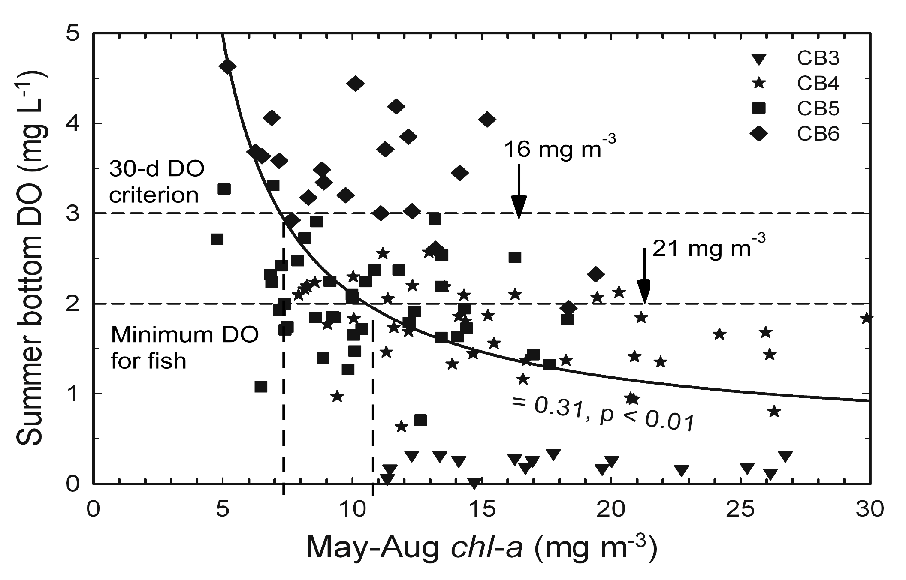
Dissolved Oxygen (DO)
2
R
From L. W. Harding et al. 2013. Scientific bases for numerical chlorophyll criteria in Chesapeake Bay. Estuaries and Coasts doi:10.1007/s12237-013-9656-6
Notes:
Several impairments informed the chl-a criteria we developed. Dissolved oxygen is not the cleanest proxy for chl-a in this system, but at same level substrate availability represented by chl-a is linked to the severity of hypoxia. Tom Fisher analyzed data for four stations in the main stem bay (north to south) in the context of specific impairments captured in published DO criteria. The horizontal lines are DO criteria established by environmental managers and the line is the non-linear fit (hyperbolic) to the assembled data. Intersections of these lines identify
chl-a of 7.4 to11 mg m-3 corresponding to DO from 2 to 3 mg L⁻¹.

Slide 22
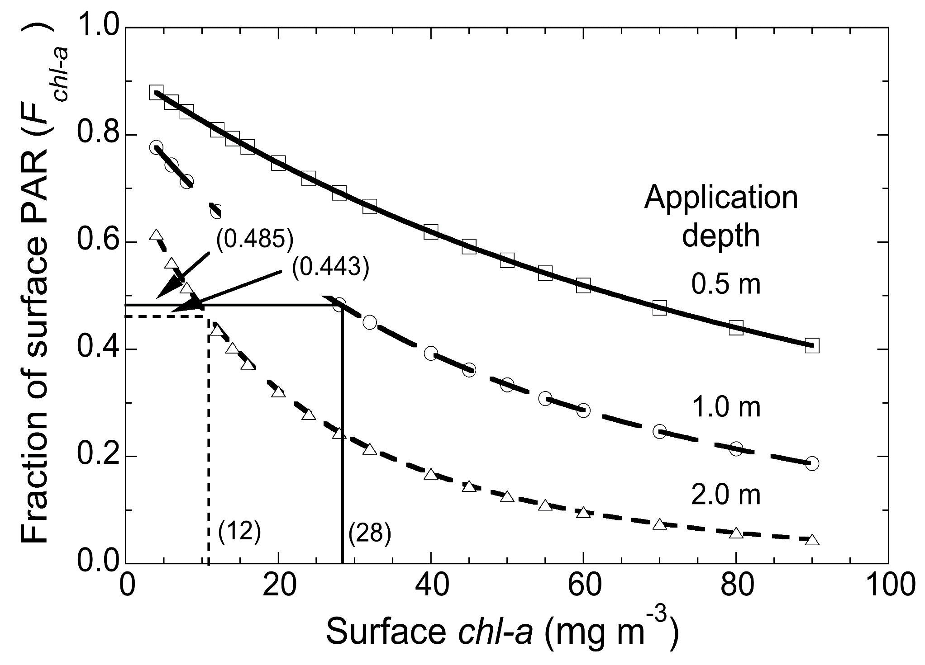
Submerged Aquatic Vegetation (SAV)
From L. W. Harding et al. 2013. Scientific bases for numerical chlorophyll criteria in Chesapeake Bay. Estuaries and Coasts doi:10.1007/s12237-013-9656-6
Notes:
A second impairment we considered was water clarity and its effect on submerged aquatic vegetation (SAV). Chuck Gallegos undertook this work based on chl-a that would be required to attain light conditions supportive of SAV growth at specific depth horizons, or application depths, using an assumption of 0.3 of the attenuation due to chl-a based on extensive observations Chuck’s group and mine have made on the bay. Bio-optical modeling with Curt Mobley’s program, Hydrolight, generated chl-a corresponding to specific fractions of surface PAR that would reach application depths of 1.0 and 2.0 m, shown on this graphic and the next one.

Slide 23
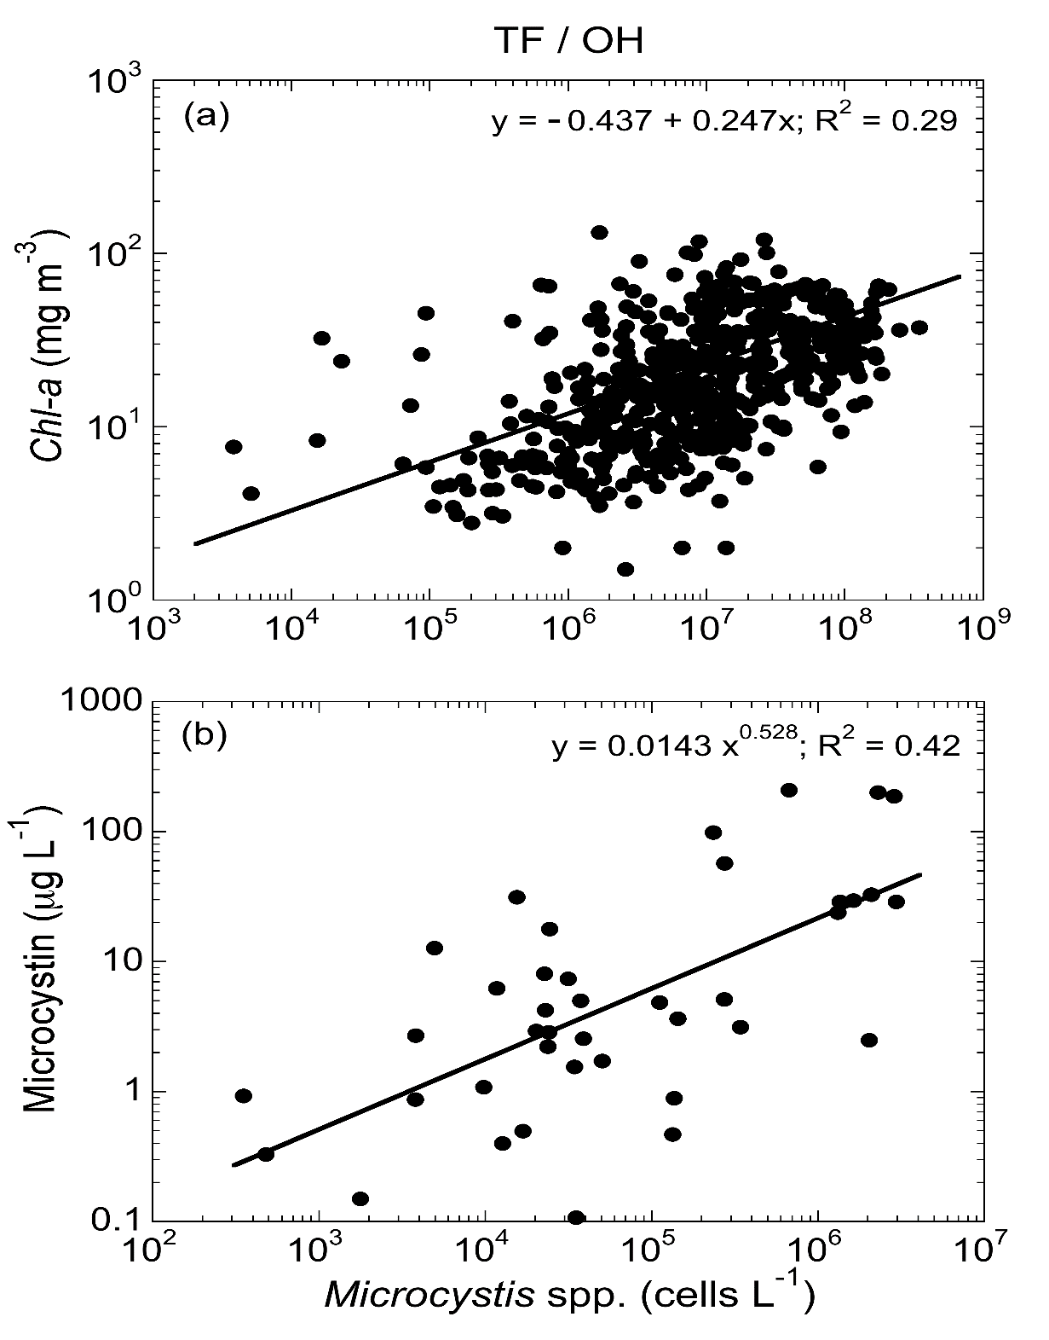
HABs – Microcystis spp.
From L. W. Harding et al. 2013. Scientific bases for numerical chlorophyll criteria in Chesapeake Bay. Estuaries and Coasts doi:10.1007/s12237-013-9656-6
Notes:
Lastly, we considered impairments due to harmful algal blooms (HABs), focusing on Microcystis spp, for which a link of chl-a to toxin concentrations was established. Much-publicized blooms of toxic dinoflagellates are rare in the bay and there is no link of chl-a to toxins, indeed, the entire phytoplankton cell-counts data base shows very few observations of harmful red tides. High chl-a is largely associated with diatoms that are not toxic, although they do have negative impacts on DO and water clarity. I won’t go into the details of this approach, suffice it to say specific human-health effects of microcystin were linked to cell concentrations, and in turn to chl-a to identify concentrations that would lessen exposure to toxic effects of Microcystis spp.

Slide 24
Evaluated Frameworks
Water Framework Directive (developed in United Kingdom)
Water quality index
Phytoplankton index
Taxa index
Assessment of Estuarine Trophic Status (ASSETS)
Chlorophyll
Dissolved oxygen
The French Research Institute for the Exploration of the Sea (IFREMER) Classification for Mediterranean Lagoons
Notes:
Suzanne showed that there are a number of existing frameworks, for this exercise we selected a subset with indicators that could be generated from the existing data.
For the most part we cherry picked the indicators out of the frameworks, ignoring the integrative aspects of the frameworks for the moment.

Slide 25
Why These Three?
These three frameworks differ sufficiently in approach, results demonstrate how organizing principles affect outcome.
Method | Application | Indicator Use
 |  | Light limitation on seagrass | Unbalanced algal assemblage | Organic matter over-production
ASSETS | Broad in scope; designed to be used in all estuaries | X | X | X
UK-WFD | Designed for estuaries in the UK (strong seasonality) | X | X | X
IFREMER | Limited to shallow, Mediterranean Lagoons | X | X

Slide 26
Indicators: ASSETS
Classification is assessed using a multi metric approach
For this analysis; indicators for chlorophyll a and dissolved oxygen were assessed independently
Classification | 10th Percentiles Annual Dissolved Oxygen
High | > 5 mg L⁻¹
Biologically Stressful | 2 - 5 mg L⁻¹
Hypoxia | 0 - 2 mg L⁻¹
Anoxia | 0 mg L⁻¹
Classification | 90th Percentile Annual CHL a
Low | ≤ 5 μg L⁻¹
Medium | 5 – 20 μg L⁻¹
High | 20 – 60 μg L⁻¹
Hypereurophic | > 60 μg L⁻¹
Notes:
Broadly applied, protective of all three aspects for CHL

Slide 27
Indicators: IFREMER
Classification is assessed using a series of indicators and thresholds
Indicator | Unit | Eutrophic Status
 |  | Blue | Green | Yellow | Orange | Red
%O2 Saturation | % SAT | <20 | 20-30 | 30-40 | 40-50 | >50
Turbidity | NTU | <10 | 10-20 | 20-30 | 30-40 | >40
phosphate | μM | <0.3 | 0.3-1 | 1-1.5 | 1.5-4 | >4
Dissolved inorganic nitrogen | μM | <15 | 15-20 | 20-40 | 40-60 | >60
Nitrite | μM | <0.5 | 0.5-1 | 1-5 | 5-10 | >10
Nitrate | μM | <7 | 7-10 | 10-20 | 20-30 | >30
Ammonia | μM | <7 | 7-10 | 10-20 | 20-30 | >30
CHL-a | μg L⁻¹ | <5 | 5-7 | 7-10 | 10-30 | >30
CHL-a + phaeopigments | μg L⁻¹ | <7 | 7-10 | 10-15 | 15-40 | >40
Total nitrogen | μM | <50 | 50-75 | 75-100 | 100-120 | >120
Total phosphorus | μM | <1 | 1-2 | 2-5 | 5-8 | >8
Notes:
Focused on shallow lagoons, thresholds for CHL are lower to be more protective of seagrass habitat

Slide 28
Indicators: UK-WFD Phytoplankton
Each statistic is given a point value of 1 if it does not exceed the threshold, the sum of points accumulated yields the final classification.
Statistic | Low Salinity Threshold (0-25 ppt) | High Salinity Threshold (> 25 ppt)
Average Annual CHL-a | ≤ 15 µg L⁻¹ | ≤ 10 µg L⁻¹
Median Annual CHL-a | ≤ 12 µg L⁻¹ | ≤ 8 µg L⁻¹
% CHL-a less than 10 µg L⁻¹ | > 70 % | > 75 %
% CHL-a less than 20 µg L⁻¹ | > 80 % | > 85 %
% CHL-a less than 50 µg L⁻¹ | < 5 % | < 5 %
Points | Classification
5 | High
4 | Good
3 | Moderate
2 | Poor
0-1 | Bad
Notes:
Uses five different data integration periods, very different from IFREMER and ASSETS.

Slide 29
Indicators: UK-WFD Taxa
Classification is assessed as the sum of a series of exceedences
Sum of % Exceedences Σ(CHL + S + P + T) | Classification
0-10 | High
10-20 | Good
20-40 | Moderate
40-60 | Poor
60-100 | Bad
Index | Statistic | Threshold
CHL | Chlorophyll (CHL) | > 10 µg L⁻¹
S | Any phytoplankton taxa (S) | > 10⁶ cells L⁻¹
P | Phaeocystis sp.* (P) *used Cyanobacteria | > 10⁶ cells L⁻¹
T | Total taxa counts (T) | > 10⁷ cells L⁻¹

Slide 30
Indicators: UK-WFD Water Quality Index
Classification is assessed via progression through three indices
Statistic for Index |  | Index 1: I_{DIN} Nutrient Concentration | Index 2: I_{PP} Production* | Index 3: I_{DO} Undesirable Disturbance
 |  | Mean Winter Dissolved Inorganic Nitrogen (µM) | Growing Season Potential Primary Productivity (g C m⁻² y⁻¹) | Growing Season Mean Dissolved Oxygen Concentration (mg L⁻¹)
Eutrophic Status | High | I_{DIN} ≤ 12 | n/a | n/a
 | Good | I_{DIN} < 30 | n/a | n/a
 | Good |  | I_{DIN} ≥ 30 µM I_{PP} < 300 | I_{DO} > 5
 | Moderate |  | I_{DIN} ≥ 30 µM I_{PP} ≥ 300 | I_{DO} > 5
 | Poor |  | I_{DIN} ≥ 30 µM I_{PP} ≥ 300 | I_{DO} ≤ 5
 | Bad |  | I_{DIN} ≥ 30 µM I_{PP} ≥ 300 | I_{DO} ≤ 2
* For this exercise, potential primary production was calculated using DIN rather than loads, because loads are unavailable

Slide 31
Comparison
UK-WFD Sum of Multiple Statistics
Statistic |  |  | Low Salinity Threshold (0-25 ppt) |  |  | High Salinity Threshold (> 25 ppt)
Average Annual CHL-a |  |  | ≤ 15 µg L⁻¹ |  |  | ≤ 10 µg L⁻¹
Median Annual CHL-a |  |  | ≤ 12 µg L⁻¹ |  |  | ≤ 8 µg L⁻¹
% CHL-a < 10 µg L⁻¹ |  |  | > 70 % |  |  | > 75 %
% CHL-a < 20 µg L⁻¹ |  |  | > 80 % |  |  | > 85 %
% CHL-a > 50 µg L⁻¹ |  |  | < 5 % |  |  | < 5 %
Each statistic is given a point value of 1 if it does not exceed the threshold, the sum of points yields the final classification.
Classification | High | Good |  | Mod | Poor |  | Bad
Points | 5 | 4 |  | 3 | 2 |  | 0-1
Classification | ASSETS: 90th Percentile Annual CHL a | IFREMER: Annual Average CHLa
Low | 0 - 5 μg L⁻¹ | <5 μg L⁻¹
Medium-Low |  | 5-7 μg L⁻¹
Medium | 5 - 20 μg L⁻¹ | 7-10 μg L⁻¹
High | 20 - 60 μg L⁻¹ | 10 - 30 μg L⁻¹
Hypereurophic | > 60 μg L⁻¹ | > 30 μg L⁻¹
Notes:
There is a lot more to these frameworks than just chlorophyll a, but we focus here on CHL because it is a primary indicator under consideration for SF Bay. These three frameworks have different approaches and characterizing the estuary in terms of these three is instructive for designing a relevant framework for SF Bay.

Slide 32
Analysis of Existing Data Approach
Assess eutrophic condition for SF Bay and its segments
Compare results between indicators
Compare outcomes based on data integration
Inter-annual variability (yearly, six year running average)
Temporal integration of annual data (seasonal, annual average, annual median, percentile)
Spatial integration

Slide 33
Preliminary Segmentation of the Bay
Habitat types of SFB and surrounding Baylands. Water Board subembayments boundaries are shown in black. Habitat data from CA State Lands Commission, USGS, UFWS, US NASA and local experts were compiled by SFEI.

Slide 34
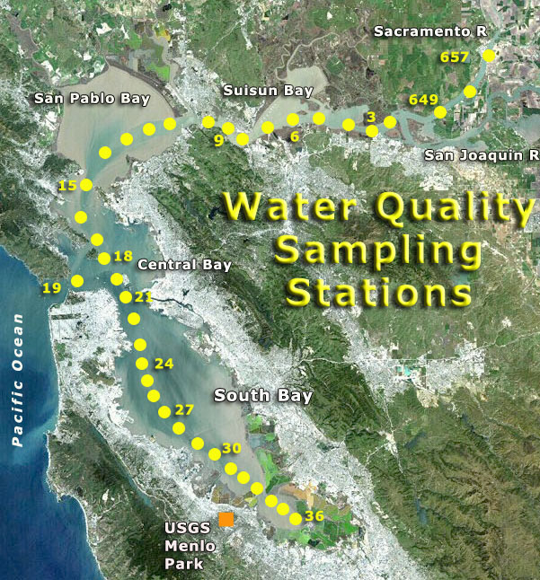
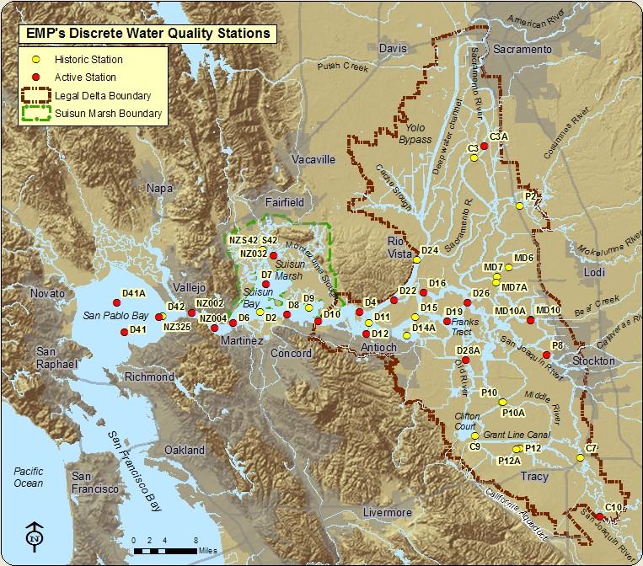
Preliminary Bay Segments
Sub-estuaries: North Bay, South Bay, Delta
Sub-basins: Suisun, San Pablo, Upper South Bay, Lower South Bay
Notes:
These are preliminary segments, we can discuss and re-draw the boundaries
We are going to look particularly closely at North Bay because it has two distinct datasets.

Slide 35
Understanding the Effects of Data Integration on Outcome
Use North Bay as a test case
Two different datasets allow
Compare results between indicators
Focus primarily on chlorophyll
Compare outcomes based on varying data integration methods
Inter-annual variability (yearly, six year running average)
Temporal integration of annual data (seasonal, annual average, annual median, percentile)
Spatial integration

Slide 36
North Bay
Notes:
These are preliminary segments, we can discuss and re-draw the boundaries
We are going to look particularly closely at North Bay because it has two distinct datasets.

Slide 37
North Bay: Comparison of Results Among Indicators
Notes:
Take home messages:
Different indicators give different results for North Bay
Overall CHL and DO show not much problem, Nutrients tell a different story
Three different frameworks give different results on different years. So focus on CHL a.

Slide 38
North Bay: Incorporation of Inter-Annual Variability
Yearly Data
Six Year Running Average
Year | WFD CHL | ASSETS CHL | IFREMER CHL | WFD TAXA | WFD WQ
1975 | GOOD | HIGH | YELLOW |  | GOOD
1976 | HIGH | HIGH | YELLOW |  | GOOD
1977 | HIGH | MEDIUM | BLUE |  | MODERATE
1978 | HIGH | HIGH | YELLOW |  | MODERATE
1979 | HIGH | HIGH | YELLOW |  | MODERATE
1980 | HIGH | MEDIUM | GREEN |  | GOOD
1981 | HIGH | HIGH | YELLOW |  | GOOD
1982 | GOOD | HIGH | ORANGE |  | GOOD
1983 | HIGH | MEDIUM | BLUE |  | GOOD
1984 | GOOD | MEDIUM | YELLOW |  | GOOD
1985 | HIGH | MEDIUM | GREEN |  | GOOD
1986 | GOOD | HIGH | YELLOW |  | GOOD
1987 | HIGH | MEDIUM | BLUE |  | GOOD
1988 | HIGH | LOW | BLUE |  | GOOD
1989 | HIGH | LOW | BLUE |  | GOOD
1990 | HIGH | LOW | BLUE |  | MODERATE
1991 | HIGH | LOW | BLUE |  | MODERATE
1992 | HIGH | LOW | BLUE |  | MODERATE
1993 | HIGH | LOW | BLUE |  | GOOD
1994 | HIGH | LOW | BLUE |  | MODERATE
1995 | HIGH | MEDIUM | BLUE |  | GOOD
1996 | HIGH | LOW | BLUE |  | GOOD
1997 | HIGH | MEDIUM | BLUE |  | GOOD
1998 | HIGH | MEDIUM | BLUE |  | GOOD
1999 | HIGH | LOW | BLUE |  | GOOD
2000 | HIGH | LOW | BLUE |  | GOOD
2001 | HIGH | MEDIUM | BLUE |  | GOOD
2002 | HIGH | MEDIUM | BLUE |  | GOOD
2003 | HIGH | MEDIUM | BLUE |  | GOOD
2004 | HIGH | MEDIUM | BLUE |  | GOOD
2005 | HIGH | MEDIUM | BLUE |  | GOOD
2006 | HIGH | LOW | BLUE |  | GOOD
2007 | HIGH | MEDIUM | BLUE |  | MODERATE
2008 | HIGH | MEDIUM | BLUE |  | MODERATE
2009 | HIGH | LOW | BLUE |  | MODERATE
2010 | HIGH | MEDIUM | BLUE |  | GOOD
2011 | HIGH | MEDIUM | BLUE | HIGH | GOOD
2012 | HIGH | MEDIUM | BLUE | POOR | GOOD
Year | WFD CHL | ASSETS CHL | IFREMER CHL | WFD TAXA | WFD WQ
1975
1976 |  |  |  |  | GOOD
1977 |  |  |  |  | GOOD
1978 |  |  |  |  | GOOD
1979 |  |  |  |  | GOOD
1980 | HIGH | MEDIUM | GREEN |  | GOOD
1981 | HIGH | MEDIUM | GREEN |  | GOOD
1982 | HIGH | MEDIUM | YELLOW |  | GOOD
1983 | HIGH | MEDIUM | YELLOW |  | GOOD
1984 | HIGH | MEDIUM | YELLOW |  | GOOD
1985 | HIGH | MEDIUM | GREEN |  | GOOD
1986 | HIGH | MEDIUM | YELLOW |  | GOOD
1987 | HIGH | MEDIUM | GREEN |  | GOOD
1988 | HIGH | LOW | BLUE |  | GOOD
1989 | HIGH | LOW | BLUE |  | GOOD
1990 | HIGH | LOW | BLUE |  | GOOD
1991 | HIGH | LOW | BLUE |  | MODERATE
1992 | HIGH | LOW | BLUE |  | MODERATE
1993 | HIGH | LOW | BLUE |  | MODERATE
1994 | HIGH | LOW | BLUE |  | MODERATE
1995 | HIGH | LOW | BLUE |  | MODERATE
1996 | HIGH | LOW | BLUE |  | MODERATE
1997 | HIGH | LOW | BLUE |  | GOOD
1998 | HIGH | LOW | BLUE |  | GOOD
1999 | HIGH | MEDIUM | BLUE |  | GOOD
2000 | HIGH | MEDIUM | BLUE |  | GOOD
2001 | HIGH | MEDIUM | BLUE |  | GOOD
2002 | HIGH | MEDIUM | BLUE |  | GOOD
2003 | HIGH | MEDIUM | BLUE |  | GOOD
2004 | HIGH | MEDIUM | BLUE |  | GOOD
2005 | HIGH | MEDIUM | BLUE |  | GOOD
2006 | HIGH | MEDIUM | BLUE |  | GOOD
2007 | HIGH | MEDIUM | BLUE |  | GOOD
2008 | HIGH | MEDIUM | BLUE |  | MODERATE
2009 | HIGH | MEDIUM | BLUE |  | MODERATE
2010 | HIGH | MEDIUM | BLUE |  | MODERATE
2011 | HIGH | MEDIUM | BLUE | MODERATE | MODERATE
2012 | HIGH | MEDIUM | BLUE | POOR | MODERATE
Notes:
Difference in results can be attributed to temporal averaging
Question is how to incorporate year to year variability: do you want to fail someone for one year?
What is the right averaging period: 3 yrs, 5 yrs, 10 yrs?

Slide 39
North Bay: Differences in Spatial Sampling
Sampling in Main Channel and Shallower Waters
Sampling in Main Channel Only
Year | WFD CHL | ASSETS CHL | IFREMER CHL
1975
1976
1977 | HIGH | MEDIUM | BLUE
1978 | HIGH | MEDIUM | GREEN
1979 | HIGH | MEDIUM | GREEN
1980 | HIGH | MEDIUM | BLUE
1981 | HIGH | LOW | BLUE
1982
1983
1984 | HIGH | LOW | BLUE
1985
1986
1987
1988 | HIGH | LOW | BLUE
1989 | HIGH | LOW | BLUE
1990 | HIGH | LOW | BLUE
1991 | HIGH | LOW | BLUE
1992 | HIGH | LOW | BLUE
1993 | HIGH | LOW | BLUE
1994 | HIGH | LOW | BLUE
1995 | HIGH | MEDIUM | BLUE
1996 | HIGH | LOW | BLUE
1997 | HIGH | MEDIUM | BLUE
1998 | HIGH | MEDIUM | BLUE
1999 | HIGH | LOW | BLUE
2000 | HIGH | LOW | BLUE
2001 | HIGH | MEDIUM | BLUE
2002 | HIGH | MEDIUM | BLUE
2003 | HIGH | MEDIUM | BLUE
2004 | HIGH | MEDIUM | BLUE
2005 | HIGH | MEDIUM | BLUE
2006 | HIGH | LOW | BLUE
2007 | HIGH | MEDIUM | BLUE
2008 | HIGH | MEDIUM | BLUE
2009 | HIGH | LOW | BLUE
2010 | HIGH | MEDIUM | BLUE
2011 | HIGH | MEDIUM | BLUE
2012 | HIGH | MEDIUM | BLUE
Year | WFD CHL | ASSETS CHL | IFREMER CHL
1975 | GOOD | HIGH | YELLOW
1976 | HIGH | HIGH | YELLOW
1977 | HIGH | MEDIUM | BLUE
1978 | GOOD | HIGH | ORANGE
1979 | MODERATE | HIGH | ORANGE
1980 | GOOD | HIGH | ORANGE
1981 | GOOD | HIGH | ORANGE
1982 | GOOD | HIGH | ORANGE
1983 | HIGH | MEDIUM | BLUE
1984 | GOOD | MEDIUM | YELLOW
1985 | HIGH | MEDIUM | GREEN
1986 | GOOD | HIGH | YELLOW
1987 | HIGH | MEDIUM | BLUE
1988 | HIGH | LOW | BLUE
1989 | HIGH | LOW | BLUE
1990 | HIGH | LOW | BLUE
1991 | HIGH | LOW | BLUE
1992 | HIGH | LOW | BLUE
1993 | HIGH | MEDIUM | BLUE
1994 | HIGH | LOW | BLUE
1995 | HIGH | LOW | BLUE
1996 | HIGH | LOW | BLUE
1997 | HIGH | LOW | BLUE
1998 | HIGH | MEDIUM | BLUE
1999 | HIGH | MEDIUM | BLUE
2000 | HIGH | MEDIUM | BLUE
2001 | HIGH | LOW | BLUE
2002 | HIGH | LOW | BLUE
2003 | HIGH | LOW | BLUE
2004 | HIGH | LOW | BLUE
2005 | HIGH | LOW | BLUE
2006 | HIGH | MEDIUM | BLUE
2007 | HIGH | LOW | BLUE
2008 | HIGH | MEDIUM | BLUE
2009 | HIGH | LOW | BLUE
2010 | HIGH | MEDIUM | BLUE
2011 | HIGH | MEDIUM | BLUE
2012 | HIGH | LOW | BLUE
USGS Only
DWR Only
Notes:
Incoproating the shallows can make the score slightly worse

Slide 40
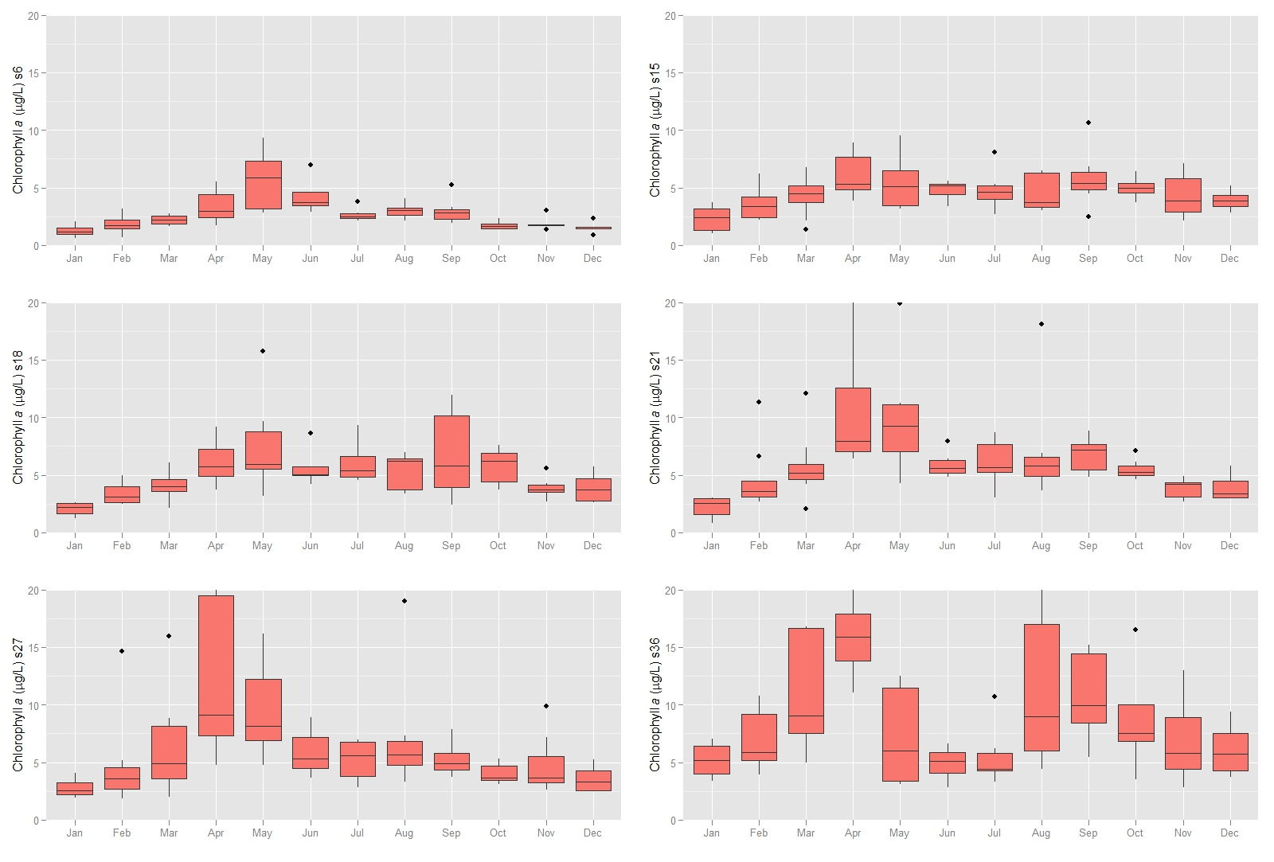
North Bay: Defining the Averaging Period
Annual Average, Median Value, Percentile
Monthly average chl-a (mg m⁻³) – 2006-2011
20
Suisun
20
San Pablo
15
15
10
10
5
5
0
0
J
F
M
A
M
J
J
A
S
O
N
D
J
F
M
A
M
J
J
A
S
O
N
D
Growing Season?
Data source: http://sfbay.wr.usgs.gov/access/wqdata/

Slide 41
North Bay: Effect of Statistic and Threshold
IFREMER Thresholds
ASSETS Thresholds
ASSETS Thresholds

Slide 42
North Bay: Effect of Statistic and Threshold
WFD 95% < 50 ug/L = 1 point
ASSETS 90% > 60, 20, 5 ug/L
WFD 85% < 20 ug/L = 1 point
WFD 75% < 10 ug/L = 1 point
Notes:
Not only worried about the threshold but also the duration. Could exceed threholds once, but how much is too much?

Slide 43
Take Home Messages- Preliminary Analysis of Existing Data
Finite set of indictors considered
Phytoplankton biomass and/or productivity
Phytoplankton assemblage, harmful algal blooms
Nutrients, when employed, are secondary
Convergence on thresholds
Differences in spatial and temporal statistic used for data interpretation matter!

Slide 44
Outcome of Discussion on Analysis of Existing Data
Discussion on indicators and metrics
Suggestions for additional analysis of existing data

Slide 45
Discussion on Indicators and Metrics
Phytoplankton biomass and productivity
Phytoplankton assemblage
HAB species abundance and toxin concentration
Affirmed that nutrient forms and ratios would be monitoring but not considered upfront
Minority dissent

Slide 46
Suggestion for Additional Analysis of Existing Data
Refine previous analyses, using new segmentation boundaries per Jassby et al. (1997)
New indicator for productivity
Suggestions for additional datasets to be included in the analyses
1989 Ota et al. USGS open file report has detailed spatial data of SF Bay. Rerun analysis to show comparison of shallow and deepwater stations
With R. Kudela, redefine metric applicable to phytoplankton assemblage or HAB species cell count (biovolume) and/or toxin concentrations.
Provide graphic of climate context for time series
Locate 1970s Ball and Arthur data set that featured large blooms in Suisun Bay associated with low DO

Slide 47
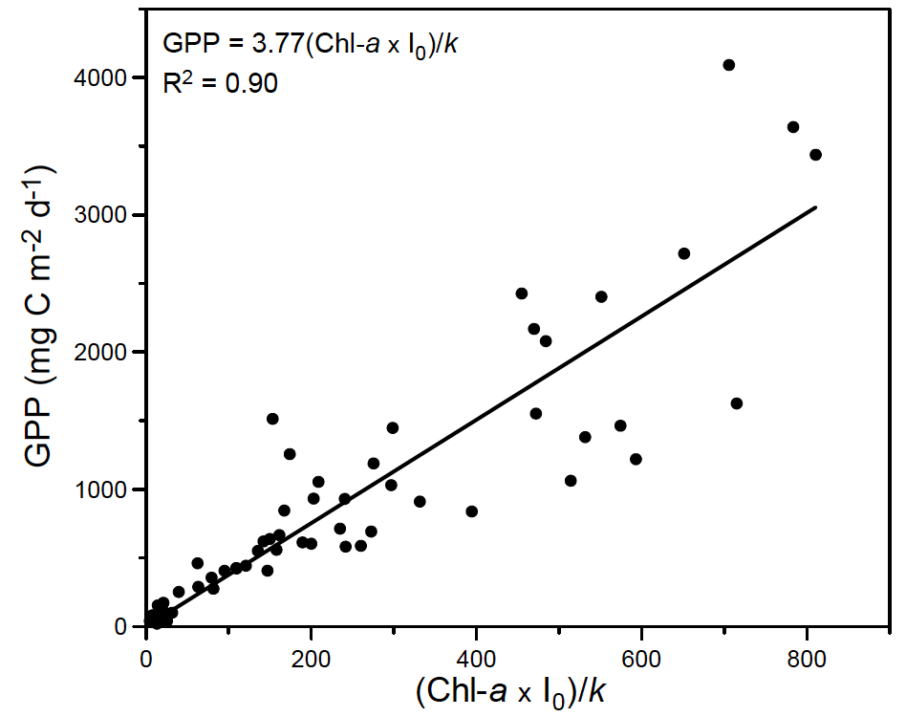

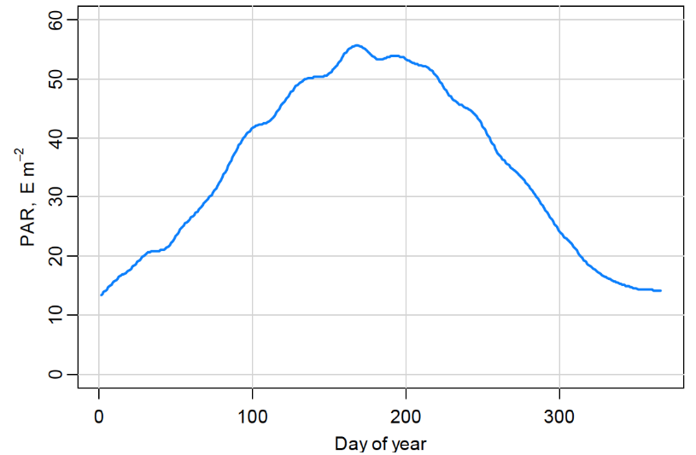
Prospective Indicator: Gross Primary Production
Modeled for each data point from existing dataset following Cloern et al. 2007:
GPP = 3.77 (CHLa * I₀)/k
k estimated from suspended particulate matter (SPM)
k= 0.567 + 0.0586 * SPM
I₀ estimated by day from average irradiance profile fit to a fourth order polynomial
All points in each segment were averaged to generate an annual average GPP
y = 4E-08x⁴ - 2E-05x³ + 0.0042x² + 0.0646x + 14.093 R² = 0.9831

Slide 48
Modeled GPP by Segment

Slide 49
Spatial Analysis
1980 USGS dataset with sampling along channel and across channel transects
South Bay, San Pablo Bay, Suisun Bay
Compare main channel chlorophyll and GPP with same analyses in shallower sites in same basin
Use measurements at 2m in main channel and 1m in shallows

Slide 50
Basin Average Chlorophyll in Deep Main Channel Vs. Shallow Water Survey

Slide 51
Analysis of 1980 High Spatial Coverage Dataset Using Existing Frameworks
Segment | Depth | WFD CHL | ASSETS CHL | IFREMER CHL
San Pablo Bay | Deep | HIGH | MEDIUM | BLUE
 | Shallow | MODERATE | HIGH | ORANGE
Suisun Bay | Deep | GOOD | MEDIUM | YELLOW
 | Shallow | POOR | HIGH | ORANGE
South Bay | Deep | HIGH | LOW | BLUE
 | Shallow | HIGH | MEDIUM | YELLOW

Slide 52
Goal and Roadmap for This Agenda Item
Goal: Provide opportunity for SAG technical input on approach prior to for technical team workshop
Road map:
Overview of process, approach and timeframe
Geographic scope, focal habitats, and proposed segmentation
Informing the process: analysis of existing data
Charge for February 11-12, 2014 workshop
Discussion (all)

Slide 53
Goals/Charge for February Workshop
Consensus on assessment framework metrics and methods of measurement (e.g. chl a, productivity, phytoplankton assemblage, HAB abundance, toxin)
For each metric, consensus on:
What is the temporal density of data need to make an assessment (e.g. CTD casts, continuous moored sensor, etc.)
What is the temporal statistic used to make the assessment (e.g. trends, 90th percentile of annual samples, geomean of March – Oct, etc.)
What is the spatial density of data needed to make an assessment, specific to habitat types, number of stations?
What is the spatial statistic would be used to make an assessment (combined shallow and deep?, mean or percentile of stations?

Slide 54
Next Steps
Assuming goals of February workshop are met, we will have the skeleton of a “proto-monitoring” program for core assessments of SF Bay
Late February or early march meeting to get your feedback on workshop recommendations
Things that you would like Technical Team to consider
Next workshop..(early April?)
Refinements to proto-monitoring program
Begin discussion on thresholds

