Slide 1
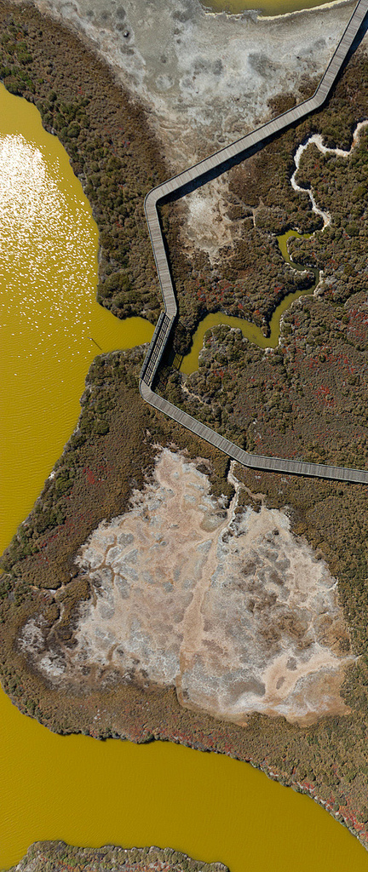

Monitoring Program Development
Background/assumptions
Monitoring Program Development: proposed approach
  3 year plan
  Year 1
Feedback
David Senn, Emily Novick, Anthony Malkassian
February 4, 2014
Source: C. Benton

Slide 2
Discussion Topics/Questions
Goal: Feedback on discussion topics
Highest priority experimental studies to inform monitoring?
Highest priority data analysis to inform monitoring?
Approach to program development

Slide 3
Nutrient science/management questions
Increasing biomass ← does trajectory indicate future impacts?
Phytoplankton composition, toxins ← Caused by nutrients?
Low DO in margin habitats, impacts ← Anthropogenic nutrients?
Future adverse impacts ← Current loads + future scenarios
How do various nutrient sources contribute to ambient concentrations (space, time) Bay?
What load reductions will mitigate or prevent impairment?

Slide 4
Monitoring Program Background
Need for a sustainably-funded, regulatory-driven nutrient monitoring program
Declining support ($) for USGS science program
Future monitoring program will
  include/build around current USGS program + other efforts
  regulatory-driven approach will have different requirements
Program should be an optimal blend blend of ship-based measurements, moored sensors, and other methods (e.g., AUVs, remote sensing)

Slide 5
Monitoring Program Background
Broad goals of program:
  Assess current conditions (impaired? yes or no)
  Track status and trends
  Data for model calibration (physical, chemical, biological)
Want/need to take advantage of cooperative/collaborative efforts
  USGS-Menlo Park
  USGS-Sac (moored sensors)
  IEP/DWR (both discrete and moored programs)
  other institutions (e.g., RTC)
Need for a research vessel
  Polaris aging, USGS may not continue supporting
  need to carry out work on shoals/shallows

Slide 6
What will shape Monitoring Program?

Slide 7
Nutrient Science Program
Assessment
Framework
Modeling
Loads
Monitoring
Special Studies

Slide 8
Nutrient Management/Science Questions
Assessment
Framework
Modeling
e.g.,
identify magnitude, duration, size of a problematic bloom
spatial/temporal resolution of monitoring to detect a problem
Model Calibration
- high resolution data (moored sensors for chl-a, DO, turbidity)
- additional analytes (e.g, TN, TP)
- rate measurements
- hydrodynamic or physical data
Indicators
chl-a
dissolved oxygen
phytoplankton composition
algal toxins
…
others (?)
Monitoring
Supporting measurements
…

Slide 9
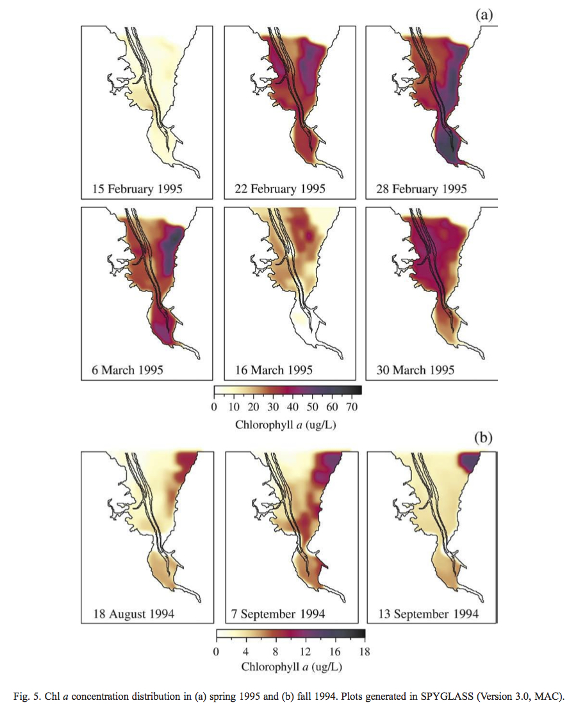
Either for…
compliance
model calibration
What monitoring is needed to detect this?
?
?
?
Long-term USGS cruises/stations
Moorings, continuous sensors
Thompson et al., 2008

Slide 10
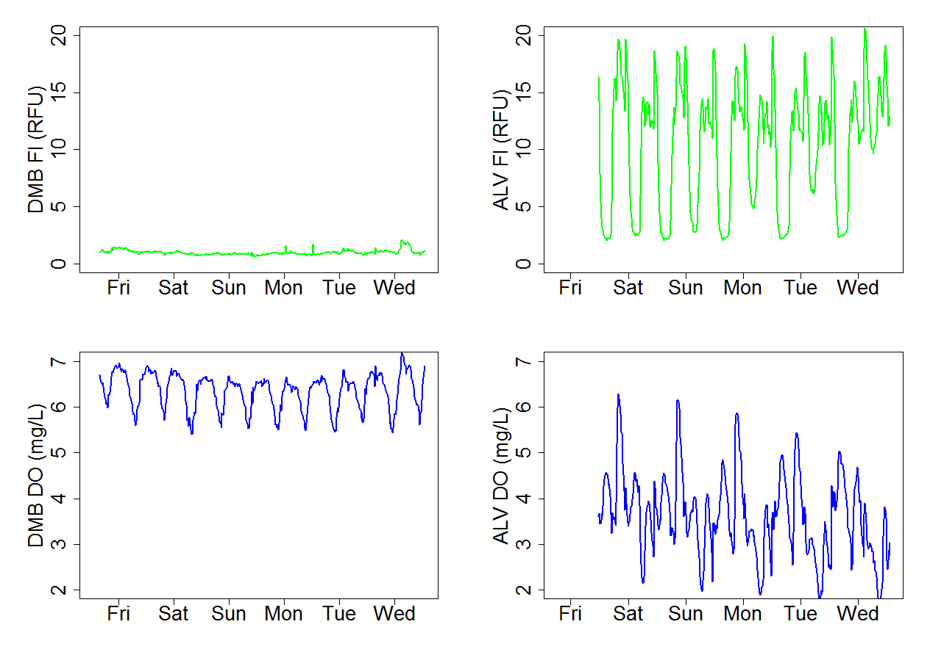
Dumbarton
Alviso Slough
Chl-a
Chl-a
9/6/13 9/8/13 9/10/13
9/6/13 9/8/13 9/10/13
Dissolved Oxygen
Dissolved Oxygen
9/6/13 9/8/13 9/10/13
9/6/13 9/8/13 9/10/13

Slide 11
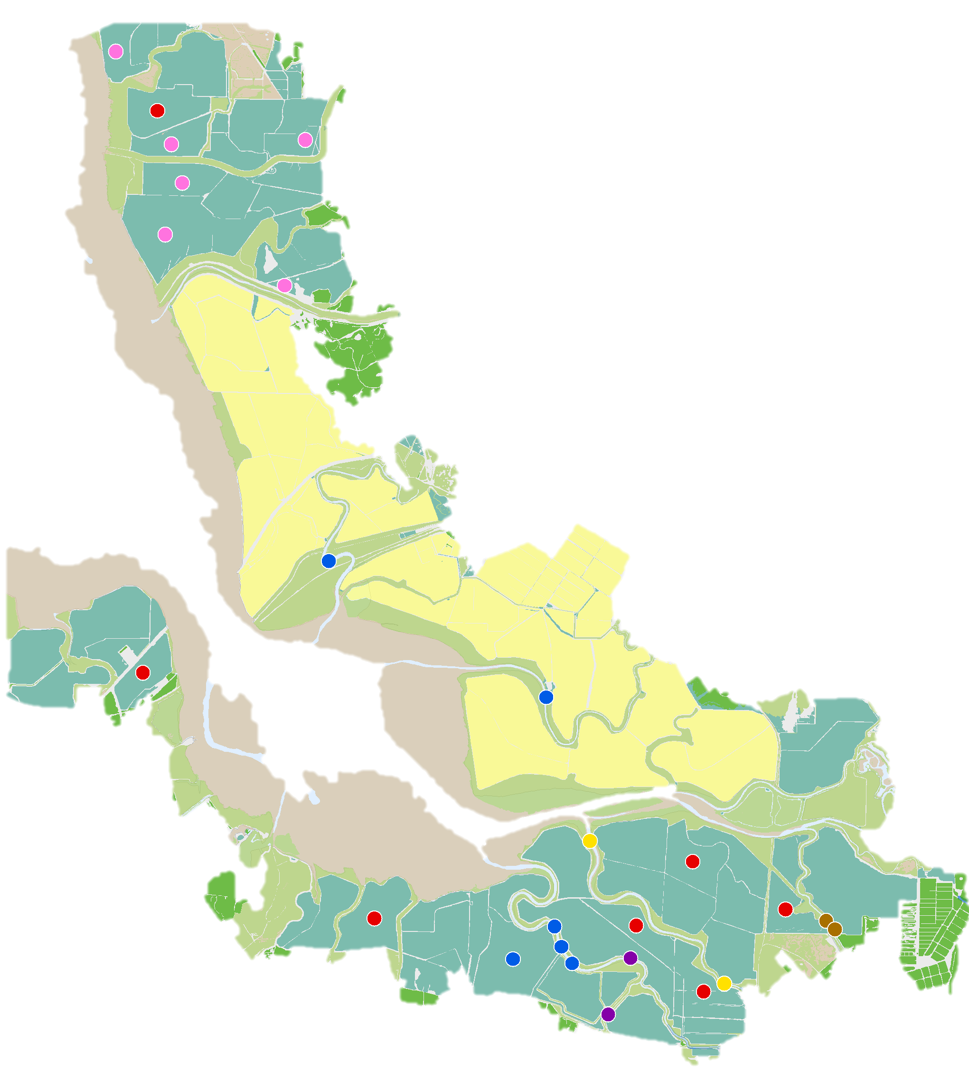
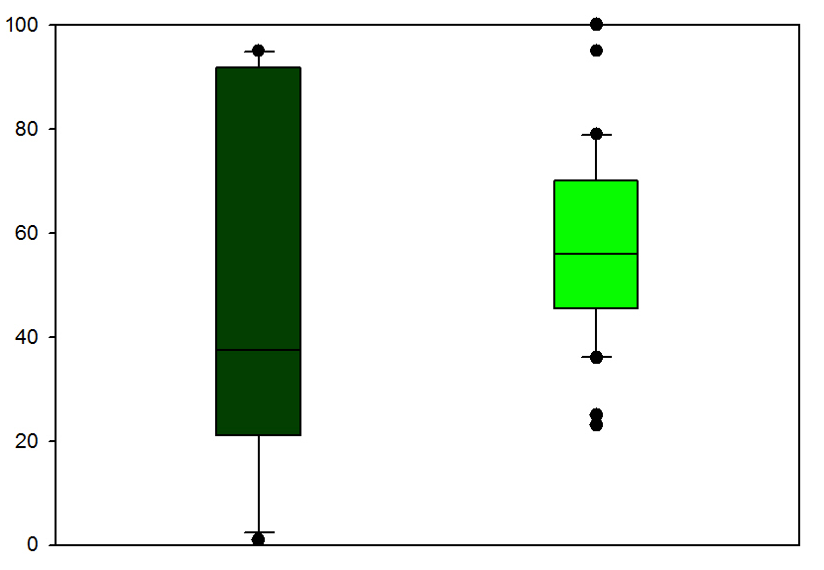
DO in Sloughs and Former Salt Ponds (data = 2004-2012)
%Time below 5 mg L⁻¹
100
80
60
40
20
0
Sloughs
Former Salt Ponds
n=10
n=14
SFEI (2013)
Notes:
Switch now to DO in shallow habitats

Slide 12
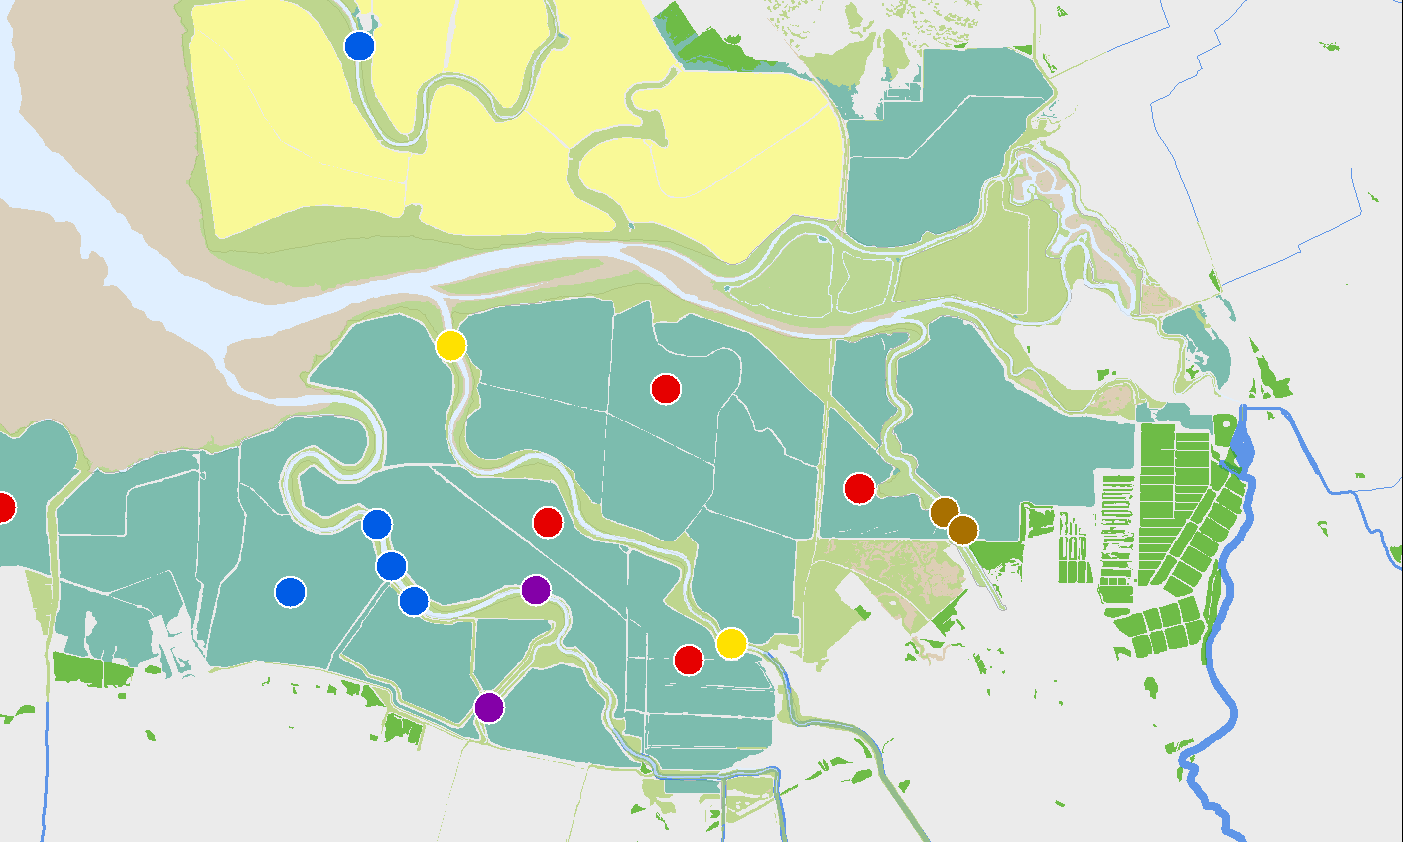
Alviso Slough: June 2012 – April 2013
10
8
4
Data: M Downing-Kunz, USGS
0

Slide 13
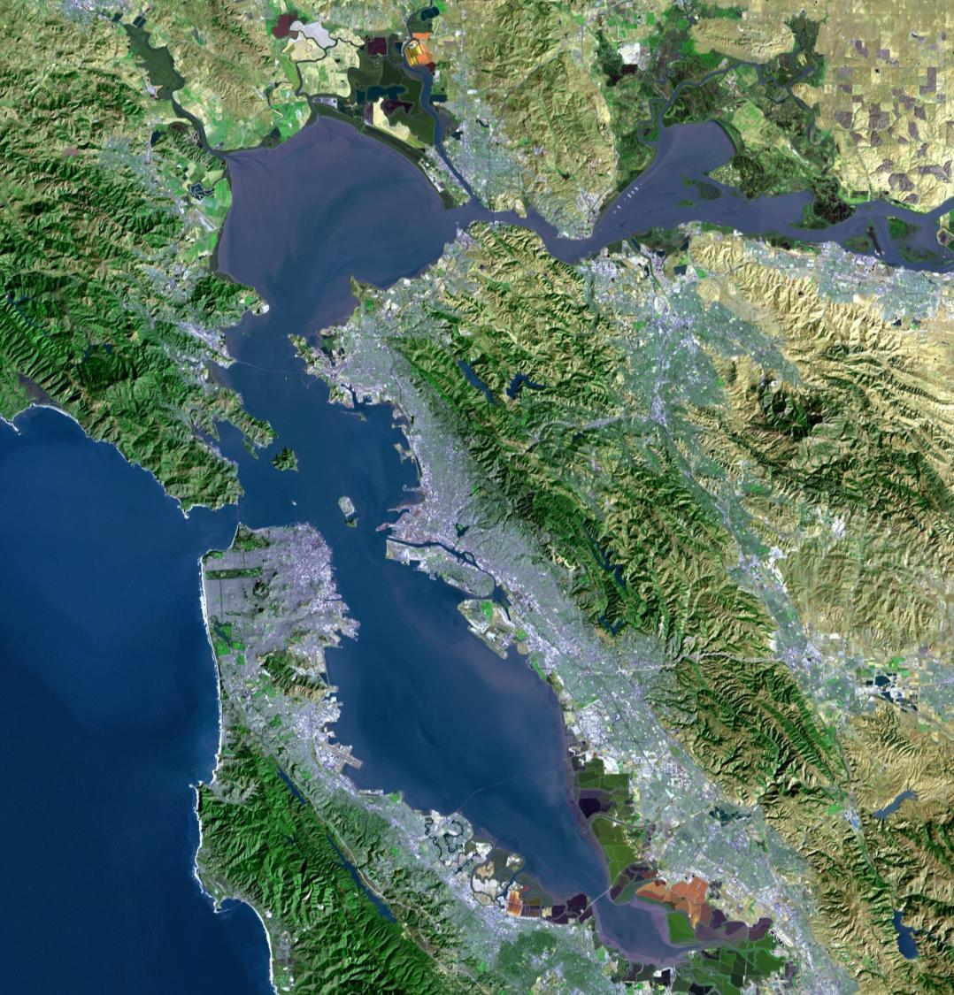
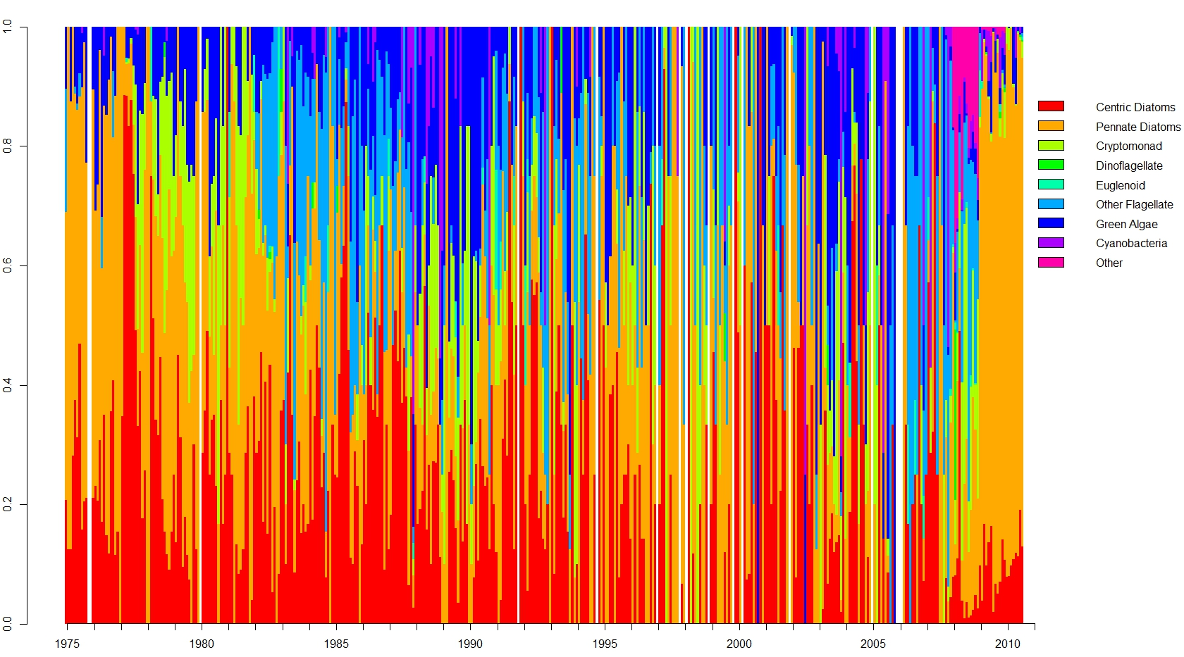
Phytoplankton composition in South Bay and Lower South Bay
s18
s27
s32
s36
Cell counts (%total)
Cyanobacteria
Green Algae
Other Flagellates
Euglenoids
Dinoflagellates
Cryptomonads
Pennate Diatoms
Centric Diatoms
Data: USGS

Slide 14
Nutrient Management/Science Questions
Assessment
Framework
Modeling
e.g.,
identify magnitude, duration, size of a problematic bloom
spatial/temporal resolution of monitoring to detect a problem
Model Calibration
- high resolution data (moored sensors for chl-a, DO, turbidity)
- additional analytes (e.g, TN, TP)
- rate measurements
- hydrodynamic or physical data
Indicators
chl-a
dissolved oxygen
phytoplankton composition
algal toxins
…
others (?)
Monitoring
Supporting measurements
…

Slide 15
Monitoring Planning Needs
Habitats
Deep subtidal
Shoals
margins
Compartments
Sediments
  Biota
  chemistry/process
Water column
  Basic chemistry
  Other chemistry, processes, toxins
  Phytoplankton biomass, composition
  Other biota
Approach
Ship-based
Moorings, AUVs
What to measure
Analytes/processes
Approach(es)
Organizational/Institutional
Funding, partnerships, logistics

Slide 16
2014
2015
2016
2017
Implement Phase 1 v1.0
→
Phase 1 v1.1, v2.0
→
Phase 2 v1.0
→ Phase 3 v1.0

Slide 17
2014
2015
2016
2017
Assessment framework
Iterative refinement of indicators, criteria, etc.
Implement Phase 1 v1.0
→|
→|
→|
→
Phase 1 v1.1, v2.0
→
Phase 2 v1.0
→ Phase 3 v1.0
Reporting or meetings
March 2014
Draft Program Development Plan

Slide 18
2014
2015
2016
2017
Assessment framework
Iterative refinement of indicators, criteria, etc.
Implement Phase 1 v1.0
→|
→|
→|
→
Phase 1 v1.1, v2.0
→
Phase 2 v1.0
→ Phase 3 v1.0
Reporting or meetings
March 2014
Draft Program Development Plan

Slide 19
2014
2015
2016
2017
Assessment framework
Iterative refinement of indicators, criteria, etc.
Implement Phase 1 v1.0
→|
→|
→|
→
Phase 1 v1.1, v2.0
→
Phase 2 v1.0
→ Phase 3 v1.0
Modeling
Model development Carry out modeling studies
Reporting or meetings
March 2014
Draft Program Development Plan

Slide 20
2014
2015
2016
2017
Assessment framework
Iterative refinement of indicators, criteria, etc.
Implement Phase 1 v1.0
→|
→|
→|
Monitoring
program Development
Inventory potential program components to address high priority issues
Evaluate and prioritize monitoring program components
→
Phase 1 v1.1, v2.0
→
Phase 2 v1.0
→ Phase 3 v1.0
Modeling
Model development Carry out modeling studies
Reporting or meetings
March 2014
Draft Program Development Plan

Slide 21
2014
2015
2016
2017
Assessment framework
Iterative refinement of indicators, criteria, etc.
Implement Phase 1 v1.0
→|
→|
→|
Monitoring
program Development
Inventory potential program components to address high priority issues
Draft Program Structure
Program Structure v1.0
Evaluate and prioritize monitoring program components
→
Phase 1 v1.1, v2.0
→
Phase 2 v1.0
→ Phase 3 v1.0
Modeling
Model development Carry out modeling studies
Reporting or meetings
March 2014
Draft Program Development Plan

Slide 22
2014
2015
2016
2017
Assessment framework
Iterative refinement of indicators, criteria, etc.
Implement Phase 1 v1.0
→|
→|
→|
Monitoring
program Development
Inventory potential program components to address high priority issues
Draft Program Structure
Program Structure v1.0
Evaluate and prioritize monitoring program components
→
Phase 1 v1.1, v2.0
Monitoring
Program
Investigations
Identify studies and data analysis needed to inform monitoring component requirements/structure
→
Phase 2 v1.0
→ Phase 3 v1.0
Modeling
Model development Carry out modeling studies
Reporting or meetings
March 2014
Draft Program Development Plan

Slide 23
2014
2015
2016
2017
Assessment framework
Iterative refinement of indicators, criteria, etc.
Implement Phase 1 v1.0
→|
→|
→|
Monitoring
program Development
Inventory potential program components to address high priority issues
Draft Program Structure
Program Structure v1.0
Evaluate and prioritize monitoring program components
→
Phase 1 v1.1, v2.0
Monitoring
Program
Investigations
Identify studies and data analysis needed to inform monitoring component requirements/structure
→
Phase 2 v1.0
Carry out Data analyses/studies
Carry out Experimental studies
→ Phase 3 v1.0
Modeling
Model development Carry out modeling studies
Reporting or meetings
March 2014
Draft Program Development Plan

Slide 24
2014
2015
2016
2017
Assessment framework
Iterative refinement of indicators, criteria, etc.
Implement Phase 1 v1.0
→|
→|
→|
Monitoring
program Development
Inventory potential program components to address high priority issues
Draft Program Structure
Program Structure v1.0
Evaluate and prioritize monitoring program components
→
Phase 1 v1.1, v2.0
Monitoring
Program
Investigations
Identify studies and data analysis needed to inform monitoring component requirements/structure
→
Phase 2 v1.0
Carry out Data analyses/studies
Carry out Experimental studies
→ Phase 3 v1.0
Modeling
Model development Carry out modeling studies
Reporting or meetings
March 2014
Draft Program Development Plan

Slide 25
2014
2015
2016
2017
Assessment framework
Iterative refinement of indicators, criteria, etc.
Implement Phase 1 v1.0
→|
→|
→|
Monitoring
program Development
Inventory potential program components to address high priority issues
Draft Program Structure
Program Structure v1.0
Evaluate and prioritize monitoring program components
→
Phase 1 v1.1, v2.0
Monitoring
Program
Investigations
Identify studies and data analysis needed to inform monitoring component requirements/structure
→
Phase 2 v1.0
Carry out Data analyses/studies
Carry out Experimental studies
→ Phase 3 v1.0
Modeling
Model development Carry out modeling studies
Reporting or meetings
March 2014
Draft Program Development Plan

Slide 26
2014
2015
2016
2017
Assessment framework
Iterative refinement of indicators, criteria, etc.
Implement Phase 1 v1.0
→|
→|
→|
Monitoring
program Development
Inventory potential program components to address high priority issues
Draft Program Structure
Program Structure v1.0
Evaluate and prioritize monitoring program components
→
Phase 1 v1.1, v2.0
Monitoring
Program
Investigations
Identify studies and data analysis needed to inform monitoring component requirements/structure
→
Phase 2 v1.0
Carry out Data analyses/studies
Carry out Experimental studies
→ Phase 3 v1.0
Modeling
Model development Carry out modeling studies
Programmatic/Institutional Considerations
Reporting or meetings
March 2014
Draft Program Development Plan

Slide 27
2014
2015
2016
2017
Assessment framework
Iterative refinement of indicators, criteria, etc.
Implement Phase 1 v1.0
→|
→|
→|
Monitoring
program Development
Inventory potential program components to address high priority issues
Draft Program Structure
Program Structure v1.0
Evaluate and prioritize monitoring program components
→
Phase 1 v1.1, v2.0
Monitoring
Program
Investigations
Identify studies and data analysis needed to inform monitoring component requirements/structure
→
Phase 2 v1.0
Carry out Data analyses/studies
Carry out Experimental studies
→ Phase 3 v1.0
Modeling
Model development Carry out modeling studies
Programmatic/Institutional Considerations
Reporting or meetings
March 2014
Draft Program Development Plan

Slide 28
March 2014
Draft Program Development Plan

Slide 29
Monitoring Planning Needs
Habitats
Deep subtidal
Shoals
margins
Compartments
Sediments
  Biota
  chemistry/process
Water column
  Basic chemistry
  Other chemistry, processes, toxins
  Phytoplankton biomass, composition
  Other biota
Approach
Ship-based
Moorings, AUVs
What to measure
Analytes/processes
Approach(es)
Organizational/Institutional
Funding, partnerships, logistics

Slide 30
March 2014
Draft Program Development Plan
Lay out issues related to …
  Habitat
  Compartments
  Approach
  What to measure/how
  Organizational/Institutional
Put forward…
  Approach for monitoring program development
  Obvious major components
  Major unknowns, uncertainties

Slide 31
Monitoring
Program
Investigations
Identify studies and data analysis needed to inform monitoring component requirements/structure
✔
Some work underway
Carry out Data analyses/studies
Carry out Experimental studies
Data analysis
  Historical data: spatial/temporal resolution to address need
  Historical data + modeling
    what are we measuring (mixing, space, time)?
  Moored sensors: data analysis, logistics/maintenance
✔
✔
Experimental Studies
  Measuring phytoplankton composition
    Pigments
    flow cytometry/imaging
  Toxins
✔
✔

Slide 32
Discussion Topics/Questions
Highest priority experimental studies to inform monitoring?
Highest priority data analysis to inform monitoring?
Approach to program development

