Slide 1
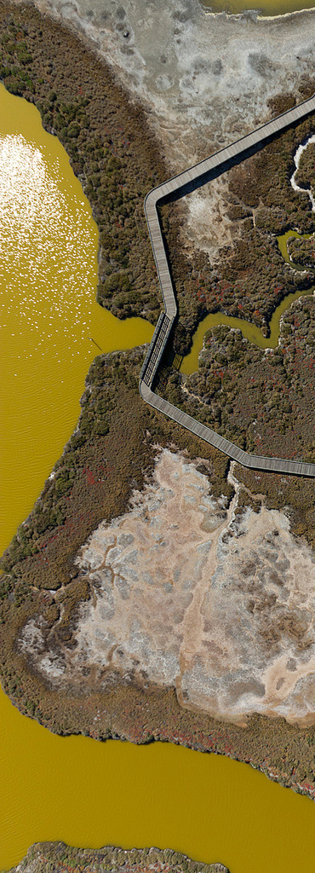
DO in shallow habitats: initial data analysis and next steps …and, time permitting, CY2013/FY2014 project updates
David Senn and Emily Novick
davids@sfei.org
Image: C. Benton

Slide 2
Highest Priority Issues – CM report
Determine whether increasing biomass signals future impairment
Characterize/quantify factors that adversely affect phytoplankton composition, including harmful algal blooms
Determine if low DO in shallow habitats causes impairment
Quantify role of nutrients
Test future scenarios that may lead to worsening conditions
Quantify nutrient contributions to different areas of the Bay
Test mitigation/prevention scenarios

Slide 3
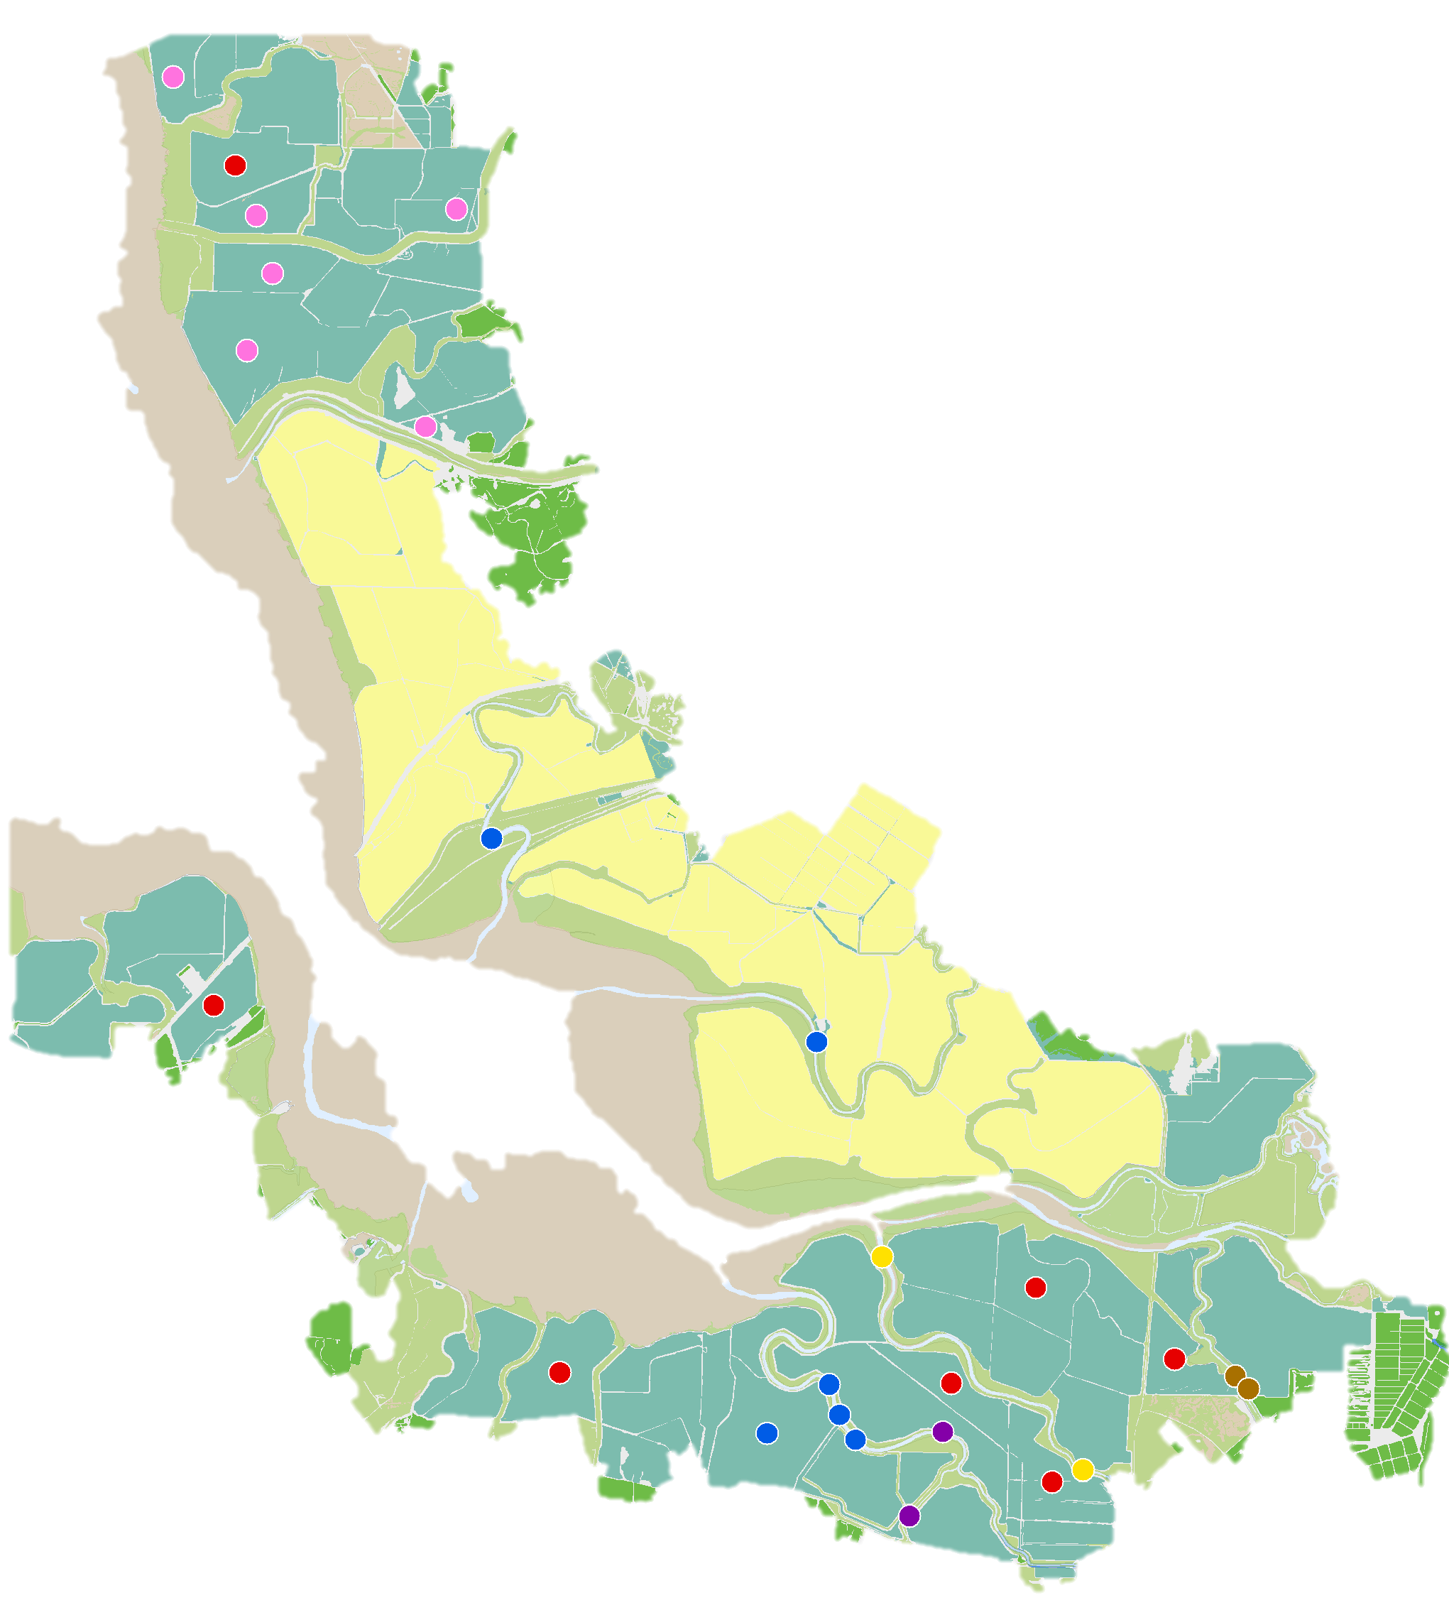
DO in Sloughs and Former Salt Ponds of LSB
Key Questions
Is low DO occurring?
‘Worse’ than natural conditions?
Frequency, duration, severity
Limiting habitat for fish and benthos?
Mechanisms…?
Anthropogenic nutrients?
Salt ponds?

Slide 4
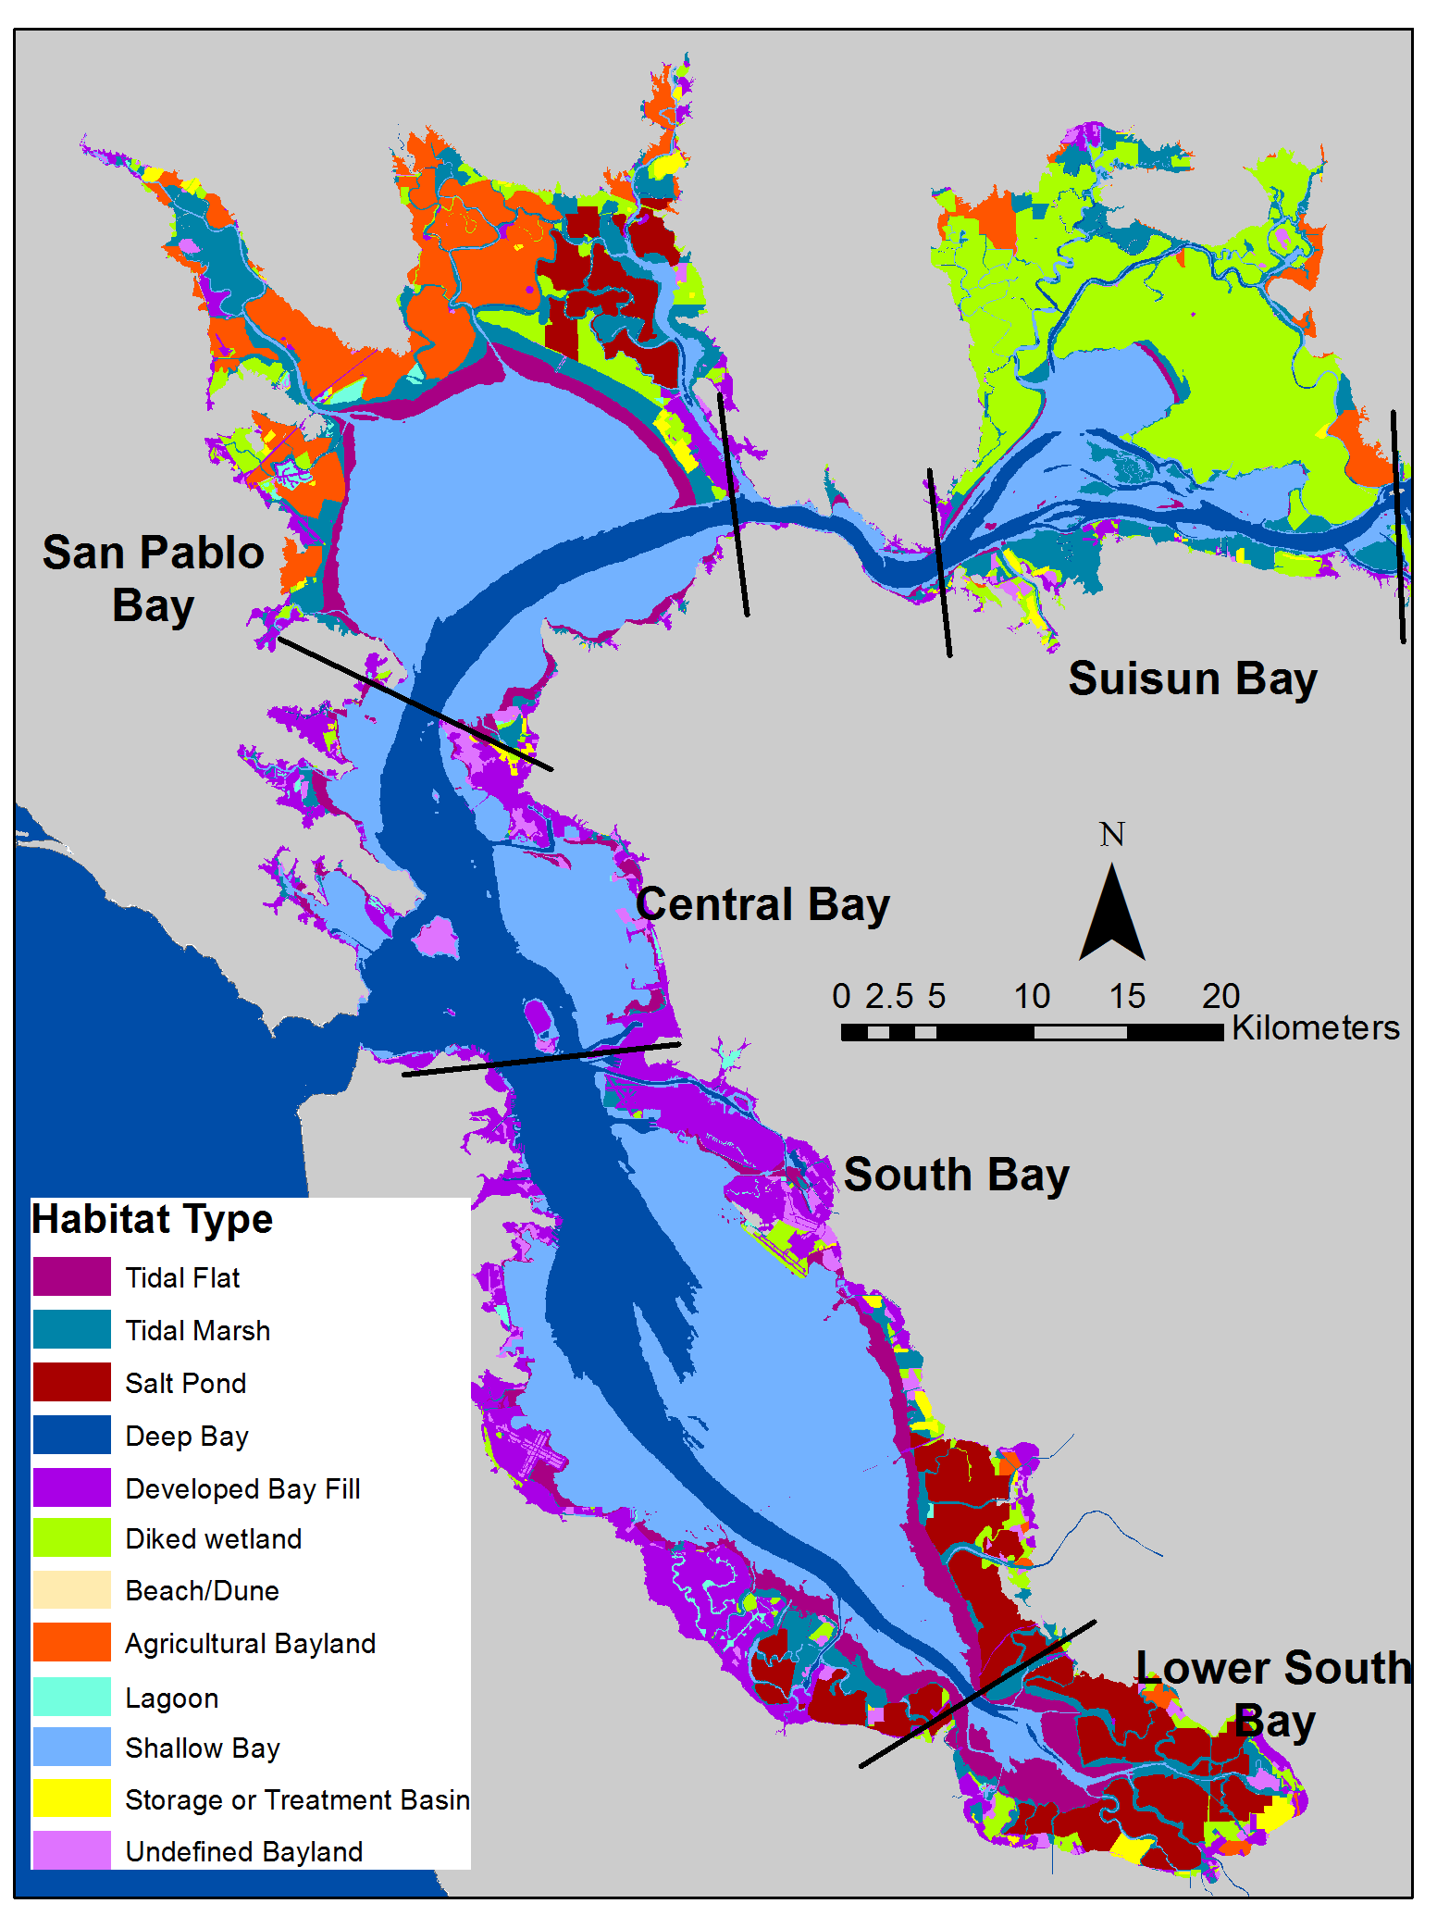
Why do we care?

Slide 5
Why do we care?
…Fish like O₂, and some need more than others
DO
Species A
Species B
Species D
Species C
T

Slide 6
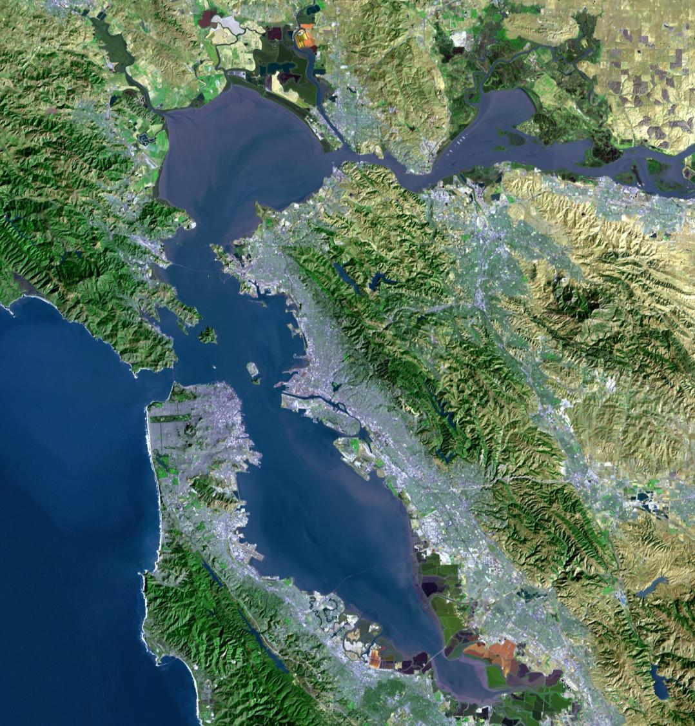
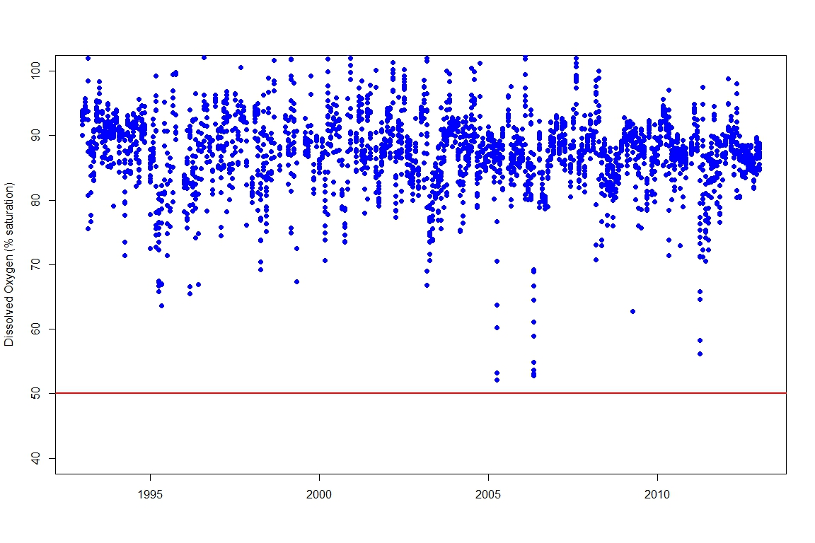
Dissolved Oxygen (%sat) in Lower South Bay
**Deep subtidal**
100
80
60
40
1995
2000
2005
2010
Pulse of the Bay (2013)
Data: USGS

Slide 7
DO in Sloughs and Former Salt Ponds of LSB
Approach
Report #1
Data gathering, cleaning
Basic data analysis…
<5mg L⁻¹
<2.8 mg L⁻¹
SFEI (Jabusch et al.)
Report #2
Mechanistic analysis
SFEI + USGS (Downing-Kunz, Senn…)

Slide 8
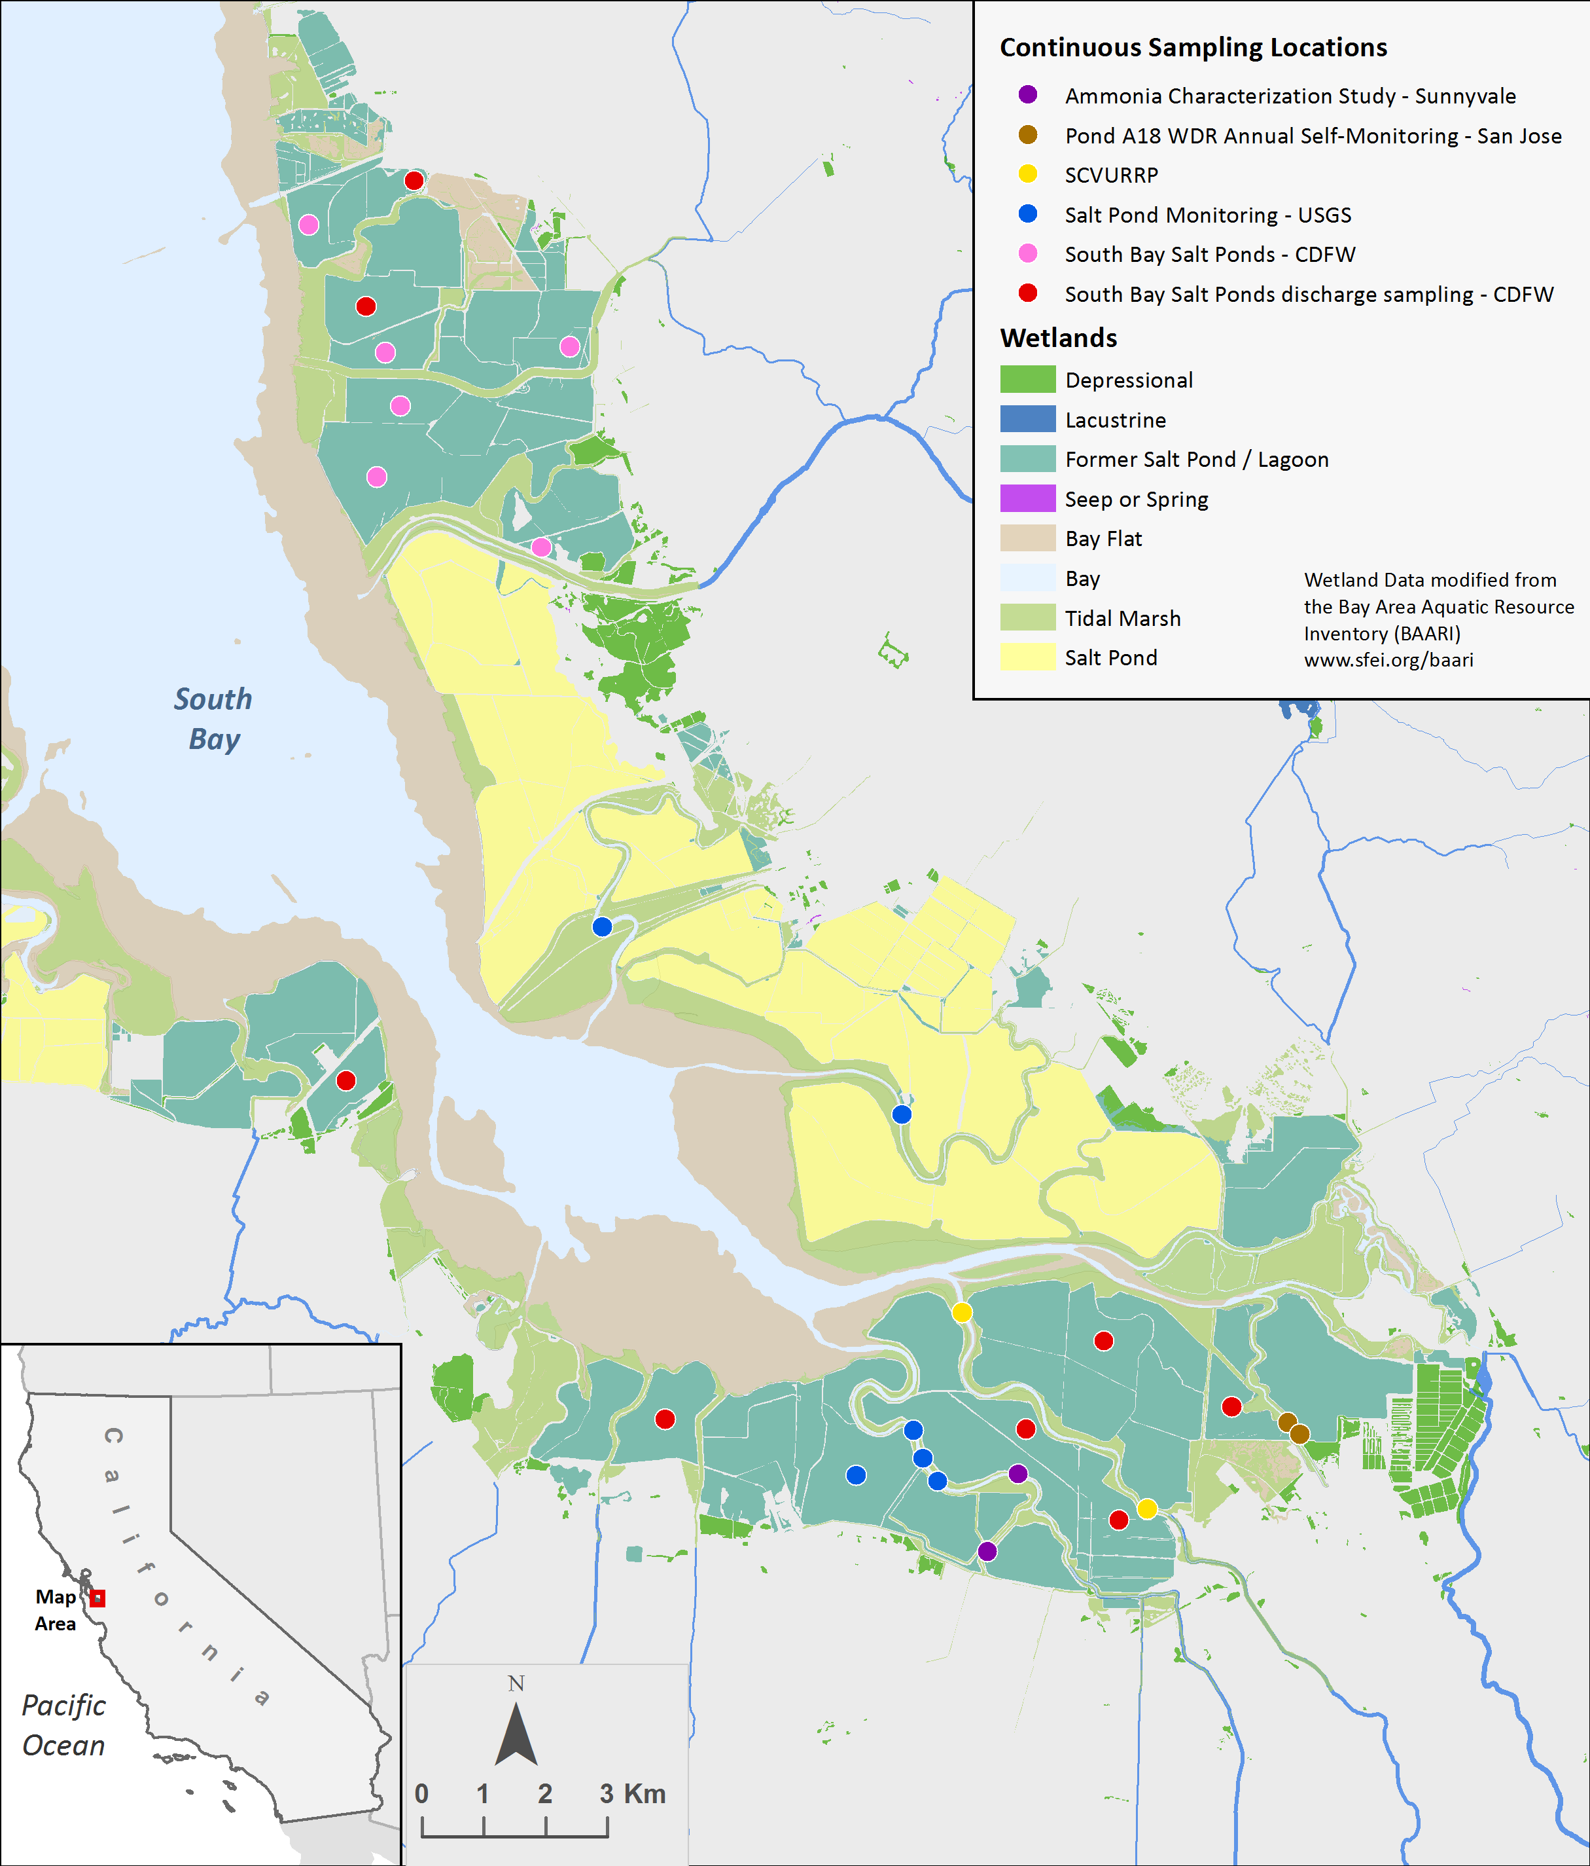
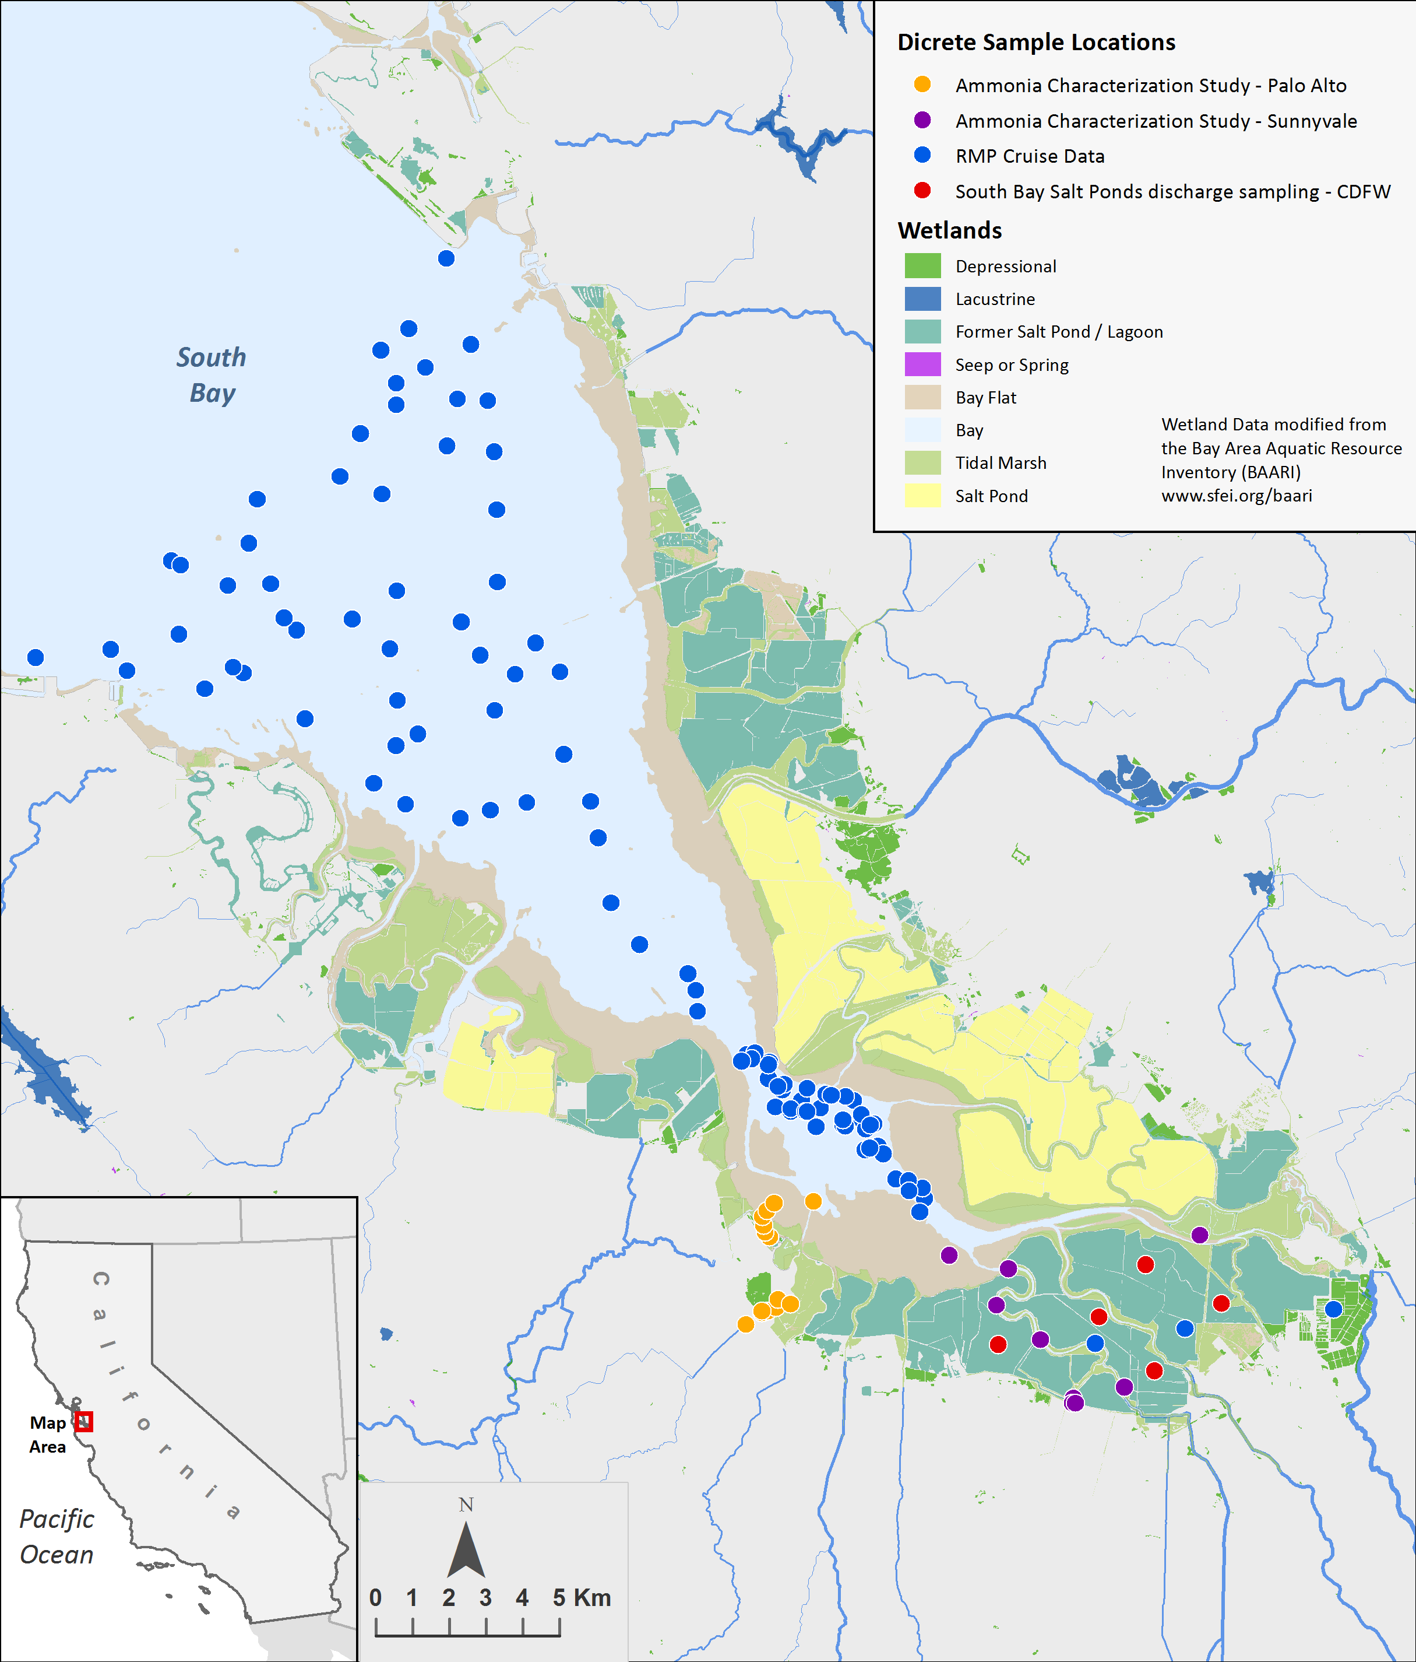
Dissolved oxygen data in LSB and South Bay margins
Continuous
Discrete

Slide 9
DO in Sloughs and Former Salt Ponds (data = 2004-2012)
%Time below 5 mg L⁻¹
100
80
60
40
20
0
Sloughs
Former Salt Ponds
n=10
n=14
SFEI (2013)
Notes:
Switch now to DO in shallow habitats

Slide 10
Data Availability: color = frequency < 5 mg L⁻¹
2004
2006
2008
2010
2012
Creeks/sloughs
Ponds

Slide 11
Major factors influencing DO
exchange
organic matter
(+) Photosynthesis
[DO]
tides, flows
( - ) respiration
[DO]
Photosynthesis:
mid-day max
~constant
semi-diurnal,
spring/neap
Respiration:
Tides:

Slide 12
Alviso Slough: June 2012 – April 2013
10
8
4
Data: M Downing-Kunz, USGS
0

Slide 13
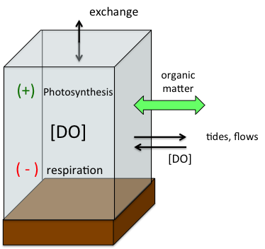
Alviso Slough: June 2012 – April 2013
10
8
4
Data: M Downing-Kunz, USGS
0

Slide 14
Tides vs. DO production vs. DO consumption……………….Who wins?
Time of Day
Jun 15 2012
Sep 14 2013
Date

Slide 15
Tides vs. DO production vs. DO consumption……………….Who wins?
Time of Day
Jun 15 2012
Sep 14 2013
Date
Data: M Downing-Kunz, USGS
Mean = 3.9 mg L⁻¹

Slide 16
Depth
Time of Day
Jun 15 2012
Sep 14 2013
Data: M Downing-Kunz, USGS
Data: M Downing-Kunz, USGS

Slide 17
DO with Depth Overlay
Time of Day
Jun 15 2012
Sep 14 2013
Date
Data: M Downing-Kunz, USGS
Mean = 3.9 mg L⁻¹

Slide 18
DO with Depth Overlay
Time of Day
Jun 15 2012
Sep 14 2013
Date
Data: M Downing-Kunz, USGS
Mean = 3.9 mg L⁻¹

Slide 19
Tides vs. production vs. consumption……………….Who wins?
Time of Day
Jun 15 2012
Apr 9 2013
Date
Data: M Downing-Kunz, USGS

Slide 20
Data: M Downing-Kunz, USGS

Slide 21
Data Availability: color = frequency < 5 mg L⁻¹
2004
2006
2008
2010
2012
Creeks/sloughs
Ponds

