Slide 1
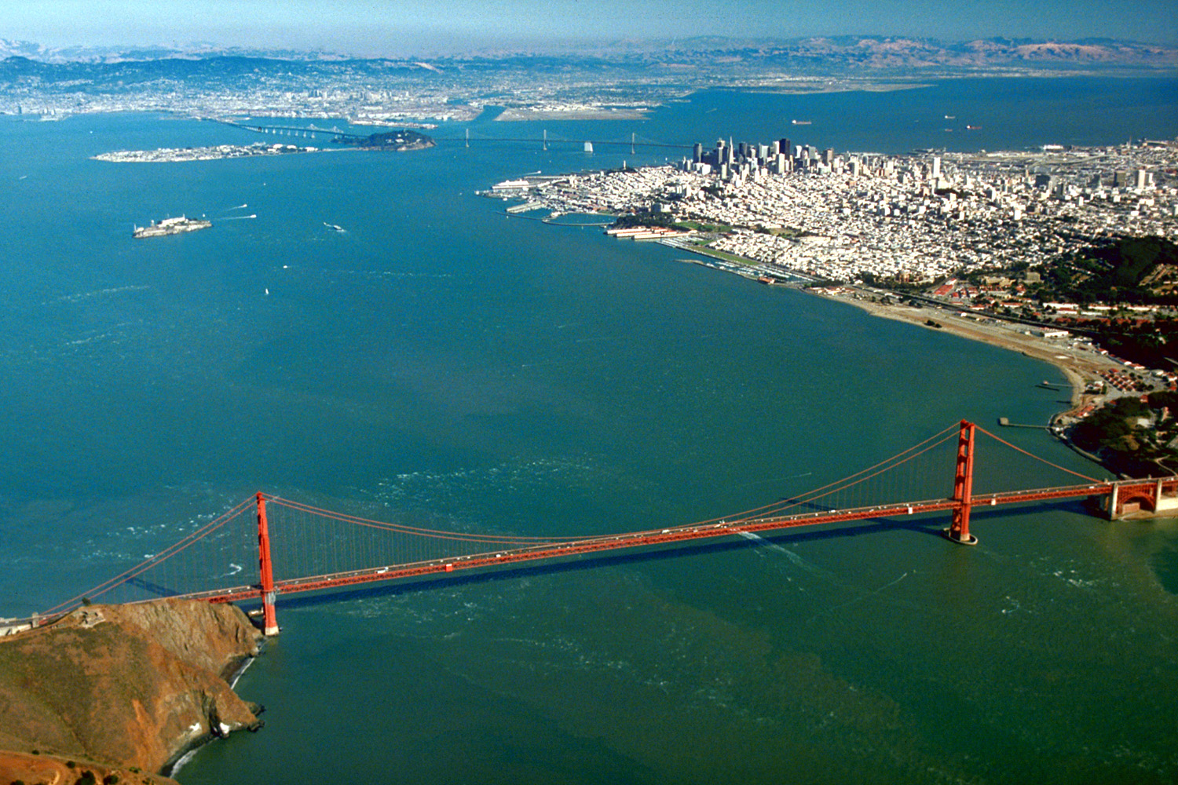
Update on SF Bay Nutrient Assessment Framework Development
Stakeholder Advisory Group Meeting
December 6, 2013

Slide 2
Context for Assessment Framework
Conceptual Model
Assessment Framework
Modeling Strategy
SF Bay Monitoring Program
Core Monitoring and Special Studies
Nutrient-Response Model Development and Validation
Regulatory
Basin Plan Objectives
Waterbody Assessments
and 303(d) listing
NPDES Permit Limits
NPS
Control

Slide 3
What is An Assessment Framework?
Decision support
  Transparent
  Peer-reviewed
  Capacity to evolve framework as science advances
  Indicators, metrics & endpoints may differ by Bay segment or season
Key components
  Supported by SF Bay conceptual models
  Specifies what to measure, temporal and spatial frequency in which those indicators/metrics should be measured
  Specifies how to use data to classify the Bay (or segments of the Bay) in “risk categories”
Assessment frameworks do not:
  Specify regulatory thresholds – that is a policy decision

Slide 4
Process and Schedule to Develop Assessment Framework
Begin with conceptual models
  Identify indicators, linkages to beneficial uses at relevant spatial and temporal scales
Review available assessment frameworks
  White paper that synthesizes approaches, data required
Utilize those frameworks with existing SF Bay data (if available) to demonstrate applicability
  Inform decision-making
Utilize demo results, in tandem with conceptual models, to craft strawman framework with experts
  Demonstrate with existing data
Vete and refine assessment framework (…repeat)
Fall 2012
Spring 2013
Fall 2013
Spring 2014
Summer 2014

Slide 5
At Previous Stakeholder Meetings….
Discussed work plan to create assessment framework
Presented white paper summarizing existing approaches to creating assessment frameworks
  Site-specific (Chesapeake Bay chlorophyll a criteria)
  Regional (Florida, European Water Framework Directive)

Slide 6
Progress Since Last Meeting
Completed preliminary analysis of existing data
Held first conference call of expert team to lay groundwork
First workshop is scheduled for February 2014

Slide 7
Who Are The Experts
International experts in assessment frameworks, criteria:
  Suzanne Bricker (NOAA)
  Larry Harding (University of Maryland/UCLA)
  James Hagy (EPA ORD)
Local experts in SF Bay nutrient biogeochemistry and eutrophication, but not limited to:
  Jim Cloern
  Dick Dugdale
  Raphael Kudela
  Anke Mueller-Solger

Slide 8
What’s Ahead: Three 2-Day Experts Workshops To Develop Draft Framework
Workshop 1 (January-February 2014)
  Confirm indicators (and metrics) of interest
  Agree on SF Bay “segments” and targeted habitats
  Identify temporal elements of assessment framework
  Identify spatial elements of assessment framework
Workshop 2 (March- April 2014)
  Develop proto-monitoring program
  Discussion of thresholds for classification scheme
Workshop 3 (May-June 2014)
  Develop classification scheme by Bay segment
  Discuss uncertainty associated with classification scheme
Conference calls (June – July 2014)
  Comment on assessment framework document

Slide 9
Conceptual Model Development Lays Groundwork for Assessment Framework
Problem statement: Management endpoints of concern (primary indicators)
Elevated chlorophyll a biomass and/or primary productivity
  Increased frequency and duration of phytoplankton blooms
Reduced chlorophyll a biomass and/or primary productivity
Imbalanced phytoplankton community composition
      Harmful algal species and toxin concentrations
Low dissolved oxygen concentrations

Slide 10
Conceptual Model Discussions Confirm Preliminary Assessment of Indicator Suitability
Primary
Dissolved oxygen
Chlorophyll a (biomass) and/or primary productivity
HAB species and toxin concentration
  Cyanobacteria
Supporting
Phytoplankton assemblages or taxonomic composition
Nutrient concentrations and/or ratios

Slide 11
White Paper Outline
  Context for assessment framework
  Conceptual approach to nutrient objectives in SF Bay
  Previous work
Review of existing approaches
  Regulatory (Chesapeake Bay, Florida) and non-regulatory
  How is the approach used to assess waterbody condition
    What is the basis of the ranking
    Indicators, categories, thresholds
    Method used to measure indicator
    Data requirements for the assessment
    How are the data used to calculate the score/category

Slide 12
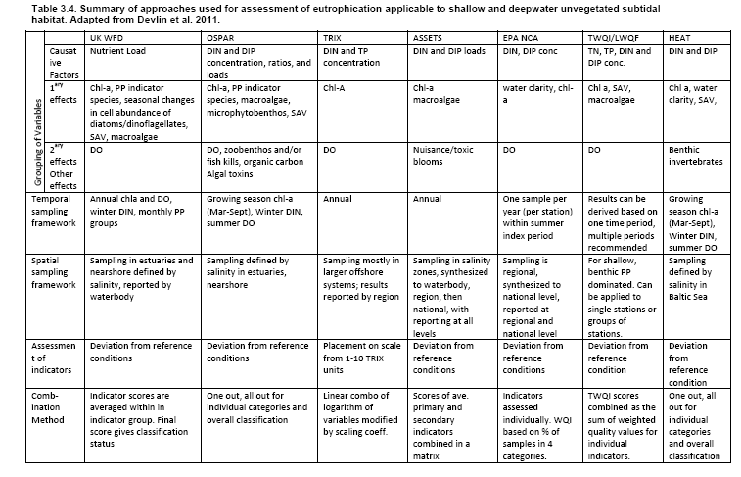
Overview of Regional Approaches

Slide 13
Objective of Analysis of Existing Data
Inform the process of developing an appropriate assessment framework and monitoring program
  Test out existing indicators and assessment frameworks using real data
  Understand how categorization of condition varies as function of magnitude, frequency and duration (thresholds, space and time)
  Provoke a visceral reaction from local experts to “bring home” options that we are considering
First phase of analysis pending feedback from group– application of existing frameworks to SF Bay does not imply that we are going to use them!!!
Just a jumping off point for discussion!!

Slide 14
Frameworks Supported By Existing Data
Water Framework Directive (United Kingdom)
  Phytoplankton index based on chlorophyll a
  Taxa index
Assessment of Estuarine Trophic Status (ASSETS)
  Chlorophyll a
The French Research Institute for the Exploration of the Sea (IFREMER) Classification for Mediterranean Lagoons

Slide 15
Indicators:
UK-WFD Phytoplankton
Each statistic is given a point value of 1 if it does not exceed the threshold, the sum of points accumulated yields the final classification.
Statistic | Low Salinity Threshold (0-25 ppt) | High Salinity Threshold (> 25 ppt)
Average Annual CHL-a | ≤ 15 µg L⁻¹ | ≤ 10 µg L⁻¹
Median Annual CHL-a | ≤ 12 µg L⁻¹ | ≤ 8 µg L⁻¹
% CHL-a less than 10 µg L⁻¹ | > 70 % | > 75 %
% CHL-a less than 20 µg L⁻¹ | > 80 % | > 85 %
% CHL-a less than 50 µg L⁻¹ | < 5 % | < 5 %
Points | Classification
5 | High
4 | Good
3 | Moderate
2 | Low
0-1 | Very Low
Classification presented with respect to ecological condition

Slide 16
Indicators:
UK-WFD Taxa
Classification is assessed as the sum of a series of exceedences
Sum of % Exceedences Σ(CHL + S + P + T) | Classification
0-10 | High
10-20 | Good
20-40 | Moderate
40-60 | Low
60-100 | Very Low
Index | Statistic | Threshold
CHL | Chlorophyll (CHL) | > 10 µg L⁻¹
S | Any phytoplankton taxa (S) | > 10⁶ cells L⁻¹
P | Phaeocystis sp.* (P) *used Cyanobacteria | > 10⁶ cells L⁻¹
T | Total taxa counts (T) | > 10⁷ cells L⁻¹
Classification presented with respect to ecological condition

Slide 17
Indicators:
IFREMER
Classification is assessed using a series of indicators and thresholds—focus on chlorophyll a
Indicator | Unit | Ecological Condition
 |  | High | Good | Moderate | Low | Very Low
%O2 Saturation | % SAT | <20 | 20-30 | 30-40 | 40-50 | >50
Turbidity | NTU | <10 | 10-20 | 20-30 | 30-40 | >40
phosphate | μM | <0.3 | 0.3-1 | 1-1.5 | 1.5-4 | >4
Dissolved inorganic nitrogen | μM | <15 | 15-20 | 20-40 | 40-60 | >60
Nitrite | μM | <0.5 | 0.5-1 | 1-5 | 5-10 | >10
Nitrate | μM | <7 | 7-10 | 10-20 | 20-30 | >30
Ammonia | μM | <7 | 7-10 | 10-20 | 20-30 | >30
CHL-a | μg L⁻¹ | <5 | 5-7 | 7-10 | 10-30 | >30
CHL-a + phaeopigments | μg L⁻¹ | <7 | 7-10 | 10-15 | 15-40 | >40
Total nitrogen | μM | <50 | 50-75 | 75-100 | 100-120 | >120
Total phosphorus | μM | <1 | 1-2 | 2-5 | 5-8 | >8
Classification presented with respect ecological condition

Slide 18
Indicators:
ASSETS
Classification is assessed using a multi metric approach
For this analysis, chlorophyll a assessed independently
Classification | 90th Percentile Annual CHL a
Low | < 5 mg L⁻¹
Medium | 5 – 20 mg L⁻¹
High | 20 -60 mg L⁻¹
Hypereutrophic | ≥ 60 mg L⁻¹
Classification presented with respect to status of eutrophication

Slide 19
Data Sets Used for Analysis of Existing Data
USGS Water Quality Monitoring Surveys
  Chlorophyll (1975-present)
  Dissolved oxygen (1971-present)
  Inorganic nutrients (1971-present)
Interagency Ecological Program (IEP) Bay –Delta monitoring program (CA Department of Water Resources)
  Chlorophyll (1975-present)
  Taxa (1975-present)
  Dissolved oxygen (1971-present)
  Inorganic nutrients (1971-present)
  Total nutrients (1971-present)
  Turbidity (1975-present)

Slide 20
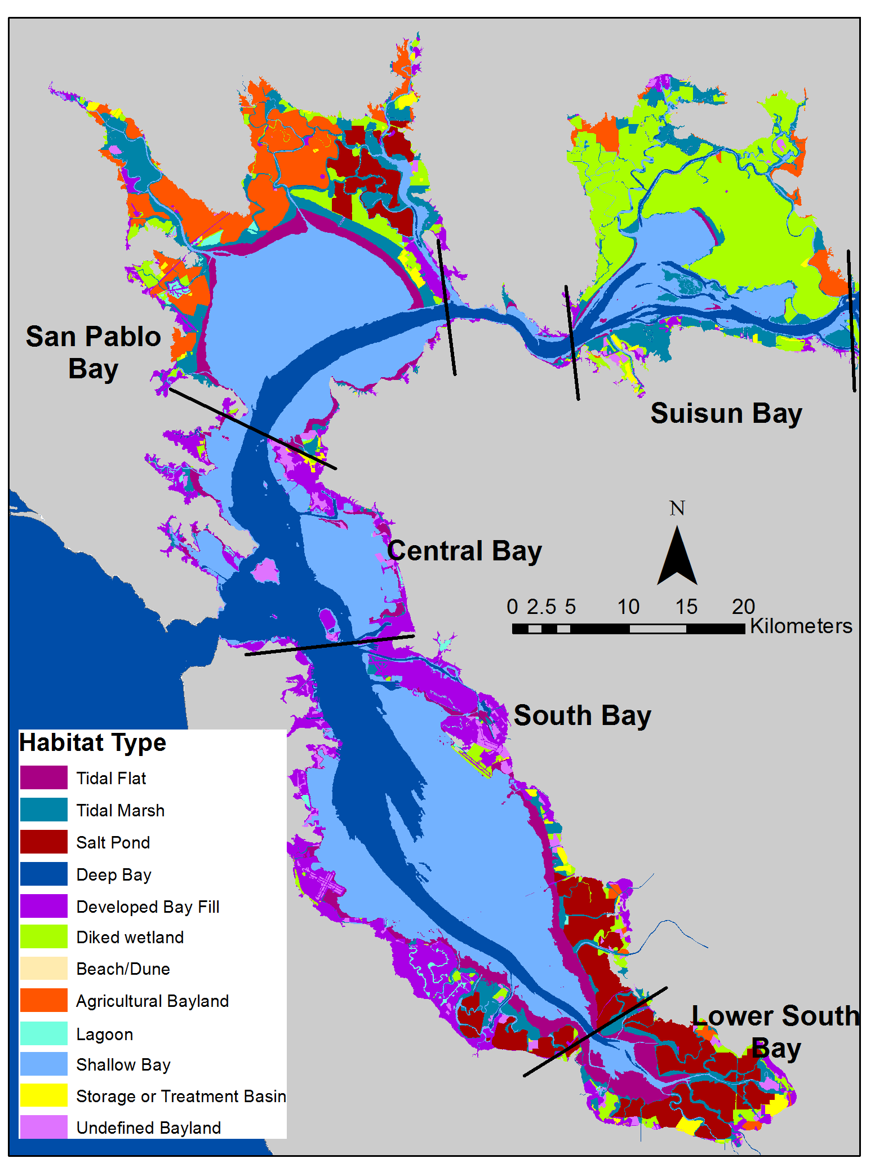
Preliminary Segmentation of the Bay
Habitat types of SFB and surrounding Baylands. Water Board subembayments boundaries are shown in black. Habitat data from CA State Lands Commission, USGS, UFWS, US NASA and local experts were compiled by SFEI.

Slide 21
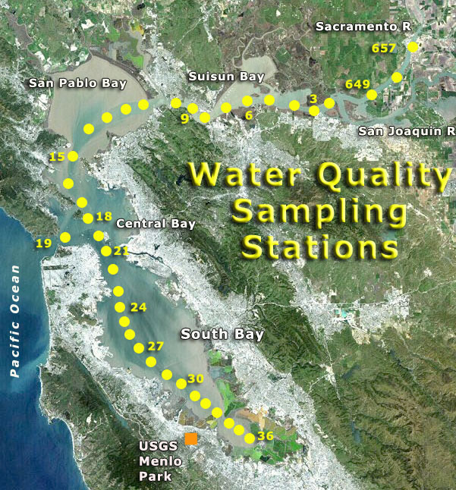
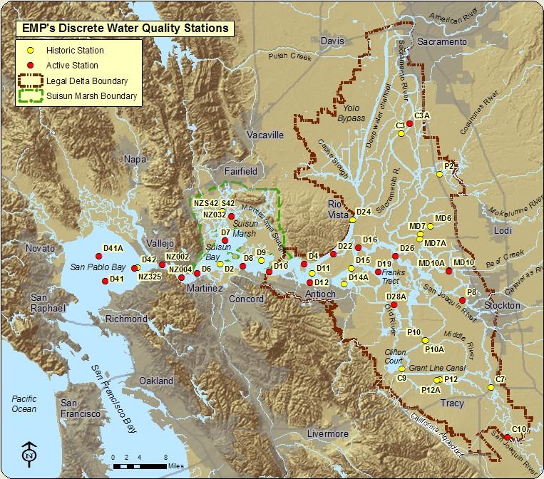
Preliminary Bay Segments Used to Aggregate USGS and IEP Data Into Sub-basins
Suisun, San Pablo, Upper South Bay, Lower South Bay

Slide 22
Approach
Classify sub-basins using existing approaches
Compare outcomes based on varying data integration methods
  Inter-annual variability (yearly, six year running average)
  Temporal integration of annual data (seasonal, annual average, annual median, percentile)
  Spatial integration
Use as a jumping off point to consider options for what to develop specifically for SF Bay

Slide 23
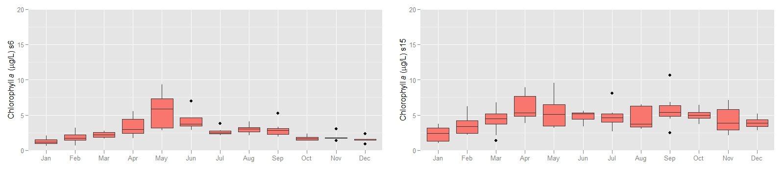
Defining How to Use Data to Make An Assessment—Critical Period?
Annual Average? Median Value? Percentile? “Growing Season”?
Monthly average chl-a (mg m⁻³) – 2006-2011
20
Suisun
20
San Pablo
15
10
10
5
5
0
0
J
F
M
A
M
J
J
A
S
O
N
D
F
M
A
M
J
J
A
S
O
N
D
Data source: http://sfbay.wr.usgs.gov/access/wqdata/

Slide 24
Effect of Threshold and Temporal Aggregation on Categorization: North Bay
ASSETS Thresholds
IFREMER Thresholds
ASSETS Thresholds

Slide 25
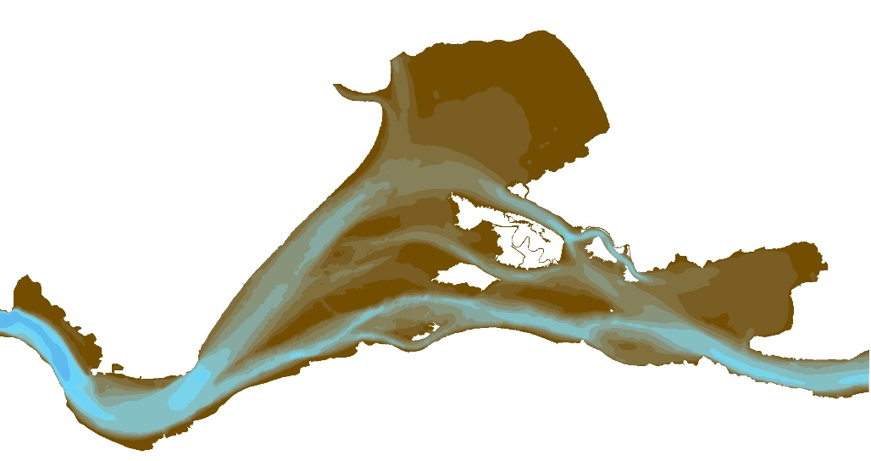
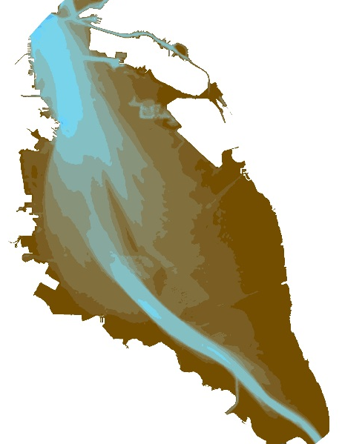
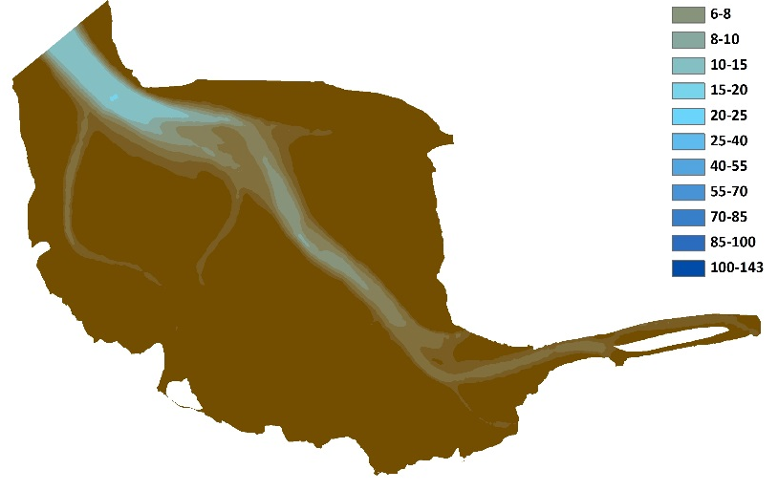
Targeted Habitats and Effect of Spatial Aggregation on Categorization
San Pablo Bay
Suisun Bay
South of Dumbarton Bridge
South Bay

Slide 26
Three 2-Day Workshops, With 1-2 Conference Calls To Revise Draft Framework
Workshop 1 (January-February 2014)
  Confirm indicators (and metrics) of interest
  Agree on SF Bay “segments” and targeted habitats
  Identify temporal elements of assessment framework
  Identify spatial elements of assessment framework
Workshop 2 (March- April 2014)
  Develop proto-monitoring program
  Discussion of thresholds for classification scheme
Workshop 3 (May-June 2014)
  Develop classification scheme by Bay segment
  Discuss uncertainty associated with classification scheme
Conference calls (June – July 2014)
  Comment on assessment framework document

Slide 27
Context for Assessment Framework
Conceptual Model
Assessment Framework
Modeling Strategy
SF Bay Monitoring Program
Core Monitoring and Special Studies
Nutrient-Response Model Development and Validation
Regulatory
Basin Plan Objectives
Waterbody Assessments
and 303(d) listing
NPDES Permit Limits
NPS
Control

Slide 28
What Happens to It After That?
  Technical Team Viewpoint….
  Employed as a part of a revised monitoring program for SF Bay
  Tested for a few years to see how well it jives with best professional judgment and optimize integration with monitoring and modeling
  Decision by Water Board whether to explicitly incorporate into regulatory policy, and/or use to establish nutrient limits in permits

Slide 29
Stakeholder Input on Process
Discuss existing approaches and proposed analysis of existing data with technical experts (November 2013)
  Webinar for stakeholders (January 2014)
Expert workshops, proto-monitoring program (February – April 2014)
  Webinar or meeting with stakeholders (early March – April 2013)
Expert workshops, draft assessment framework (June 2014)
  Meeting with stakeholders (July 2014)
Written draft of assessment framework (July 2014)
  Meeting with stakeholders (September 2014)

