Slide 1
Nutrient Watershed Permit
Stakeholder Advisory Group Meeting
December 6, 2013
Robert Schlipf
San Francisco Bay Water Board
NPDES Division

Slide 2
Permit Components
Effluent Monitoring
Annual Reporting
Nutrient studies
Treatment optimization & upgrades evaluation

Slide 3
Monitoring & Reporting
Monitoring similar to current effort
Reporting on nutrient trends
Investigating any nutrient trends

Slide 4
Support Nutrient Studies
Nutrient studies
Monitoring, modeling, special studies, data synthesis
Cost allocation to be developed
Coordinate via Nutrient Strategy governance structure

Slide 5
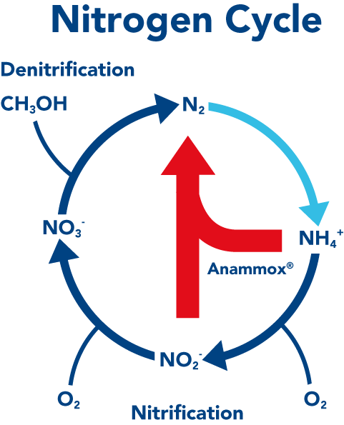
Treatment Plant Optimization and Upgrade Evaluation
Understand load reduction feasibility and cost
Prevent process change that would increase nutrient discharge
Inform short and long-term management decisions

Slide 6
Permit Time Line
Winter
Tentative Order
Spring
Adoption

