Slide 1
Chemical Oxidant + Activator: Silica/Silicates
LA WDR Meeting July 17th, 2013
Submitted by: Regenesis, San Clemente, CA

Slide 2
Rationale For inclusion in General WDR: SILICA/SILicates
Approved under the current general WDR permit SINCE 2010
1,584 APPLICATIONS IN US and Canada
148 APPLICATIONS IN California
On the market for 8 years (2005)
Leaves only non-toxic soil-like residuals (silica/silicates)
Highly effective contaminant oxidation
Known for safety and ease of application

Slide 3
Identity of Reagent
SILICA
Chemical Name: Silicon dioxide
Formula SiO₂
Common names: silica, silica gel
Silicates
Chemical Name: sodium silicate
Formula Na_{x}Si_{y}O_{z}
Common Names: silicate

Slide 4
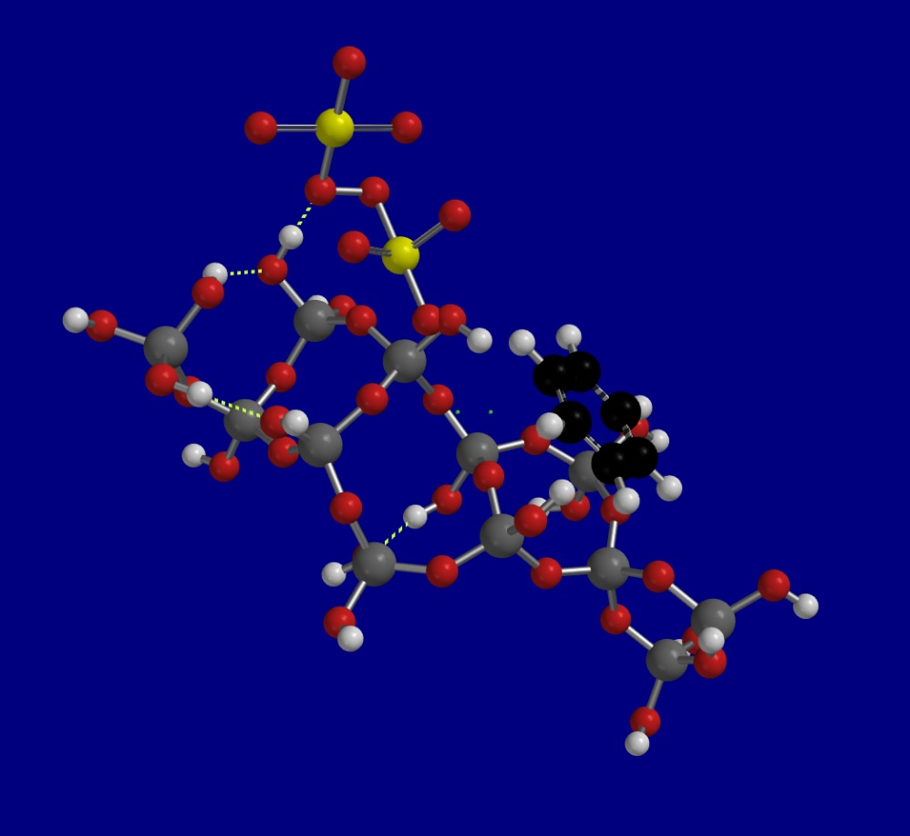
Chemistry
CALCULATED STRUCTURE
Oxidant
Silica surface Catalyst
Sorbs contaminants
Sorbs oxidizers
Percarbonate
Persulfate
permanganate
Catalyzes oxidation
Contaminant
(Benzene)
Catalyst
(Silica)

Slide 5
Applications in Los Angeles AREA
INSERT MAP

Slide 6
REPRESENTATIVE Case Studies
31 Case studies POSTED ONLINE (Click Here)
TYPICAL APPLICATION APPROACHES:
DIRECT PUSH
PERMANENT INJECTION WELLS
SOIL MIXING
EXCAVATIONS
Contaminants: BTEX, TPH, PCE, TCE, DCE, VC, TCA, MTBE, etc.

Slide 7
California case studies
Industrial facility, Hollywood ca – vadose zone soil mixing
FORMER GAS STATION, CULVER CITY, CA – DIRECT PUSH INJECTION
INDUSTRIAL DRY CLEANER, CA – DIRECT PUSH INJECTION
FORMER INDUSTRIAL FACILITY, HAYWARD, CA – SOIL MIXING
MANUFACTURING FACILITY, SANTA CLARA, CA – DIRECT PUSH INJECTION
INDUSTRIAL SITE, ATTLEBORO, MA – INJECTION WELLS
FORMER GAS SERVICE STATION, BRONX, NY – INJECTION WELLS

Slide 8
Rationale For inclusion in General WDR: SILICA/SILicates
Approved under the current general WDR permit SINCE 2010
1,584 APPLICATIONS IN us and Canada
148 APPLICATIONS IN California
On the market for 8 years (2005)
Leaves only non-toxic soil-like residuals (silica/silicates)
Highly effective contaminant oxidation
Known for safety and ease of application

