Slide 1
Health, Safety and Performance
SiREM Bioaugmentation Cultures

Slide 2
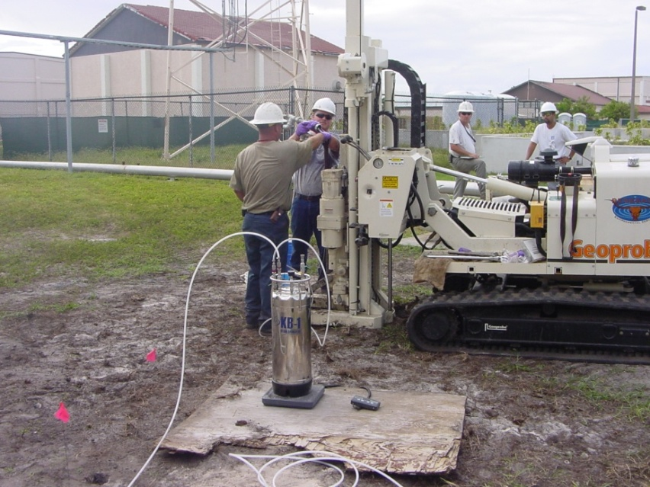
Bioaugmentation
Bioaugmentation:
the addition of beneficial microorganisms to improve the rate or extent of biodegradation
KB-1® and KB-1® Plus: commercial Dhc and Dhb cultures used to introduce beneficial organisms to sites where they are absent or the wrong type
Injection of KB-1® at a site in Florida
Notes:
Mention that you will get into more info on Dhb later on

Slide 3


SiREM Bioaugmentation Cultures
Chlorinated Ethenes (PCE, TCE, cDCE
and VC) degrading culture + 1,2-DCA
Primarily Dehalococcoides
Custom blended cultures, degrade;
  Chlorinated Ethanes (tetrachloroethane,
  1,1,2-TCA and 1,1,1-TCA, 1,1-DCA)
  Chlorinated Methanes (CT/CF/DCM)
Primarily Dehalobacter and
Dehalogenimonas

Slide 4
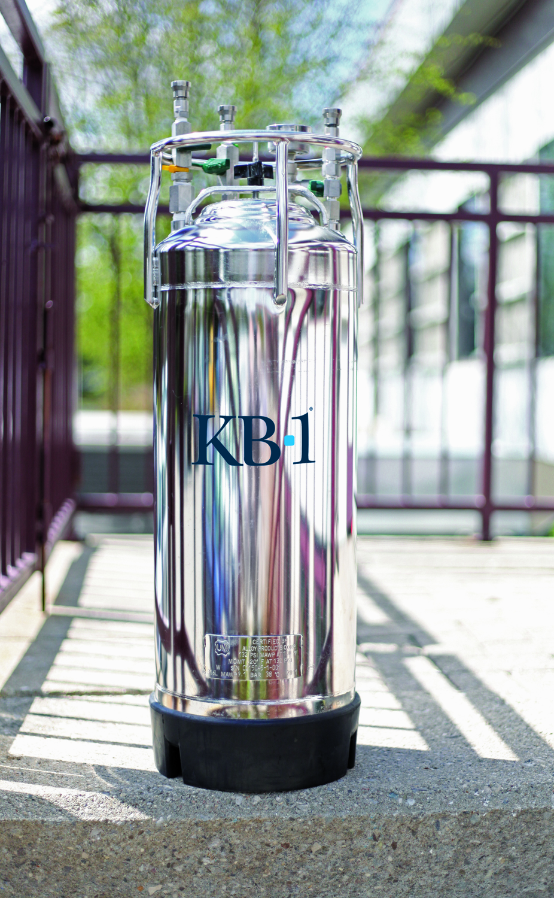
SiREM Bioaugmentation: Safe/Dependable/Approved/Guaranteed
SiREM cultures are proven performers used for over 10 years at more sites than any other cultures
Regulatory approval obtained in many jurisdictions based on excellent quality control and extensive culture characterization
Delivered in high quality stainless steel pressure vessels
SiREM has the only cultures with performance guarantees
High level of technical support through the planning, injection and data analysis stages

Slide 5
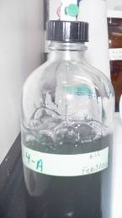
KB-1® (101)
Anaerobic liquid bioaugmentation
culture enriched from Ontario, Canada TCE site
Contains > 100 billion Dhc/Liter
In addition to Dhc ~30 other identified microorganisms =microbial consortium
Not genetically engineered
Pathogen free

Slide 6
Microbial Characterization: of KB-1 by qPCR

Slide 7
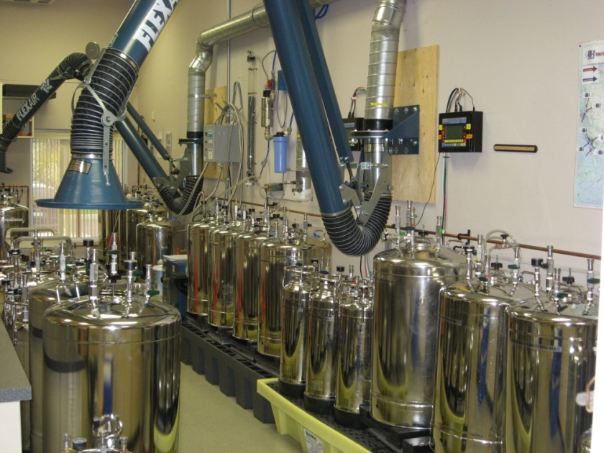
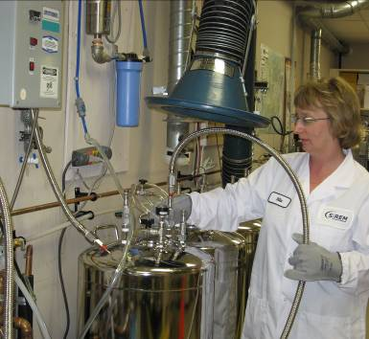
Bioaugmentation Culture Production
SiREM has facilities for growing thousands of liters of bioaugmentation cultures
Steam in place methods used for
growth media and vessel sterilization

Slide 8
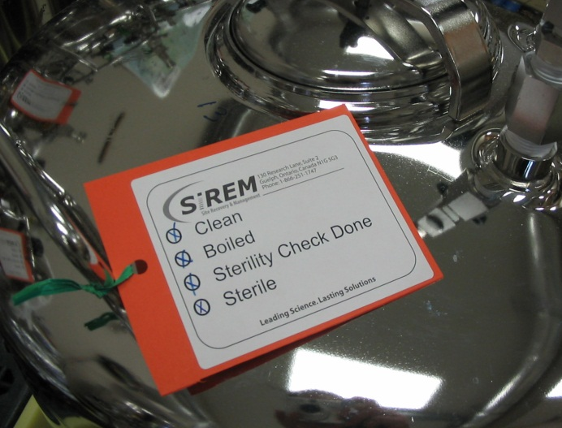
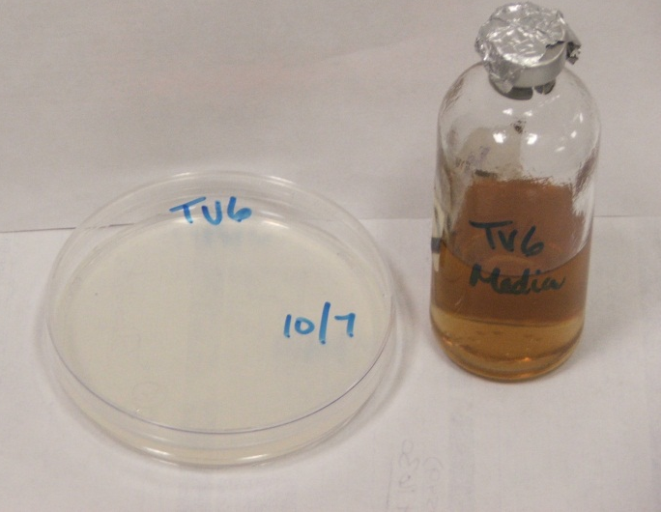
Preventing and Detecting Pathogens
Pathogen free initial inoculum
Sterile production methods
Sterile media
Pre-sterilization of growth vessels
- Filtration of purge gases
- Sterilized hoses etc.
Media Sterility Checks
(e.g. plate counts)
Regular stability and pathogen screening
High quality delivery vessels

Slide 9
KB-1/KB-1 Plus Non-Detect for Pathogenic Microorganisms in over 10 years of Commercial Production
Organism* | Status in KB-1
Salmonella sp. | Not Detected
Listeria monocytogenes | Not Detected
Vibrio sp. | Not Detected
Campylobacter sp. | Not Detected
Hemolytic Clostridia sp. | Not Detected
Bacillus anthracis | Not Detected
Pseudomonas aeruginosa | Not Detected
Yersinia sp. | Not Detected
Pathogenic Yeast and Mold | Not Detected
Fecal coliforms | Not Detected
Enterococci | Not Detected
*Environment /Health Canada-Recommendations for Testing of Microbial Consortia under New Substances Notification Guidelines

Slide 10
Assessing Stability and Composition of Bioaugmentation Culture KB-1 using DGGE

Slide 11
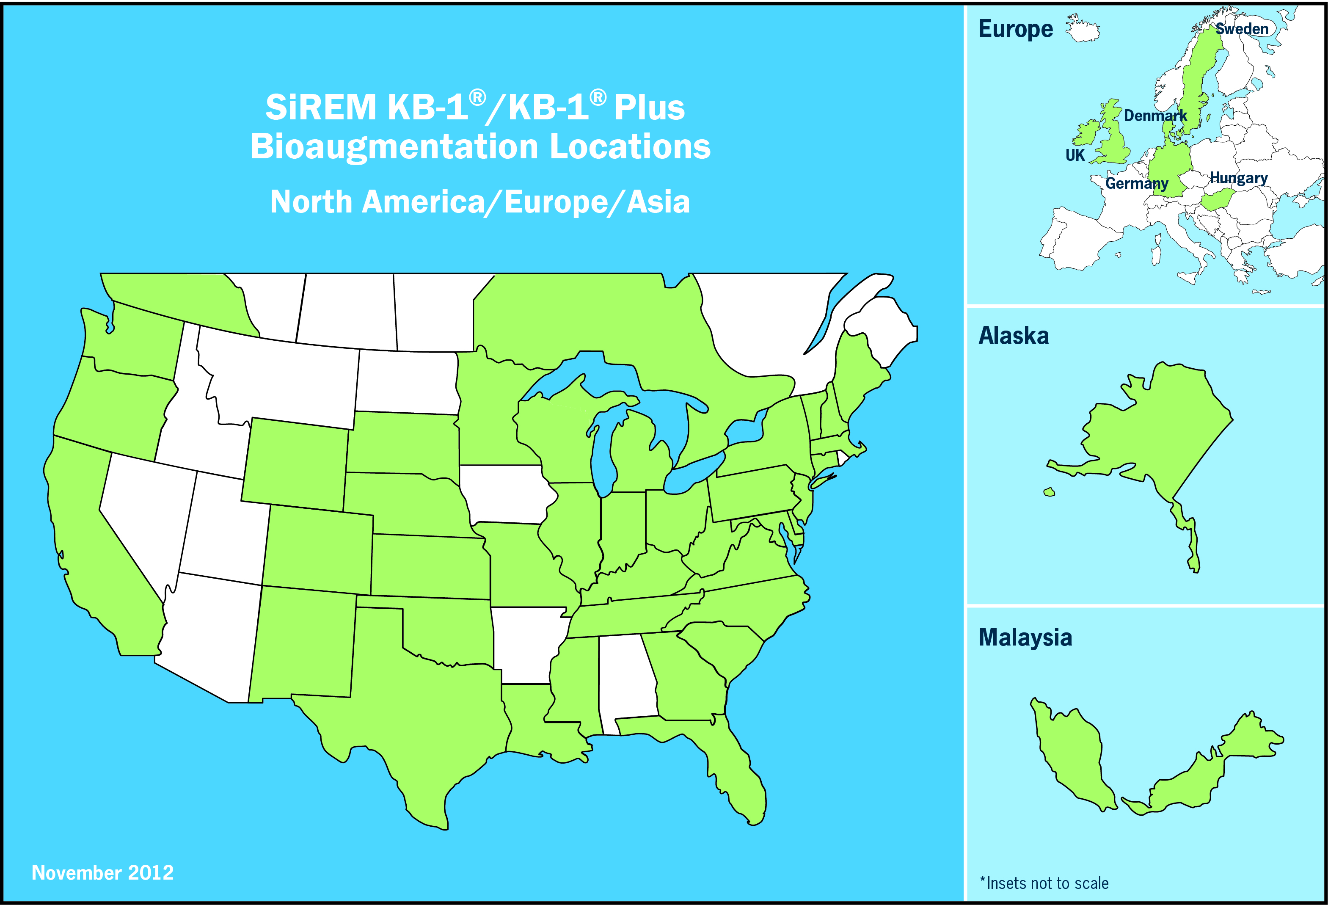
KB-1®/KB-1® Plus Bioaugmentation Locations
With over 300 hundred sites bioaugmented with KB-1®& KB-1® Plus our ability to understand the performance and conditions under which these cultures are effective continues to increase
Now Also Approved
for use in Australia

Slide 12
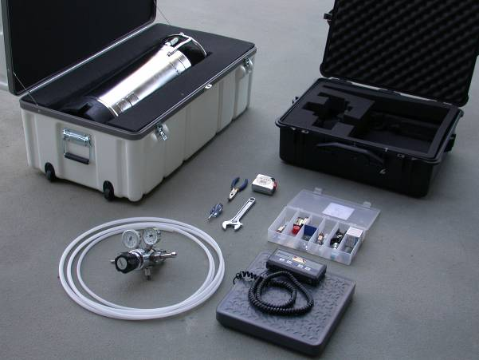
Bioaugmentation Kit
Materials Shipped to Site by Air Freight

Slide 13
Bioaugmentation Culture Field Application
Culture Vessel
Argon
Argon
blanket
Injection well
MW-1
MW-2
DHC-ve
DHC +ve
DHC +ve
DHC-ve
Ethene
Microbial Growth
TCE Plume
TCE DNAPL
Groundwater Flow

Slide 14
Minimizing Risks Associated with Bioaugmentation
Culture source with low likelihood of pathogens
(e.g., groundwater)
Sterile production methods-prevent pathogen introduction
Contained growth and application process
Knowledge of effective antibiotics in rare case of
human exposure
Periodic pathogen screening of product/seed cultures
Normal drinking water treatment prior to consumption of
treated groundwater

Slide 15




Questions
For more information
siremlab.com
1-866-251-1747
-Phil Dennis, ext. 238 pdennis@siremlab.com
-Sandra Dworatzek, ext. 236 sdworatzek@siremlab.com
-Jeff Roberts, ext. 228 jroberts@siremlab.com

