Slide 1
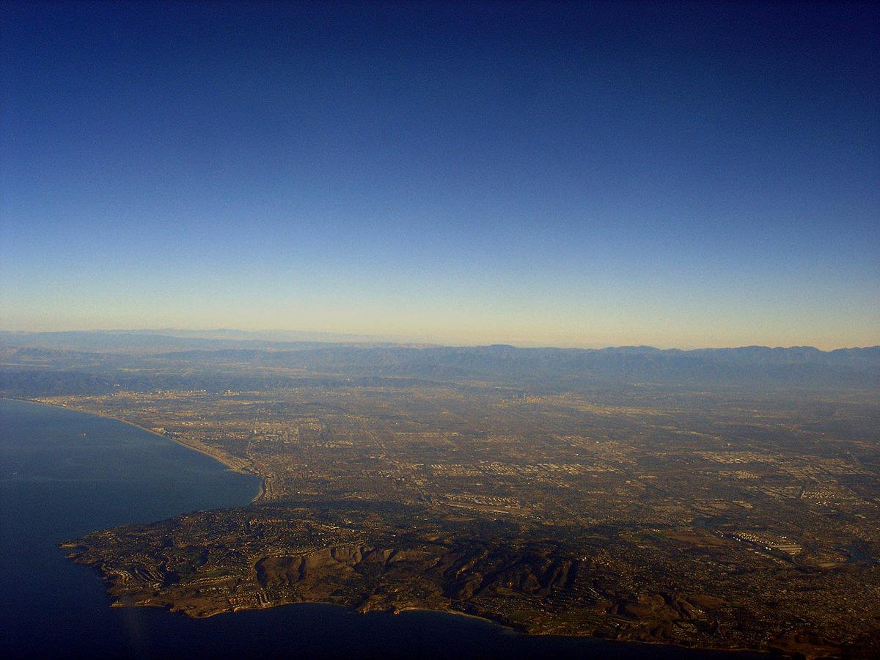
Item 19:
Incorporation of Stakeholder-Proposed Groundwater Quality Management Measures for Salts and Nutrients in the Central and West Coast Groundwater Basins
Los Angeles Regional Water Quality Control Board
February 12, 2015

Slide 2

Elements of a SNMP
Salt & Nutrient Management Plan
Source ID,
Loading Estimates, Assimilative Capacity (AC)
Salt and Nutrient Management Measures, Anti-degradation Analysis
Water Recycling and Stormwater Recharge Goals
Basin-wide Monitoring Plan & CEC Monitoring for Recycled Water Projects
CEQA Analysis
SNMP

Slide 3
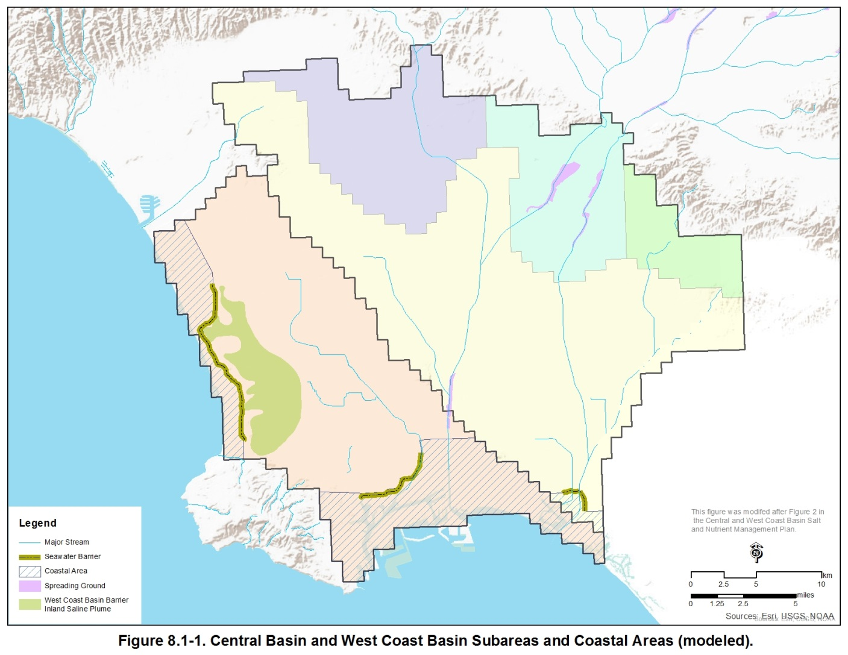
Description of Basins
Los Angeles Narrows
Hollywood Basin
Whittier Narrows
Santa Monica Basin
Los Angeles
Forebay
Montebello Forebay
Whittier Area
West Coast
Basin Barrier
Pressure Area
Central Basin
Santa Monica Bay
West Coast Basin
Dominguez Gap
Barrier
Alamitos Barrier
LA/LB Harbor

Slide 4
Salt and Nutrient Loads to Basins
Precipitation
Mountain Front Recharge
Irrigation
Groundwater Production
Spreading Ground
Stormwater + artificial recharge
Seawater Barrier
Pumping Well
Injection Well
Ocean
Unconfined Aquifer
Semi-permeable Confining Layer
Other Basins
Sub-surface Inflow
Seawater Intrusion
Confined Aquifer
Bedrock

Slide 5
Salt and Nutrient Loads to Basins
Source Water | Central Basin |  |  | West Coast Basin
 | TDS | Chloride | Nitrate | TDS | Chloride | Nitrate
Total Inflow (tons) | 134,849 | 22,956 | 419.0 | 50,090 | 19,099 | 35.9
Spreading Grounds | 48.9% | 57.2% | 73.4% | 0.3% | 0.1% | 2.2%
Seawater Barriers | 1.7% | 1.9% | 1.2% | 17.6% | 10.4% | 42.6%
Precipitation Infiltration | 2.5% | 2.0% | 0.9% | 3.4% | 1.2% | 5.3%
Mountain Front Recharge | 1.6% | 1.4% | 3.2% | 1.6% | 0.6% | 13.9%
Irrigation Return Flows | 23.5% | 20.0% | 1.2% | 25.4% | 16.1% | 6.1%
Subsurface Inflow | 21.9% | 17.5% | 20.1% | 51.8% | 71.1% | 29.8%
Total Outflow (tons) | -133,663 | ‐17,323 | -111.3 | -57,937 | -28,999 | -4.0
Groundwater Production | 100% | 100% | 100% | 100% | 100% | 100%
Annual Change in mass (tons) | 1,186 | 5,633 | 307.7 | -7,847 | -9,900 | 31.9

Slide 6
Basin Groundwater Quality
TDS ( 640 ) Chloride ( 81 ) Nitrate ( 0.15 )
TDS ( 530 ) Chloride ( 88 ) Nitrate ( 1.13 )
Los Angeles
Forebay
TDS ( 1007 ) Chloride ( 121 ) Nitrate ( 0.57 )
Montebello Forebay
Whittier Area
West Coast
Basin Barrier
TDS ( 747 ) Chloride ( 224 ) Nitrate ( 0.05 )
Pressure Area
TDS ( 508 )
Chloride ( 73 )
Nitrate ( 0.28 )
TDS ( 1424 ) Chloride ( 660 ) Nitrate ( 0.14 )
Central Basin
West Coast Basin
Dominguez Gap
Barrier
Alamitos Barrier

Slide 7
Assimilative Capacity
  AC = Water Quality Objective - Average Basin Concentration
  Average Basin Concentration
  1007
  No Assimilative Capacity
  -307
  Whittier Area
  Water Quality Objective
  700
  TDS
  Assimilative Capacity
  60
  Los Angeles Forebay
  Average Basin Concentration
  640

Slide 8
Groundwater Basins’ Assimilative Capacity for Salts and Nutrients
Location | Assimilative Capacity (mg/l)
 | TDS | Chloride | Nitrate
Central Basin Water Quality Objectives | 700 | 150 | 10
Los Angeles Forebay | 60 | 69 | 9.85
Montebello Forebay | 166 | 62 | 8.87
Whittier Area | -307 | 29 | 9.43
Central Basin Pressure Area | 215 | 85 | 9.90
West Coast Basin Water Quality Objectives | 800 | 250 | 10
West Coast Basin (excluding seawater impacted areas) | 53 | 26 | 9.95
West Coast Basin (including seawater-impacted areas) | -624 | -410 | 9.95
  AC = Water Quality Objective - Average Basin Concentration

Slide 9
Assimilative Capacity & Anti-degradation Analysis
Assimilative Capacity Use (AC)
Anti-degradation Requirements
Single Project using < 10%
or
Multiple Projects using < 20%
Demonstrate/Verify Use of AC
Single Project using >10%
or
Multiple Projects using > 20%
Conduct a full-scale analysis
  Projects Improve TDS and Chloride Conditions in West Coast Basin and limit use of Nitrate Assimilative capacity to < 10% over the planning period

Slide 10
Major Planned (Future) Salt and Nutrient Projects and Management Strategies
Replace Imported Water with Advanced Treated Recycled Water at Seawater Intrusion Barriers
2014/15
Water Replenishment District of Southern California & City of Los Angeles
Replace Imported Water with Tertiary Recycled Water and/or Advanced Treated Recycled Water for Basin Recharge
2015-2018
Water Replenishment District of Southern California
Expand Existing Goldsworthy De-salter and Increase Groundwater Pumping for Treatment by the Goldsworthy De-salter and Brewer De-salter
2015
Water Replenishment District of Southern California
Increase Recycled Water Use for Irrigation
On-going
County Sanitation Districts of Los Angeles County

Slide 11
Projected Impact of Projects on Basin Water Quality
Basin/Sub-Basin | Projected Impact of Future Projects and Baseline Conditions
Change (2010 to 2025) (mg/L) | TDS | Chloride | Nitrate
Los Angeles Forebay | -0.6 | 1.6 | 0.15
Montebello Forebay | -66.1 | -0.7 | 0.16
Whittier Area | -41.5 | -3.1 | 0.05
Pressure Area | 18.8 | 8.2 | 0.13
Central Basin Change (2010 to 2025) Assimilative Capacity Used (2010 to 2025)(%) | 1.1 0.7% | 5.6 6.7% | 0.14 1.4%
West Coast Basin Change (2010 to 2025) Assimilative Capacity Used (2010 to 2025)(%) | -58.6 NA | -34.1 NA | 0.06 0.6%

Slide 12
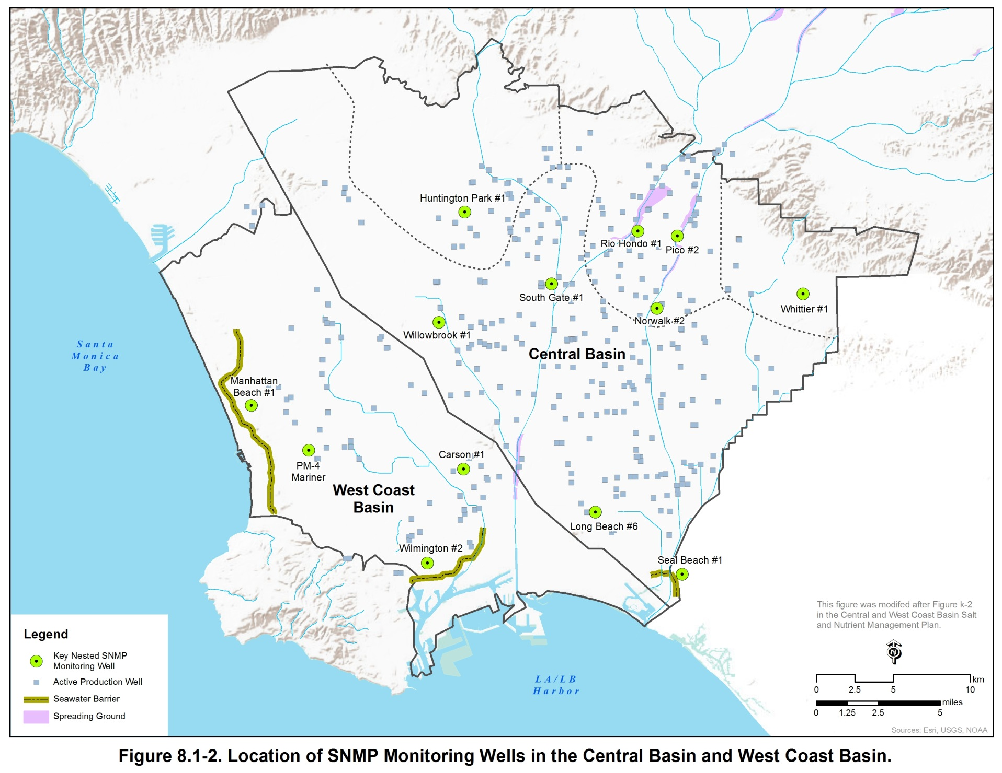
Monitoring Program

Slide 13
WRD Presentation
Stakeholder Process
SNMP Model
Planned Projects and Monitoring
CEQA
SNMP

Slide 14

Salt/Nutrient Management Plan (SNMP)
for the
Central Basin & West Coast Basin (CBWCB)
February 12, 2015
LARWQCB Board Meeting
Presented by WRD on behalf of the CBWCB Stakeholders

Slide 15
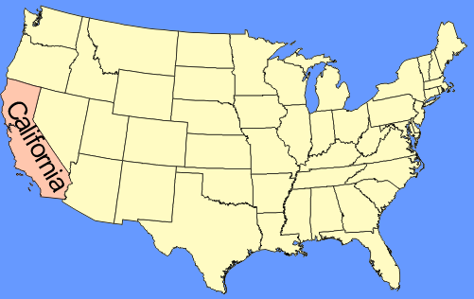
SNMP Study Area (CBWCB)
Area ≈ 420 square miles
San Gabriel Mtns
43 Cities (highly urbanized)
Merced Hills
San Gabriel Valley
Puente Hills
Santa Monica Mtns
Los Angeles
Central Basin
Coyote Hills
Newport-Inglewood Uplift
San Gabriel River
Los Angeles River
West Coast Basin
Long Beach
Newport-Inglewood Uplift
Palos Verdes
Hills
~4 Million people
(>10% of California’s population)
Pacific Ocean
Managed Aquifer Recharge conducted to supplement natural groundwater recharge

Slide 16
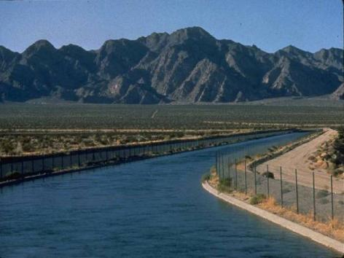
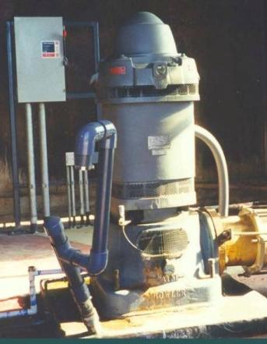
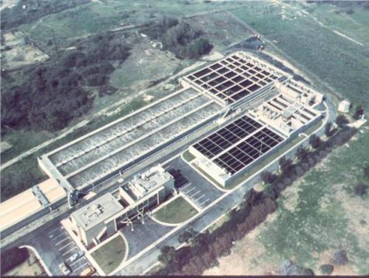
Sources of Water in CBWCB
IMPORTED WATER: 60%
from State Water Project,
Colorado River, or
LA Aqueduct
GROUNDWATER: 40%
>400 Active Production Wells
Pump ~245,000 acre-feet/yr
RECYCLED WATER: Growing uses (irrigation, industrial applications, groundwater recharge)

Slide 17
Major Salinity Control Measures
Excessive pumping between 1900 and 1950s caused groundwater
levels to drop below sea level, which resulted in seawater intrusion
West Coast Basin
Barrier Project
1950s
Goldsworthy
Desalter
2002
Alamitos Gap
Barrier Project
1960s
Brewer
Desalter
1993
Residual “Saline Plume”
PV Hills
Dominguez Gap
Barrier Project
1970s
Nearly 300 injection wells and 16 miles long

Slide 18





SNMP Stakeholders
Funding Partners
Other SNMP Stakeholders
Regulatory Agencies | Water Purveyors & Water Associations | Environmental Groups
Los Angeles Regional Water Quality Control Board California Department of Public Health (SWRCB Division of Drinking Water) California Department of Water Resources | Metropolitan Water District of Southern California City of Los Angeles, Bureau of Sanitation Central Basin Municipal Water District Central Basin Water Association City of Compton, Municipal Water Department City of Inglewood City of Long Beach Water Department City of Manhattan Beach City of Torrance Golden State Water Company West Basin Water Association | Council for Watershed Health Heal the Bay University of California, Los Angeles, Institute for Environment and Stability Santa Monica Bay Restoration Commission Natural Resources Defense Council Friends of Los Angeles River

Slide 19
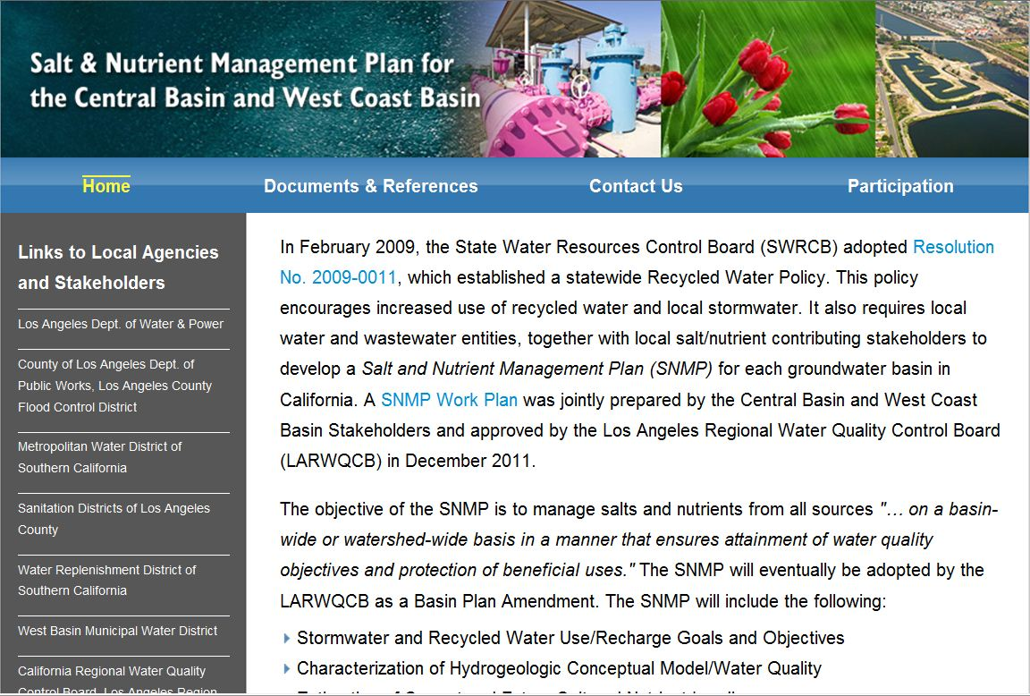
SNMP Stakeholder Process
Multiple opportunities for stakeholder participation and collaboration:
  Seven SNMP Stakeholder Workshops hosted by WRD & also attended by LARWQCB staff
  Presentations at LARWQCB Workshops, to regional planning meetings/groups, conferences, etc.
  CEQA Scoping Meeting held on Oct 21, 2013
  Six Technical Memoranda issued for 30-day public & LARWQCB review
Data Sharing & Communication:
  CBWCB SNMP website: http://www.wrd.saltnutrient.com/
  E-mail address: wrd@saltnutrient.com
  FTP site: fileshare.rmcwater.com

Slide 20
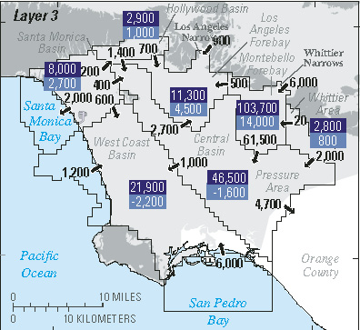
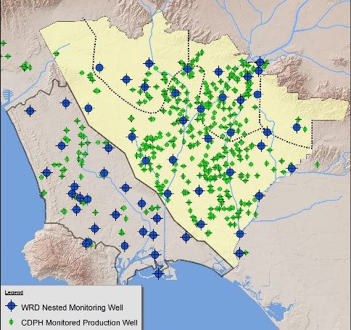
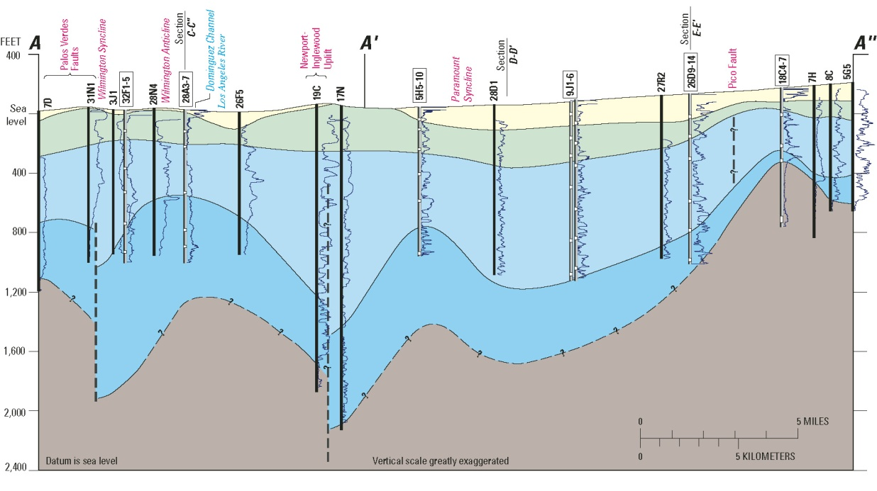
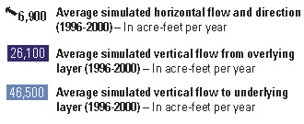
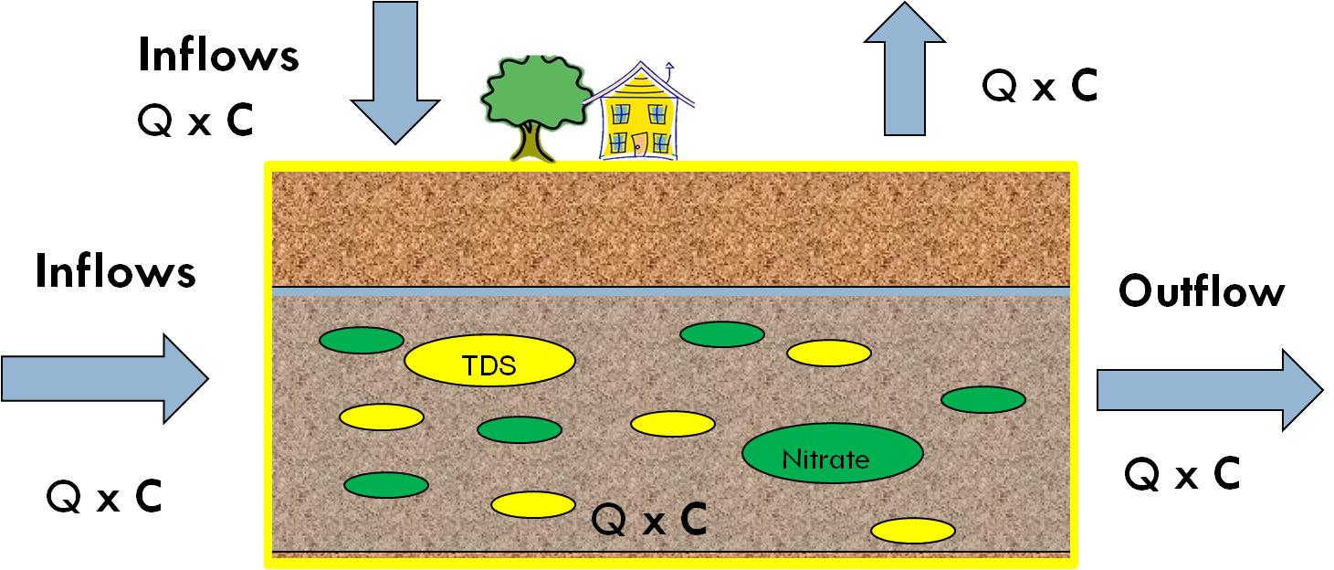
SNMP Water Quality Assessment
STEP 1
Compiled all water quality data
STEP 2
Utilized existing groundwater model to obtain volumes and flows
STEP 3
Developed SNMP Mixing Model to calculate future groundwater quality & salt/nutrient mass loading to 2025

Slide 21
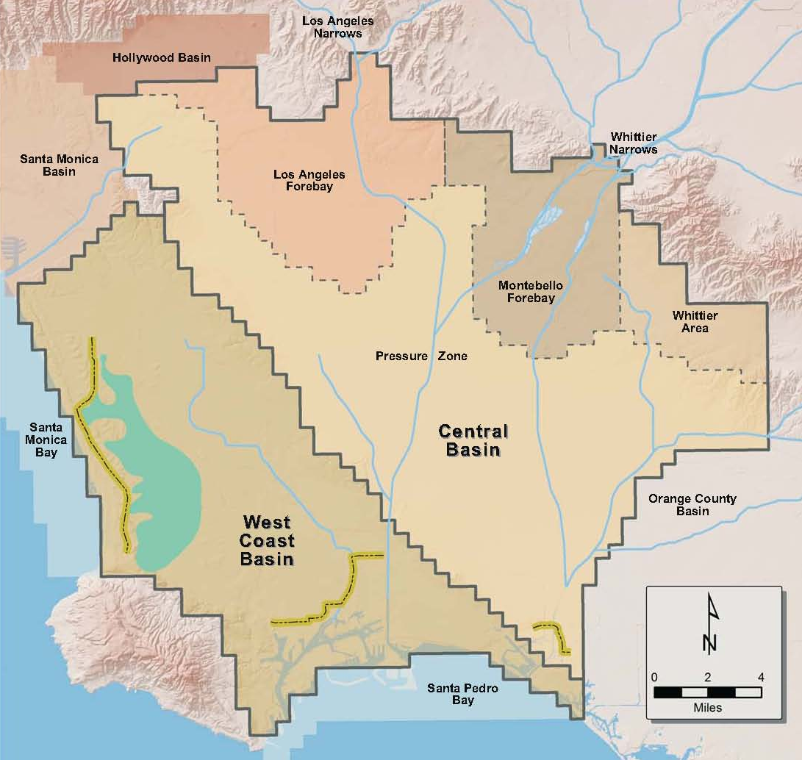
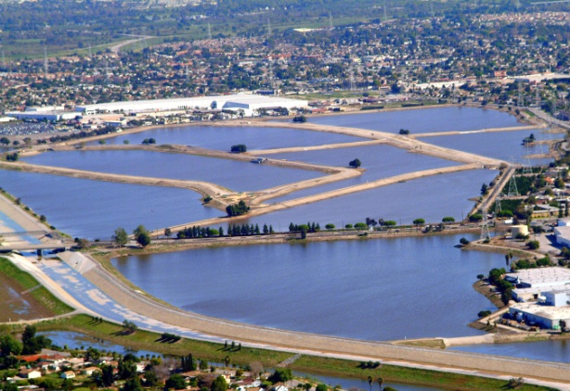
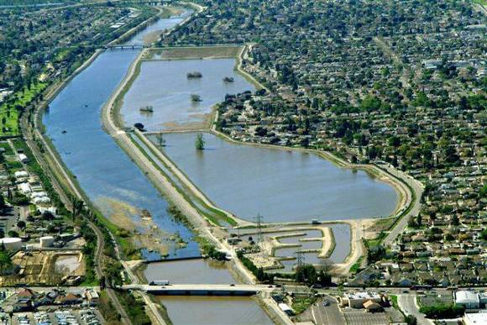
Proposed Major Projects Modeled in the SNMP
Stormwater
Advanced Treated (AWT) and/or Tertiary
Recycled Water (RW) by 2018
Imported Water
Tertiary
Recycled Water (RW)
Rio Hondo
Montebello Forebay
Spreading Grounds
Saline Plume
San Gabriel
Groundwater Reliability Improvement Program (GRIP)

Slide 22
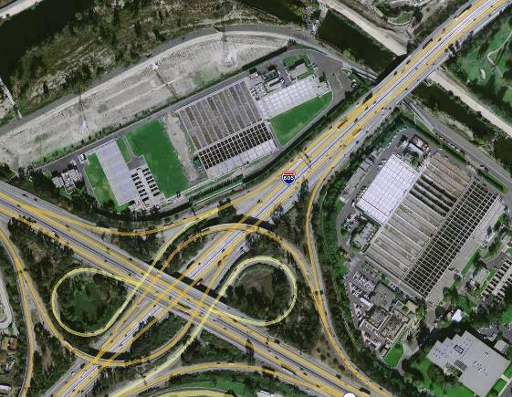

Assessment
Two Recycled Water Project Options Considered:
21,000 AF Imported Water
GRIP A
GRIP B
11,000 AF Tertiary RW
21,000 AF Tertiary RW
10,000 AF AWT RW
Potential WQ impacts from both GRIP A and GRIP were evaluated separately using the SNMP mixing model
GRIP A had negligible impacts on groundwater quality
GRIP B slightly increases TDS, chloride, & nitrate concentrations, but levels remain well below Water Quality Objectives and would utilize less than 10% of the available Assimilative Capacity in the Central Basin

Slide 23
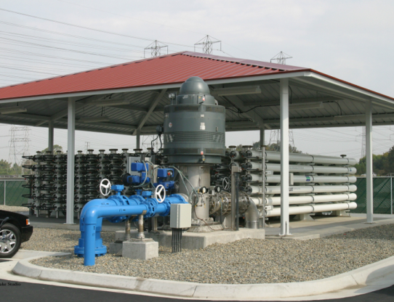
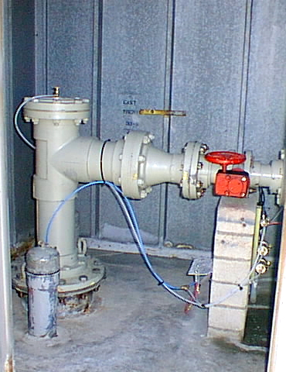
Proposed Major Projects Modeled in the SNMP
Total AWT recycled water will increase from 9,500 to 31,700 AFY by 2019
TDS and chloride concentrations significantly decrease in both basins
In West Coast Basin, achieve Water Quality Objectives by ~2035 (all implementation measures)
Nitrate remains significantly below WQO in both basins
Imported Water
Saline Plume
Advanced Treated (AWT)
Recycled Water (RW)
Seawater Intrusion Barriers

Slide 24
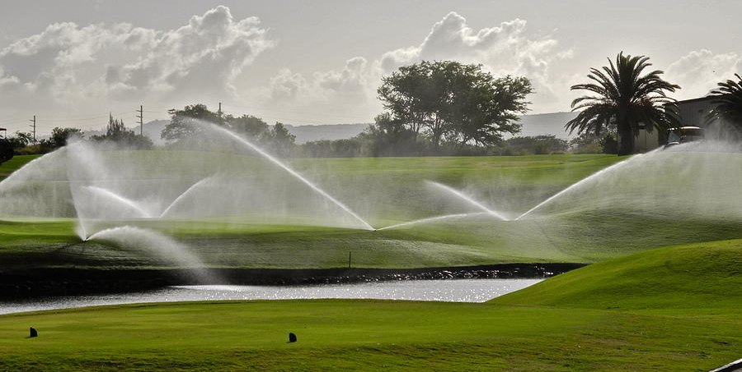
Proposed Major Projects Modeled in the SNMP
Anticipated to increase from 10,600 to 23,100 AFY by 2025 (replacing imported water & groundwater usage)
Minimal impact on TDS and chloride loading in both basins, even at SMCLs; these minor impacts are more than offset by implementation measures that reduce salt/nutrient loading
In Central Basin, use significantly less than 10% of the available Assimilative Capacity
Nitrate remains significantly below WQO in both basins
Recycled Water (RW)
Saline Plume
Increased Use of Recycled Water for Irrigation

Slide 25
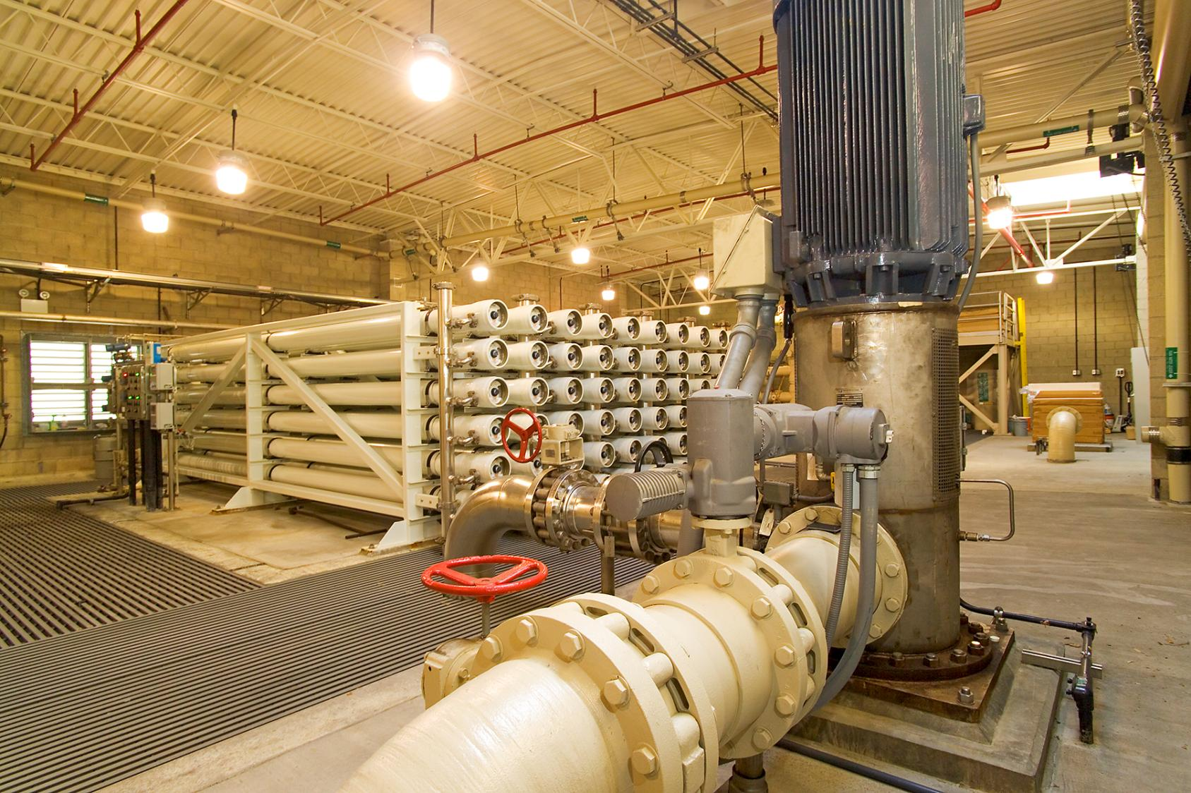
Proposed Major Projects Modeled in the SNMP
Goldsworthy Desalter will be expanded by end of 2015
Total groundwater pump & treat by desalters will increase from 2,400 to 6,400 AFY
Significant decrease of TDS and chloride concentrations; anticipated to achieve Water Quality Objectives by ~2035 (includes all implementation measures)
No impact on nitrate loading in West Coast Basin
Expansion of the Goldsworthy Desalter
Saline Plume
Increased Groundwater Pump & Treat by the Two Desalters

Slide 26
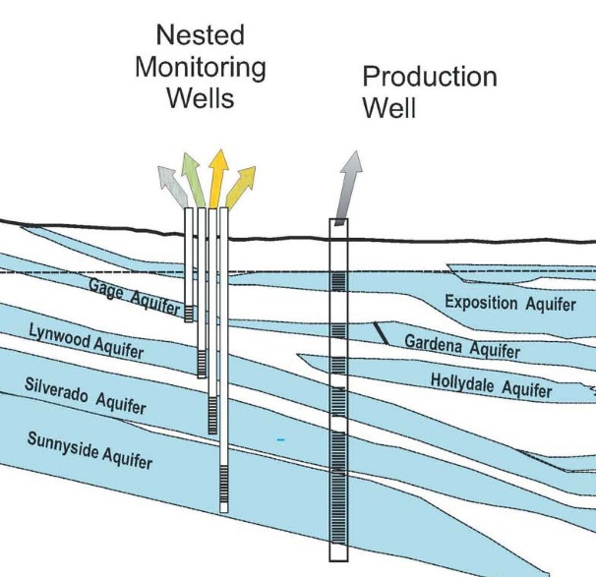
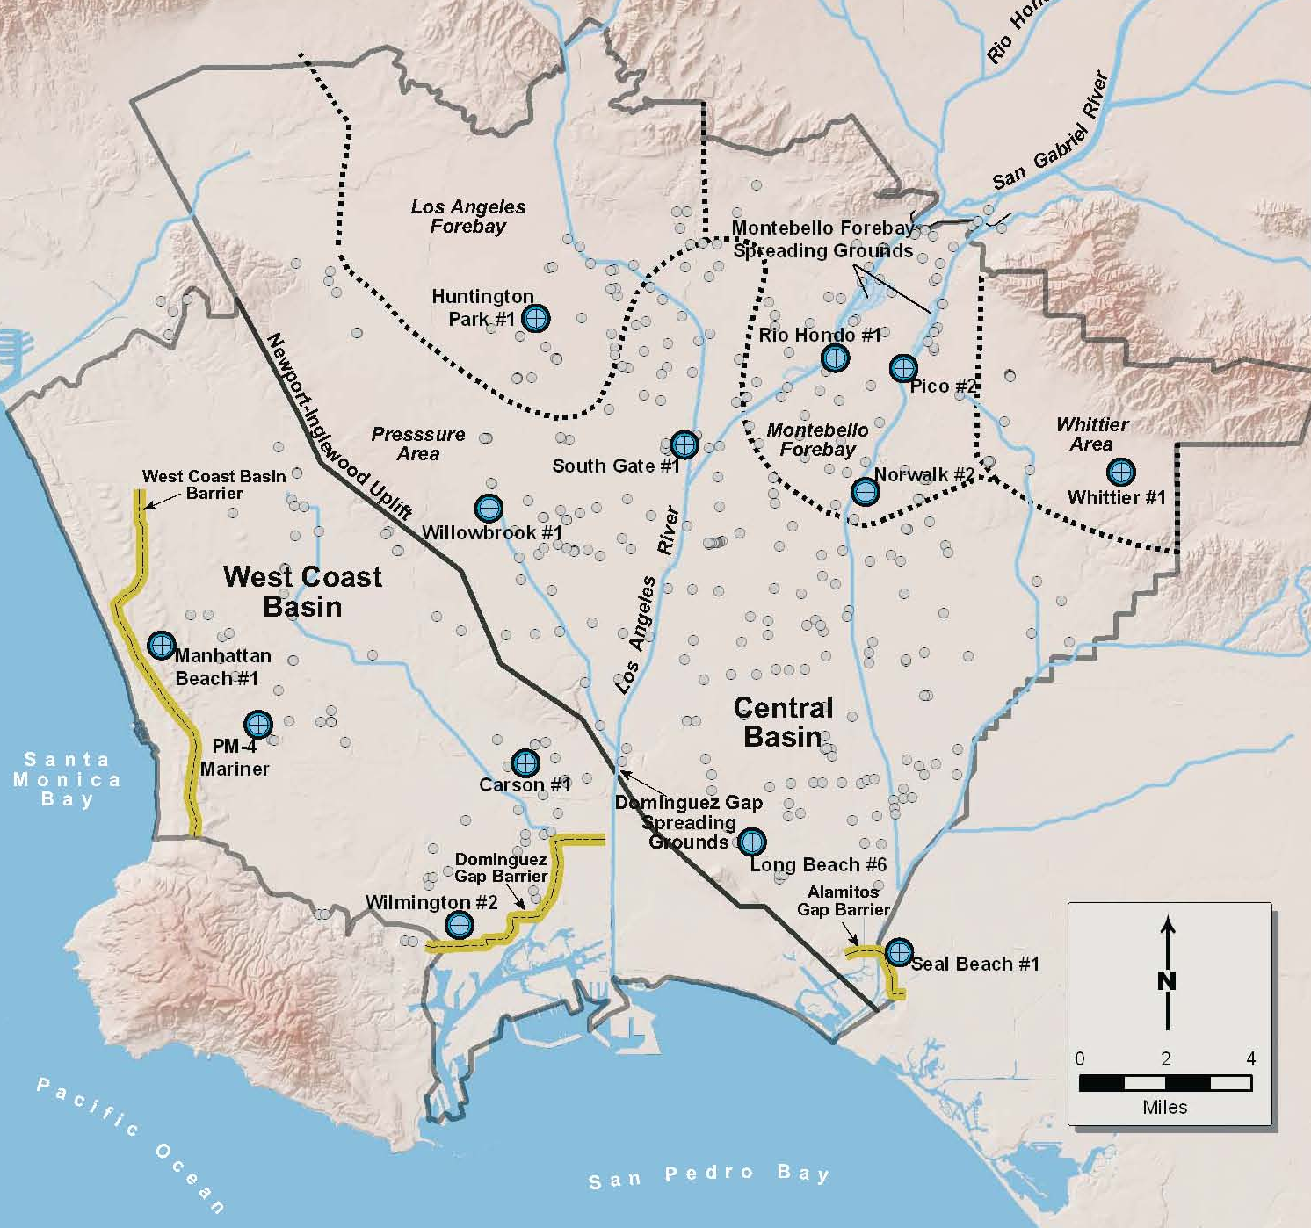
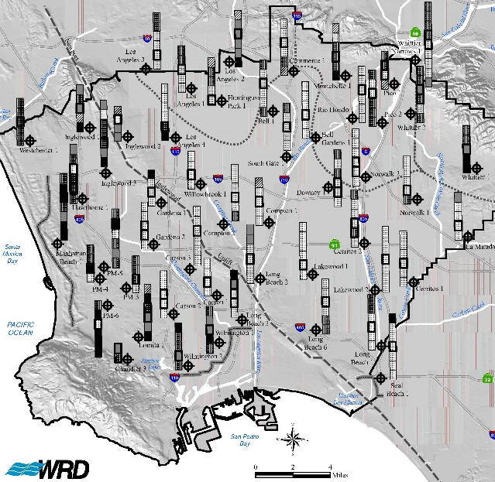
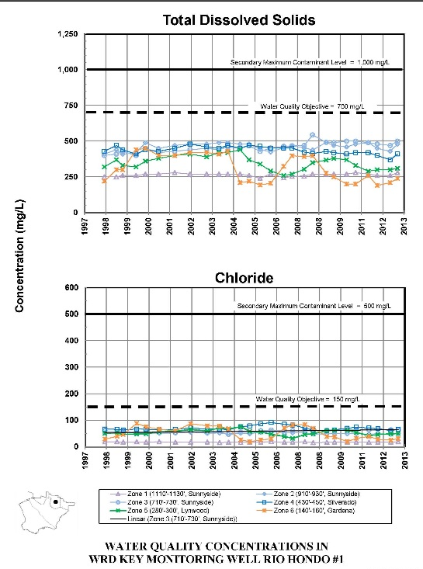
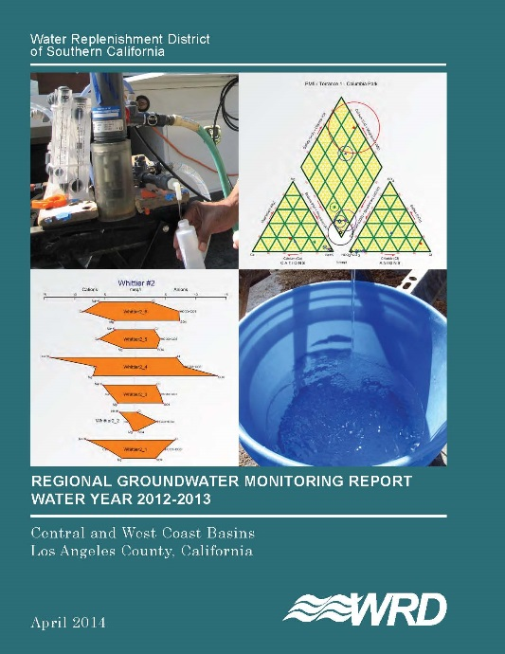
SNMP Monitoring Plan
70 Nested groundwater monitoring wells at 13 locations throughout the most critical areas of the basins

Slide 27

SNMP – Major Implementation Measures
Seawater Intrusion Barriers – Continued operation & planned upgrade to 100% advanced treated recycled water at all 3 barriers
Desalters – Continued operation of 2 desalters & expansion of the Goldsworthy Desalter
Spreading Grounds – Continued operation, improved stormwater capture, potential use of some advanced treated recycled water (i.e. GRIP)
SNMP Monitoring Program – 70 Nested groundwater monitoring wells @ 13 locations throughout the basins; continue existing robust monitoring programs for all other source waters
MS4 Program – Rigorous monitoring requirements that will improve surface water quality
LID and Stormwater Capture Projects – Will increase stormwater recharge
Wastewater Source Control Programs – Reduces salts & nutrients in recycled water
Salinity Control Programs – MWD (i.e. Southern California Salinity Coalition)
Public Outreach – WRD, Council for Watershed Health, & Southern California Salinity Coalition
15
27

Slide 28
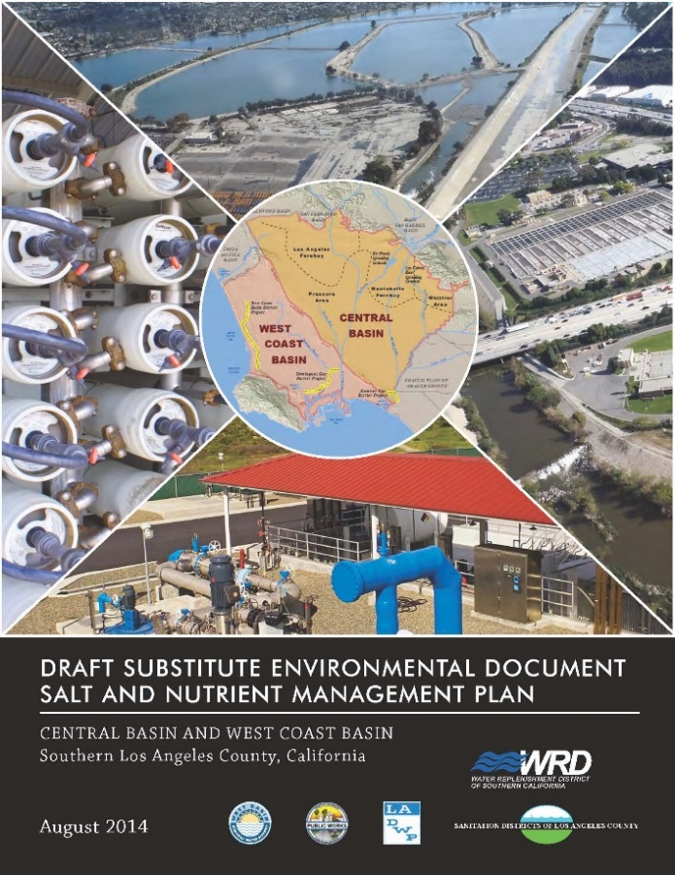
CEQA Analysis
3 Program Alternatives were evaluated:
  Program 1: No planned implementation measures or proposed major projects
  Program 2: All implementation measures, recycled water – volume & quality, & GRIP A
  Program 3: All implementation measures, recycled water – volume & quality, & GRIP B
Conducted program-level environmental analysis and selected Program 2 as the Recommended Program Alternative, which results in less than significant adverse environmental impacts
Subsequent project-level environmental analyses will be conducted by the responsible parties as specific projects are implemented

Slide 29
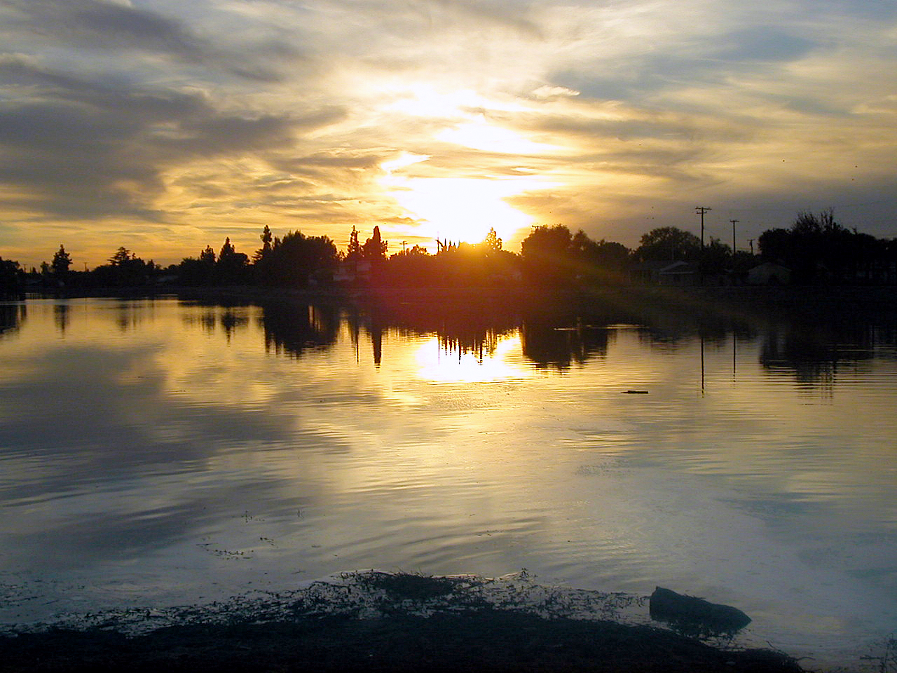
Questions?
Thank You
Phuong Ly
562-275-4246 | ply@wrd.org
Notes:
WRD Groundwater Tours
September 21, 2002
29

Slide 30
Wrap Up &
Staff Recommendation
SNMP

Slide 31
Updates to the Salt and Nutrient Management Measures
Salt and nutrient management measures will be updated:
At the end of the planning horizon (i.e. 2025)
To reflect changing conditions in the CBWCB
Where results from SNMP Monitoring Program indicate modifications are warranted
SNMP

Slide 32
Regulatory Implications
The salt and nutrient management strategies are stakeholder-proposed measures to protect beneficial uses.
Further Regional Water Board action will only be taken where data and/or other information indicate that the projected water quality conditions are not being met.
Routine permitting of existing and proposed facilities/projects will continue.
SNMP

Slide 33
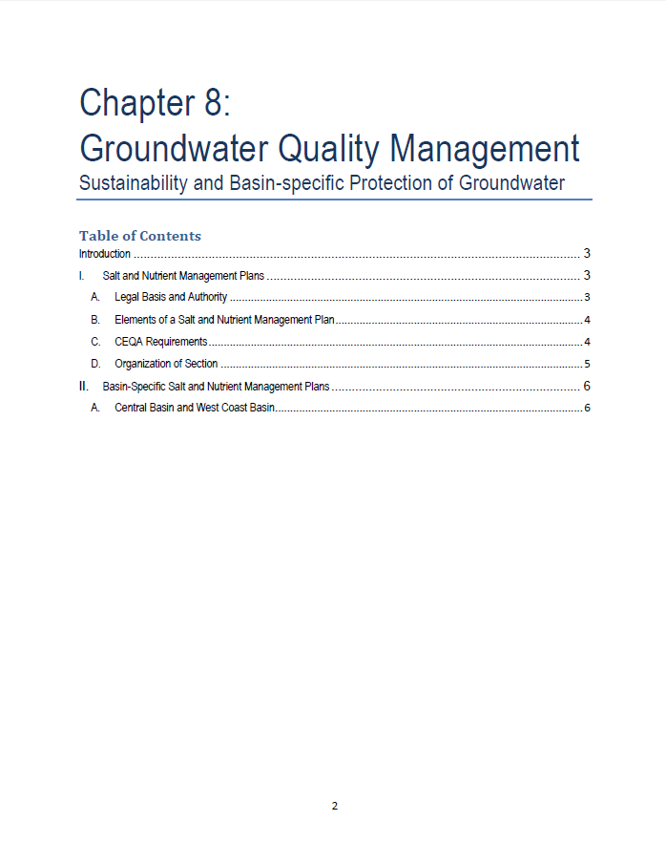
Creation of New Basin Plan Chapter
Chapter 8: Groundwater Quality Management
  Salt and nutrient management measures for each basin
  Future implementation provisions for groundwater quality management
SNMP

Slide 34
Comments
These management measures were proposed and developed by stakeholders through an open process.
Stakeholder input was solicited and considered throughout plan development.
No comments were received on the proposed incorporation of these measures into the Basin Plan item.
SNMP

Slide 35
Staff Recommendation
Adopt the Stakeholder-Proposed Salt and Nutrient Management Measures for the Central and West Coast Basins
SNMP

