Slide 1
City of El Monte
Draft Watershed Management Program (WMP)
Ed Suher, P.G.
CASC Engineering and Consulting
October 9, 2014

Slide 2
Draft Watershed Management Program
Permittee: City of El Monte (Individual WMP)
Los Angeles River and San Gabriel River Watersheds
Principle Receiving Waters: Rio Hondo (tributary to Los Angeles River), Legg Lake, and San Gabriel River

Slide 3
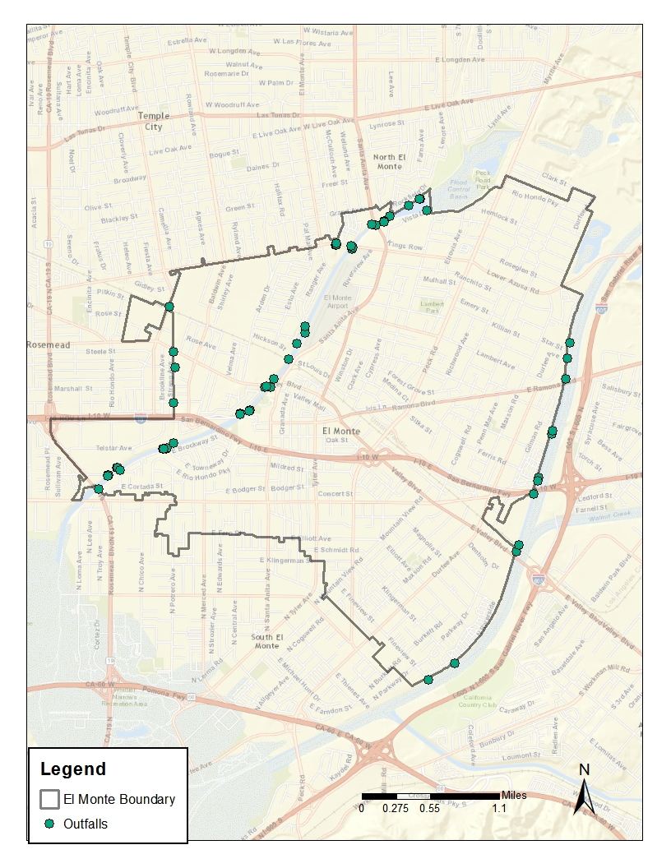
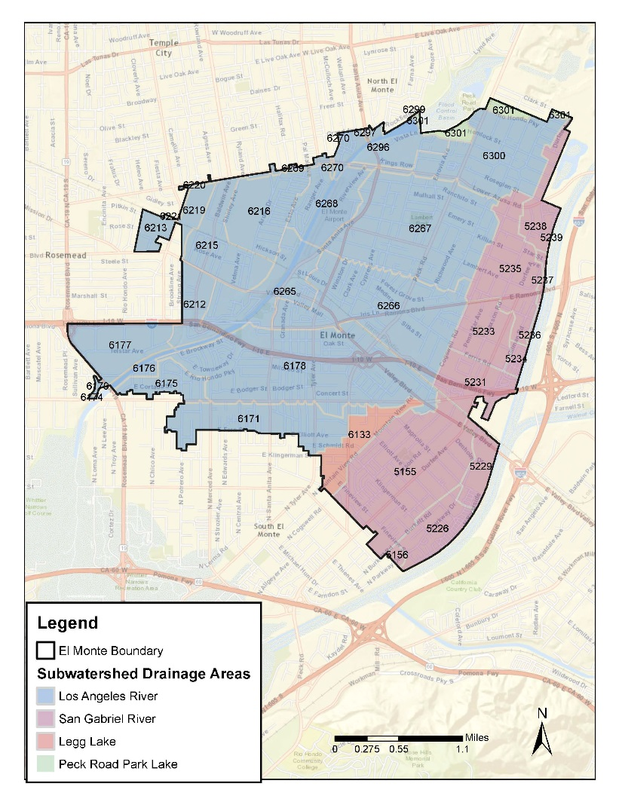
Major outfalls and drainage areas

Slide 4
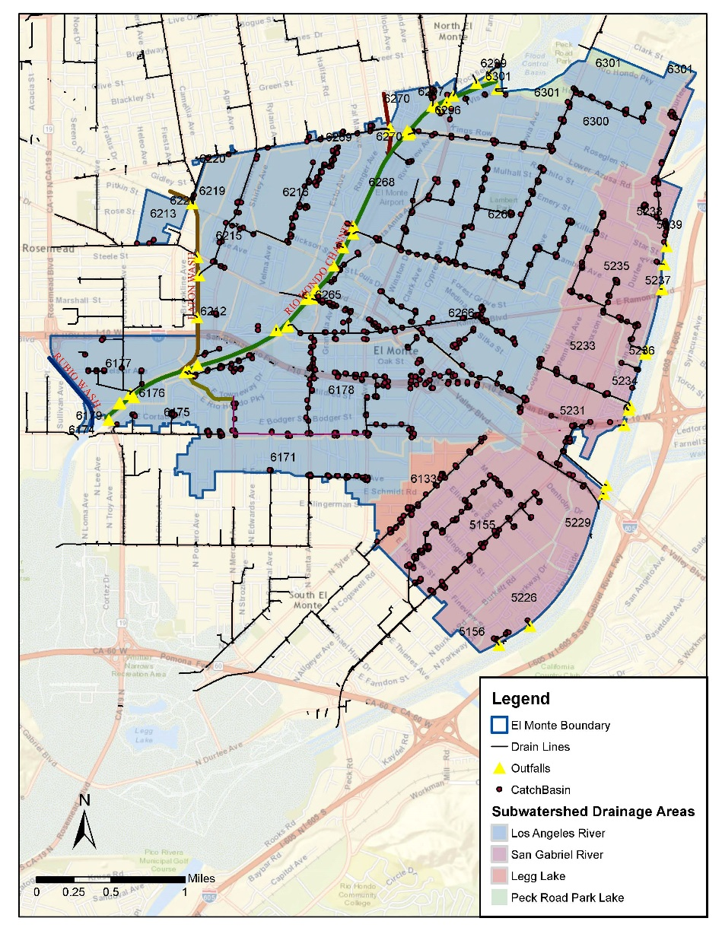
Outfalls, catch basins, and drainage areas

Slide 5
Water Quality Priorities
TMDLs (Category 1)
TMDL Name | Water Body | Action
Los Angeles River Watershed Trash TMDL | LA River | Retrofit catch basins with trash excluders
Los Angeles River Nitrogen Compounds and Related Effects TMDL | LA River | None; Modeled concentrations below limits
Los Angeles River and Tributaries Metals TMDL | LA River | None; Modeled concentrations below limits
Los Angeles River Watershed Bacteria TMDL | LA River | Develop Load Reduction Strategy for Bacteria
Los Angeles Area Lakes TMDL (Peck Road Park Lake) | Peck Road Park Lake | None at this time; confirm discharge to lake
Legg Lake Trash TMDL | LA River | Retrofit catch basins with trash excluders
Los Angeles Area Lakes TMDL (Legg Lake Nutrients) | Legg Lake | Retrofit catch basins to remove nutrients
Dominguez Channel and Greater Los Angeles and Long Beach Harbor Waters Toxic Pollutants TMDL | LA River | Collaborate with Lower Los Angeles River Watershed Group on TMDL monitoring (yearly)
Dominguez Channel and Greater Los Angeles and Long Beach Harbor Waters Toxic Pollutants TMDL | San Gabriel River | Collaborate with Lower San Gabriel River Watershed Management Group on TMDL monitoring (yearly)
San Gabriel River and Impaired Tributaries Metals and Selenium TMDL | San Gabriel River | None; Modeled concentrations below limits

Slide 6
Pollutant Reduction Strategy
Use modeling and monitoring to target highest concentration areas
Generate maps to guide implementation of BMPs in targeted areas
Install distributed BMPs and/or retrofit existing BMPs
Enhance/modify non-structural BMPs and source controls

Slide 7
Watershed Control Measures
Low Impact Development (LID ) Ordinance adopted June 10, 2014
Green Streets Policy implemented in June 2014
MCMs under review for possible customization
Structural BMPs: Modular Wetland Systems and catch basin retrofits (distributed; targeted for highest pollutant concentration areas )
Non-structural BMPs and source control: eliminate overwatering

Slide 8

Outreach and Stakeholder Input
Heal the Bay (received comments on draft WMP/IMP)
The Public (received comment on draft WMP/IMP)
City Departments (receiving training on WMP elements)
Citizens of El Monte (provided with information on stormwater)
Local organizations, groups, and schools (City is encouraging involvement)

Slide 9
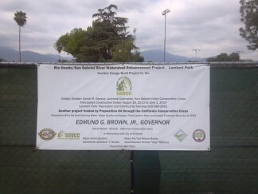
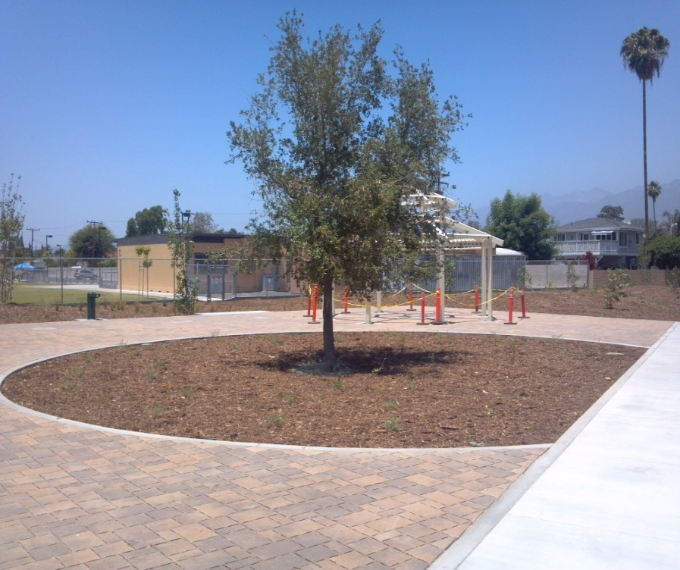
Stormwater improvement projects
Lambert Park and
Ramona Blvd Improvements

Slide 10
Integrated Monitoring Program (IMP)
Draft IMP determines/characterizes pollutants and predicts concentrations (through modeling) discharged from MS4, assesses compliance with RWLs and TMDLs, identifies sources of runoff, and uses collected information to improve water quality.
Establish relationships with surrounding groups to collaboratively monitor Receiving Waters
Develop storm drain , channels, and outfall maps /database (individually)
Perform storm water outfall monitoring (individually)
Perform non-storm water outfall screening and monitoring (individually)
Conduct New Development/Re-development BMP Effectiveness Tracking (individually)
Work with other groups conducting Regional Studies and provide monitoring data to help fill in gaps in watershed data (collaboratively)

