Slide 1
Webcast: video.calepa.ca.gov/
Technical or language interpretation assistance email: safer@waterboards.ca.gov
Public Comment: email your name, affiliation, last 3 digits of phone number, if you'd like to read your comment yourself, comment topic with the subject - “AGM3 Public Comment” to safer@waterboards.ca.gov
SAFER Drinking Water Advisory Group Meeting

Slide 2
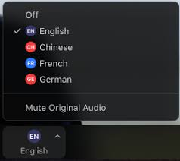
Language Interpretation through Zoom
Spanish Interpretation is being provided.
All attendees are asked to find and click on the Interpretation Icon.
Those choosing English must select English and then Mute Original Audio
Those choosing Spanish must select Spanish and then Mute Original Audio
Note: In order to use the Language Interpretation feature, attendees must download the Zoom application on their desktop.
Technical or language interpretation assistance email: safer@waterboards.ca.gov
English
Spanish

Slide 3
SAFER Drinking Water Advisory Group Meeting
April 30, 2020

Slide 4
Welcome and Meeting Logistics
Amanda Ford
Office of Public Participation (OPP)

Slide 5
Meeting Guidelines
Mute yourself when you’re not speaking
Advisory Group members, please join by video (if possible)
Take breaks as needed
Use your participation packet

Slide 6
Public Comment 1

Slide 7
Introductions
When called on, unmute yourself and share your
Name
Where you are calling in from
One thing that motivates you as an Advisory Group member.
Having trouble? Send a message to safer@waterboards.ca.gov

Slide 8
SAFER Review and Updates
Adriana Renteria, Director
Office of Public Participation (OPP)

Slide 9
Meeting Goals
1) Share updates on the SAFER Program and to recap the upcoming timeline.
2) Discuss the Fund Expenditure Plan in an effort to learn and receive feedback from AG members and public commenters.

Slide 10
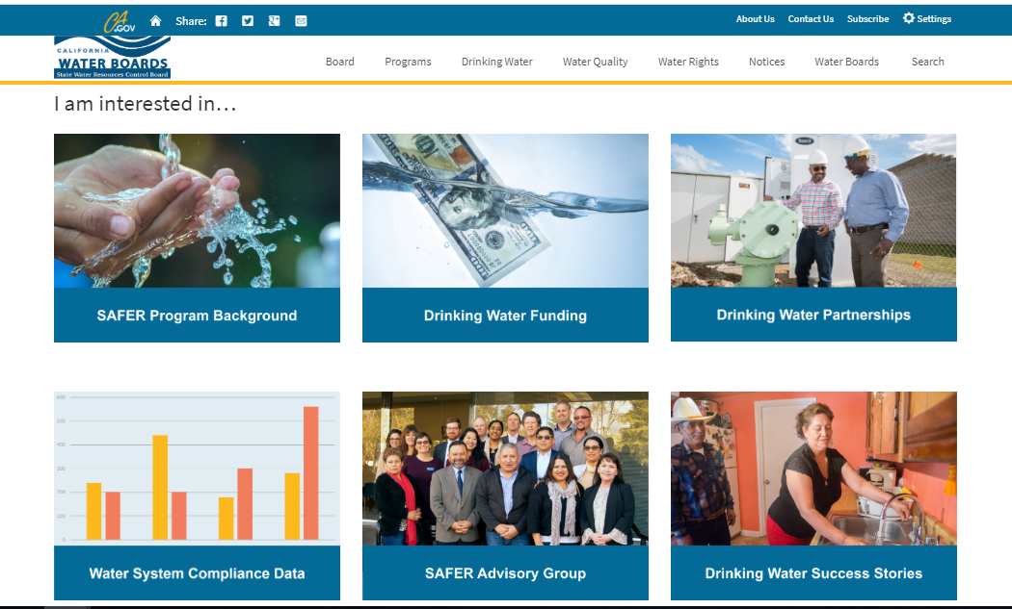
SAFER Updates
www.waterboards.ca.gov/safer
SAFER website
Frequently Asked Questions
Drinking Water Needs Assessment Workshop- April 17th

Slide 11
SAFER Recap
SB 200 (Monning, 2019) -- Establishes the Safe and Affordable Drinking Water Fund to address funding gaps and provide short- and long-term solutions to water systems.
Fund Expenditure Policy -- Guides how the Fund Expenditure Plan will be developed and implemented. The Policy defines key terms, discusses who is eligible for funding, and what types of projects are eligible.
Fund Expenditure Plan -- Adopted annually by the State Water Board, directs how money from the Fund can be spent. The Fund Expenditure Plan is based on a drinking water needs assessment that prioritizes projects for funding.

Slide 12
Upcoming SAFER 2020 Timeline
May 26, 2020
Release Draft Plan for Public Comment
June 2020
Advisory Group Meeting #4
June 19, 2020
End of Public Comment Period for Plan
April 30, 2020
Advisory Group Meeting #3
May 5, 2020
1) Board Adoption of Policy
2) Board Workshop on Plan
July 7, 2020
Board Adoption of Plan
September 2020
Board update on SAFER

Slide 13
Fund Expenditure Plan
Adriana Renteria, Director
Office of Public Participation (OPP)

Slide 14
Fund Expenditure Plan Overview
What is the Fund Expenditure Plan?
Approved annually, the Plan outlines how funds from the Safe and Affordable Drinking Water Fund will be spent, including which water systems will be prioritized and which potential solutions might be used.
When will the Fund Expenditure Plan be approved?
May 5 – State Water Board workshop
July 7- Board adoption of plan

Slide 15
What topics are included in the Fund Expenditure Plan?
1) Drinking Water Needs Analysis – identifies which water systems and domestic wells need solutions
2) Distribution of Funds – prioritizes systems and established a solution list
3) Explanation of administrators, technical assistance, operations & maintenance, and interim/emergency solutions
4) Community Engagement and Advisory Group
5) Goals and metrics

Slide 16
Breakout Session 1

Slide 17
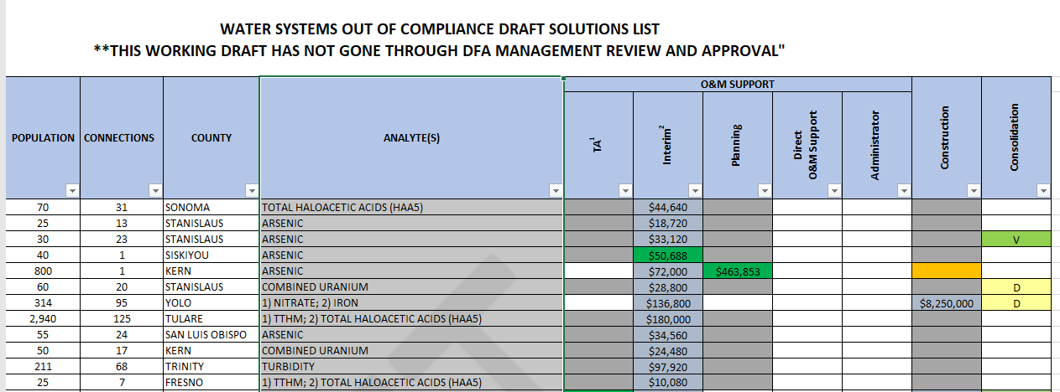
Water Systems Out of Compliance &
Draft List of Solutions

Slide 18
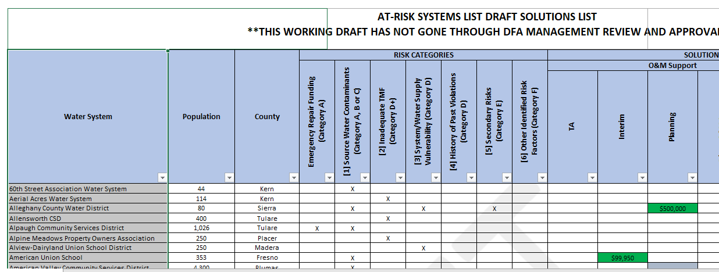
At-Risk Water Systems & Draft List of Solutions

Slide 19
Breakout Session 1: Water systems needs
Goal: Review the two spreadsheets to better understand current drinking water funding needs and cost estimates for potential future solutions.
15-minute small group discussion
Assign note taker/reporter
Discussion Qs:
What questions, concerns, or comments do you have about current and future funding needs?
Do you have recommendations for the best way to share this information? Is there any other information you wish you had available to review?

Slide 20
Breakout Group Report Outs
What were your group's top three takeaways?
What questions came up?

Slide 21
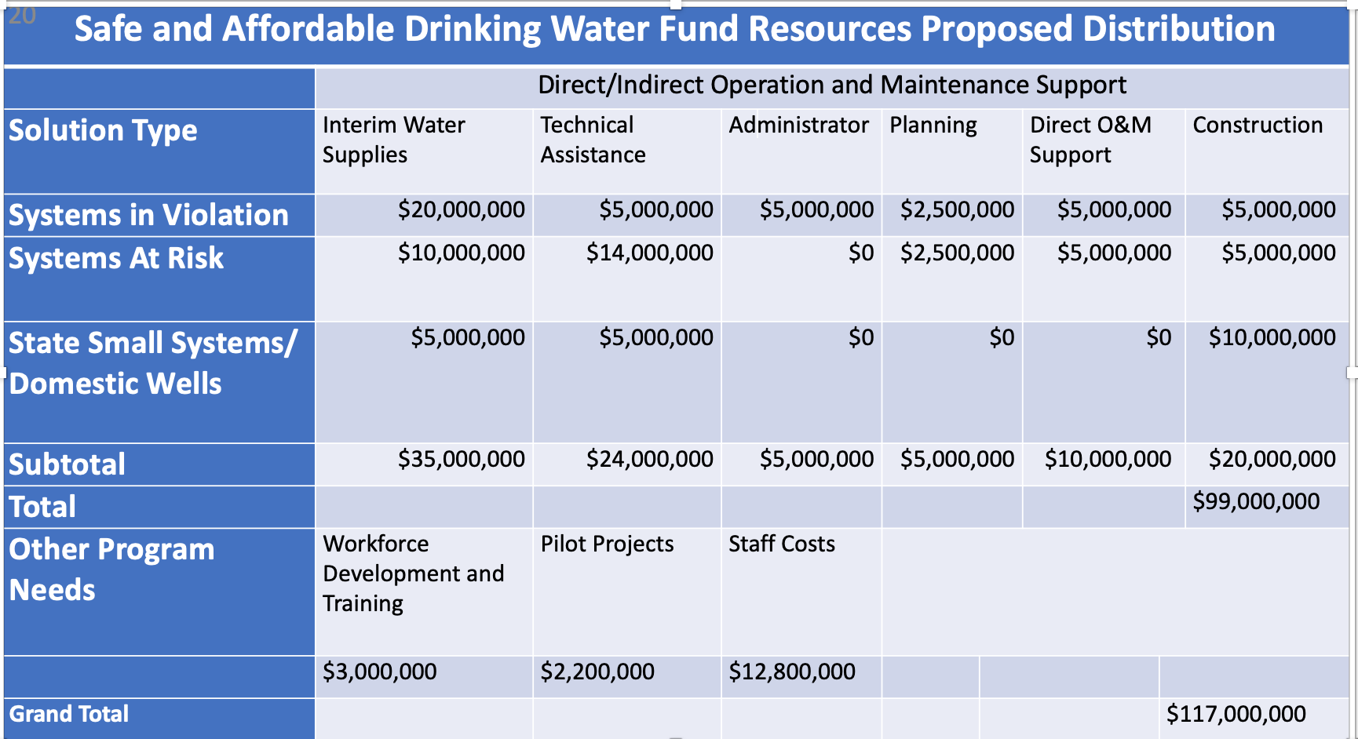
Safe and Affordable Drinking Water Fund Resources Proposed Distribution

Slide 22
Breakout Session 2: Proposed distribution of funding
Goal: Review the proposed funding distribution table and discuss if any adjustments should be made.
15-minute small group discussion
Assign note taker/reporter
Discussion Qs:
Based on your review of the spreadsheets in Breakout Session 1, is the proposed distribution of funding in alignment with the needs of communities?
Are there any categories that you recommend be allocated more/less funding? If so, which categories and why?

Slide 23
Breakout Group Reportouts Session 2:
What were your group's top three takeaways?
What questions came up?

Slide 24
Public Comment

Slide 25
Closing Remarks and Next Steps
Adriana Renteria and Amanda Ford
Office of Public Participation (OPP)

Slide 26
Recap: Upcoming SAFER 2020 Timeline
May 26, 2020
Release Draft Plan for Public Comment
June 2020
Advisory Group Meeting #4
June 19, 2020
End of Public Comment Period for Plan
April 30, 2020
Advisory Group Meeting #3
May 5, 2020
1) Board Adoption of Policy
2) Board Workshop on Plan
July 7, 2020
Board Adoption of Plan
September 2020
Board update on SAFER

Slide 27
Next Steps:
1) Evaluation: Copy the link on the agenda in the participant packet
2) Next Advisory Group virtual meeting in June 2020
3) Notes will be uploaded to SAFER website
4) Public SAFER Q&A Session TODAY 2-3:30PM

Slide 28
Closing

Slide 29
ADJOURN SAFER Advisory Group Meeting April 30, 2020

