Slide 1

Tribal Beneficial Uses: California Update
Adriana Renteria, Tribal Liaison
CALIFORNIA WATER BOARDS RTOC: January 26, 2022

Slide 2


What are Tribal Beneficial Uses?
Group of beneficial uses that can help protect activities specific to Native American cultures and their uses of California waters, including the consumption of non-commercial fish or shellfish.
Comprised of:
Tribal Subsistence Fishing (T-SUB)
Tribal Tradition and Culture (CUL)
*Subsistence Fishing (SUB)
CALIFORNIA WATER BOARDS TRIBAL BENEFICIAL USES

Slide 3
Regulatory Process for Tribal Beneficial Uses
Ongoing Step | Engage with California Tribes and the public. Highly encourage California Tribes and the public to submit support letters at three critical steps.
Step 0 | (Optional) Adopt a triennial review with TBU designations listed as a priority project
Step 1* | Adopt TBU definition(s) into the Basin Plan
Step 2 | Gather data for designations
Step 3* | Designate waterbodies or parts of a waterbody with TBU(s)​
Step 4 | Create Implementation Plans​
*Steps 1 and 3 can be done at the same time
CALIFORNIA WATER BOARDS TRIBAL BENEFICIAL USES

Slide 4
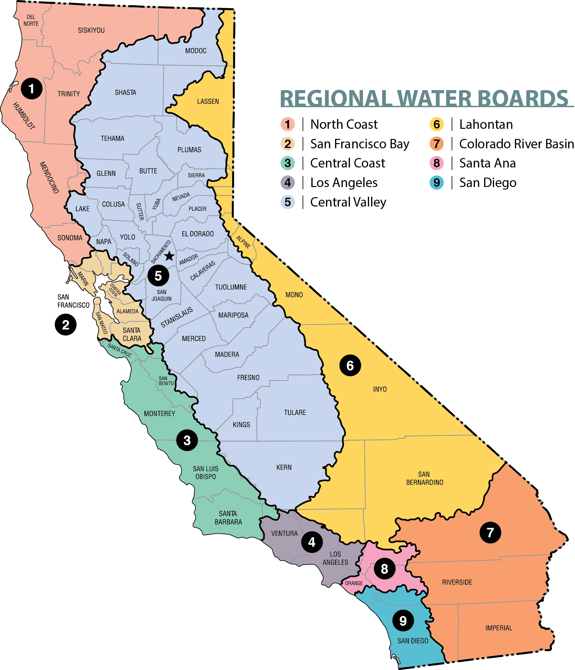
Region 1 – North Coast
Step 1: Adopt TBU definition(s) into the Basin Plan
Upcoming Meeting/Key Dates:
None Scheduled
Action Step:
Submit support letter to adopt TBU definitions
Tribal Coordinator:
Cody.Walker@waterboards.ca.gov
(707) 576-2642
Region 1 has previous beneficial uses that protect Native American Culture and Subsistence Fishing
CALIFORNIA WATER BOARDS TRIBAL BENEFICIAL USES

Slide 5
Region 2 – San Francisco Bay
Step 2: Gather data for designations
(completed Step 0; plan to do Steps 1 & 3 as one process)
Upcoming Meeting/Key Dates:
Early March: TBD
Action Step:
Send a letter to Sami Harper with interest
Tribal Coordinator:
Samantha.Harper@waterboards.ca.gov
(510) 622-2415
5 tribes submitted support for TBUs on the Triennial Review, 0 tribes attended Triennial Review hearing
CALIFORNIA WATER BOARDS TRIBAL BENEFICIAL USES

Slide 6
Region 3 – Central Coast
Step 0: Adopt a triennial review with TBU designations listed as a priority project
Upcoming Meeting/Key Dates:
2024: Next Triennial Review
Action Step:
Submit support letter to prioritize TBUs in Triennial Review
Tribal Coordinator:
Angela.Schroeter@waterboards.ca.gov
(805) 542-4644
0 tribes submitted support for TBUs on the 2021 Triennial Review, or attended Triennial Review workshop
CALIFORNIA WATER BOARDS TRIBAL BENEFICIAL USES

Slide 7
Region 4 – Los Angeles
Step 1: Adopt TBU definition(s) into the Basin Plan
Upcoming Meeting/Key Dates:
Feb 17, 5pm: Comments on Basin Plan Amendment due
March 10, 9am: Board Hearing
Action Step:
Submit support comments to adopt TBU definitions
Attend Board Hearing to voice support
Tribal Coordinator:
Susana.Lagudis@waterboards.ca.gov
(213) 576-6694
2 tribes and 41 attendees participated in TBU September 2021 public workshop
CALIFORNIA WATER BOARDS TRIBAL BENEFICIAL USES

Slide 8
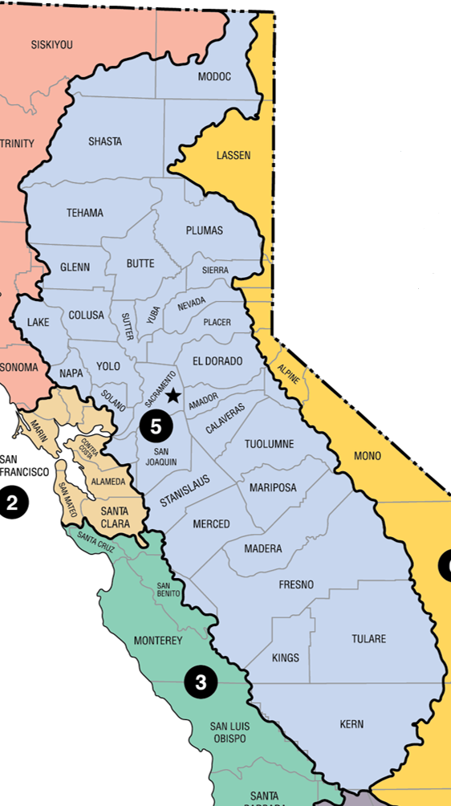
Region 5 – Central Valley
Step 1 & 2: Adopt TBU definition(s) into the Basin Plan & Gather data for designations
Upcoming Meeting/Key Dates:
Feb 17 and 18, 9am: Board Hearing
April/May TBD: Tribal Update Meeting
Action Step:
Submit letters to request TBU designations
Tribal Coordinator:
Robert.LHeureux@waterboards.ca.gov
(916) 464-4736
5 support letters received for the proposed Basin Plan Amendment
CALIFORNIA WATER BOARDS TRIBAL BENEFICIAL USES
Notes:
TBU Lead Staff:
Taran Sahota: Taranjot.Sahota@waterboards.ca.gov
Lauren Smitherman: Lauren.Smitherman@Waterboards.ca.gov

Slide 9
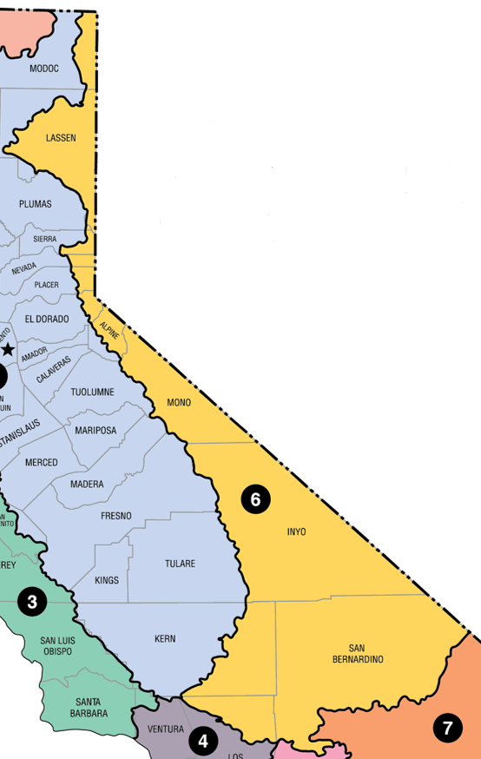
Region 6 – Lahontan
Step 2: Gather data for designations
(completed Step 1 in 2020)
Upcoming Meeting/Key Dates:
March 9-10: Triennial Review hearing
Action Step:
Attend Triennial Review hearing
Attend future Tribal Summit
Tribal Coordinator:
Daniel.McClure@waterboards.ca.gov
(530) 542-5443
2 support letters received for Triennial Review TBU project, met with interested tribes regarding Triennial Review
CALIFORNIA WATER BOARDS TRIBAL BENEFICIAL USES

Slide 10
Region 7 – Colorado River Basin
Step 1: Adopt TBU definition(s) into the Basin Plan
Upcoming Meeting/Key Dates:
None Scheduled
Action Step:
Submit support letter to adopt TBU definitions
Tribal Coordinator:
Maria.Davydova-Flores@waterboards.ca.gov
(760) 776-8947
2 tribes submitted support letters for Triennial Review
CALIFORNIA WATER BOARDS TRIBAL BENEFICIAL USES

Slide 11
Region 8 – Santa Ana
Step 1: Adopt TBU definition(s) into the Basin Plan
Upcoming Meeting/Key Dates:
2022 TBD: Triennial Review start
Action Step:
Submit support letter to adopt TBU definitions
Tribal Coordinator:
Claudia.Tenorio@waterboards.ca.gov (951) 782-4963
3 tribes participated in March 2021 workshop
CALIFORNIA WATER BOARDS TRIBAL BENEFICIAL USES

Slide 12
Region 9 – San Diego
Step 2: Gather data for designations
Upcoming Meeting/Key Dates:
None Scheduled
Action Step:
Submit letters to request TBU designations
Tribal Coordinator:
Cynthia.Gorham@waterboards.ca.gov (619) 521-3921
6 tribes participated in August 2021 summit
CALIFORNIA WATER BOARDS TRIBAL BENEFICIAL USES

Slide 13
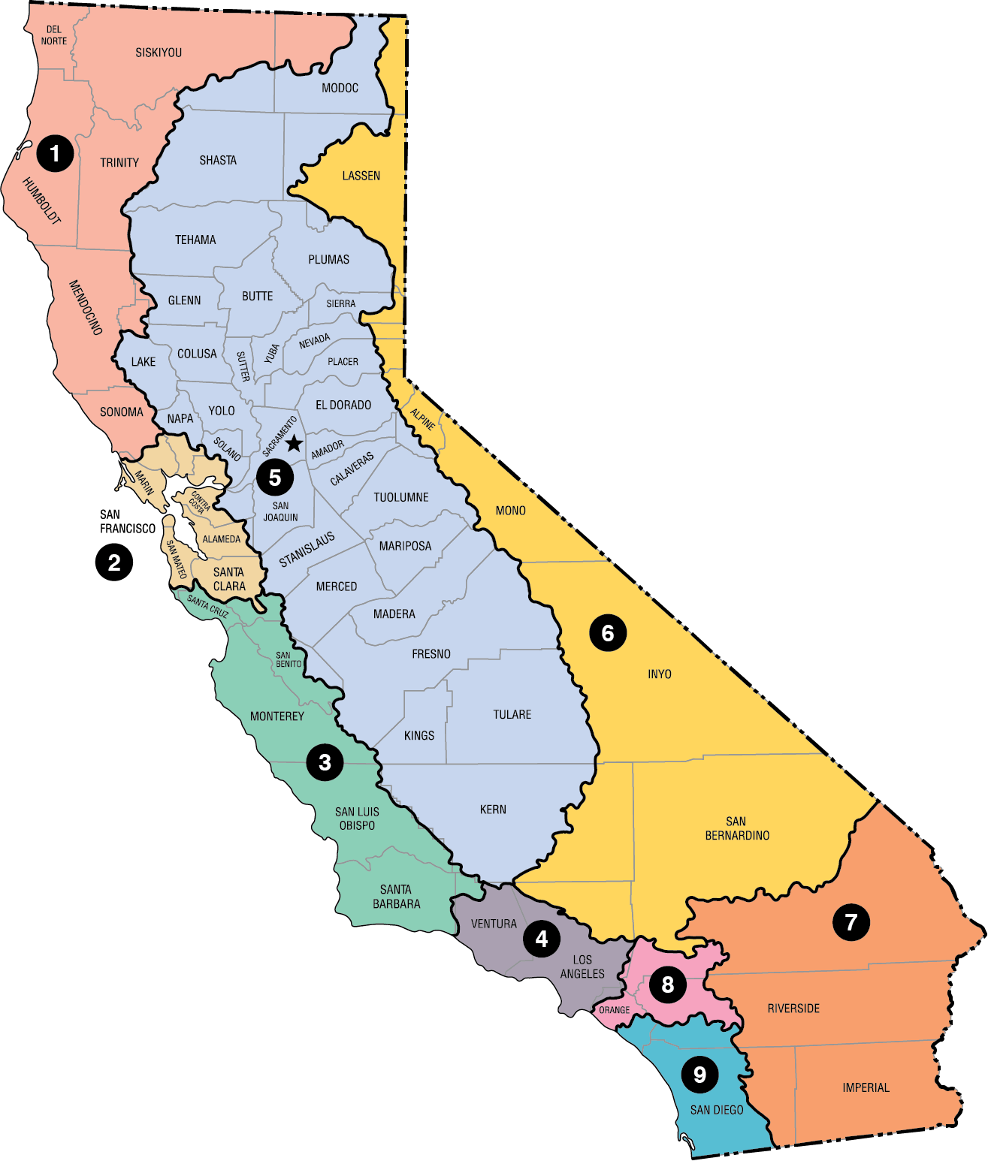
Division of Water Quality – Ocean Plan
Step 1: Adopt TBU definition(s) into the Ocean Plan
Upcoming Meeting/Key Dates:
None Scheduled
Action Step:
Submit support letter to adopt TBU definitions
Tribal Coordinator:
Daniel.Ellis@waterboards.ca.gov (916) 322-7787
12 tribes attended 2019 Ocean Plan Review tribal outreach meeting
CALIFORNIA WATER BOARDS TRIBAL BENEFICIAL USES

Slide 14
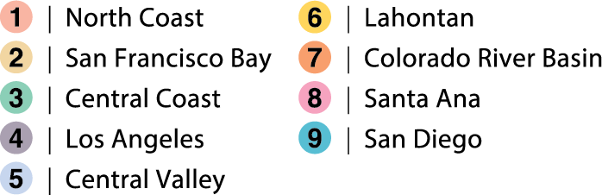
Resources and Contacts
Tribal Affairs Website​: waterboards.ca.gov/tribal_affairs
Tribal Beneficial Uses Website​: waterboards.ca.gov/tribal_affairs/beneficial_uses.html
Tribal Coordinators Contact Information​:
waterboards.ca.gov/tribal_affairs/tribal_contacts.html​​
Adriana Renteria, Tribal Liaison
Tribal-Liaison@waterboards.ca.gov, (916) 216-1126
CALIFORNIA WATER BOARDS TRIBAL BENEFICIAL USES

Slide 15

Questions?
CALIFORNIA WATER BOARDS TRIBAL BENEFICIAL USES

