Slide 1
The Sacramento/San Joaquin River Delta
Michael Patrick George, Delta Watermaster
Presentation to Nixon Peabody
Los Angeles, September 24, 2015

Slide 2
Disclaimers
I am not speaking for the SWRCB or the DSC
I am not presenting State policy
I am expressing personal observations and opinions, except where specifically referenced to published materials

Slide 3
Role of the Delta Watermaster
Statutory
Established by the Delta Reform Acts of 2009
Responsible for administration of water rights in the Delta
Independent; four-year term; report jointly to the SWRCB and the DSC
Advisory
Synthesize information; frame issues
Promote efficiency of Delta bandwidth
Mediate, reconcile, badger and cajole

Slide 4
Overview of Presentation
Background and Context
Current Issues
Discussion

Slide 5
Background and Context

Slide 6
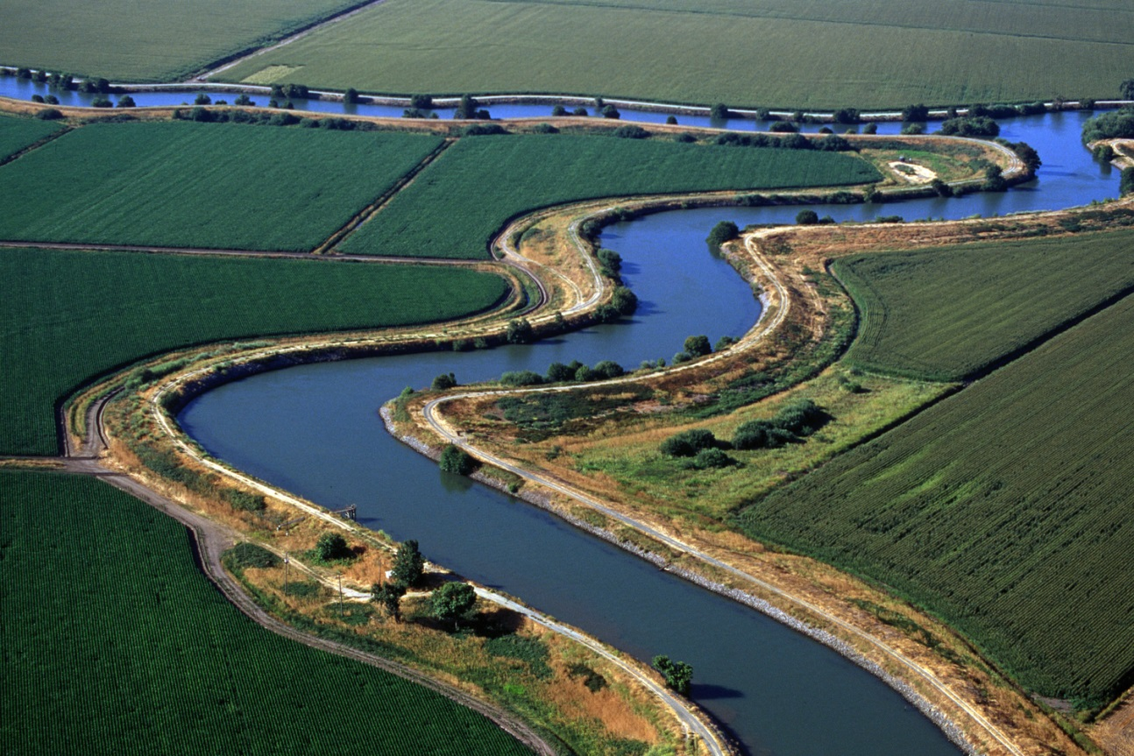
Delta Orientation
Today’s Delta has been shaped by public and private interests carrying out government policies
Transition from estuary and marsh to “reclaimed” land dedicated to agriculture
Water “development” made the Delta the “crossroads” of the State’s plumbing system

Slide 7
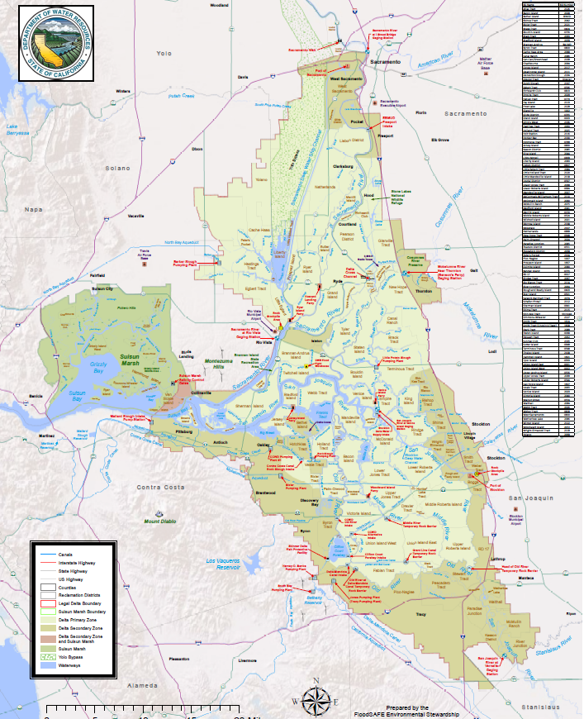
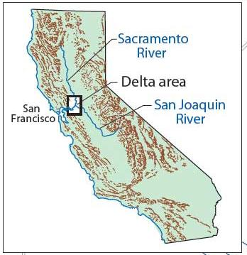

Slide 8
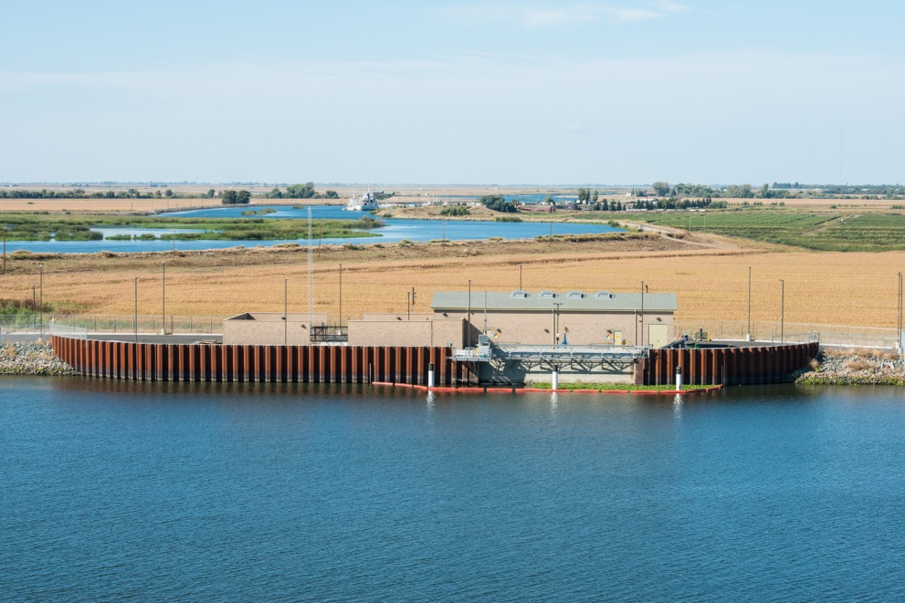
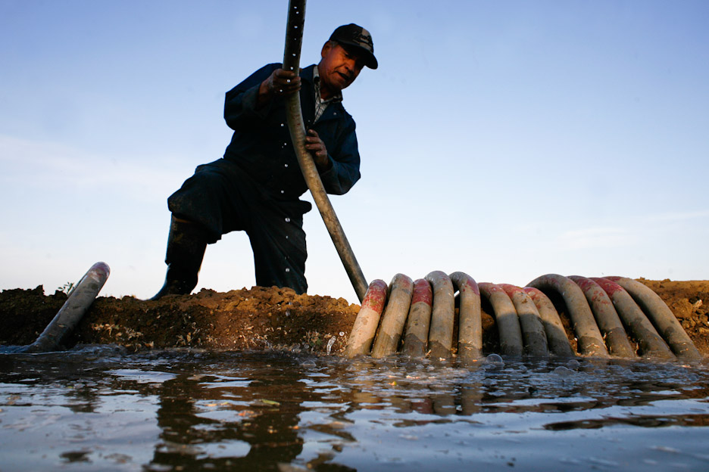
Water: “Over, Under, Around and Through” the Delta
1500 to 2,000 separate surface water diversion structures in the Delta
Pumps, siphons, weirs, gates

Slide 9
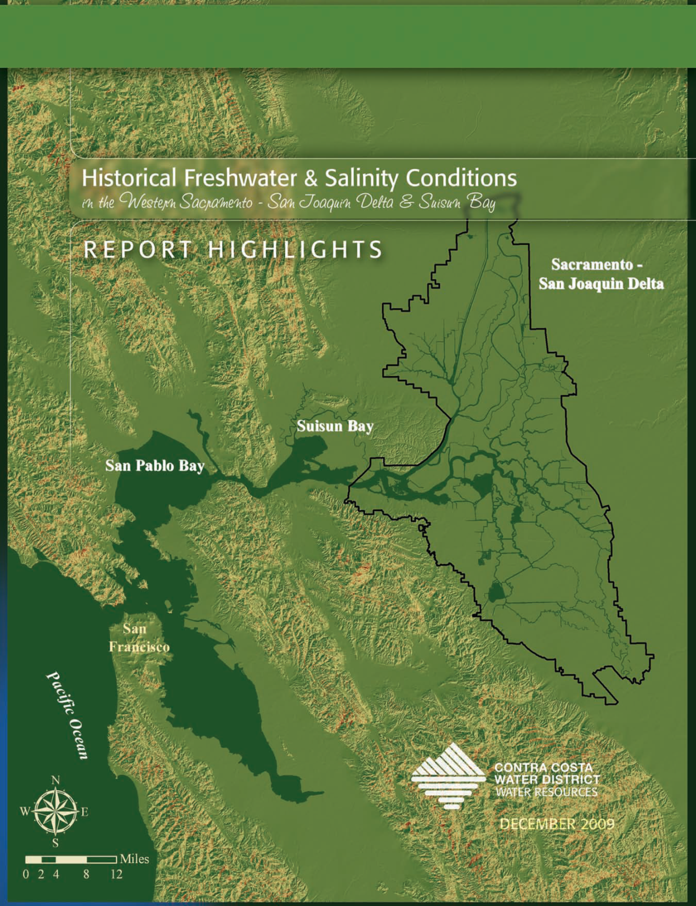
Upstream development
Irrigation from tributaries [Antioch]
Reduced flushing
Increased salt water intrusion [Contra Costa WD Study]

Slide 10
The Projects: CVP & SWP
Area of Origin protections
Project purposes
Upstream storage reservoirs
Pumping and conveyance facilities
Contractors pay for the facilities to get “available water” from junior water rights
Temporary misuse of the Delta for conveyance (1960)
Peripheral Canal: rejected by voters in 1982

Slide 11
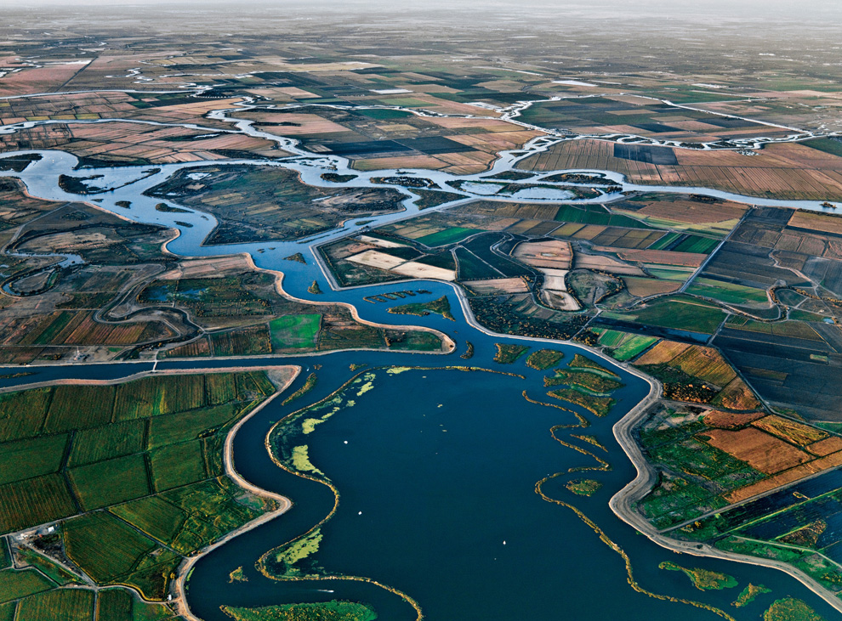
Stress on the Delta
Channelization
Dikes and subsidence
Tributary depletions
Project exports
Invasives
Pollution

Slide 12
Current Issues: Responses to Decline of the Delta
Who Cares?
Environmentalists
Bureaucrats and regulators
Farmers inside and outside of the Delta
Water users (from Redding to San Diego)
Those who like to eat, drink and breathe
The Delta drains 60% of California’s land mass

Slide 13
Unscrambling the Egg
CVPIA (1992), CalFed (1994) and the State Water Board’s Decision-1641 (2000): Imposing Conditions on Projects
Temporary but unsustainable expedient
Time, money and regulatory space to evaluate alternatives
Monitoring, litigating, and studying
Restoration versus reconciliation

Slide 14
Water Quality Control Plans: Balancing beneficial uses of water
Competing demands for limited supplies
Priorities, Riparians, Public Trust and Reasonable Use
Process, Phases and Timing
Fear and trembling among water rights claimants
The co-equal goals
“’Coequal goals’ means the two goals of providing a more reliable water supply for California and protecting, restoring, and enhancing the Delta ecosystem. The coequal goals shall be achieved in a manner that protects and enhances the unique cultural, recreational, natural resource, and agricultural values of the Delta as an evolving place.” (CA Water Code §85054)

Slide 15
Bay Delta Conservation Plan
CEQA/NEPA compliance process identified “twin tunnels” as the preferred project
Projects proposed a habitat conservation plan to get a 50-year operating permit
Nine years; a few hundred million dollars in studies; voluminous critical comments
Plan of finance behind the “user pays” fig leaf
USEPA (and others) identified fatal flaws under ESA
DWR ultimately abandoned the permitting effort

Slide 16
Drought responses
Proclamation of drought emergency
Notices of insufficient water supply at various priorities (“curtailment”)
Exercise of “reasonable use” doctrine
Temporary Urgency Change Petitions
Voluntary 25% cut in riparian diversion
Heroic (routine) water system management

Slide 17
BDCP 2.0: California WaterFix and EcoResore
Pending DEIR/EIS (comments due 10/30)
Petition for Change in Points of Diversion (revised to 9/18)
http://www.californiawaterfix.com/
http://resources.ca.gov/ecorestore/
http://restorethedelta.org/

Slide 18
Pending Regulatory Issues
Implementation of the Sustainable Groundwater Management Act
Delta Water Quality Control Plan update
Measurement of agricultural diversions
State Water Contractors’ complaint alleging unlawful diversion from the Delta

Slide 19
Current Litigation
Woods Irrigation Company (settled 9/16)
MID vs. Tanaka (in trial)
CDO against West Side ID
ACL against Byron-Bethany ID
WSID, BBID et al vs. SWRCB

Slide 20
Discussion

Slide 21
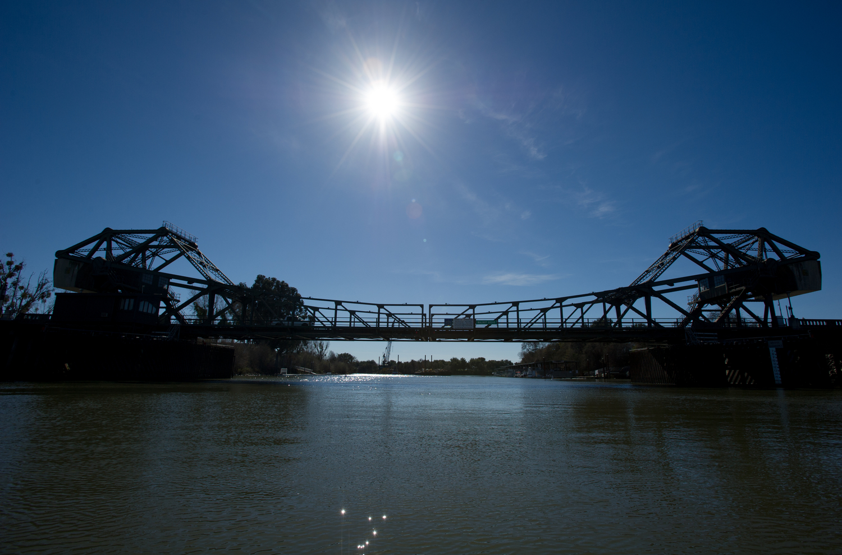

Slide 22
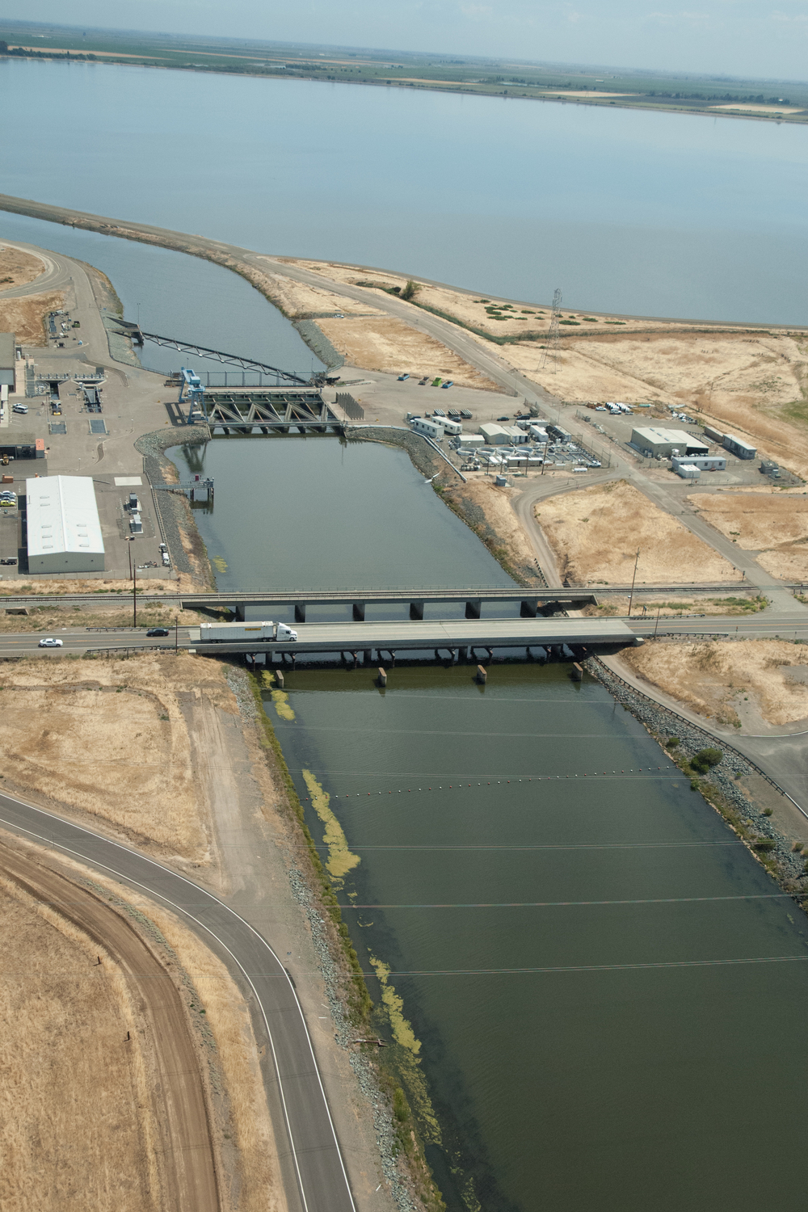

Slide 23
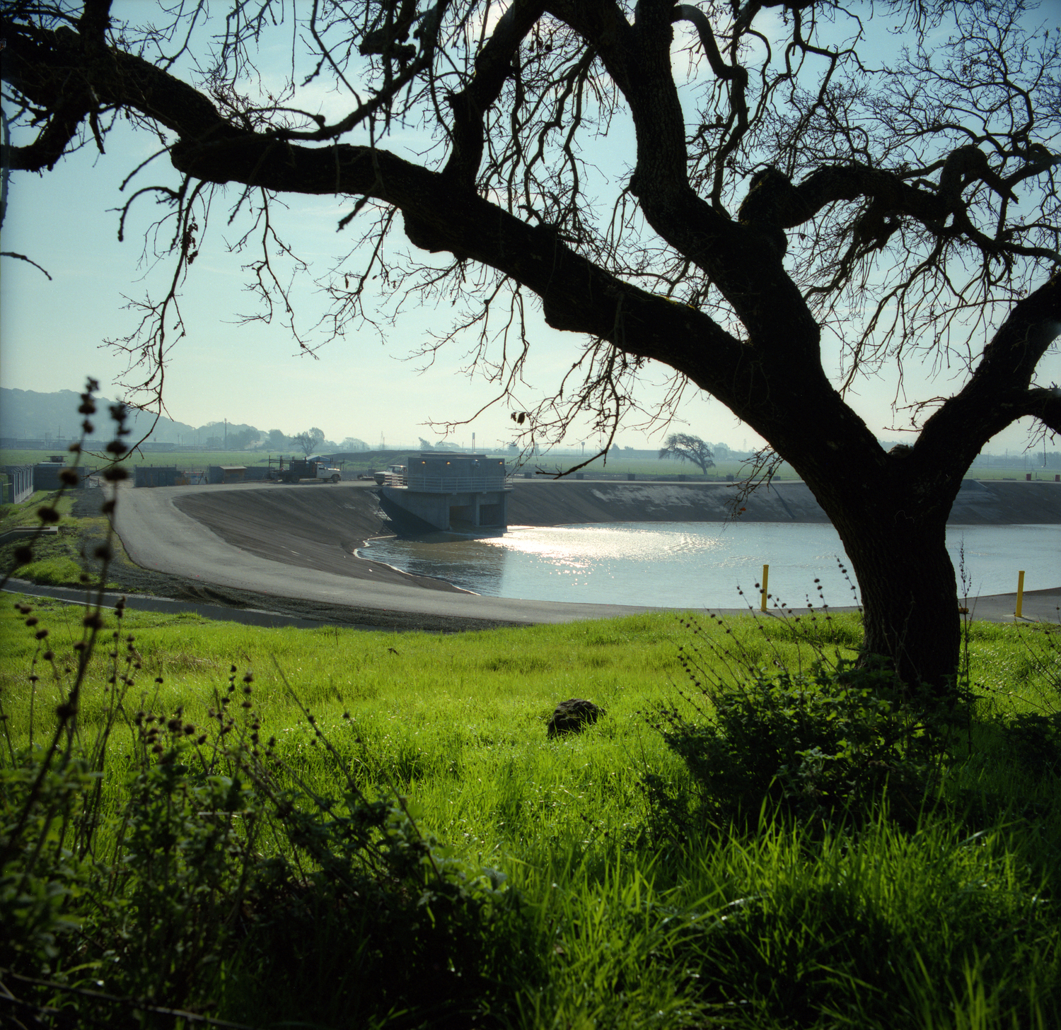

Slide 24
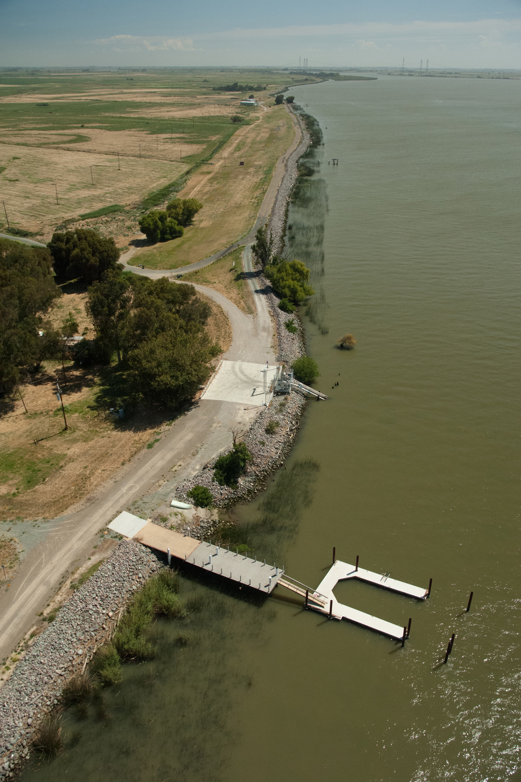

Slide 25
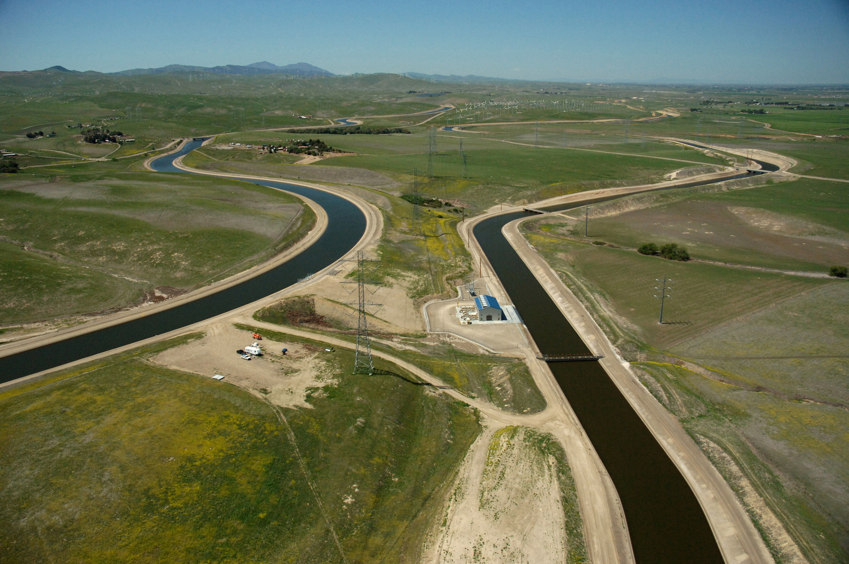

Slide 26
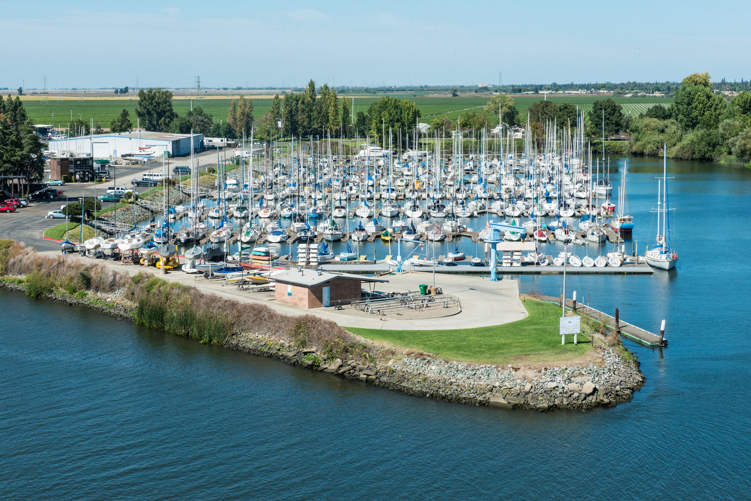

Slide 27
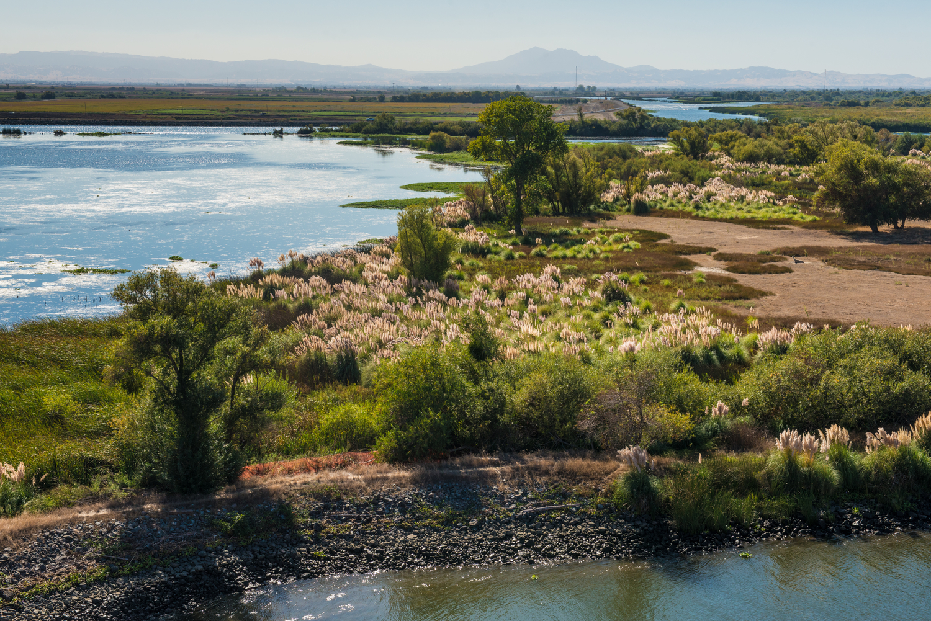

Slide 28
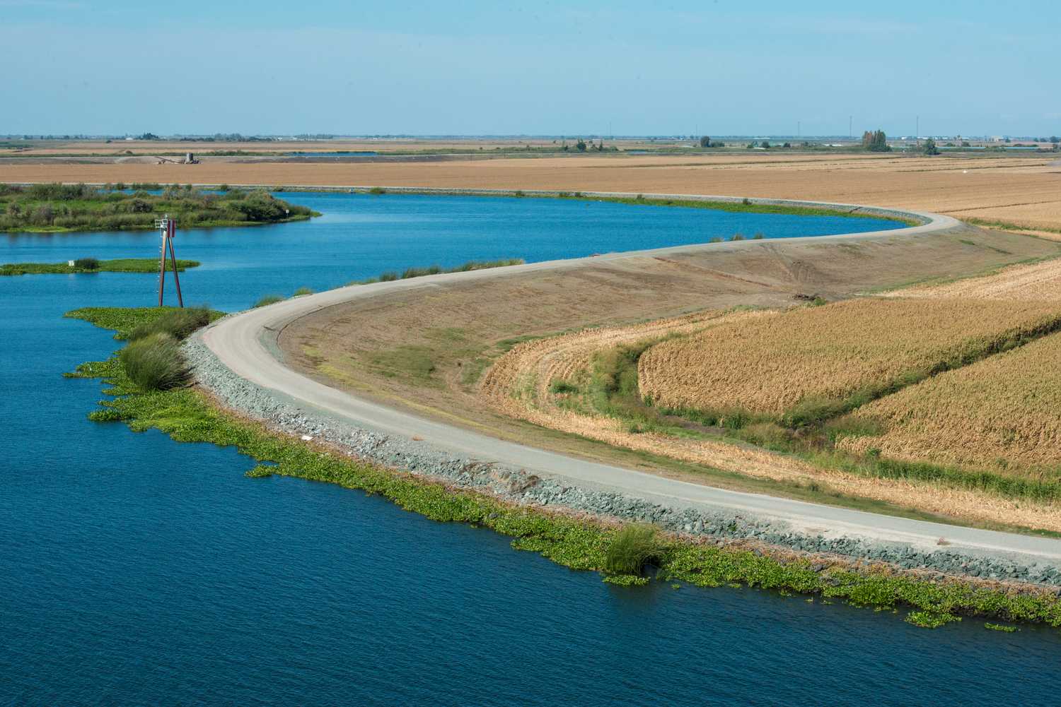

Slide 29
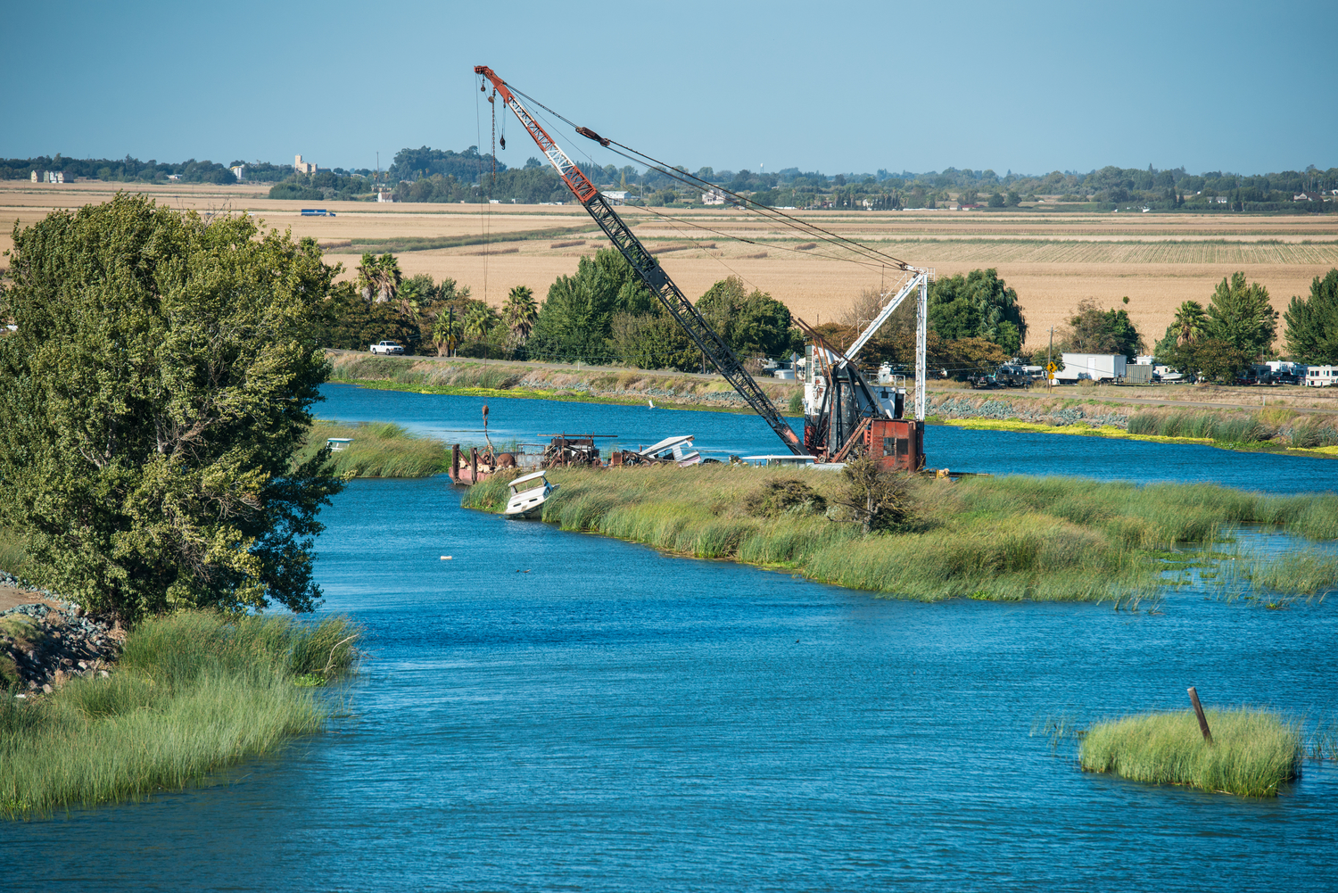

Slide 30
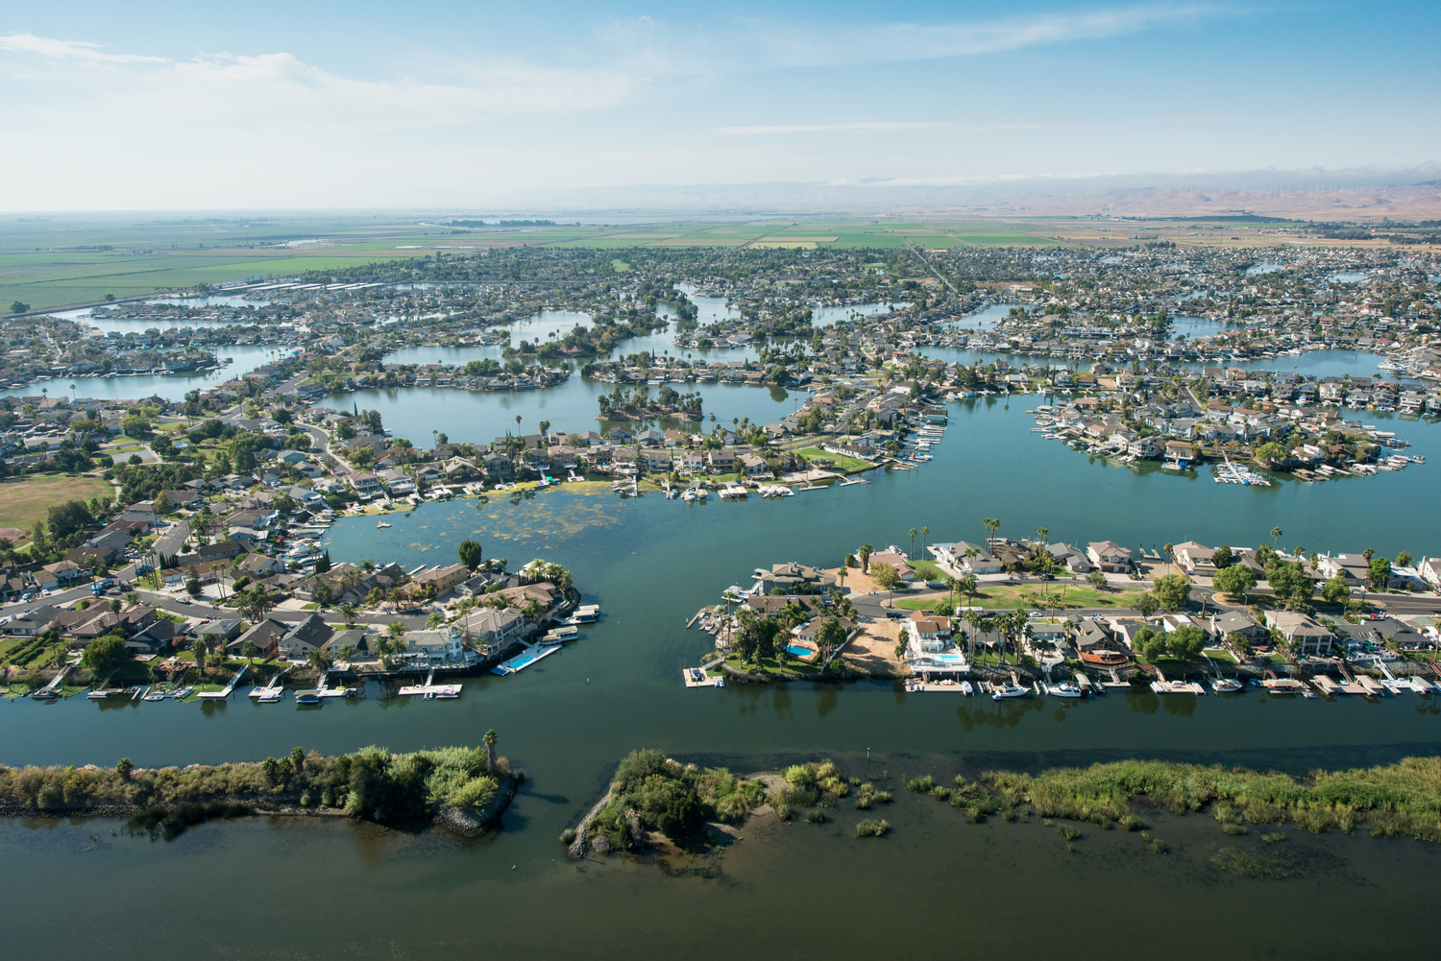

Slide 31
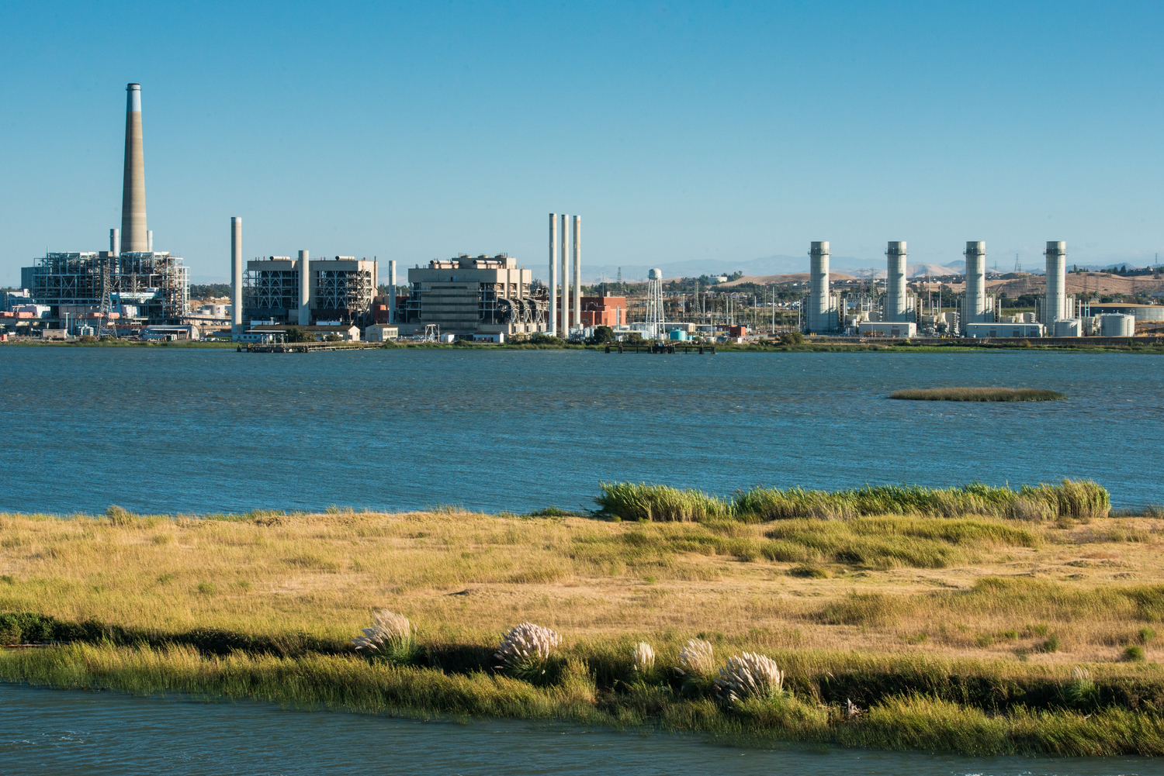

Slide 32
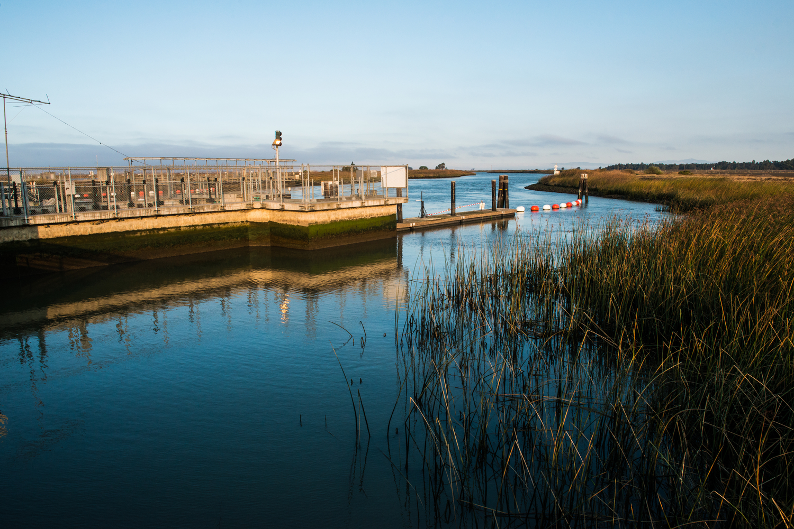

Slide 33
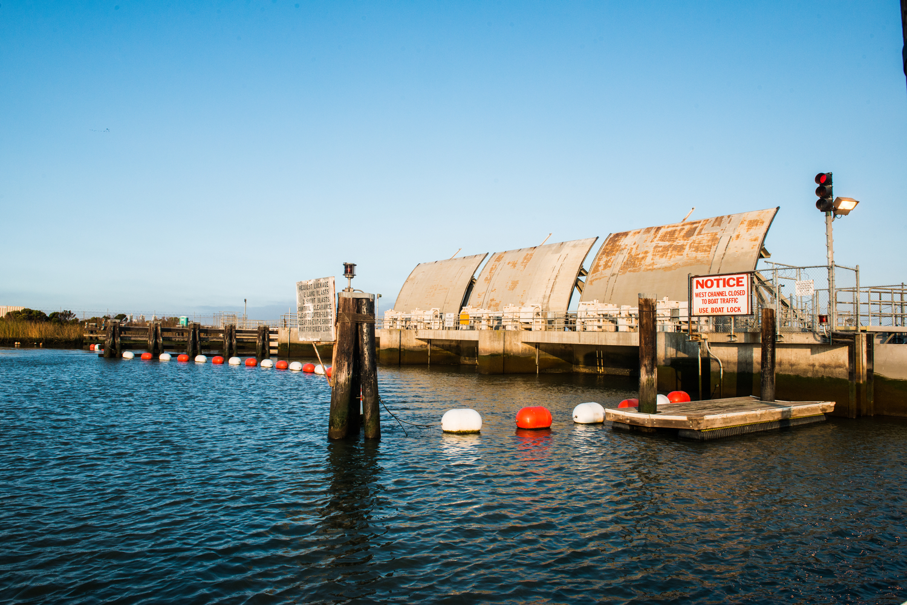

Slide 34
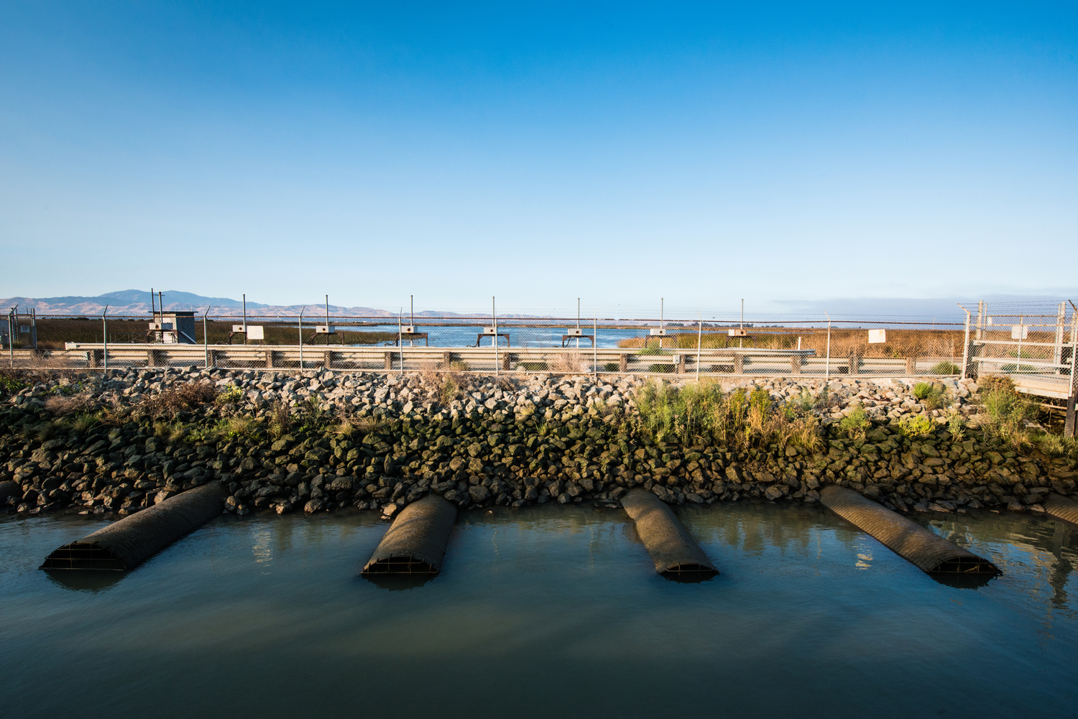

Slide 35
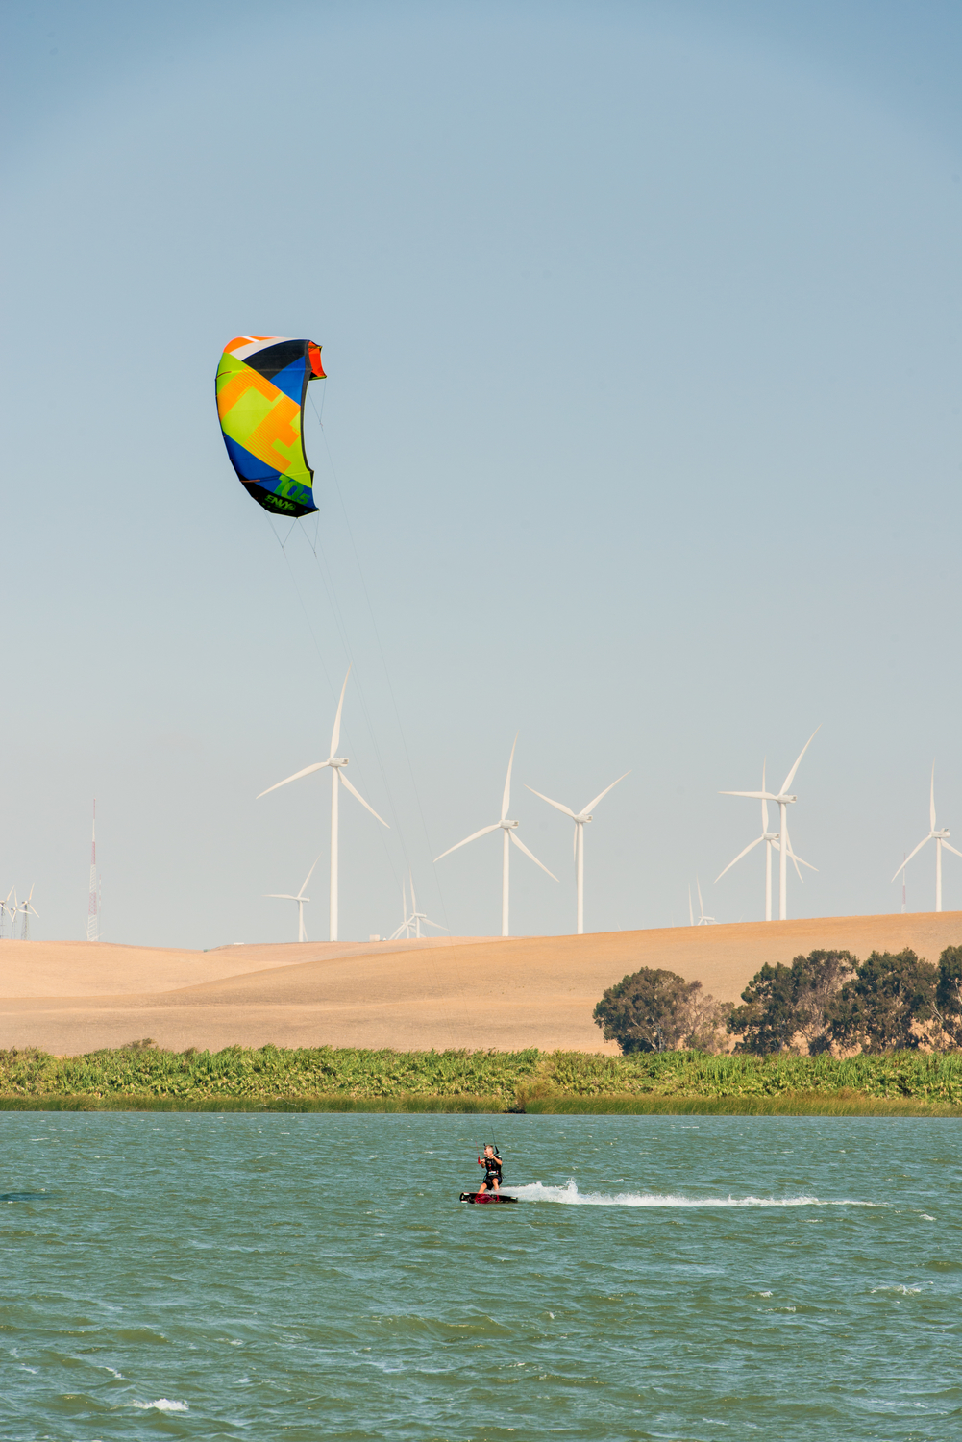

Slide 36
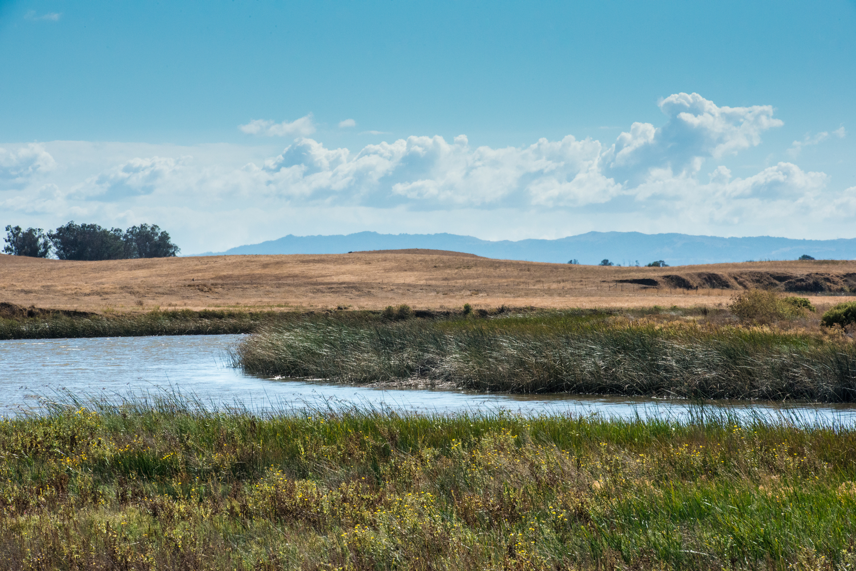

Slide 37
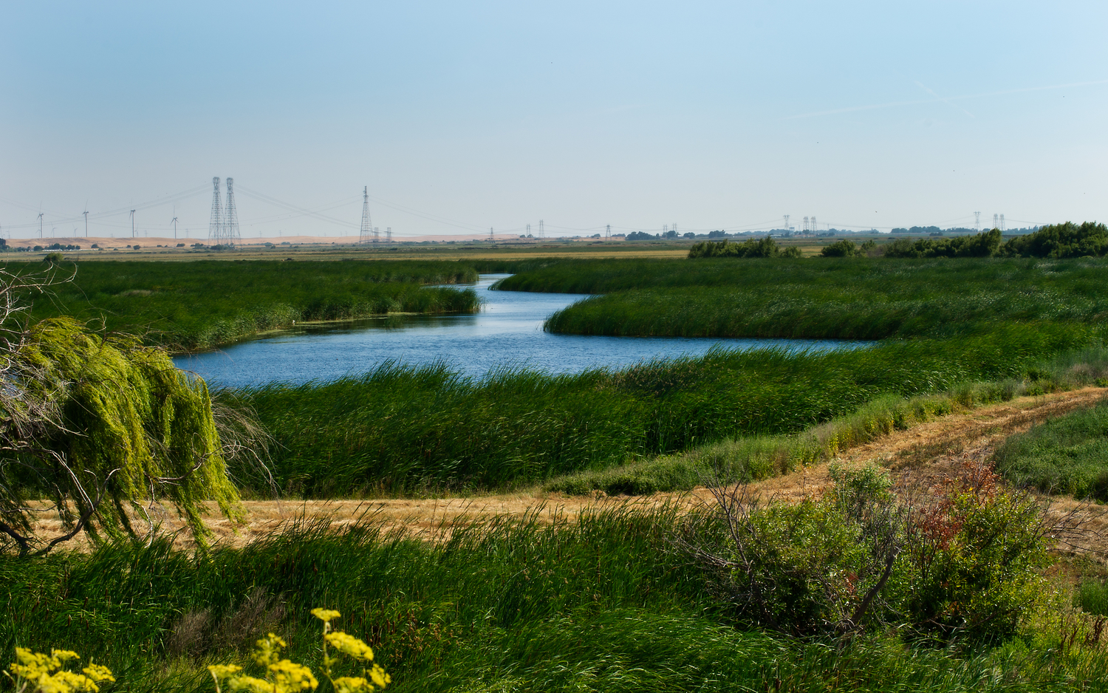

Slide 38
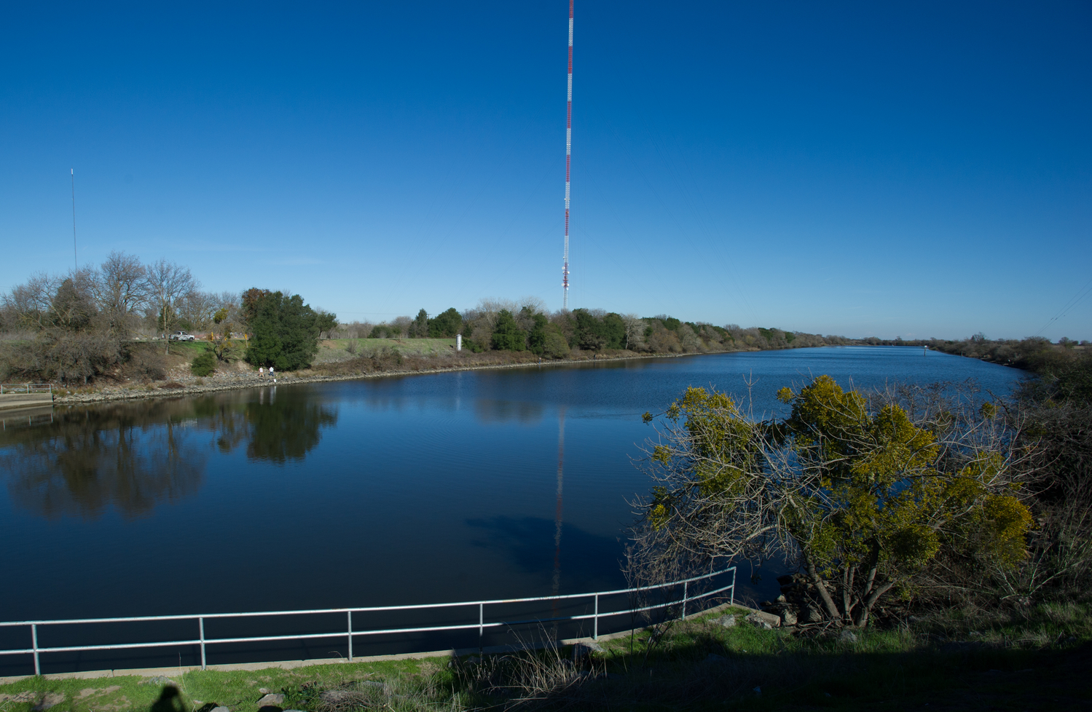

Slide 39
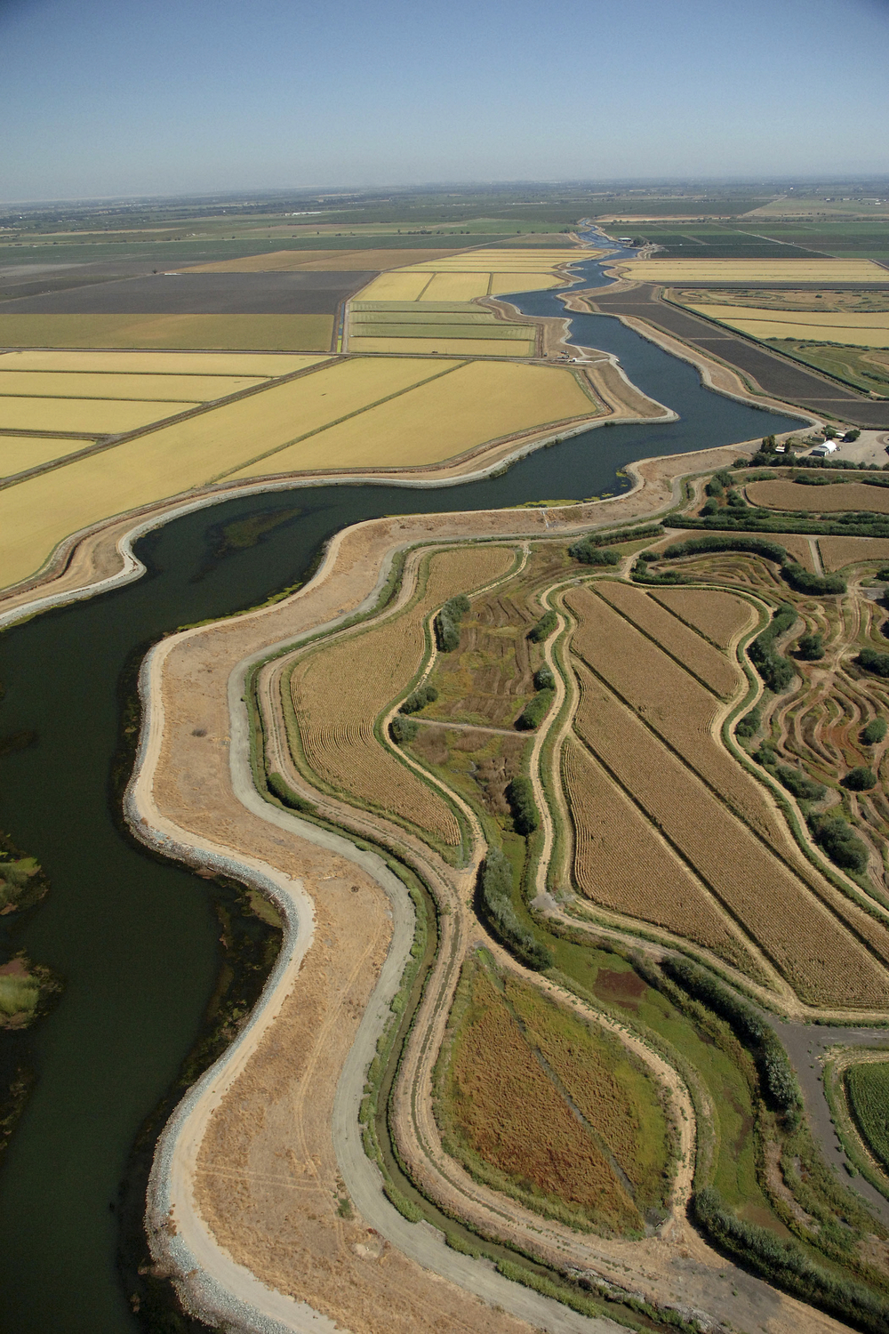

Slide 40
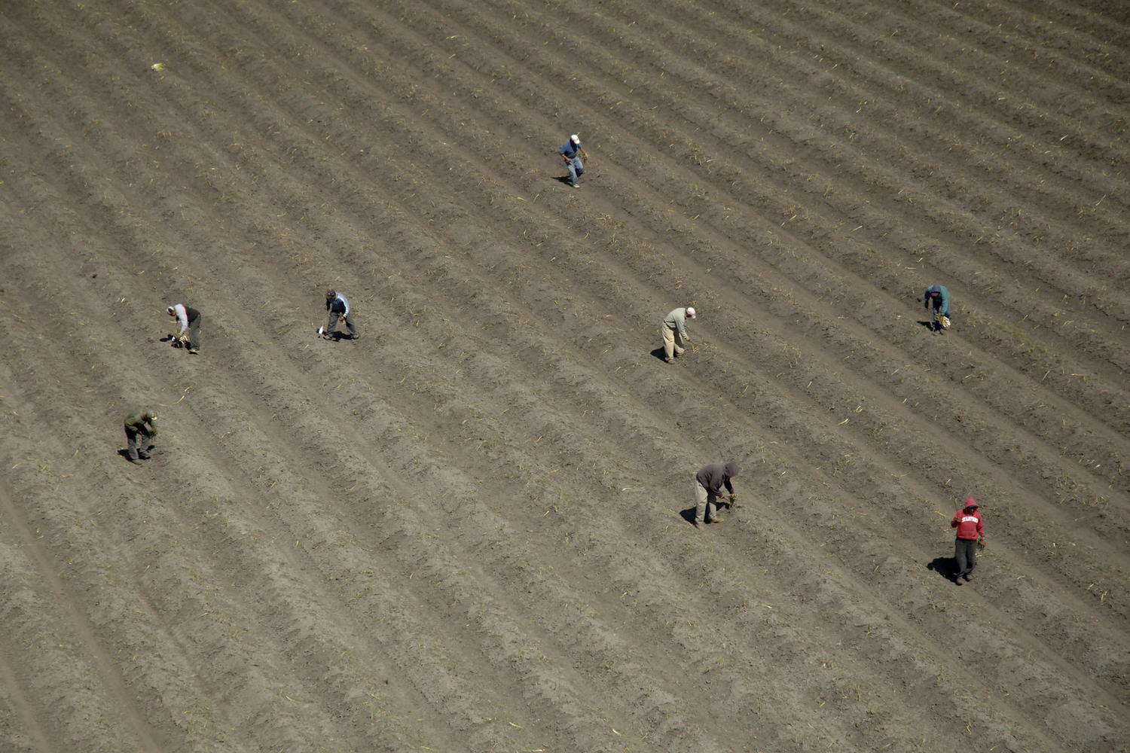

Slide 41
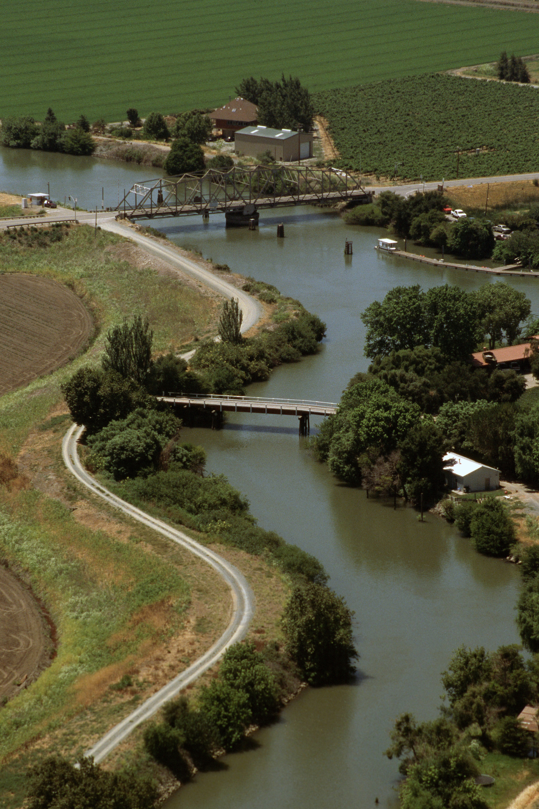

Slide 42
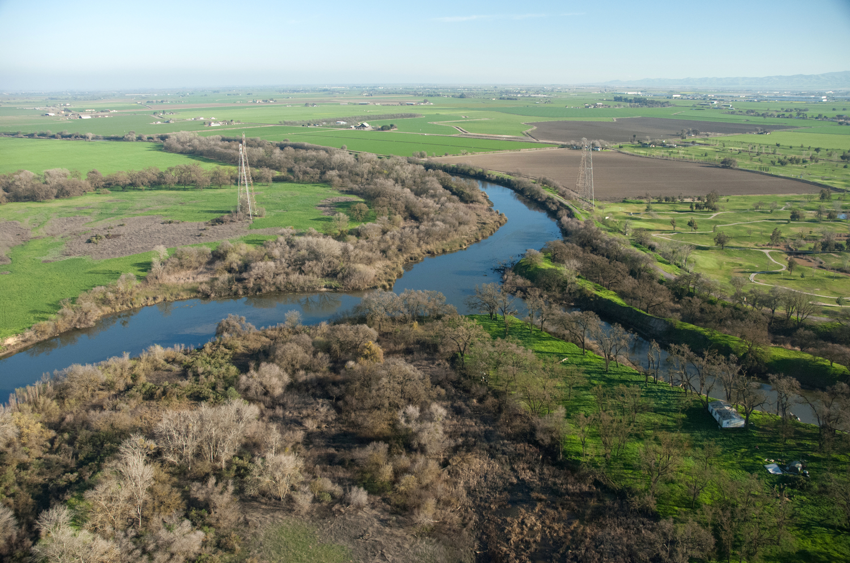

Slide 43
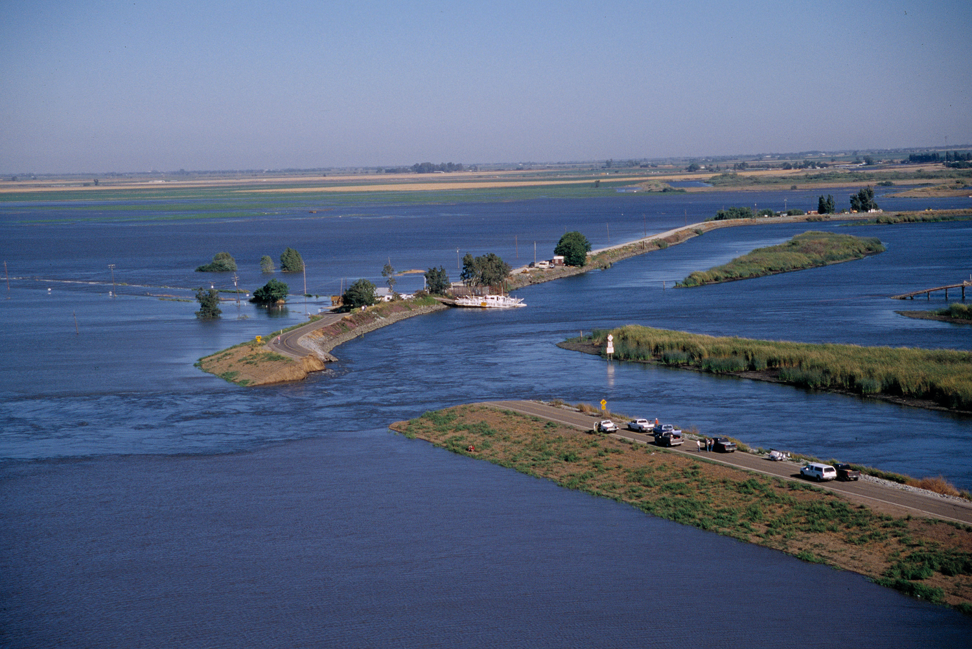

Slide 44
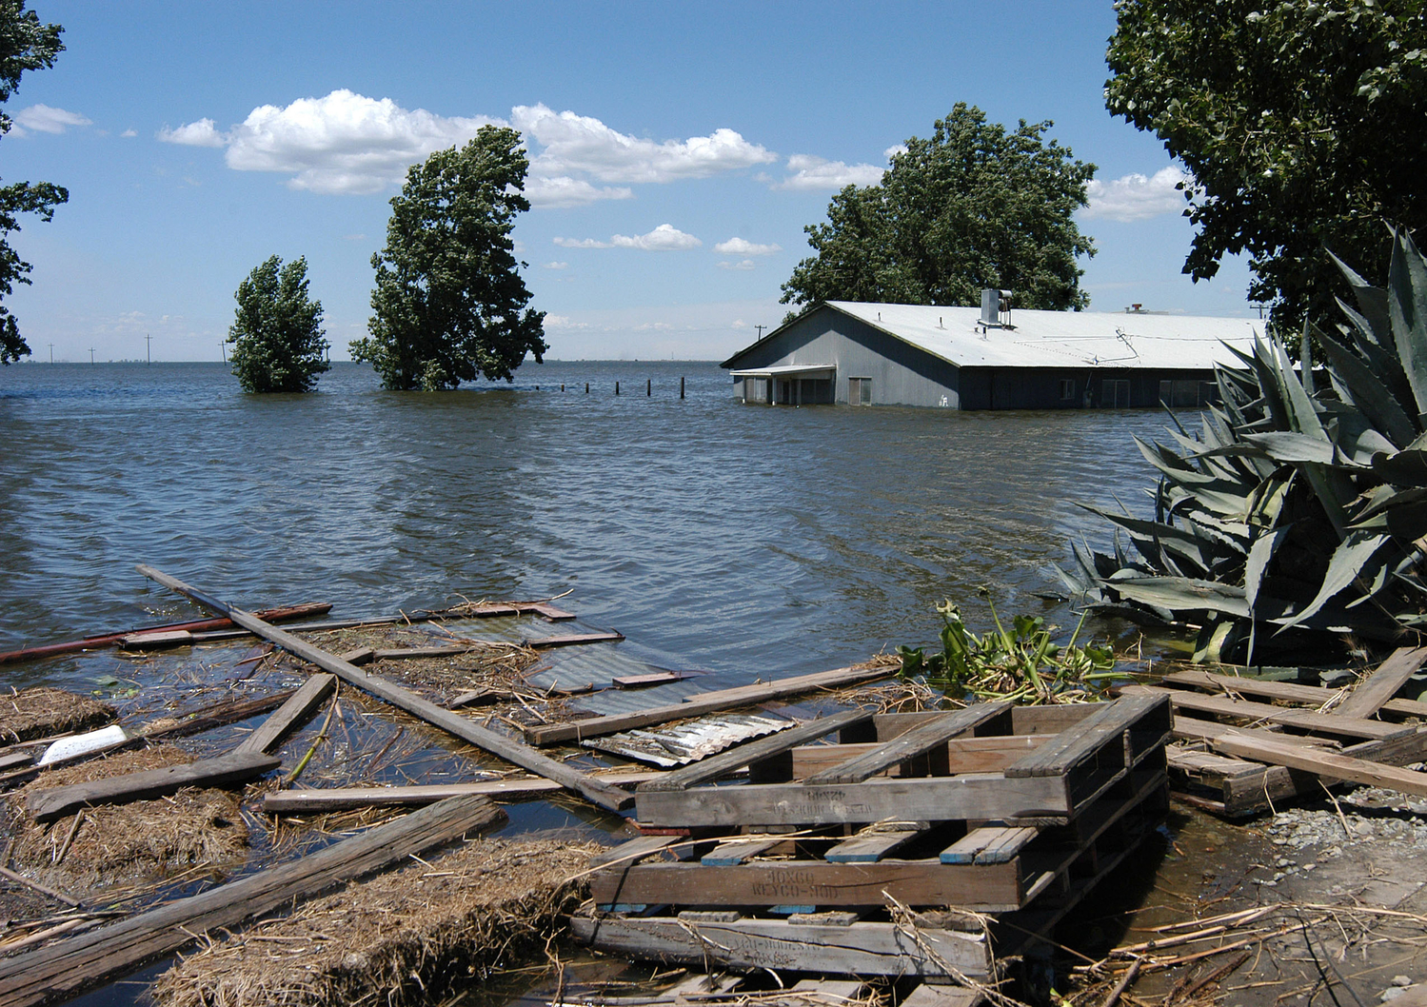

Slide 45
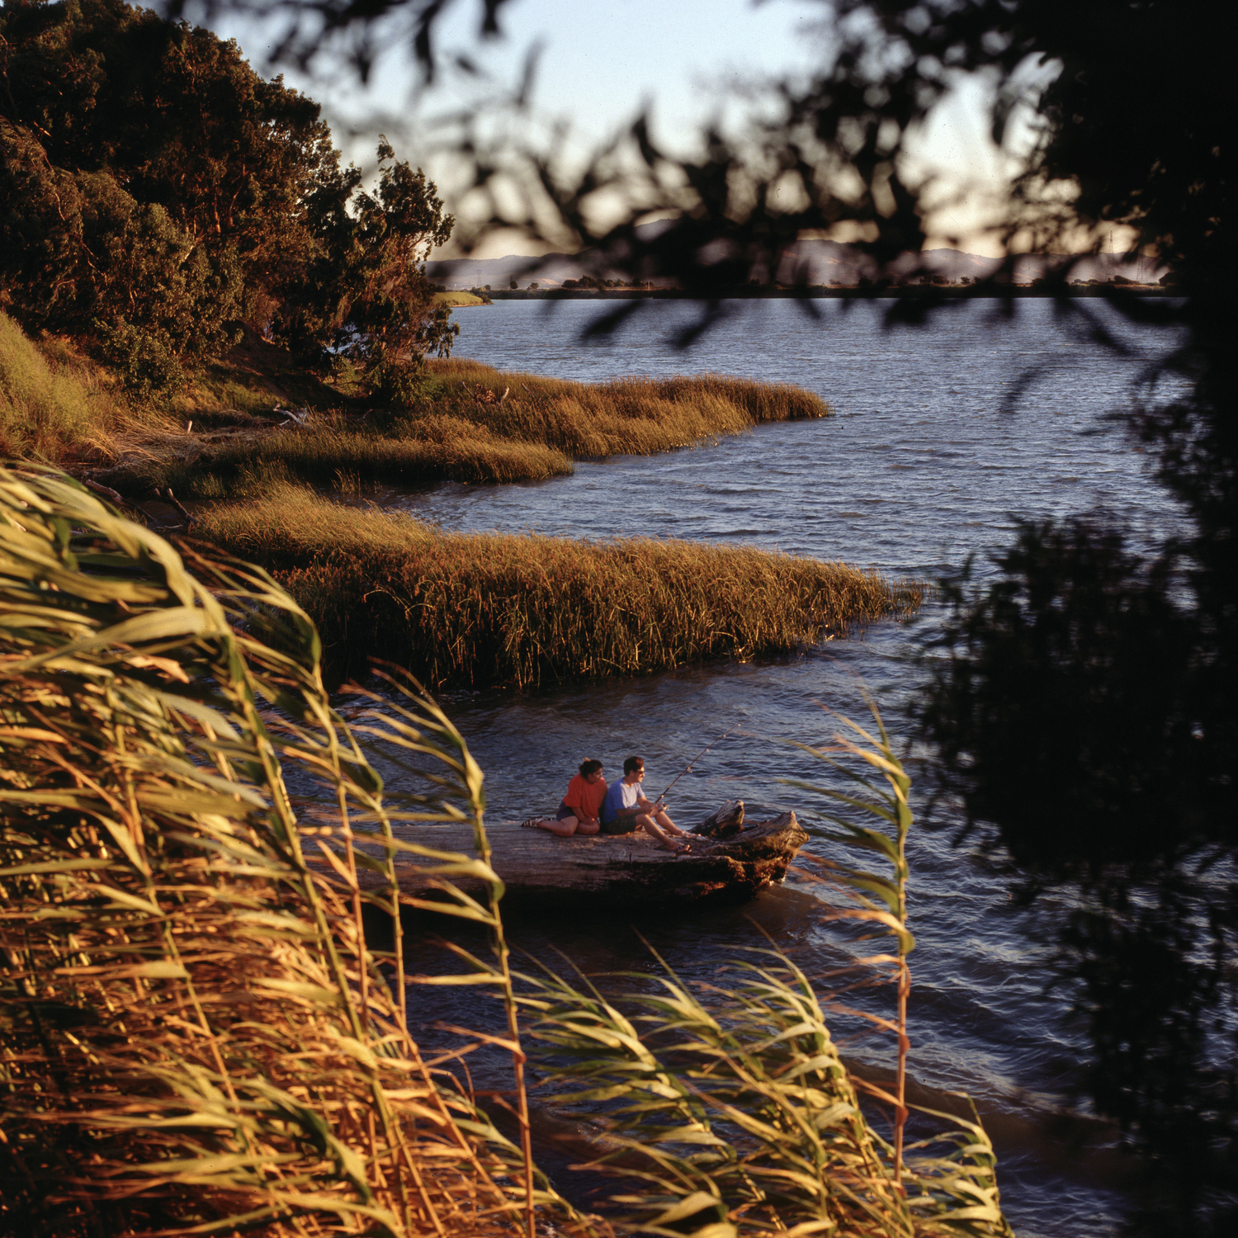

Slide 46
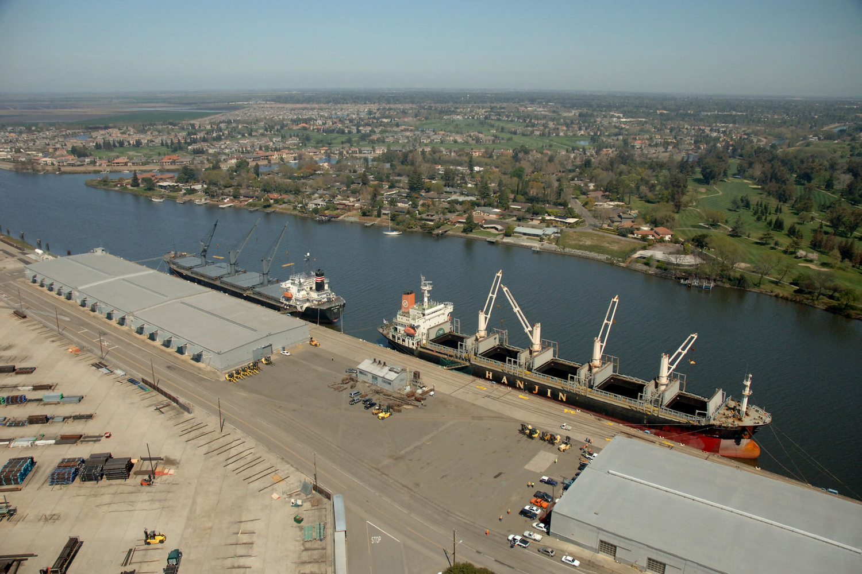

Slide 47
