Slide 1

Diversion Reporting and Measurement Regulation
Michael Patrick George, Delta Watermaster
Suisun Resource Conservation District Landowner Workshop
April 20, 2016

Slide 2

Reporting Requirements
Since Delta Reform Act of 2009
Every Diversion Must Report Use
  Originally due every third year
  Now, every year (currently, by June 30)
Statement of Diversion and Use
  STILL due, independent of new measurement requirement
  Non-filers risk loss of legal protection for the water right claim

Slide 3
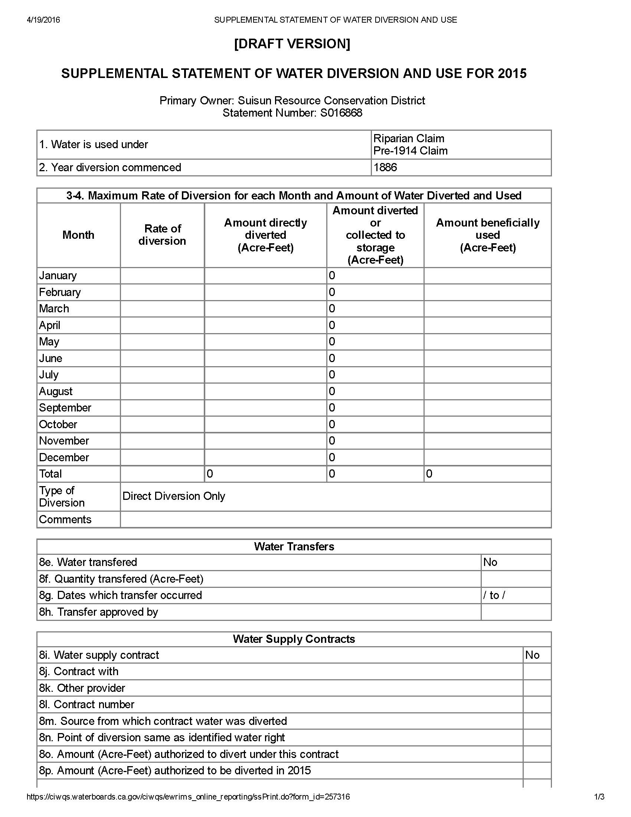

Slide 4
New Measurement Overview
New Regulation (Jan. 19) Implements SB 88
Applies to Every Claim to Use >10 Acre-feet/year
Sets Measurement Accuracy Performance Standard: ±10%
Comply with:
  Measuring Device or
  Measurement Method
In Circumstances where Standard Compliance is Infeasible
  Alternative Compliance Plan
  Specified Minimum Content
No Regulatory Approval
  Develop and Implement, Subject to Compliance Audit

Slide 5
Measuring Devices
No “Approved Devices”
Performance standards for both accuracy and monitoring frequency
Type of Diversion (af = acre-feet) | Installation Deadline | Required accuracy | Required Monitoring Frequency | Qualifications for Installation And Certification
Direct Diversion ≥ 1,000 af/year Storage ≥ 1000 af | January 1, 2017 | 10% | Hourly | Engineer/Contractor/Professional
Direct Diversion ≥ 100 af/year Storage ≥ 200 af | July 1, 2017 | 10% | Daily | Engineer/Contractor/Professional
Direct Diversion > 10 af/year Storage ≥ 50 af | January 1, 2018 | 15% | Weekly | Individual experienced with measurement and monitoring
Storage > 10 af | January 1, 2018 | 15% | Monthly | Individual experienced with measurement and monitoring

Slide 6
Measurement Methods
A Diverter May Employ a Measurement Method
  Must Meet the Same Performance Standard: ±10%
  Provides Flexibility to Adapt to Individual Circumstances
  Encourages Cooperation among Diverters on a Common System
  May be Simpler and More Economical than Meters
Examples:
  Meter at Point of Diversion with Allocation Formula to Each Claim
  Tidal Gate with Measurement Algorithm Tied to Published Tide Table
  Staff Gauge Coupled with Floodable Acreage, Monitoring and Recording
Methods for Larger Diversions Must Be Certified by a Professional

Slide 7
Enforcement
Outside the Delta: Water Board Division of Water Rights
Inside the Delta/Marsh: Delta Watermaster
Significant Civil Fines for Unlawful Diversion
Failure to Comply Jeopardizes Value of Water Right
Objective: Compliance Leading to Improved Administration of Scarce/Precious Resource

Slide 8
Alternative Compliance Plan
Available Only Where Conventional Compliance is Not Feasible
During Regulation Development SRCD Demonstrated Unique Circumstances in the Suisun Marsh
  Sought Exemption, which is Not Available
  Qualified for Alternative Compliance Plan
SRCD Is Cooperating with Watermaster to Develop an ACP
  Flexible, Consistent and Compliant
  Will be Available as an “Umbrella” for All Diverters
  Requires Affirmative “Opt In” for Protection
Those Who Do Not Opt In Must Comply Individually

Slide 9
Emerging Elements of ACP
Still in Development, so Input is Welcome
Describes the Setting and Range of Diversion Methods
Establishes Infeasibility of Conventional Compliance
Identifies Practical Strategies for Measurement, Monitoring and Reporting
Consolidates Administration at the SRCD Level
Requires Individuals to Opt In and Adhere to ACP

Slide 10
Landowner Options
Participate, Review and Evaluate ACP
“Opt In” or “Go It Alone”
Once You Opt In, You’re Covered
You Have the Opportunity to Drop Out
  Give Written Notice Rescinding Enrollment by 7/1
  Exit the ACP (Lose Coverage) on 10/1
Regardless of What Option You Choose for Measurement Compliance, EACH DIVERTER MUST STILL FILE ITS OWN ANNUAL STATEMENT OF DIVERSION AND USE BY JULY 1
  If You Opt In to the ACP, Make Sure Your Report is Consistent with the Plan

Slide 11
Current Draft of Opt In Form

Slide 12
Questions?
Contact: Lauren Barva, (916) 319-8264 or lauren.barva@waterboards.ca.gov

