Slide 1
Supplemental Statements of Water Diversion and Use
How to file the triennial reports
New Part 3: Monitoring Devices

Slide 2
2013 Supplemental Statement
Supplemental Statement form – January 1, 2013
  Triennial statement includes reporting years 2010-2012
    Contains the new measuring requirements
    Insertion of new Part 3 to Supplemental Statement Form
  July 21, 2011 workshop - guidance
  http://www.waterboards.ca.gov/waterrights/water_issues/programs/diversion_use/
    Examples of measurement devices
    Examples of alternative measuring methods
    List of vendors/suppliers

Slide 3
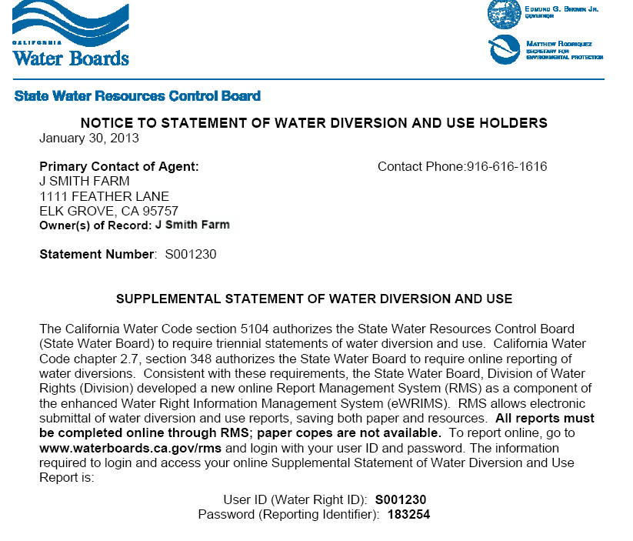

Slide 4
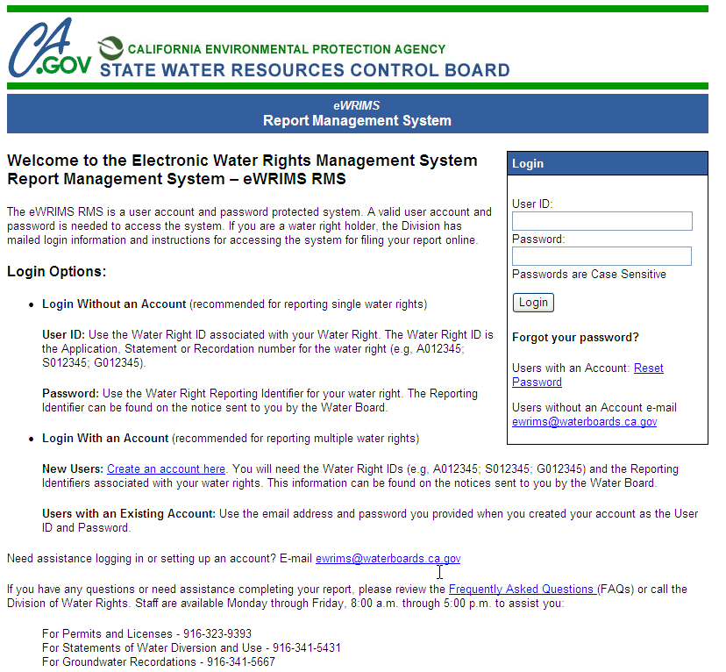

Slide 5
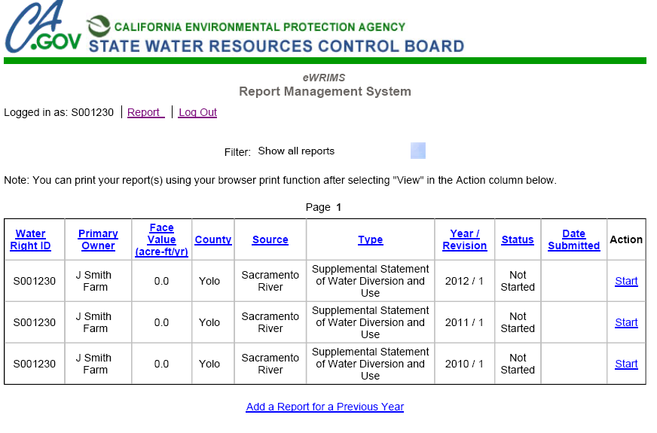


Slide 6
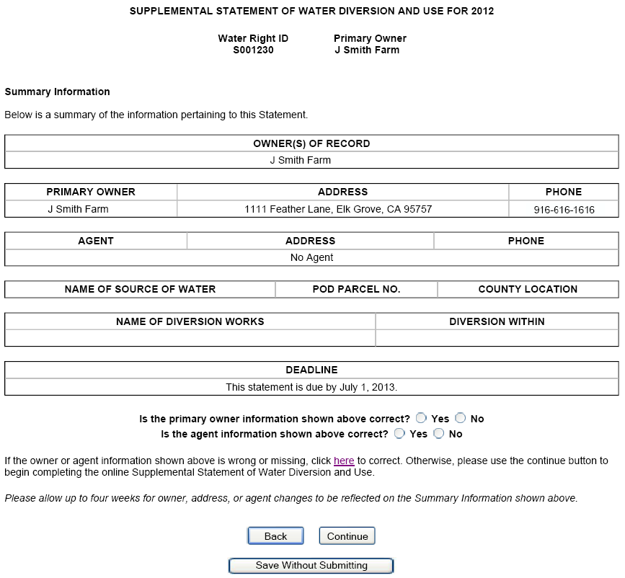


Slide 7
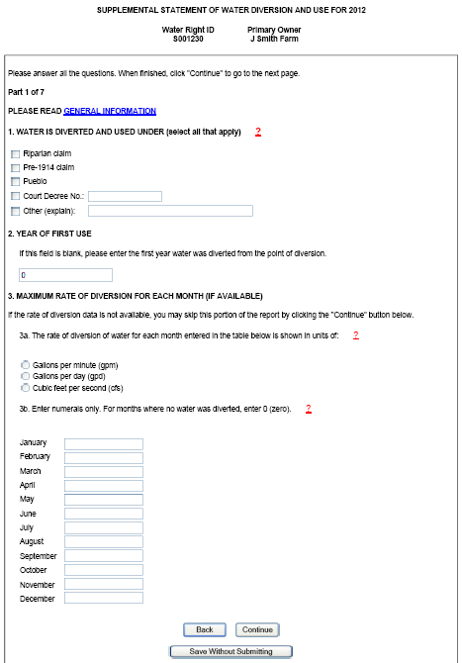
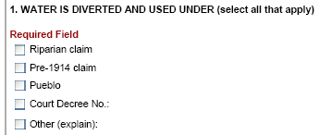

Slide 8
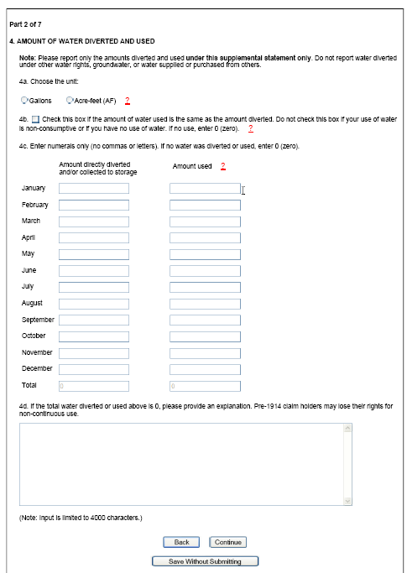
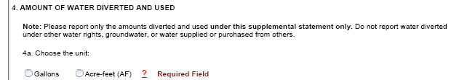
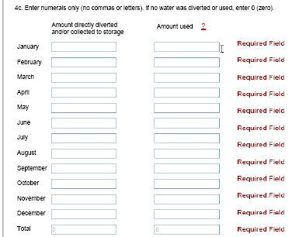

Slide 9
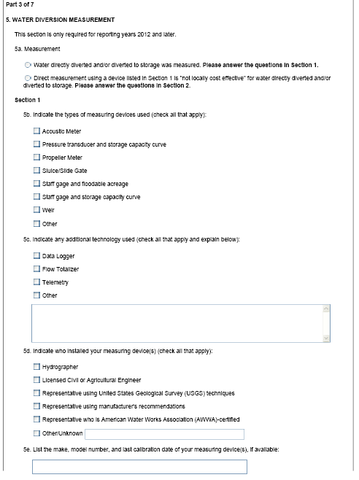
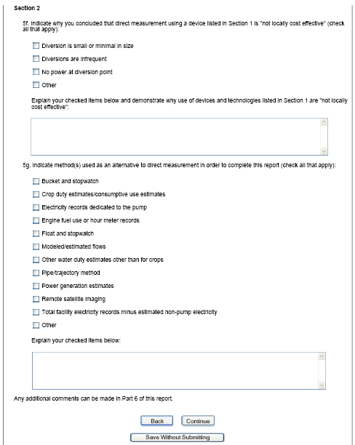

Slide 10
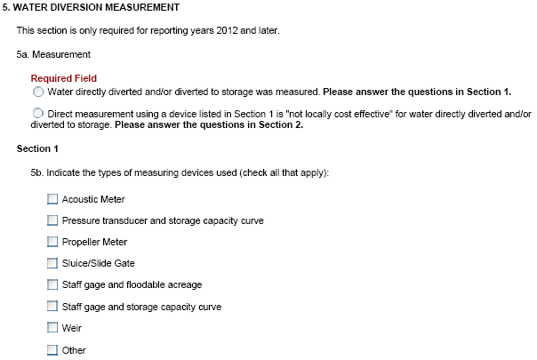

Slide 11
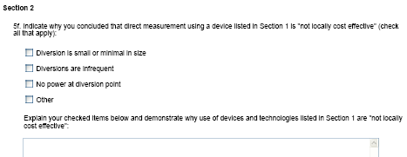
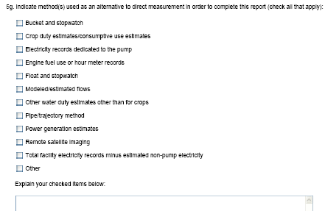

Slide 12
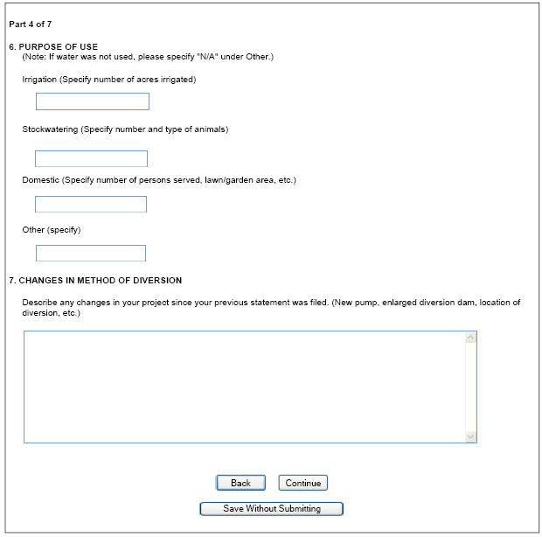


Slide 13
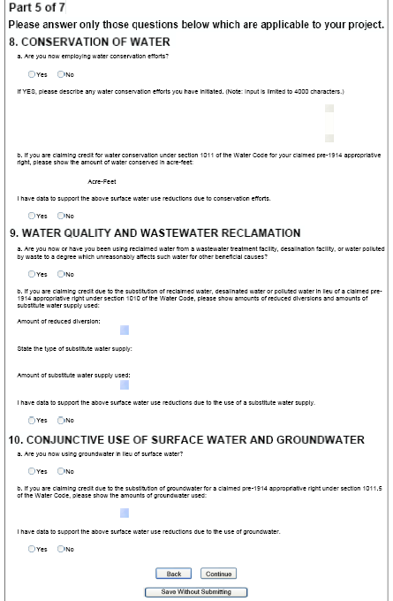

Slide 14
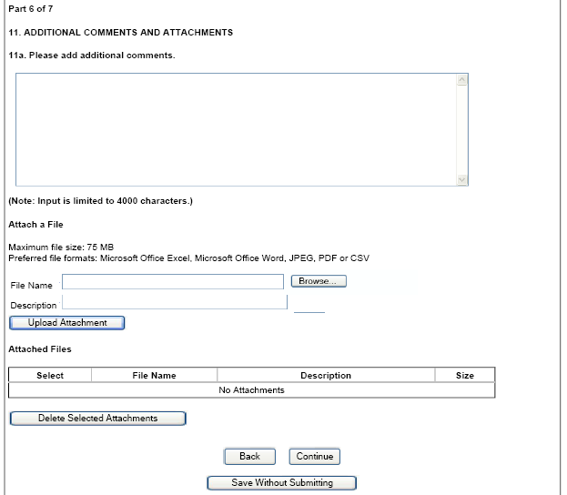

Slide 15
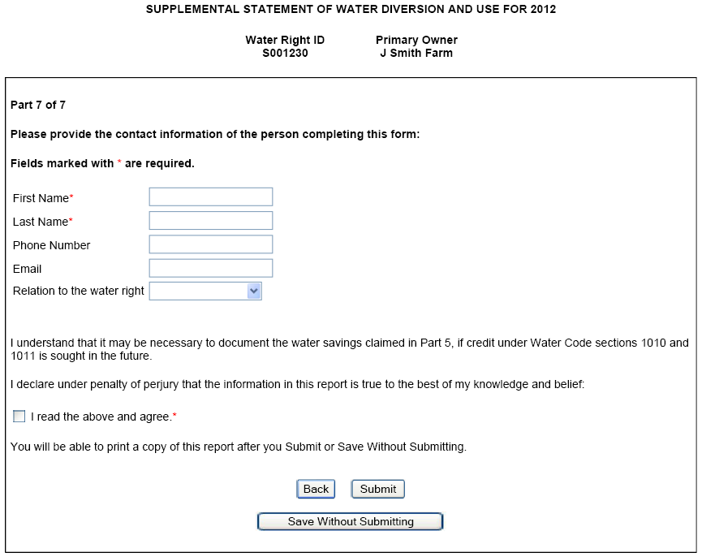

Slide 16
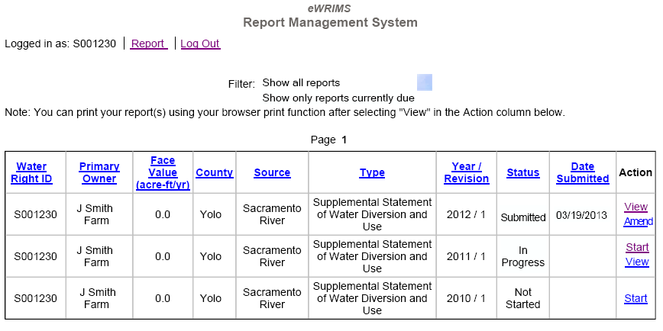



Slide 17
Reporting Penalties

Slide 18
Reporting Questions
How do I check the reporting status of my water right(s)?
  Go to the RMS login screen located at www.waterboards.ca.gov/rms and login with your water right User ID and password. On the summary page, change the filter setting for the reports from “Show all reports” to “Show only reports currently due”. Any reports that remain on the screen after this selection, will be the reports that need to be filed for the year for this water right. “Show all reports” will include all reports, those filed in prior years and all reports due.
  To check the status of a specific report, look at the Status column located in the reports table on the summary page. If the “status” box contains the words “Not Started”, the report has yet to be begun. If the “status” box contains the words “In Progress”, the report has been started, but not yet completed. If the “status” box contains the words “Submitted”, then the report has been filed.

Slide 19
Reporting Questions
When I try to log into the RMS Reporting system, why does an error message appear?
  The system is undergoing routine maintenance, the public will not be able to access the system. Wait one day to access the system. If the issue persists, please send an email to ewrims@waterboards.ca.gov .
How do I obtain a copy of my water right or previous filed report?
  Previous filed reports may be viewed or printed from the RMS system. Scanned copies of water rights are available at http://www.waterboards.ca.gov/water_issues/programs/ewrims/index.shtml . To obtain copies of water rights not yet scanned, please contact the Records Unit at 916-341-5421.

Slide 20
Reporting Questions
My password does not work. What should I do?
  If you have an account, click on “Reset Password” located on the login screen. For those without an account, double-check that the password relates to the correct water right ID. If it does, send an email to deltawatermaster@waterboards.ca.gov requesting a reset.
I have logged out of the RMS system and want to file a report for a different water right. Why does the screen show the data for the previous water right?
  The system still retains the record for the previous water right. To completely exit out of the system, log out of the system and exit the browser or close the web page screen. Return to the login screen and input the next water right ID and Password.

Slide 21
Reporting Questions
I no longer divert water under a water right. How do I notify the State Water Board?
  Please submit an email to changerequest@waterboards.ca.gov or letter to the State Water Board containing a request to cancel the water right, your name, and the associated water right number.
I no longer own the property associated with a water right. How do I notify the State Water Board of the new owner?
  Please complete an ownership change request form located at (http://www.waterboards.ca.gov/waterrights/publications_forms/forms/docs/noticeofassgnform.pdf) and email the form to changerequest@waterboards.ca.gov or send a letter to the State Water Board with the new owner’s information: name, address, and phone number, along with the associated water right number, and if available, the Assessor’s Parcels Number(s).

Slide 22
Reporting Questions
Why do I have to report monthly measuring information about my water diversion?
  In 2009, the California Senate passed new measuring requirements that beginning in January 2012. As a result, filers filing the supplemental statements in 2013 are required to include monthly measuring records made using monitoring devices or alternative measuring methods for the 2012 reporting year.
What if I do not have a measuring device for my diversion?
  You may use an alternative measuring method instead of direct measurement with a device. Examples of and/or measuring methods are available on the State Water Board website at http://www.waterboards.ca.gov/waterrights/water_issues/programs/diversion_use/wm_alt_mthds.shtml

Slide 23
Reporting Questions
Why do I have to file the supplemental statement online when I filed the initial statement on paper?
  Initial Statements of Water Diversion and Use can only be filed on paper (http://www.waterboards.ca.gov/waterrights/water_issues/programs/diversion_use/faqs.shtml) . The State Water Board adopted regulations in 2011 that require the annual and triennial reports to be filed electronically.
What do I do if I do not have a computer?
  You may have someone, such as a family member or neighbor file on your behalf. Public libraries have computers available for the public to use. You may also use one of the computers available for public use located in our Records Unit in Sacramento. Contact our Records Unit at (916) 341-5421 to schedule an appointment.

Slide 24
Reporting Questions
Are there any annual fees for statements?
  No, there are none. However, if you have a current water right on file with the State Water Board, failure to file the required reports may be subject to enforcement action. For statements, there is an immediate penalty for failure to file the triennial supplemental statements.

Slide 25
Questions?
Please email any questions and or comments to deltawatermaster@waterboards.ca.gov .

