Slide 1

HR2W Portal Workgroup
Consists of State Board Divisions and Offices
To create datasets and maps and make the information available to the public
To establish metrics defining what it means for Californians to have water that is safe, clean, affordable, and accessible
Notes:
GOOD MORNING!!!
Since our last Board update, I am happy to inform you that our HR2W portal workgroup is still very active and continue to meet on a monthly basis.
We are continuing to explore ways to develop performance measures that define what it means for Californians to have water that is 1) safe and clean, 2) affordable, and 3) accessible using the data we have available to us and display those metrics in a transparent and legible manner on the Portal.
Additionally, we continue to reach out to our NGO, EJ and other external partners for input with this project when new metrics are explored and developed.

Slide 2
HR2W Portal Updates
Reconfigured website; user friendly navigation with organized tabs
Map improvements
Added state-only violations to the exceedance/compliance status data set and map
Included more resources and links of interest to the public
Included list of water systems compliance status
Notes:
Since the launch of the Portal February of last year, the improvements that are worth noting are:
The redesigned website, which was the result of a requirement to update the webpage to a new platform in late 2017. This allowed the workgroup to reconfigure the Portal so it is more organized and easier to navigate.
The exceedance/compliance map improvements, which included:
adding additional layers to give users the ability to visualize our data using other boundaries (i.e. Regional Boards, Federal congressional districts, State senate and assembly districts boundary layers)
adding a widget that allows users to add additional reference layers to the map.
one of the largest changes visually that we made is using grey circles for systems that are in compliance or have RTCd since 2012 and the out-of-compliance systems continue to be red stars. We were starting get a sense that users more interested in the red stars only and the other colors were distracting from what was important based on feedback and data inquires.
State-only MCL violations are now included in the exceedance/compliance status data set and map (including chemicals like perchlorate, 1,2,3-trichloropropane were added to the dataset). Last year’s data set only included violations of a federal primary drinking standard.
Links/sections added/improved:
Improved the success stories section-merged our previous consolidation success stories with the new the DDW’s consolidation website→link is being provided
Created a media section where articles relate to the HR2W efforts in CA and are posted there
Added a summary of water systems’ compliance status (excel file) to the Compliance Status tab
Added downloadable GIS map data to the Water Data tab.

Slide 3
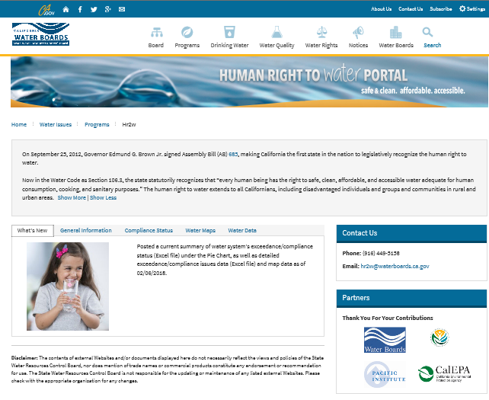
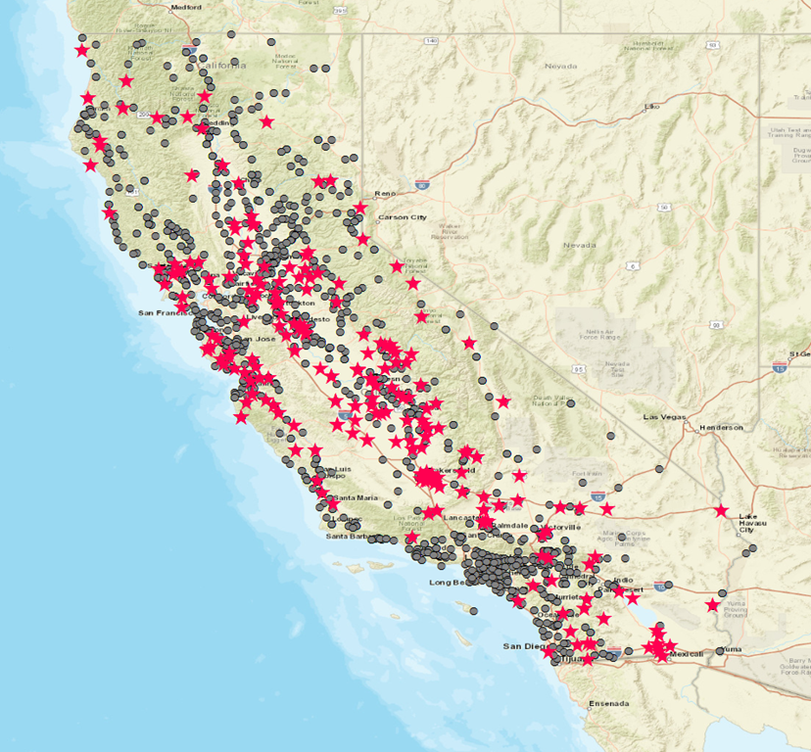
HR2W Portal Workgroup
Notes:
These are screenshots of the new layout of the Portal and the symbol change that was applied to the exceedance/compliance status. Portal→ one page to sections are tabbed Map→ RTC and in compliance systems are grey and out of compliance systems are still the red stars.

Slide 4
HR2W Portal Next Steps
Respond to Portal inquires
Improve the Portal based on stakeholder feedback
Improve the data quality
Expand the current data set
Accessibility section
Affordability section
Notes:
The workgroup’s next year goals are:
Continue to provide timely responses to inquiries and public record act requests through the Portal;
Continue to improve the Portal based on internal and external feedback, especially the comments about improving our data gaps and making the Portal more user friendly by presenting the information in ways that would be beneficial to all stakeholders. Begin gathering website usage statistics and see if there a way to market the Portal or how the Portal needs to be modified to meet the audience using it;
Continue to improve the data quality by collaborating with our DDW regulators and DDW data management unit on possible data errors→ that are found through Portal inquiries or the data uploading process.
Expand the data sets to include monitoring and reporting and rTCR violations, and disadvantage communities information
We are continuing to collaborate with our internal and external stakeholders to address the accessibility and affordability sections to ensure we are all on the same path.

