Slide 1
Overview of Draft Report by Statewide Advisory Committee on Cooling Water Intake Structures
Inter-Agency Working Group
SACCWIS Meeting
March 27, 2014

Slide 2
OTC Compliance and Infrastructure Planning
SACCWIS review of adopted OTC facility compliance dates for infrastructure realities is a key element of adopted OTC policy.
CPUC, ISO and CEC continue to assess resource, infrastructure and reliability needs.
  CPUC Long-Term Procurement Plan (LTPP)
  ISO Transmission Planning Process (TPP)
  CEC Application for Certification Process (AFC)

Slide 3
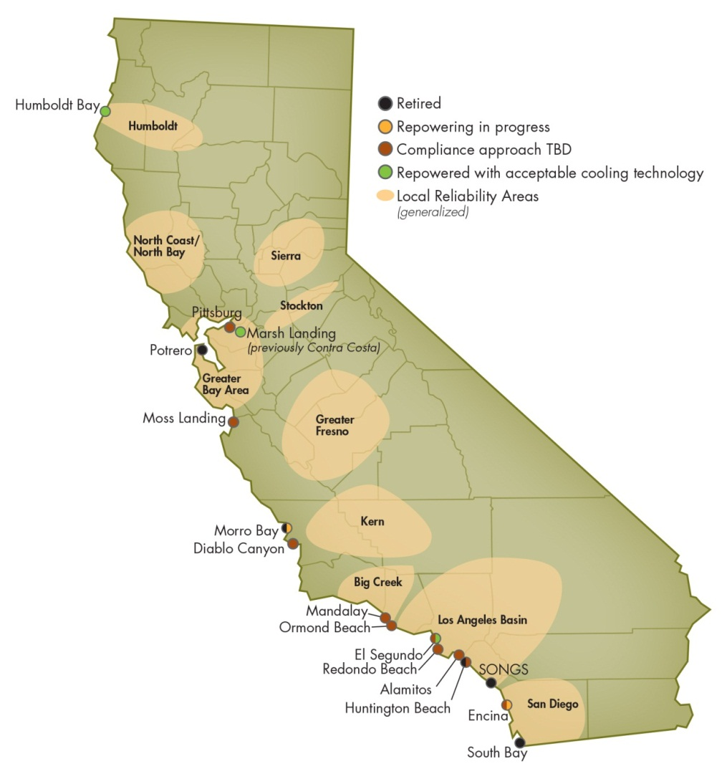
ISO Local Capacity Areas (LCA) and Once-Through Cooling Plants

Slide 4
Operational Developments
June 7, 2013 - Southern California Edison (SCE) announced the closure of SONGS.
May 1, 2013 - NRG Energy retired Contra Costa Power Plant Units 6 and 7 concurrent with bringing Marsh Landing Generating Station on line
August 1, 2013 - NRG brought El Segundo Repowering Project, consisting of two combined cycle facilities that use dry air cooling, online. As part of that repowering, NRG retired Unit 3.
February 5, 2014 - Dynegy closed the Morro Bay Power Plant.

Slide 5
CEC Actions (AFC)
Alamitos - application data adequate; review underway
Huntington Beach - Preliminary Staff Analysis, Part A complete; Part B expected March 2014
Redondo Beach – application data adequate; staff analysis and discovery underway
El Segundo – Petition to Amend El Segundo Energy Center license to replace Unit 4
Carlsbad Energy Center – license approved in May 2012 to replace three Encina units; expecting petition to amend permit for new design as peaking units and remove units 1-5.

Slide 6
CPUC Actions (LTPP)
In separate decisions the CPUC authorized:
  SCE to procure 1400-1800 MW of new resources in the LA Basin LCA and 215 to 290 MW in the Big Creek / Ventura LCA;
  SDG&E to procure 343 MW of new resources, including the repower of 45 MW at Escondido; and
  SCE to procure 500-700 MW in the LA Basin and SDG&E to procure 500-800 MW to meet local capacity needs stemming from the retirement of SONGS.

Slide 7
ISO Actions
Filed testimony in CPUC LTPP after cooperatively establishing modeling assumptions; CPUC relied upon this testimony and that of other parties in authorizing procurement in LA Basin and San Diego LCAs.
ISO has identified several transmission upgrades and additions in the 2013-2014 transmission plan to help address local reliability issues associated with the compliance schedule under the OTC Policy and the closure of SONGS (approved by ISO Board on March 20, 2014).
CPUC, ISO and CEC intend to evaluate interaction of projected on line dates, resource locations and projected retirements.

Slide 8
Pittsburg (2017)
Units 5-6 are twin 340MW steam boilers; unit 7 is 720MW with cooling towers.
Pittsburg is not required for local capacity reasons once transmission upgrades occur.
Based on current information, upgrades will be completed in time to allow the Pittsburg units to comply with the OTC Policy on schedule.
SACCWIS does not recommend a change in compliance dates.

Slide 9
Moss Landing (2017)
Moss Landing is the single largest power generating facility in California (2500MW).
  Units 5-6 are old steam boilers, 750MW each.
  Units 1-2 are new combined cycles, 500MW each.
ISO operating procedures currently assume that plant is operated under high peak load conditions for the Greater Bay Area.
ISO modeling Units 1 and 2 offline after 2017 and will provide results of studies to SACCWIS.
SACCWIS does not recommend a change in compliance dates at this time.

Slide 10
Ormond Beach (2020)
Consists of two steam boiler units with total combined capacity of 1,486 MW.
CPUC authorized 215-290 MW in area where Ormond Beach and Mandalay are located.
NRG is evaluating replacement project and reports it is on track to comply with OTC policy by December 31, 2020.
ISO modeling plant offline after 2020 and will provide results of studies to SACCWIS.
SACCWIS does not recommend a change in compliance dates.

Slide 11
Mandalay (2020)
Units 1 & 2 use once-through cooling; 215 MW each.
CPUC authorized 215-290 MW in area where Ormond Beach and Mandalay are located.
NRG is evaluating replacement project and reports it is on track to comply with OTC policy by December 31, 2020.
ISO modeling 290 MW of proxy resources and will provide study results to SACCWIS.
SACCWIS does not recommend a change in compliance dates.

Slide 12
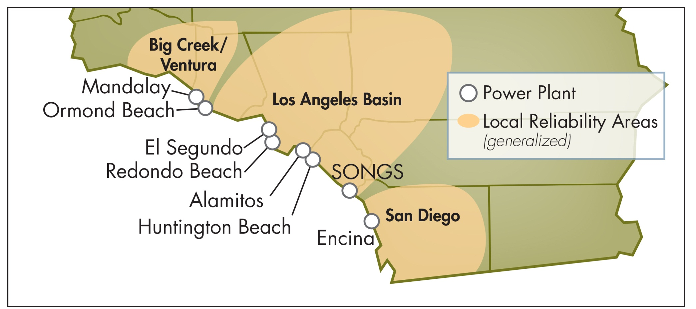
Los Angeles Basin and San Diego
Local Capacity Areas
Note:
Map does not reflect 2,895 MW of OTC capacity in LADWP’s balancing authority area.

Slide 13
El Segundo (2015)
El Segundo unit 3 retired August 1, 2013 as part of repowering project.
El Segundo 4 is a 335MW steam boiler still in operation.
NRG stated it will retire unit 4 no later than December 31, 2015.
NRG has submitted an AFC to repower Unit 4; unit must be removed in order to repower.
ISO intends to model Unit 4 as offline starting in 2015.
SACCWIS does not recommend a change in compliance dates for unit 4.

Slide 14
Encina (2017)
Consists of five steam boiler generating units using once-through cooling with an aggregate capacity of 950 MW.
NRG received permit for Carlsbad Energy Center Project (CECP) from CEC in June 2012 for 550 MW combined cycle plant to replace Units 1-3. NRG seeking to redesign CECP as set of peaking units – requires amendment to permit.
ISO modeled Encina offline at end of 2017 – identified need for new resources to satisfy regional reliability requirements for summer 2018.
SACCWIS will continue to monitor and bring forward any recommended compliance date change based on more complete information.
SACCWIS does not recommend a change in compliance dates

Slide 15
Alamitos (2020)
Consists of six units; total capacity is approximately 2,000 MW
Proposed repowering project consists of natural-gas fired, combined-cycle, air-cooled electrical generating facility with a net generating capacity of 1,936 MW
AFC process underway at CEC.
ISO intends to model Alamitos offline after 2020 and will provide results of studies to SACCWIS.
SACCWIS does not recommend a change in compliance dates.

Slide 16
Huntington Beach (2020)
Units 3 & 4 retired on October 31, 2012 and converted to synchronous condensers in 2013. Units 1 & 2 226 MW each.
Proposed repowering project impacts both Huntington Beach and Redondo Beach
  Retirement of Redondo Beach Units 6 & 8 enables repowering of first power block (470 MW) by 4th quarter 2018.
  Retirement of synchronous condensers in December 2017 to enable repowering of second power block (469 MW) by 1st quarter 2021.
  AES anticipating need for extension to December 31, 2022 due to potential need for synchronous condensers in 2018 .

Slide 17
Huntington Beach (continued)
AFC process underway.
ISO intends to review two issues:
  Need for synchronous condensers at Huntington Beach Units 3 and 4 in 2018; and
  Need for the maximum generating capacity and/or voltage support at Huntington Beach.
SACCWIS does not recommend a change in compliance date at this time.

Slide 18
Redondo Beach (2020)
Consists of four units; total capacity is approximately 1,300 MW
AES proposing to shut down Units 6 & 8 by 2018 to utilize exemptions from offsets of SCAQMD Rule 1304(a)(2) to bring first phase of Huntington Beach repowering online in 2018.
Proposed repowering project is a natural-gas fired, combined-cycle, air-cooled electrical generating facility with a net generating capacity of 496 MW.
CEC currently conducting analysis and discovery regarding AES’s application
ISO intends to model Redondo Beach offline after 2020 and will provide results of studies to SACCWIS.
SACCWIS does not recommend a change in compliance dates.

Slide 19
Conclusions
No recommendations for compliance date changes are proposed at this time.
Further analyses are needed.
The Water Board should recognize that it may be necessary to modify final compliance dates for generating units.

