Slide 1
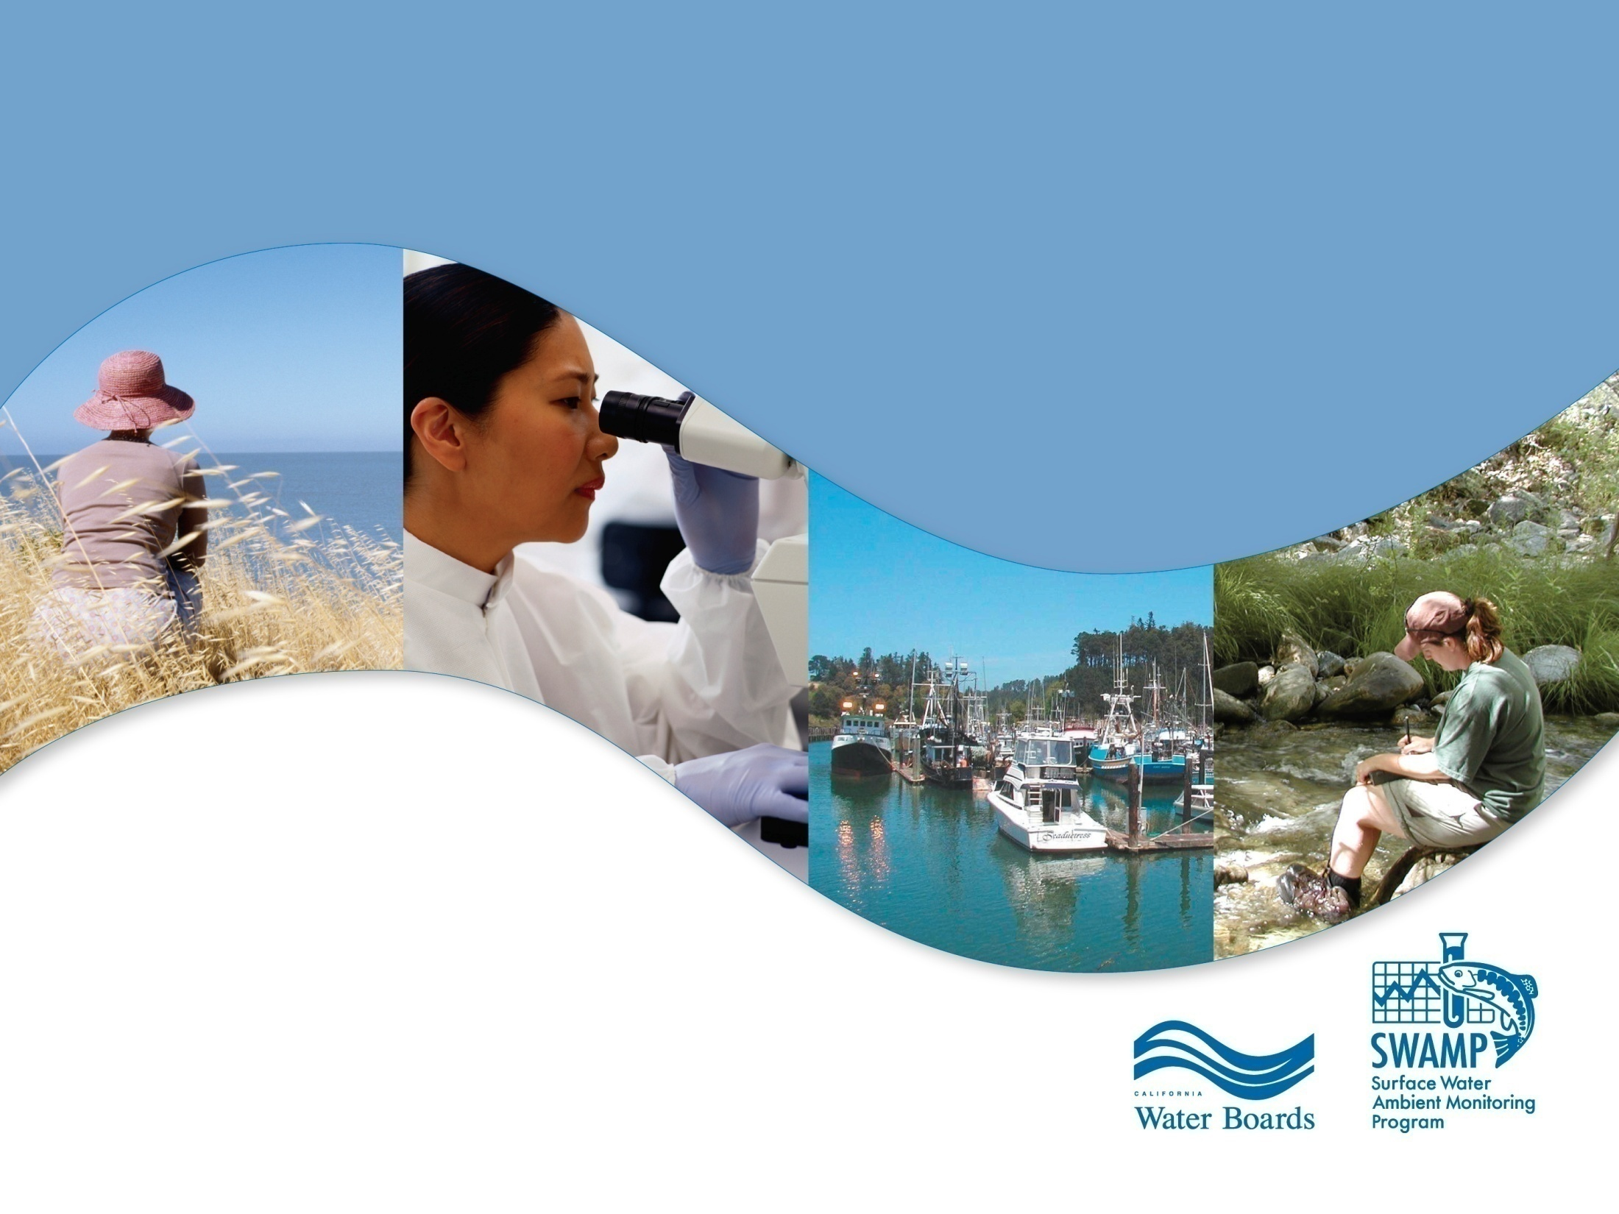
California’s Surface Water Ambient Monitoring Program (SWAMP)
Freshwater Harmful Algal Blooms (HABs) in California and SWAMP's Statewide Strategy
CCHAB Network
January 21, 2016
Beverley Anderson-Abbs
SWAMP – OIMA
Beverley.Anderson-Abbs@waterboards.ca.gov
Notes:
Good afternoon. I am Beverley Anderson and I work for the State Water Board in the Surface Water Ambient Monitoring Program, or SWAMP and the Lead on a number of cyanobacteria harmful algal bloom projects being funded by SWAMP.
My talk will be a little different from future talks as there won’t be a lot of emphasis on data visualization. Since this program is so new, we are still working to build the infrastructure needed to collect and analyze data.

Slide 2
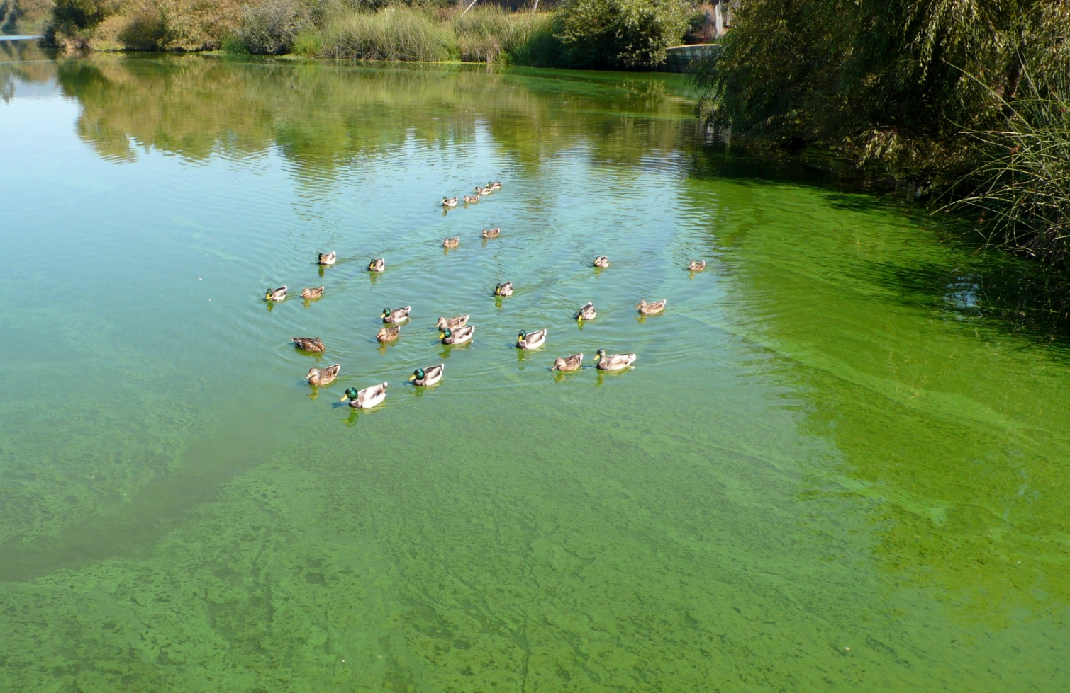
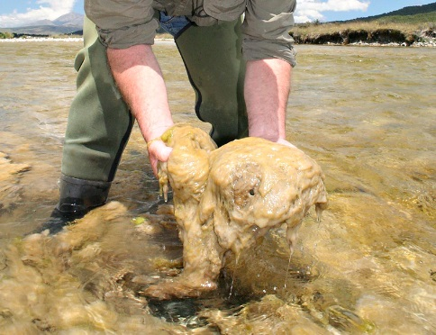
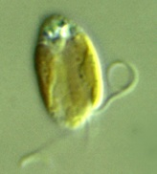
Cyanobacteria and other Freshwater HABs
Cyanobacteria (formerly called blue-green algae)
Occur in most waterbodies (fresh, brackish, marine)
Exist as single cells or as colonies
Can form dense blooms
  Potentially harmful (harmful algal bloom, HAB)
Other HABs
Prymnesium parvum (fish kills)
Didymosphenia germinate (Adverse effects on fish and invertebrate populations)
Notes:
Cyanobacteria, or blue-green algae, are found in most kinds of waterbodies and world wide
They can exist as single cells or as colonies and can form blooms that cover entire lakes. In September last year there was a bloom 600 miles long in the Ohio River. And the Klamath has seen the effects of blooms through up to almost 200 miles of river.
Some of these blooms are relatively harmless, although they may be unsightly and be associated with taste and odor chemicals,
but some release one or more toxins that can cause skin irritation, liver damage, and in the case of one toxin, Anatoxin-a can cause very rapid onset of symptoms such as vomiting and convulsions, and even death in dogs and livestock that ingest it.
There are also some non-cyanobacteria species that can form harmful algal blooms like Prymnesium or golden algae, which produces toxins that have caused massive fish kills.
This week a fish kill was reported from a reservoir in Nevada that could affect the recreational fishing there for several years, and we’ve seen similar fish losses in some lakes in southern California from Prymnesium.

Slide 3

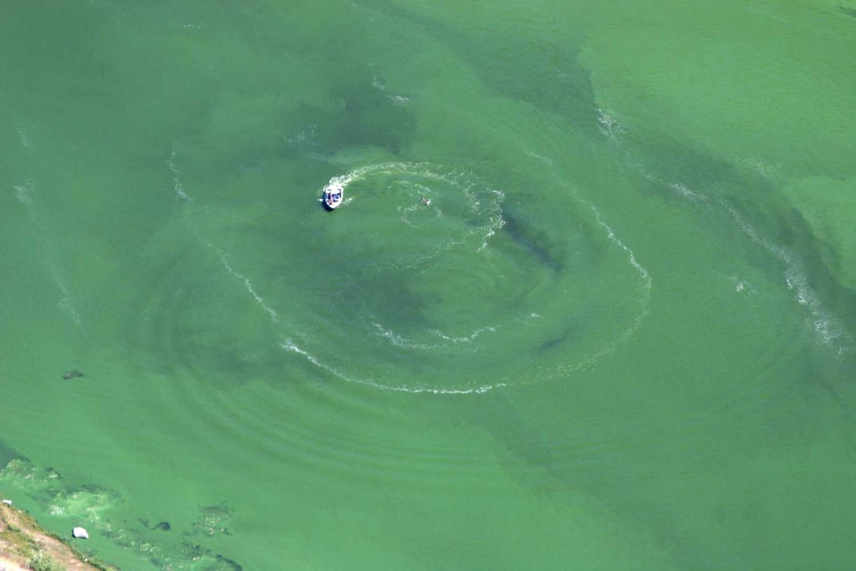
Why California needs a Freshwater Harmful Algal Bloom (HAB) Strategy
HABs increasing worldwide and in California
Increasing water temperatures
  High nutrient concentrations
  Drought – less water, low flows
HABs create significant water quality issues
There is a California marine HABs program
Notes:
Because of these increases in frequency and severity of HABs statewide and the fact that there was no consistent program to address them, it was identified that California was in need of a freshwater HAB strategy
These increases have variously been linked to:
Increasing Temperatures
High nutrients loads that support bloom growth
And the current drought, with subsequent low flows and warmer slow moving water where blooms tend to build up
Since there has been a marine HABs program, started as a requirement by FDA, for decades, the SWAMP program was developed with a focus on fresh water systems.

Slide 4
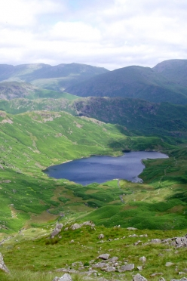
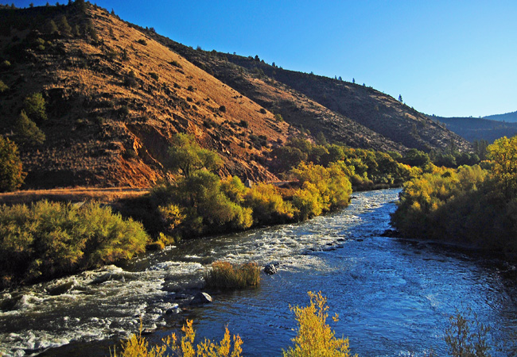
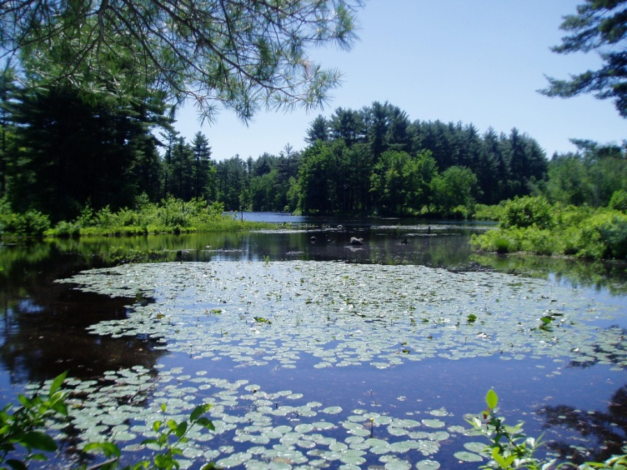
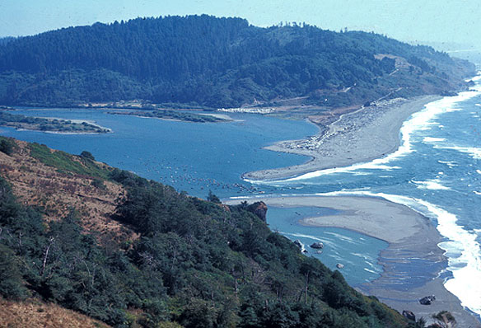
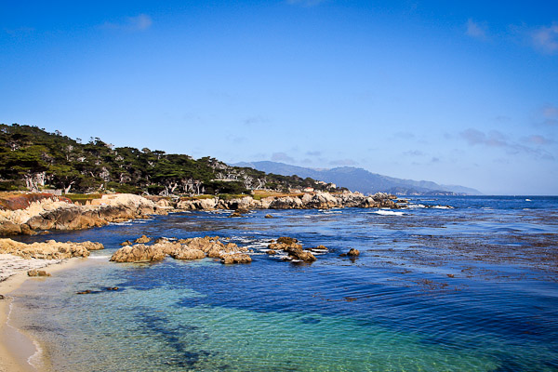
Where are they?
Lakes
Rivers and streams
Wetlands
Estuaries
Marine waters
Notes:
Cyanobacteria generally originate and bloom in fresh water bodies such as lakes and wetlands. However, blooms can also occur in rivers and streams.
In addition, rivers and streams can act as a conduit, delivering cyanobacteria and their toxins to other areas downstream, such as estuaries and marine waters.

Slide 5
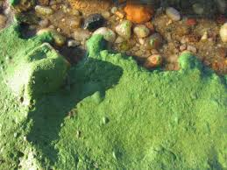
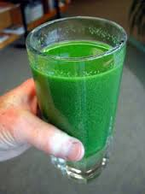
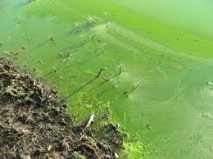
Microcystis
Most common toxic cyanobacteria
Produces microcystins
Microcystin human health thresholds
  OEHHA recreation = 0.8 ug/L
  USEPA drinking water = 0.3 ug/L
Notes:
The most common toxic cyanobacteria in California is Microcystis. It can produce several toxins, with variations of microcystins as its primary toxin. Other cyanobacteria can also produce microcystins.
In 2012 OEHHA set a recreational human health action level for microcystins of 0.8 ug/L
And just last year, USEPA set a drinking water human health advisory for microcystins of 0.3 ug/L

Slide 6
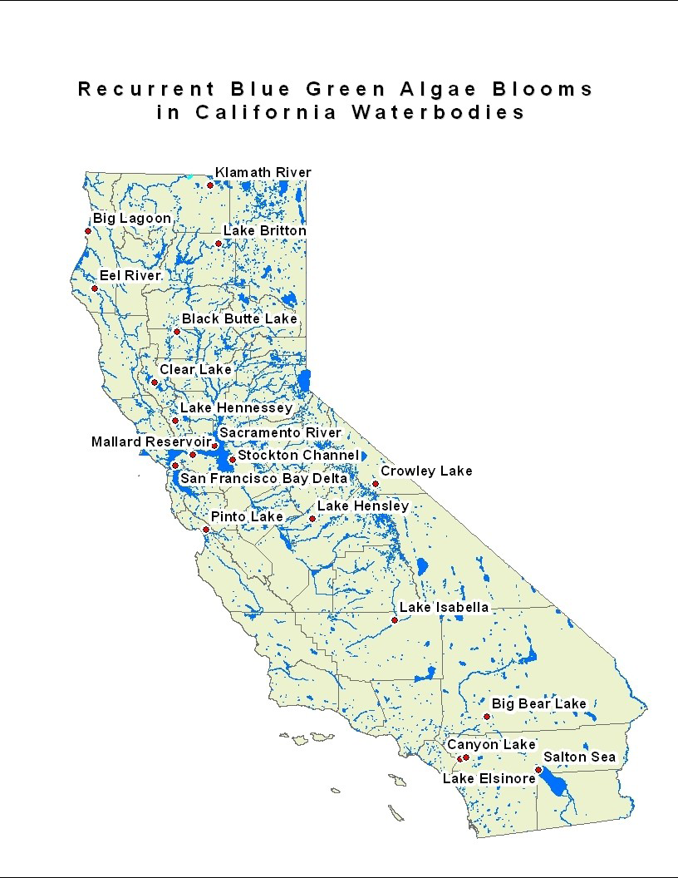
Areas in California with
Recurrent Toxic Algae Blooms
Klamath Basin
OEHHA
Fact Sheet
Clear Lake
San Francisco Bay area/Delta
Pinto Lake/Monterey Bay
Revision of Office of Environmental Health Hazard Assessment (OEHHA) Fact Sheet (2012)
Southern California
Prymnesium “Golden algae”
Notes:
We have several hot spots in California, where toxic algae blooms have been recurrent, including the Klamath, Clear Lake, Pinto Lake, and the San Francisco Bay area and East Bay Lakes,
but we are starting to see blooms and toxins in lakes and rivers that have not previously experienced them. And Southern California Lakes have been experiencing blooms of Golden Algae, which are causing massive fish kills.
I will quickly go over some of these hot spots in the next few slides

Slide 7
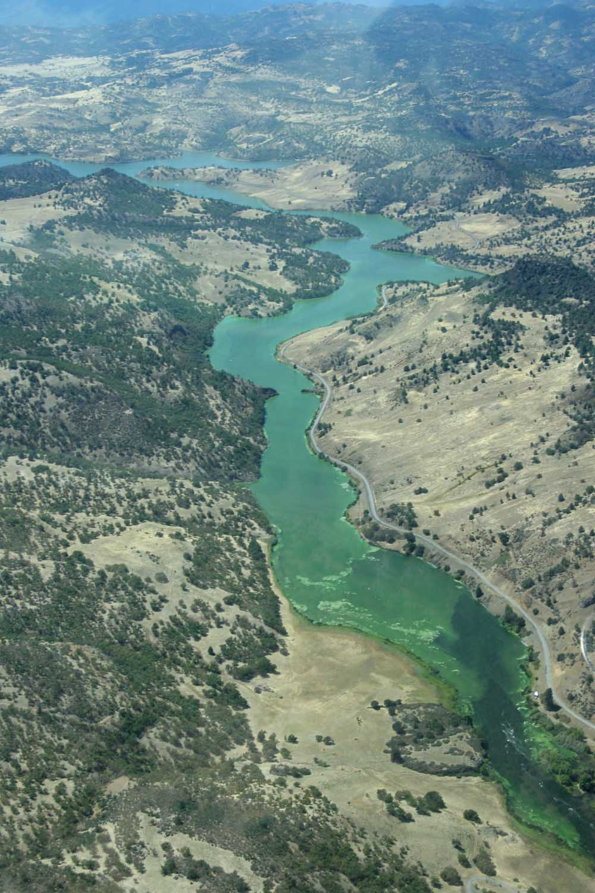
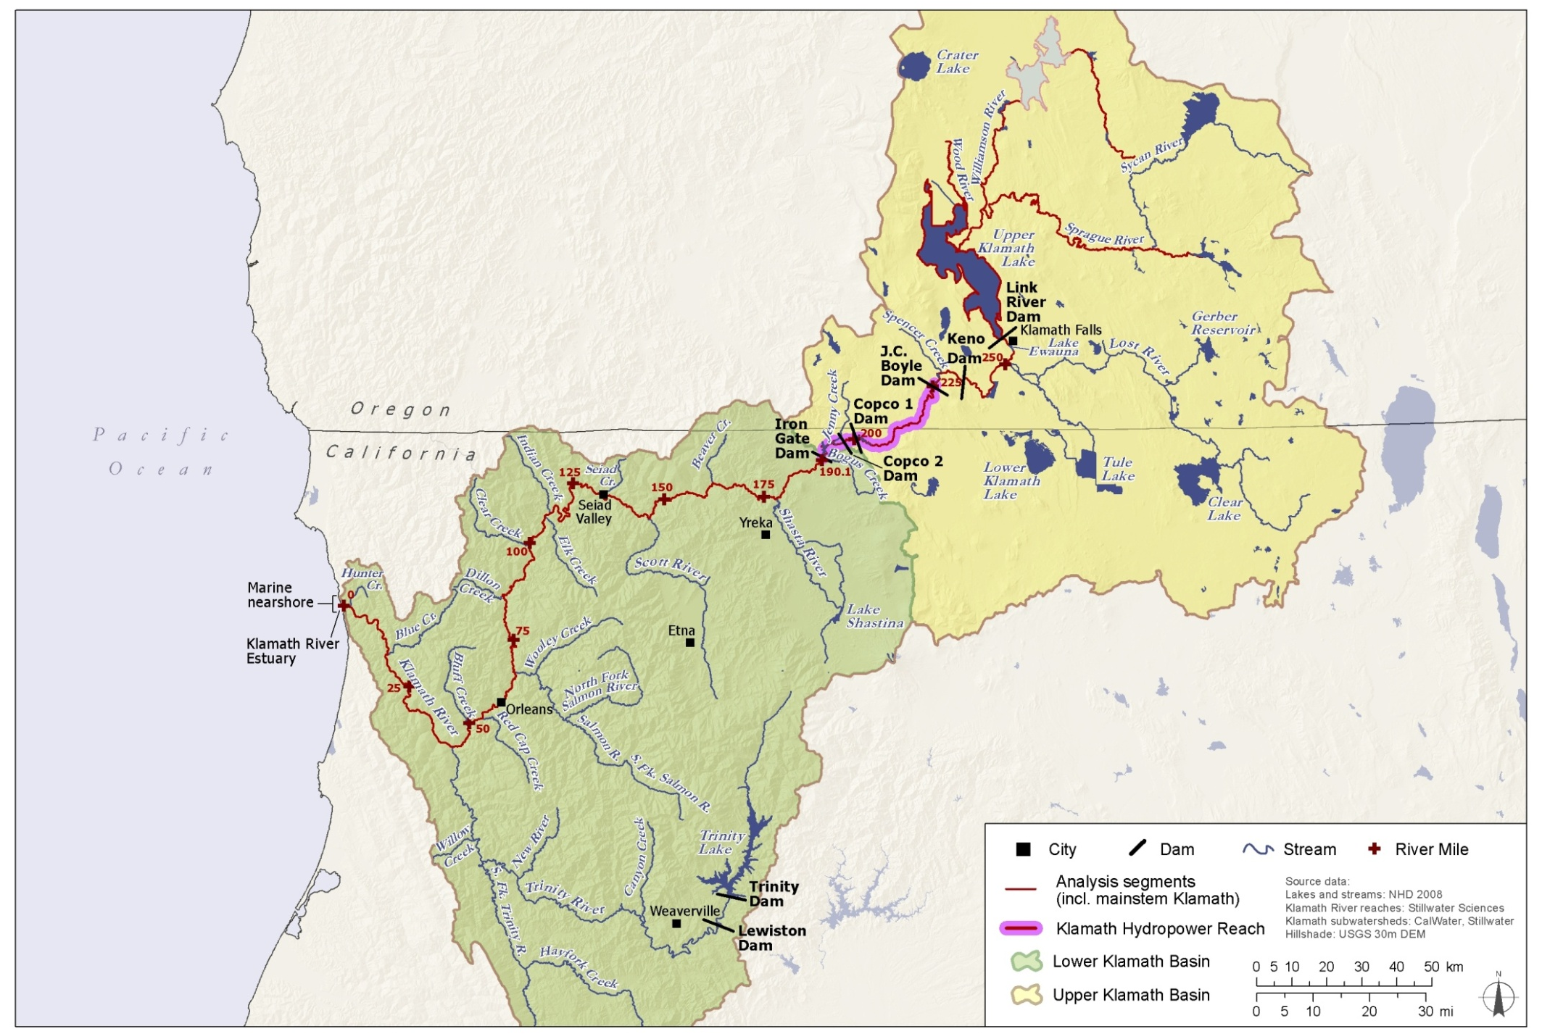
Klamath River Basin
North Coast RWQCB
Very large watershed, Multi-jurisdictional
River > 250 miles long
Since 2012 highly toxic blooms entire length of river
Nutrient TMDL
Regional monitoring program
Notes:
In the Klamath River Basin they are detecting toxin concentrations between 1,000 – 10,000 ug/L microcystins. (let me remind you the OEHHA recreational action level is 0.8ug/L)
This region has developed one of the most advanced cyanobacteria monitoring programs in the western US

Slide 8
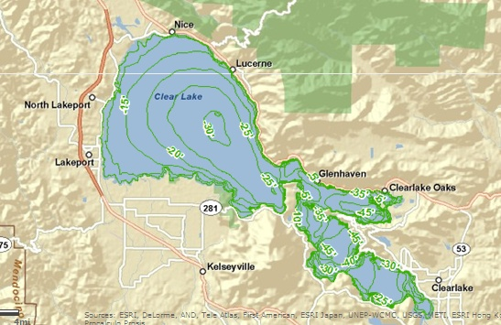
Clear Lake – Protecting drinking water
Courtesy of Lake County Public ArcGIS records
Clear Lake, CA
Drinking water intakes
Taken from presentation by Amy Little, CDPH, Aug 2012.
Eastern, Oaks Arm Clear Lake
Aerial Image from Google maps; fly in photo from 8/12 presentation by Amy Little, CDPH
Notes:
In Clear Lake, the main impact of cyanobacteria is on drinking water. 17 drinking water intakes around the lake, shown by the red diamonds, serve 44,000 people.
Clear Lake has cyanobacteria blooms through much of the year, and
although toxin levels are generally below 20 ug/L microcystin, lower than other hot spots in Ca. they are still well above the USEPA drinking water threshold of 0.3u/L
so intensive monitoring and high levels of treatment are required.
Additionally, monitoring is being done in recreational use areas and toxin levels have been detected in the range being seen in the Klamath

Slide 9
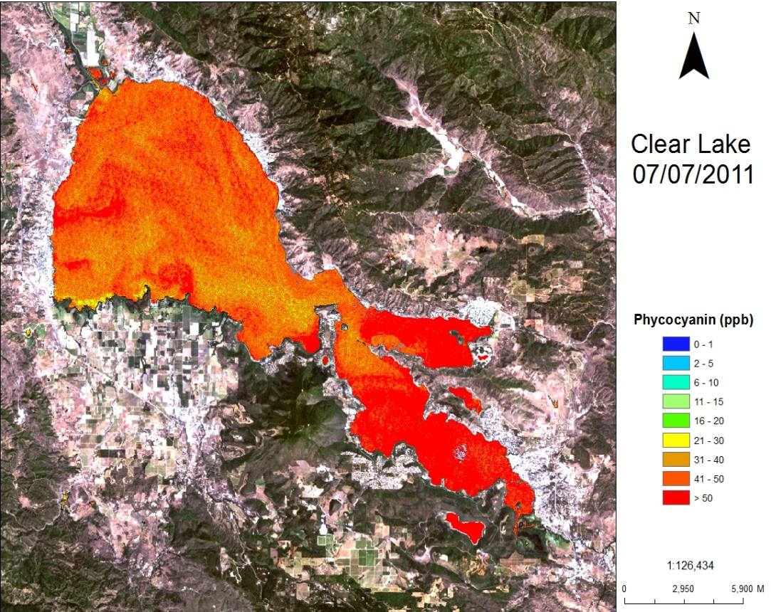
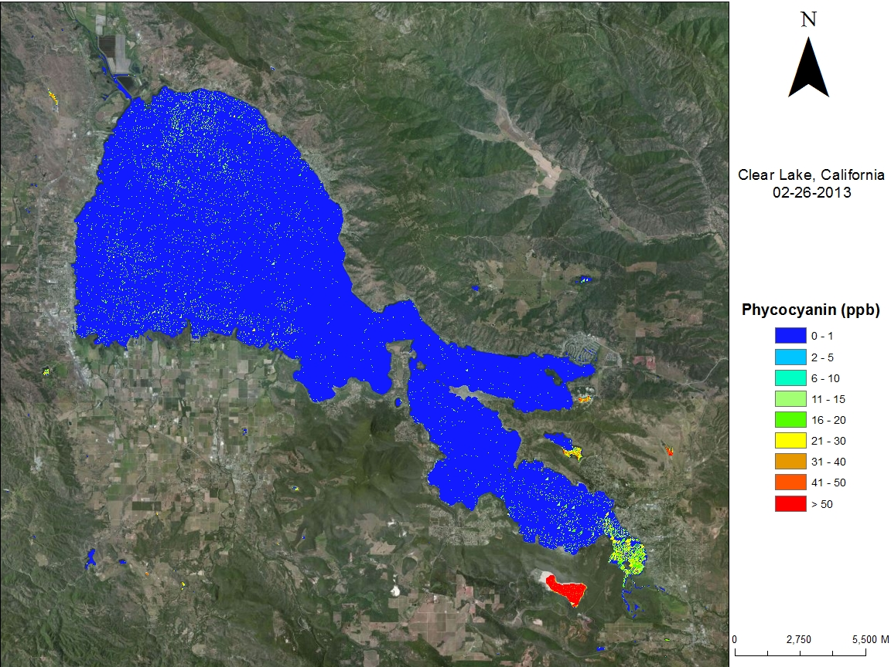
Clear Lake – Satellite imagery
Analyzed by Blue Water Satellites, Inc
Notes:
Satellite imagery has been used for several years to detect blooms in Clear Lake. This kind of monitoring can allow for an early warning if a bloom is detected.
This photo shows an image from February 2013, where the blue color indicates little to no phycocyanin detected in the main body of the lake
and this from July 2011 where the oranges and reds indicate high levels of the pigment, triggering a potential need to test for toxins.

Slide 10
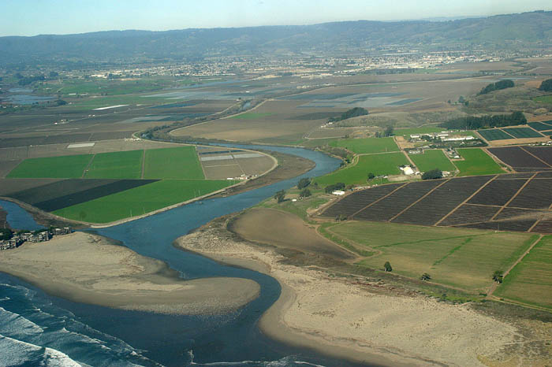
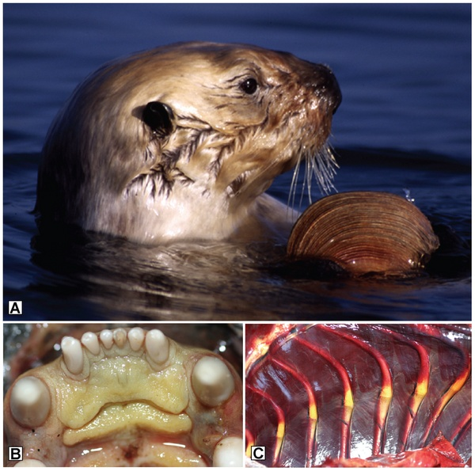
Freshwater Impacts to Marine Waters
Pinto Lake
*
Pinto Lake
~8.5 km
X- sea otter
Monterey Bay
Notes:
Another one of our hot spots is Pinto Lake. Pinto Lake provides an example of how cyanobacteria blooms in freshwater can have impacts on the marine environment.
Several years ago sick and dead sea otters were found on the beaches of Monterey Bay.
Since then more than 30 dead sea otters have been found.
The deaths were determined to be from microcystin, which was carried down river from Pinto Lake and taken up by bivalves. These were eaten by the otters, leading to liver failure and eventual death.
These photos show the jaundice in the mouth and chest cavity from liver failure. This is an example of the land/bay connection between blooms in lakes and effects in bays.
Pinto Lake’s seasonal cyanobacteria blooms can have toxin concentrations averaging around 1,000 ug/L microcystin.

Slide 11
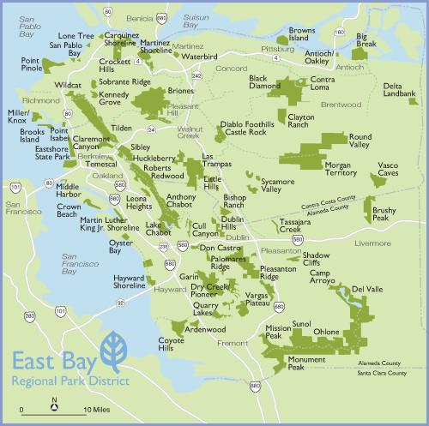
2015
2014
1Dog Death
Closed to Swimming
Closed to Swimming
150,000 ug/L microcystin
3 Dog Deaths
Closed to Swimming
Drinking BU
Closed to Swimming
Notes:
In the East Bay Parks, the summer of 2014 saw two toxic cyanobacteria blooms.
-Lake Temescal was closed to swimming for half of the summer.
-Lake Chabot had a bloom that only diminished for brief periods since it started and resulted in 3 dog deaths.
In 2015, there were toxic blooms in 6 of the park’s lakes.
In the Lake Chabot in Vallejo, there was one dog death. All of the lakes that allowed swimming were closed to swimming. The bloom in Lake Chabot reached a toxin level of 150,000 ug/L in a sample collected from scum. Then, just last month, there was a bloom in Lake Del Valle affecting several drinking water intakes.
In addition, there was a dog death associated with Anatoxin-a in the Russian River, with the toxin being detected for weeks after the incident.

Slide 12
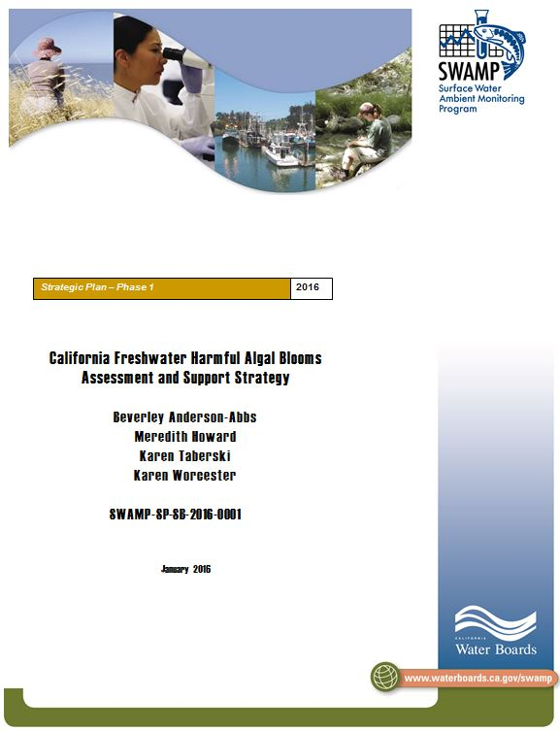

SWAMPs Freshwater HABs Assessment and Support Strategy
Goal – articulate a coordinated and widely supported, long-term program to assess, communicate, and manage freshwater HABs
Ca. CyanoHAB Network (CCHAB) anticipated to coordinate/implement strategy
Notes:
As a response to statewide blooms of freshwater HABs, SWAMP has developed an assessment and support strategy and funded some of the Infrastructure necessary for the successful implementation of the Strategy.
The goal of the strategy is to have a program to assess, communicate, and manage freshwater HABs in a collaborative fashion.

Slide 13
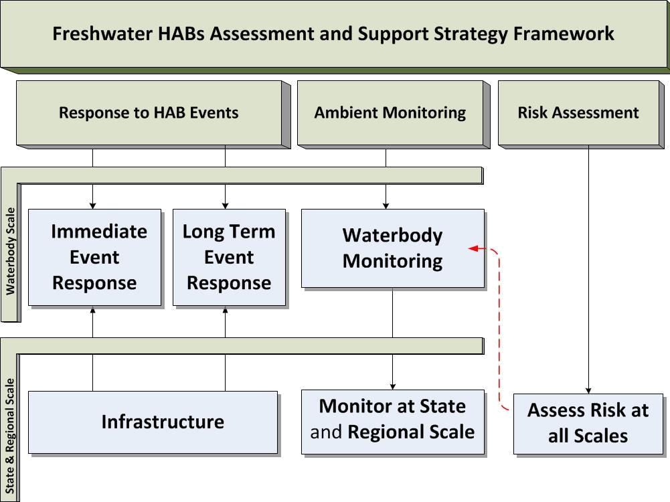
Notes:
The Strategy was developed around a SWAMP freshwater HABs program, which is providing funding for several projects to support satellite monitoring of blooms, as well as the infrastructure needed to support response to bloom events.
These projects are based on several of the goals defined by the CCHAB, and mainly fall under the “Infrastructure” component of the strategy.
The strategy itself has three components (response to events, ambient monitoring, and risk assessment), which are divided into waterbody scale, and regional or statewide scale.
At the waterbody scale:
Immediate event response would start in response to positive satellite imagery hit for phycocyanin –like the image of Clear Lake, or other evidence of a bloom, and would inform public notification and bloom management.
The updates to the 2010 Draft Voluntary Guidance document, being presented here today, include a flow chart of this process from initial identification of a bloom to posting, with toxin and other triggers for various types of posting.
Long term event response includes the development of local action plans or possiblyTMDLs, and the implementation of management and remediation strategies
The strategy also calls for regular monitoring of waterbodies with recurrent blooms, or those at high risk for blooms. This monitoring may start with visual inspections and advance when blooms are detected. Local water body managers or other agencies can much more readily mobilize for frequent or event based monitoring – the Klamath monitoring program is an excellent example of this.
At the state or regional scale the strategy calls for
monitoring on a larger spatial and temporal scale that would consist of adding cyanobacteria and toxins to ongoing monitoring programs and would not be event-based. The purpose would be to track spatial and temporal trends. SWAMP is already following this recommendation.
Risk assessments to determine which waterbodies may be most at risk for blooms can be conducted by several methods. Identification of high risk waterbodies would lead to regular monitoring.

Slide 14
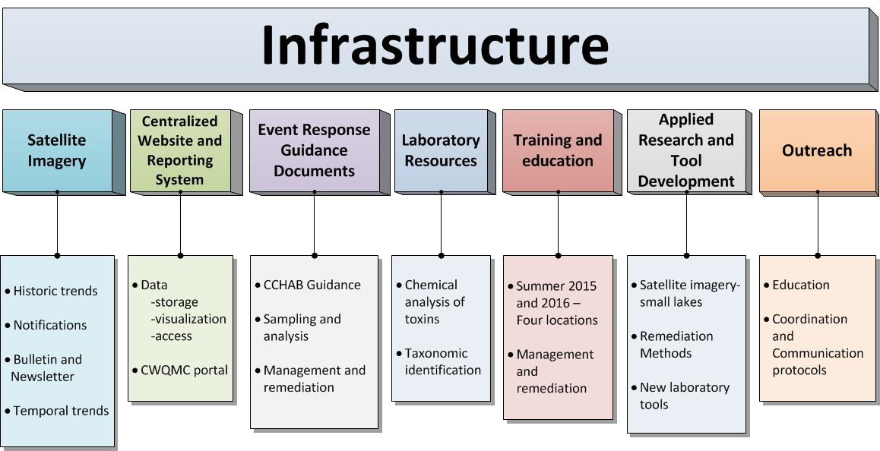
Notes:
The infrastructure part of the strategy consists of seven components (….), many of which are being funded by SWAMP.
-SWAMP has funded SFEI to download and analyze satellite imagery to notify waterbody managers of
blooms, to evaluate temporal trends and for a biweekly bulletin and quarterly newsletter,
-A centralized website is being developed, in coordination with CCHAB, for data storage, visualization and
access. This website will be a portal of the California Water Quality Monitoring Council.
-The strategy includes the development of a number of Event Response Guidance documents.
The first is the CCHAB voluntary guidance document which is being updated.
The second is a SWAMP funded document that includes protocols for sampling in multiple types of
waterbodies and analysis of samples.
The third describes remediation and management measures for freshwater HABs.
-SWAMP has also provided some funding to assist with initial lab toxin and cell identification tests
-SWAMP conducted several training courses in the summer of 2015 that taught basics of identification and dealing with CyanoHABs
and will be expanding on these course in 2016. SWAMP is also planning a workshop on management and remediation of blooms
in 2016.
-Applied research and outreach are two important areas with minimal funding. Applied research is needed to be able to identify, by
satellite imagery, blooms in waterbodies smaller than 250 acres. Some work is starting on this. Several new methods of early
detection are also being investigated and may provide future, cost effective ways of monitoring waterbodies. These include the
use of phycocyanin probes, bench-top fluorimeters, Flow-cams, and various methods of detecting toxin genes. Further
development of remediation measures is also needed.
- Outreach calls for increasing public awareness of HABs to increase recognition, reporting, and public safety. This can be done
through fact sheets, webinars, social media, focus groups etc. Outreach should be geared to health care professionals, vets,
policy makers, public agencies, and the public. Outreach also includes development of communication and coordination protocols
for agencies responsible for waterbodies with freshwater HABs. These can best be developed at the regional level.

Slide 15
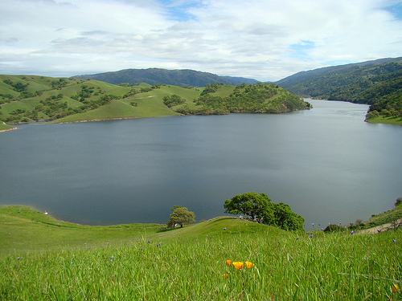
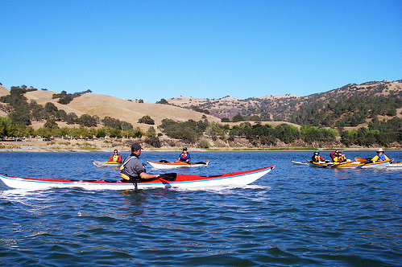
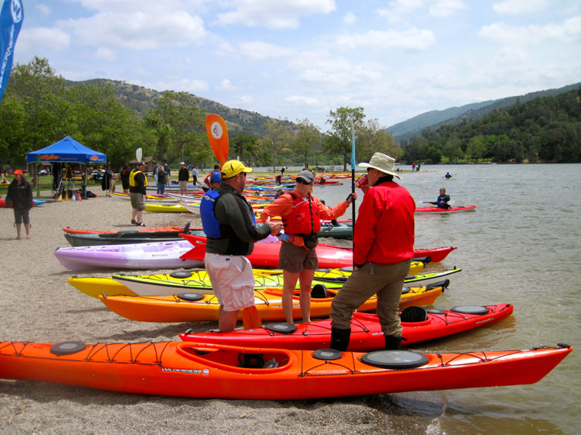
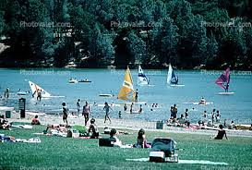
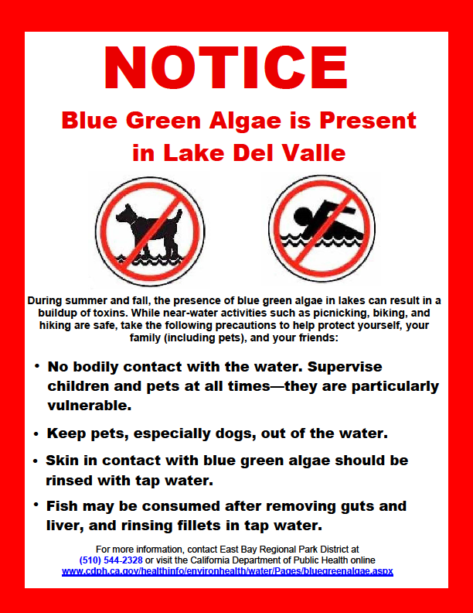
The End

Slide 16
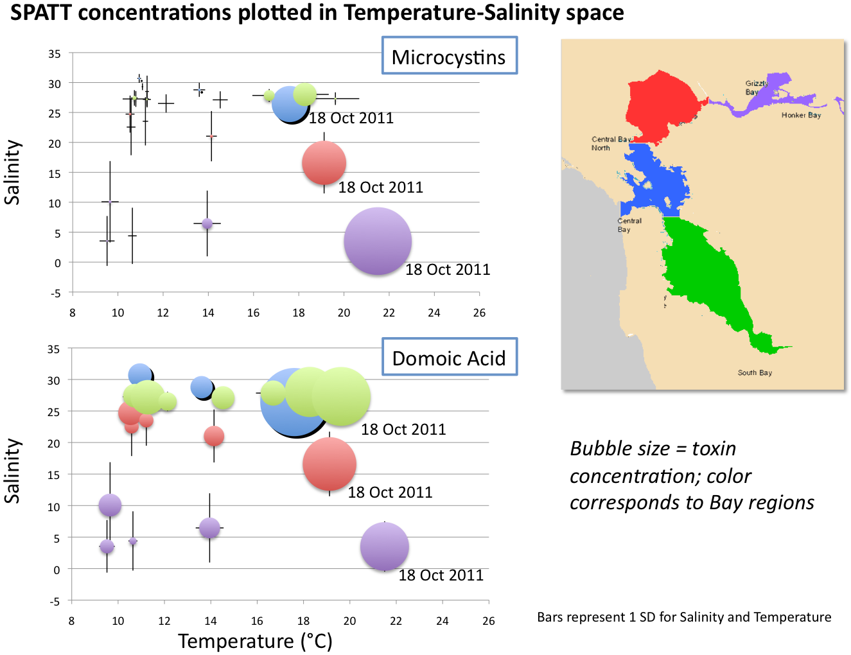
Temperature
Source: Raphe Kudela 2011
Notes:
This map and associated graph shows microcystin in the bay. The various colors correspond to sections of the Bay. This graph plots concentrations based on salinity and temperature. You can see that as we go up the Estuary, where temperatures are highest and salinity is lowest, microcystin concentrations are highest. Yet, even in the Delta, where there are recurrent blooms, concentrations rarely get over 10 ug/L. So, even though this looks high relatively, actual concentrations, although higher than guidelines, are lower than in most hot spots. Sources of the microcystins in the Bay include the Delta and freshwater sloughs, but also include creeks that connect the lakes to the Bay. This is another example of the land/bay connection that we saw in Pinto Lake.

Slide 17
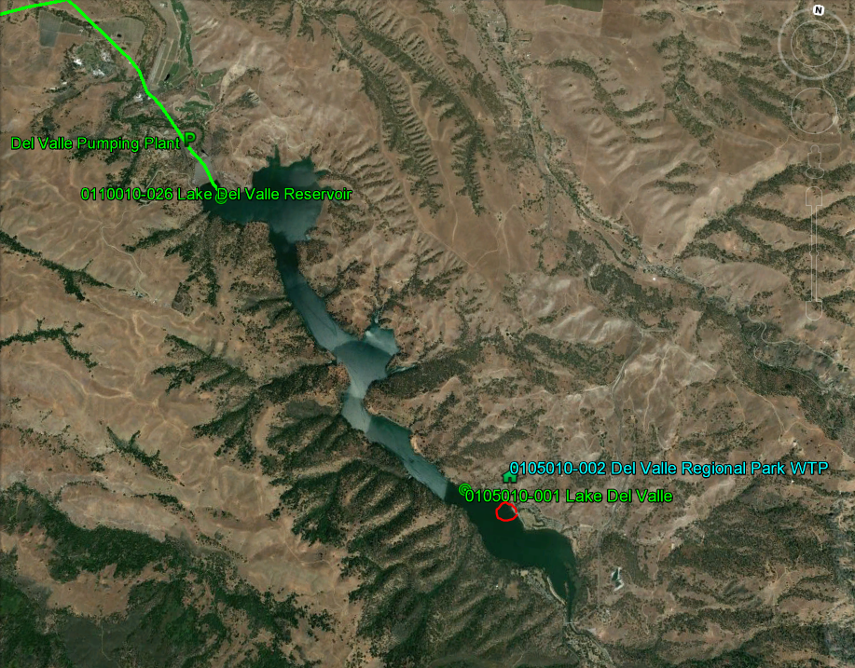
Lake Del Valle

Slide 18
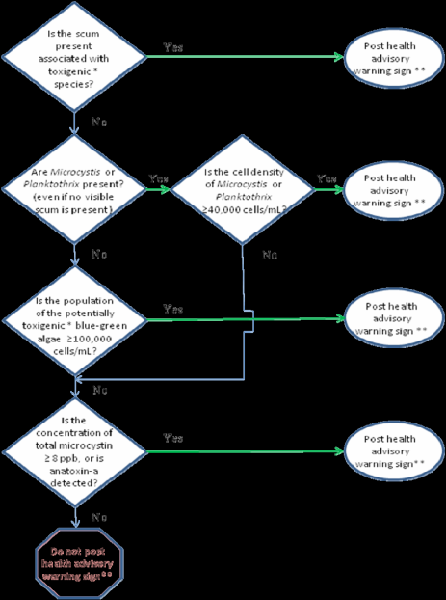
California CyanoHAB Network (CCHAB)
Established in 2005
Federal, State and local agencies, tribes, regulated community and researchers
Currently revising Voluntary Guidance- thresholds and procedures for posting (decision tree)
Forum for discussing roles in implementing Strategy

Slide 19
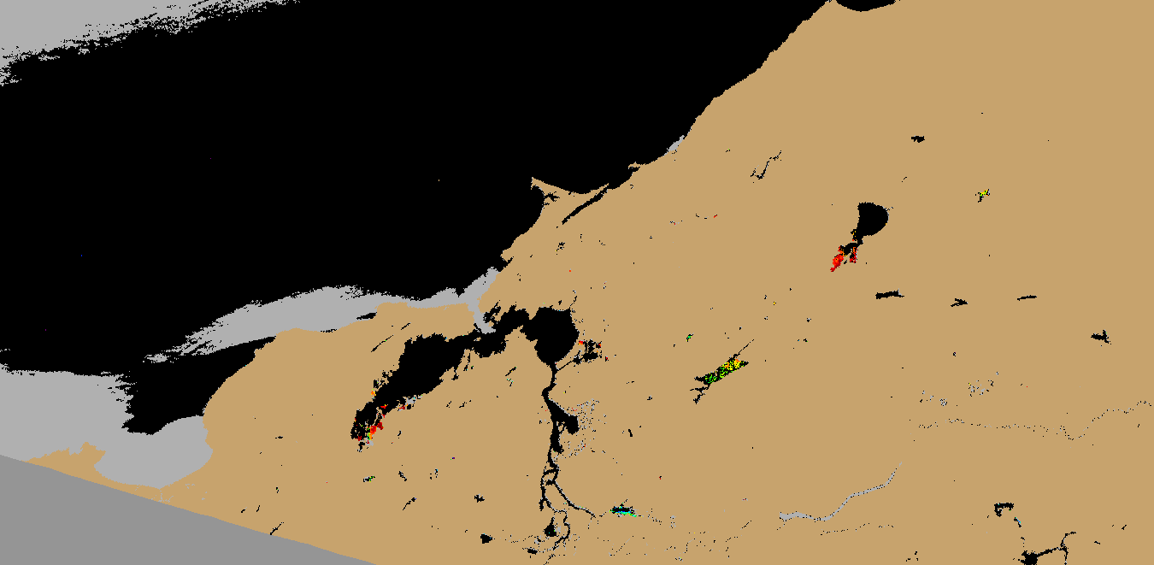
Satellite imagery and real time notification (SFEI)
Retrieve and process imagery created by satellite
Respond to requests for follow up information
Notify contacts in real time when imagery indicates a bloom

Slide 20
Satellite Health Bulletins: Florida

Slide 21
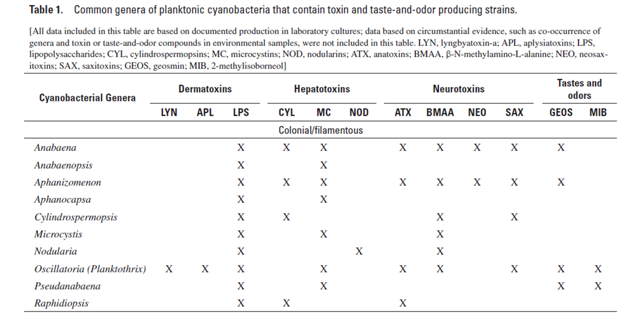
Cyanotoxins
Source: Graham, Loftin, Meyer, 2008. USGS SIR 2008-5038. http://pubs.usgs.gov/sir/2008/5038/pdf/SIR2008-5038.pdf
Notes:
Numerous cyanobacteria can produce cyanotoxins – Reggie to discuss more.
Categories – dermatoxins , hepatotoxins (acute and chronic) , neurotoxins (very acute), and taste & odor compounds
Some cyanobacteria can produce multiple toxins. Can have Toxic and non-toxic strains
Toxins are produced in the cells and released as a result of cell permeability / lysis
Toxins not necessarily correlated to bloom visibility/density, and can be colorless/odorless. So you cannot tell if toxins are present by looking at a bloom.
Responding agencies need to know: what species are present, and which toxins, if any, at what levels.

Slide 22
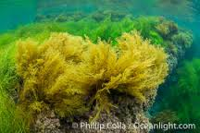
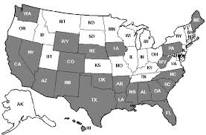
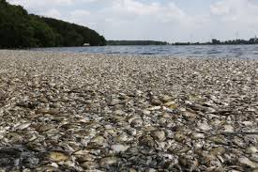
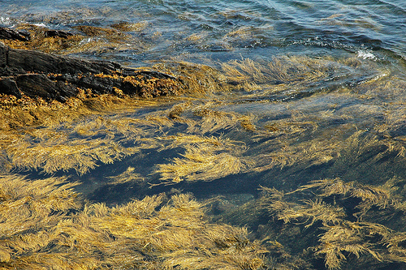
Types of freshwater HABs currently in California
Cyanobacteria (Blue Green Algae)
Prymnesium (Golden Algae)
  Southern California
  Massive fish kills
Notes:
There are currently two types of freshwater HABs in California. Cyanobacteria is the most common type of Freshwater HAB in California and has been here the longest. I will be devoting the rest of the presentation to cyanobacteria. In So. Ca. blooms of Prymnesium or golden algae have recently appeared. They were first identified in Texas in 1985. Since then they have spread to many states mostly in the southern part of the US. Blooms of this algae are currently only in S. Ca., but they may spread.
“Golden algae” causes massive fish kills – but only affects organisms with gills so they don’t have the public health affects or impacts on pets, livestock and wildlife that cyanobacteria have.

Slide 23

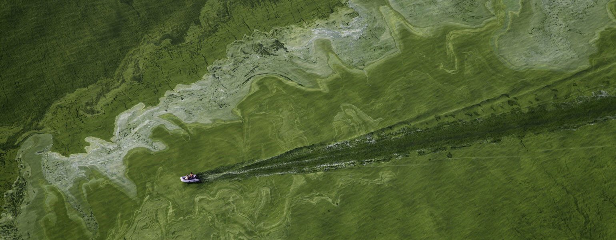
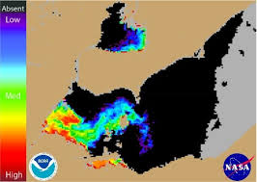
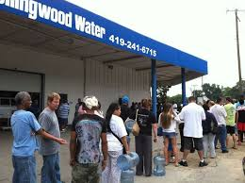
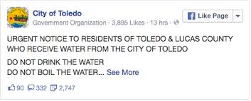
Toledo, Ohio August 2014
Microcystis bloom in Lake Erie causes loss of drinking/cooking/ bathing water for 400,000 people for 3 days
Notes:
You may recall news stories in August 2014 when the risk of cyanobacteria was brought to the attention of agencies and the public.
Lake Erie had a microcystis bloom that affected the City of Toledo, Ohio.
400,000 people were without drinking/cooking or bathing water for 3 days.
A State of Emergency was declared and the National Guard were brought in.
This incident was a main cause for USEPA to develop the health advisory values for drinking water that I just mentioned.
This is a picture of the bloom and this is a satellite image of the bloom. To the naked eye the bloom looks green. However, the satellite sensor detects phycocyanin which is a pigment in cyanobacteria. In these satellite images, blue areas are low concentrations of microcystis and red areas are high. Here is Toledo.

