Slide 1
Truckee River Watershed Council
Truckee River Sediment TMDL
Lahontan Regional Water Quality Control Board
Beth Christman & Lisa Wallace
June 19, 2014

Slide 2
Presentation Outline
Truckee River TMDL Background
TRWC Monitoring Program
Key Results
Discussion of Findings

Slide 3
Middle Truckee River Sediment TMDL
Truckee River listed for excess sediment
Included on 303(d) list in 1991 based on biological impacts – best professional judgment
TMDL adopted in 2008

Slide 4
TMDL Standards
Watershed-wide TMDL
Numeric target: 25 mg/L suspended sediment concentration (SSC)
Implementation targets
  Road sand tracking and recovery
  Ski area BMPs
  Dirt road maintenance/decommission
  Legacy site restoration/BMP installation

Slide 5
Where are we now?
TRWC began TMDL monitoring in 2010
  Only TMDL-specific monitoring
We now have data that shows biological impairment
Current TMDL standard not suited to assess biological impact
Preliminary meeting with LRWQCB staff

Slide 6
Why TRWC is Monitoring
Lack of strong monitoring plan in the adopted TMDL
Need for watershed-based vs. individual permittee reports
Inconclusive biological studies – need for more data
Establish “baseline” conditions to track progress

Slide 7
Monitoring Plan Elements
Macroinvertebrates
  Index of Biological Integrity study - reference test
  Patch-scale sediment
  Repeat LRWQCB 2004 sampling below tributaries
  Studies completed 2011
Sediment and Turbidity
  Near continuous turbidity
  Suspended sediment grab samples
  Bed surveys
  Funded through WY2014

Slide 8
Partners
Town of Truckee
Placer County

Slide 9
Technical Advisory Committee
CA Department of Water Resources
Lahontan Regional Water Quality Control Board
Placer County
Town of Truckee
U.S. Geologic Survey

Slide 10
Elements Presented Today
Macroinvertebrate – reference/test
Macroinvertebrate – patch-scale
  Studies by UCSB- SNARL, Dr. David Herbst
Suspended sediment and turbidity summary
  Studies by Balance Hydrologics

Slide 11
Key Points
1. Biological data shows impairment
2. Disconnect between current numeric standard and detecting impairment

Slide 12
Bioassessment
Reference/Test Study (2010)
Patch Scale Fine Sediment Study (2011)

Slide 13
Bioassessment 101
Using biological organisms to assess water quality
Direct indicator of stream environment
Benthic macroinvertebrates most common
Different types of insects tolerate poor water quality – assigned a “tolerance value”

Slide 14
Bioassessment “Jargon”
Index of Biological Integrity (IBI) common analysis tool
  Developed specific to a region
  Allows to look at just one “score”
EPT = Ephemeroptera (mayflies), Plecoptera (stoneflies), and Trichoptera (caddisflies)
Tolerance Value: 0-10 assigned to each species
BMI = Benthic macroinvertebrate

Slide 15
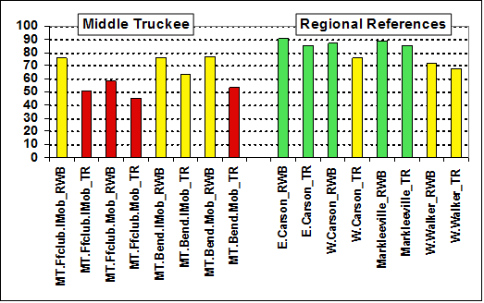
Reference/Test Results – IBI Scores
Middle Truckee samples all scored as impaired (red) or partially supporting (yellow)
Reference sites scored as partially supporting or supporting (green)

Slide 16
Patch Scale Analysis
Tightens up relationship between sediment and biota
Collect BMIs from small patches over a range of fine sediment cover (0-100%)
Survey reaches of Middle Truckee to understand pattern of fine sediment deposition

Slide 17
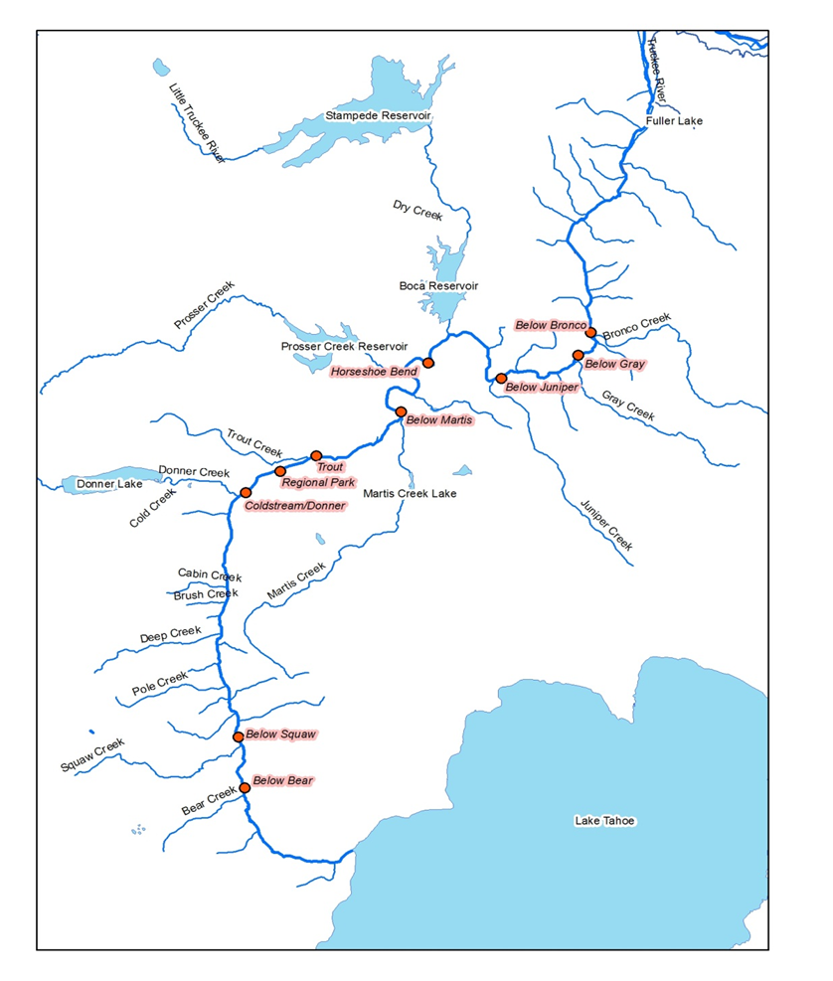
BMI Monitoring Locations – Patch Scale Study

Slide 18
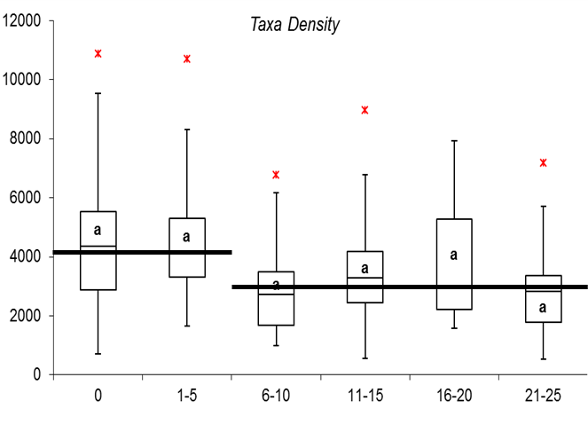
BMI Density Declines with Increased Fines
# orgs/m2
0% 1-20% 21-40% 41-60% 61-80% 81-100%
Percent Cover by Fines and Sand

Slide 19
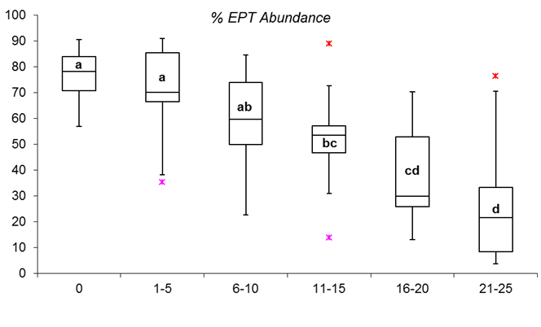
%EPT Decreases with Increased Fines
%EPT
0% 1-20% 21-40% 41-60% 61-80% 81-100%
Percent Cover by Fines and Sand

Slide 20
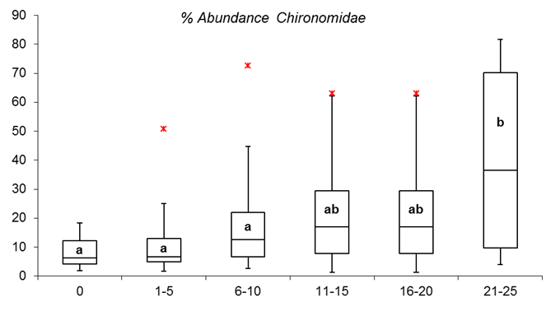
% Midges Increases with Increased Fines
% Chironomidae
0% 1-20% 21-40% 41-60% 61-80% 81-100%
Percent Cover by Fines and Sand

Slide 21
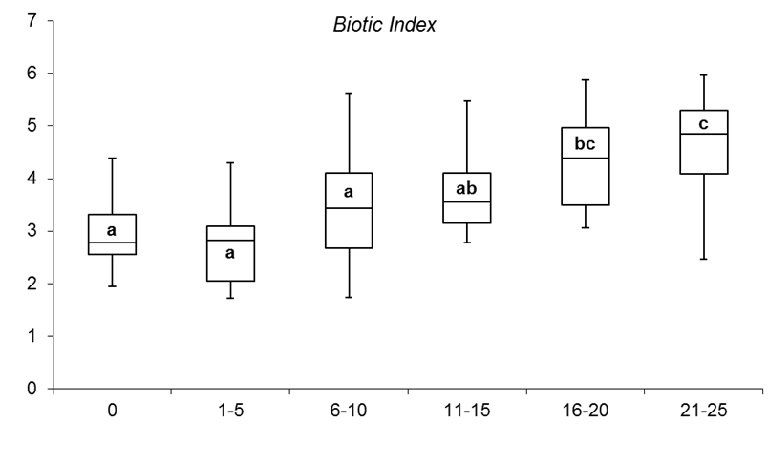
Fewer Intolerant, More Tolerant Species with Increased Fines
0% 1-20% 21-40% 41-60% 61-80% 81-100%
Percent Cover by Fines and Sand

Slide 22
Summary of Biological Impacts
Food quality and quantity decreases
  Fewer insects
  Smaller body size
Sensitive taxa are lost from the community
Sediment thresholds
  Impacts appear >20% fine and sand cover
  Impacts significant at 80%

Slide 23
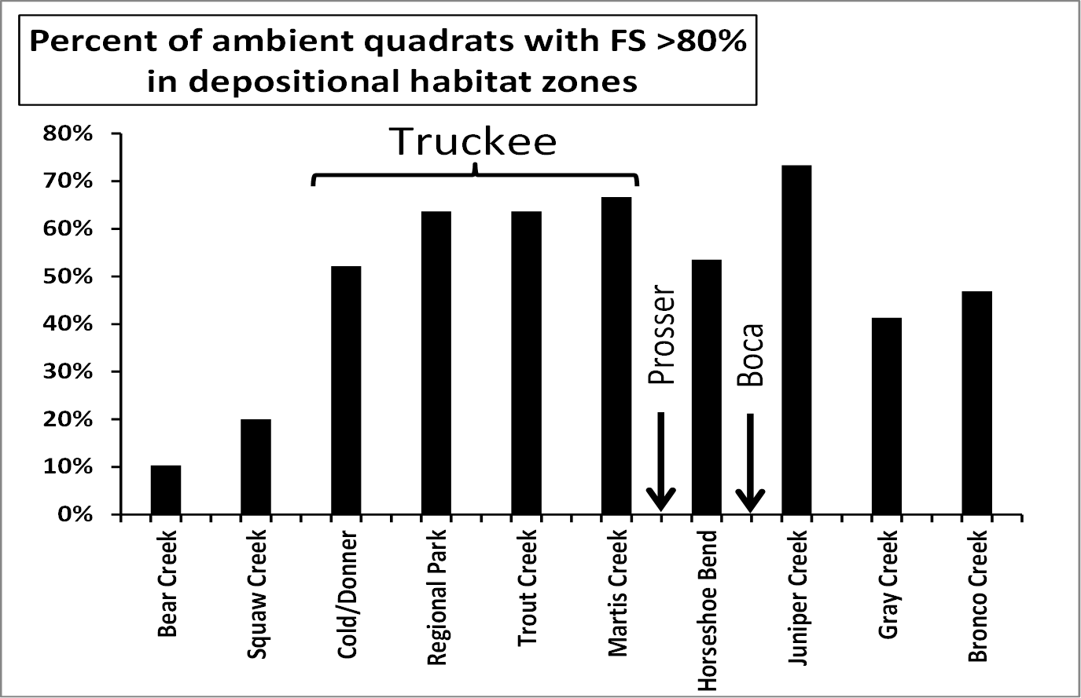
How Prevalent is Sediment
Deposition?

Slide 24
Suspended Sediment Results
Disconnect between bioassessment and sediment data

Slide 25
Sediment and Turbidity Monitoring
Stations on 3 key tributaries

Slide 26
Suspended Sediment/Turbidity Results
Data from WY 2010 – 2013
Tributaries are meeting suspended sediment concentration standard of 25 mg/L 90% of the time

Slide 27
Beneficial Uses are Impaired
Biological data show increased sediment = decreased condition
Sediment deposition is fairly widespread in sampling reaches
SSC data suggest current standard is largely met in 3 monitored tributaries

Slide 28
Next Steps
Additional standard for Truckee River that directly assesses impacts to beneficial uses
  Biological?
  Deposited Sediment?
Fund additional monitoring
  Sediment distribution
  Additional bioassessment sites
  Depending on standard:
    Annual cost $30,000 - $150,000+
    Study period 3-5 years

Slide 29
Questions?
Reports available at: www.truckeeriverwc.org
Beth Christman
(530) 550-8760
bchristman@truckeeriverwc.org

Slide 30
Additional Information – Suspended Sediment

Slide 31
Total Loading from Tributaries

Slide 32
Relationship to TMDL SSC Standard?
Water Year 2012 Data – Trout Creek

Slide 33
Relationship to TMDL SSC Standard?
Water Year 2012 Data – Donner Creek

Slide 34
Relationship to TMDL SSC Standard?
Water Year 2013 Data – Cold Creek

Slide 35
Key Sediment/Turbidity Conclusions
Tributaries are meeting suspended sediment concentration standard of 25 mg/L 90% of the time
Lower Donner watershed extremely high load contribution
Early season rain storms result in significant loading

Slide 36
Farad Data
From LRWQCB, 2011. Truckee River Status Report

