Slide 1
Temporary Permits for Groundwater Recharge Projects
June 26, 2024
Division of Water Rights, Recharge and Major Projects Permitting Unit

Slide 2





Workshop Etiquette:
            Workshop is being recorded
            Participants muted/cameras off
            Questions? Post in chat

Slide 3
Presenters
Division of Water Rights, Recharge and Major Projects Permitting
Benjamin McCovery, Engineering Geologist;
Shelby Witherby, Water Resource Control Engineer;
Mike Conway, Unit Senior
Department of Fish and Wildlife
Briana Seapy, CDFW North Central Region (Region 2)
Department of Water Resources, Sustainable Groundwater Management Office
Steven Springhorn, DWR Supervising Engineering Geologist

Slide 4
Agenda
What are temporary permits?
Examples of temporary permits
Selecting diversion triggers
Examples of temporary permit terms
CEQA considerations
Where to file: Water Rights Online Forms
Where to view applications/water rights: eWRIMS
Tips for a successful application filing
Updates regarding application fees
CDFW: consultation tips

Slide 5
Temporary Permit: What is it?
• Allow for short term diversion and use of surface water. Issued by State Water Resources Control Board Division of Water Rights.
•Temporary permits provide opportunity for one-time projects, to test projects for longer term viability, coverage as pursue standard permit.
Temporary permits are not a substitute for the permanent coverage offered by a standard water right (no priority date)
Temporary permits allow for diversion of surface water to underground storage for later use.
Temporary permits for groundwater recharge are a tool for parties to augment supply to aid in building water resiliency and help parties comply with SGMA.

Slide 6
Recharge: Water Right Permitting Options
Permitting Pathway​ | Temporary​ |  | Standard​
 | 180-Day​ | 5-Year​ | Streamlined​​ | Standard​
Long-term need for water?
File both Temporary & Standard Application
Reminder: Party will not secure priority date until Standard Permit filed. First in Time, First in Right. Code requires diligent pursuit of standard application to use temporary permits for a long-term project.

Slide 7
Example: 5-Year Temporary Permit & Streamlined Standard Filing
Application ID: T033287
Applicant: Central California Irrigation District/Del Puerto Water District
Source: Orestimba Creek, tributary to San Joaquin River
Uses: Irrigation
Season: December 1 – March 31
Method of Recharge: infiltration basins
Water Availability: Streamlined Pathway (90/20) Method 1
Incentives/Lessons Learned:
- Streamlined pathway allowed for quick processing
- Lower burden for applicant
- Objections easily resolved
- Applicant strategy: Standard application filed first (March '22), then 5-Year (Nov '22) to bridge.

Slide 8
Example: 180-Day Temporary Permit
Application ID: T033409
Applicant: Sierra Valley Groundwater Management District
Source: Smithneck Creek, tributary to Middle Fork Feather River
Uses: Fish and wildlife preservation and enhancement (consumptive), domestic, and incidental irrigation
Season: December 1 – March 31
Method of Recharge: On-farm recharge
Water Availability: Streamlined Pathway (90/20) Method 1
Incentives/Lessons Learned:
- Streamlined pathway allowed for quick processing
- Efficient CDFW consultation
- No objections received

Slide 9
Diversion Triggers
Streamlined Pathway – Method 1 (90/20) or Method 2 (flood diversion)
Designed to protect ecosystem functions, instream needs, and senior rights holders. In general, limits diversions to high flows, wet water year types, and winter storm events.
Method 1: Utilizes 30-year gage record to establish 90th percentile daily flow thresholds, for diversions between December 1 and March 31. Limits diversions to 20% of daily flow in source stream.
Method 2: Allows for diversions based on established imminent threats to public health and safety.

Slide 10
Other Diversion Triggers
Parties can propose other diversion triggers, or another trigger may be selected by Board staff
Triggers selected need to be protective of instream resources and senior diverters.
Base on robust science that lends itself to rapid evaluation timeline of temp permit
Red flags (may not be good fit for fast pace of temp permits)
  Not supported with robust information
  Relies on older science
  Tied to not yet settled matter part of active Board action or hearing
  Is a single component of a broader analysis solution that have concerns won’t work by itself (piecemealing)
Solution: Might be better suited for longer processing timeline of standard application

Slide 11
Permit Terms
Permits are conditioned by "permit terms“. For example:
Describe the project (amount, rate, season, uses, place of use, methods of recharge, storage location)
Limits because its a temporary permit
Diversion criteria and other terms to protect senior diverters and instream needs
Objection resolution/CDFW or Regional Board consultation
Monitoring and Reporting
Accounting

Slide 12
Permit Terms, Example
Term 000000W, requires pursuit of permanent water right:
"The Permittee is hereby notified that subsequent renewals of this permit or new temporary permit applications for the water proposed to be diverted and used in accordance with this permit will be subject to a review by the State Water Board regarding whether the applicant has exercised due diligence in either (1) making an application for a standard permit pursuant to Water Code section 1250 et seq. or (2) in pursuing that application to permit.
The Permittee shall provide a statement of their intention for continuation of the diversion and use of water under this project within 60 days after the expiration of this temporary permit."

Slide 13
Permit Term, Example
Term 0000213, requires fish screens:
"No water shall be diverted under this temporary permit unless the Permittee is operating the water diversion facility at the diversion ditch with existing fish screen(s)."

Slide 14
Permit Terms, Example
Term 0450300, required of diverters in the Delta watershed
“Water may be diverted under this temporary permit when the Delta is in excess conditions without restrictions under the Central Valley Project-State Water Project Coordinated Operation Agreement (COA), dated November 24, 1986…”

Slide 15
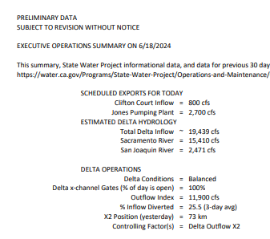
Daily Delta Conditions
Daily Delta conditions are posted by DWR and available here: https://water.ca.gov/-/media/DWR-Website/Web-Pages/Programs/State-Water-Project/Operations-And-Maintenance/Files/Operations-Control-Office/Delta-Status-And-Operations/Delta-Operations-Daily-Summary.pdf

Slide 16
Permit Terms, Example Regional Board consultation
Terms for water quality (Central Valley), 0390501 and 0400501:
“No on-farm recharge shall occur in Dairy Land Application Areas unless Temporary Permittee has first provided notification and received concurrence from staff of the Central Valley Regional Water Board…”
“The field has been in compliance with the Irrigated Lands Regulatory Program for, at minimum, the two most recent growing seasons…”
“The field has been operated under management practices for fertilizer application for at least two growing seasons…”
“The field has not had fertilizer applied within the last three months.”

Slide 17
Permit Terms, Example
Term 0109999V, requires diversion monitoring:
“No water shall be diverted under this temporary permit unless the Temporary Permittee monitors and records the rate of diversion…The device or method shall be capable of quantifying the hourly rate and volume of diversion…”
Note: Unlike standard permits, reporting of diversion only happens once for the 180-day temp permits, or at the end of each season for the 5-year temp permit

Slide 18
Permit Terms, Example
Extractions and accounting coordination
Term 9990900, extractors agreements/last in, first out
“Where the party or parties extracting the water are not the applicant, the applicant shall secure a written agreement, or other confirmation of extractors agreement as approved by the Deputy Director for Water Rights.”
“…water diverted under this temporary permit shall be the first extracted water out of the storage location by the applicant.”
Term 0110900, accounting consistent with GSA
“…use the same approach to accounting used by the applicable GSA(s)…”

Slide 19
CEQA Considerations
Governor’s Executive Order N-7-22 suspends CEQA for recharge projects targeting high flows
5-year permits (recommended entry point to permitting): Suspension may be feasible based on project specific details. To meet diligence requirement for ongoing project – expect conditioning to file standard application within 1 year. If want a renewal (if standard permit not issued yet) – plan to complete CEQA prior to requesting renewal.
180-day permits (best for: uncertain project scope/one time): Suspension may be feasible based on project specific details.
Standard permits Suspension likely poor fit due to processing timelines. Anticipate lead agency to complete CEQA.

Slide 20
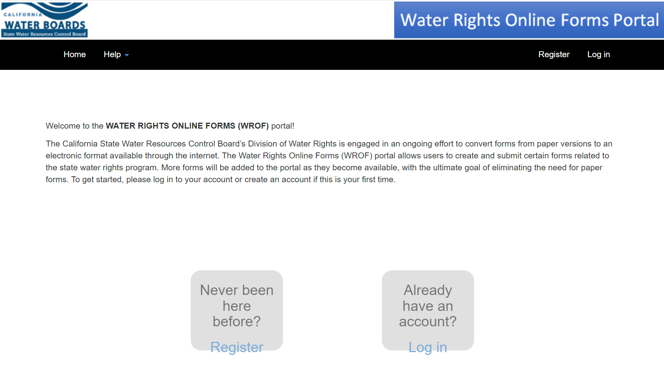
Water Rights Online Forms (WROF)
This website is where a potential applicant would come to fill out their application. Within the application is where you indicate what type of permit you are applying for.

Slide 21
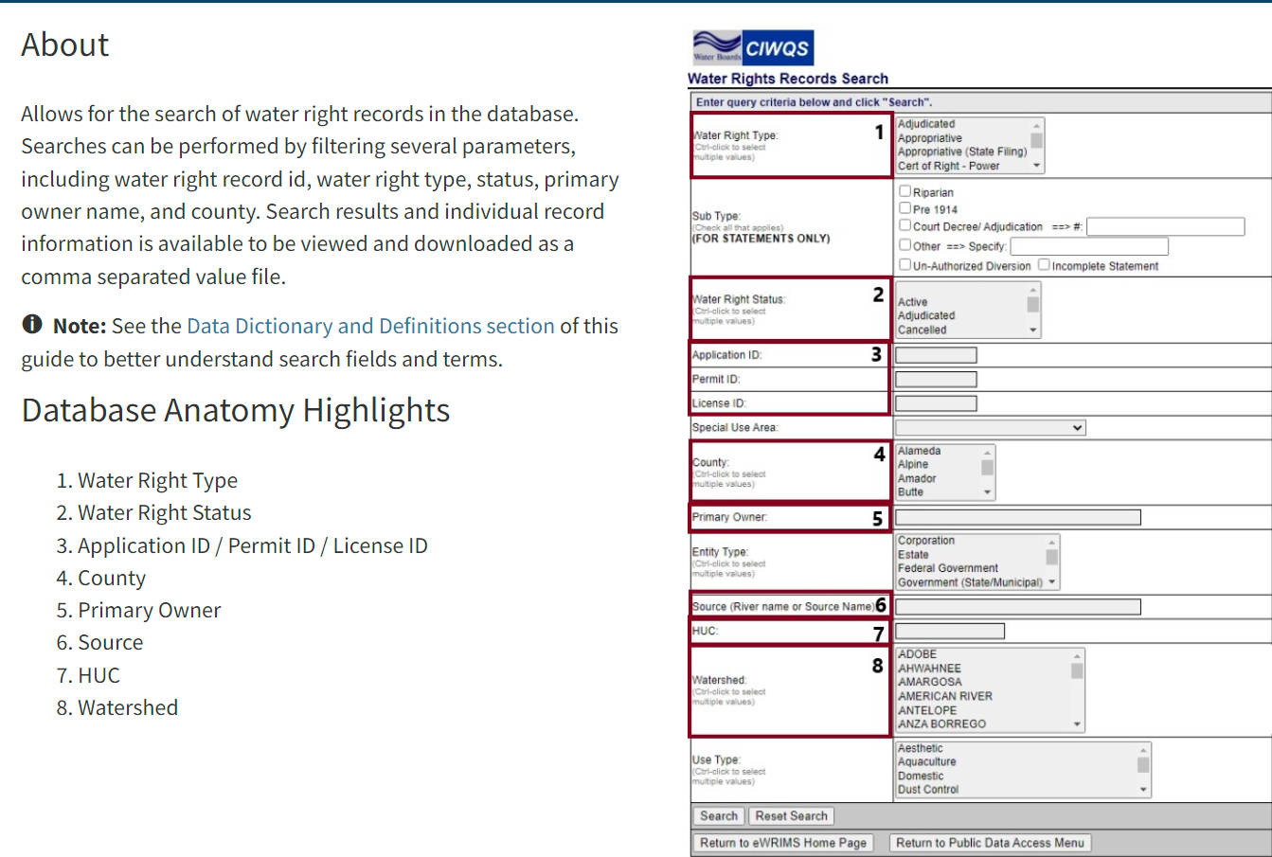
Electronic Water Rights Information Management System (eWRIMS)
eWRIMS is the database used to track the vast majority of Water Rights in California.
eWRIMS is a legacy system; as of the current date, the State is exploring options to update the Water Rights Database.

Slide 22
Tips for Filing
Early consultation with Division staff
Early consultation with CDFW
Concise project description
  Uses – types and season of use
  Season of diversion
  Points of Diversion
  Diversion triggers
Careful consideration of diversion triggers

Slide 23
Application Fee Proposal Overview
First major update since 2003
Clearer, easier to use
More appropriately priced to current workload focus, BCP if approved
Recharge permitting incentives:
  5-Year permit
  Earlier filings
  Streamlined approach – temporary (standard discount remains too)

Slide 24
Standard Application Fees
Acre-feet requested | Tier | Fee ($)
Under 10 | 1 | 5,000
10-199 | 2 | 40,000
200 – 999 | 3 | 43,000
1K->5K; 5K->10K; 10K->15K; 15K->20K; 20K->25K; 25K->30K; 30K->35K; 35K->40K; | 4 - 11 | 55,000 115,000 190,000 265,000 340,000 415,000 490,000 565,000
40K-200K | 12 | 648,914
200K+ | 13 | 811,143
Existing: Per acre-foot
Proposed: Tiered (13)
  Project Complexity Surcharge
  Splitting Footnote
  Discount for streamlined approach

Slide 25
180-Day TP for Underground Storage and Renewals
Submitted 120 days prior to requested commencement of diversion: 35% of standard
Submitted less than 120 days prior to requested commencement of diversion: 50% of standard
Renewal: Same
Amount | Current | 120+ day ahead | Less 120 days
1,000 af | $5,100 | $19,250 | $27,500
10,000 af | $6,000 | $66,500 | $95,000
100,000 af | $15,000 | $227,120 | $324,457

Slide 26
5-year TP for Underground Storage
Existing: $6,000 plus lesser of two categories, plus annual fee
Proposed:
  120 days in advance: 35% of standard
  Less than 120 days in advance: 50% of standard
Amount | Current 5-Year, Full FV Diverted | Proposed 5-Year, On-Time | Proposed: 180-Day, On-Time (5x)
1,000 af | $11,900 | $19,250 | $19,250 ($96,250)
10,000 af | $20,000 | $66,500 | $66,500 ($332,500)
100,000 af | $101,000 | $227,120 | $227,120 ($1,135,600)

Slide 27
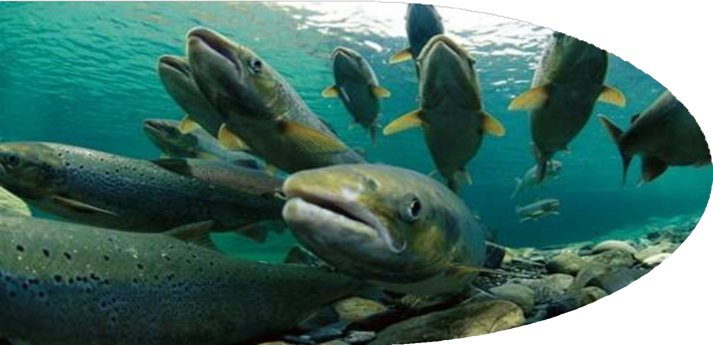
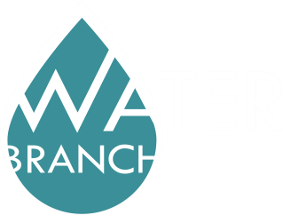

CDFW Consultation Tips
TEMPORARY PERMITS FOR GROUNDWATER RECHARGE
Briana Seapy
C D F W N o r t h C e n t r a l R e g i o n
J u n e | 2 0 2 4

Slide 28
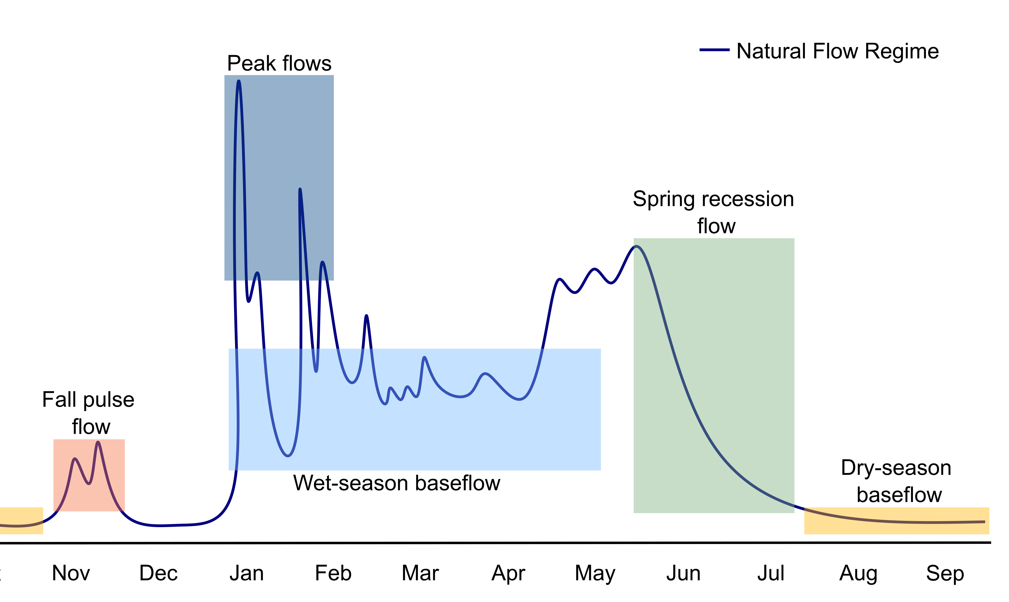
Think about how high flows help habitat.
High flow matters to habitat.

Slide 29

Think about fish & wildlife impacts early.
Aquatic animals and habitat
Terrestrial animals and habitat

Slide 30
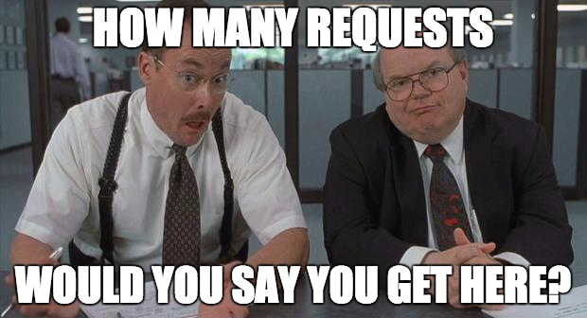
Tell us before we ask you.

Slide 31
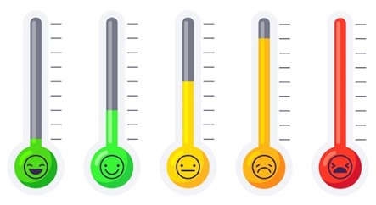
Consult and adapt.

Slide 32
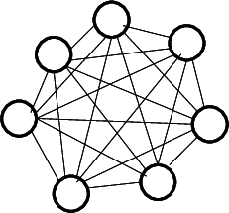
SPECIAL CASE? ALLOW MORE TIME.
Not 90/20?
Overlapping regulatory oversight?
Threatened & Endangered Species?
New construction?

Slide 33
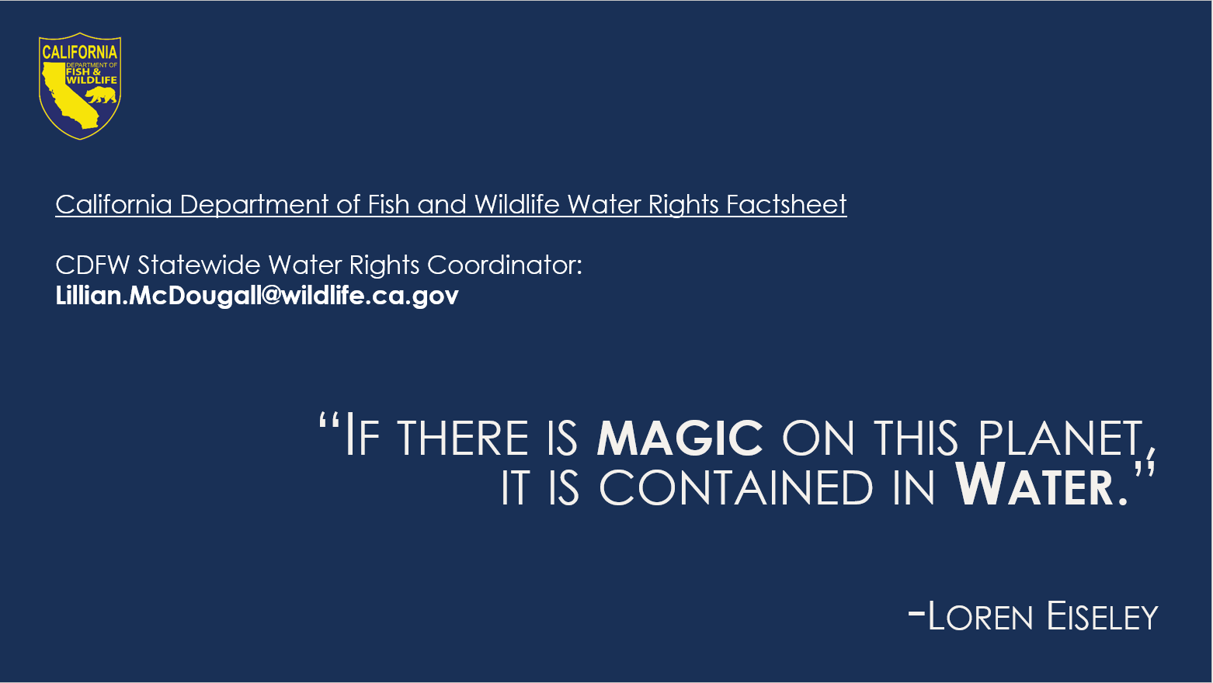

Slide 34
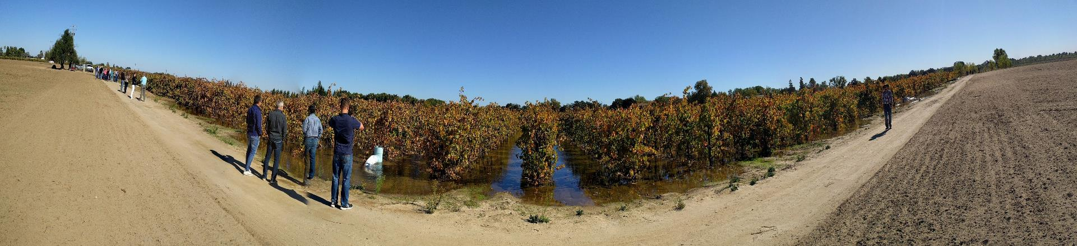
DWR Flood Diversion and Recharge Enhancement Initiatives – 2023 & 2024

Slide 35
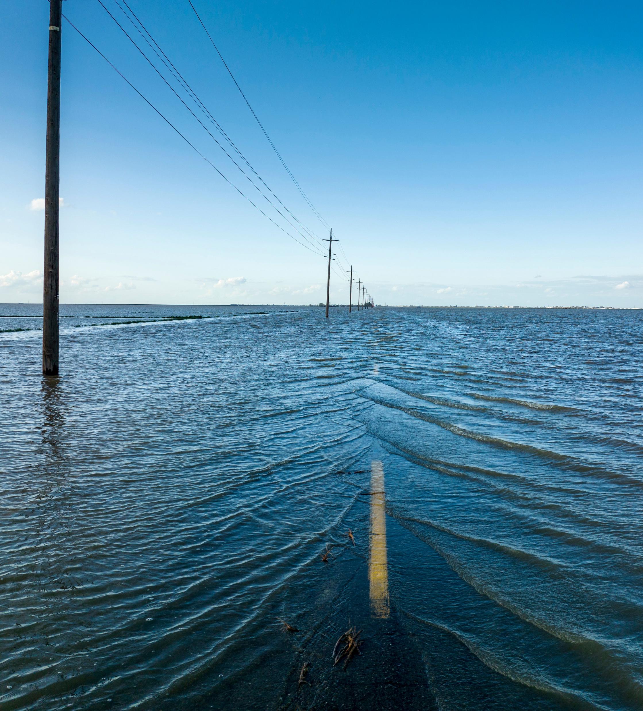
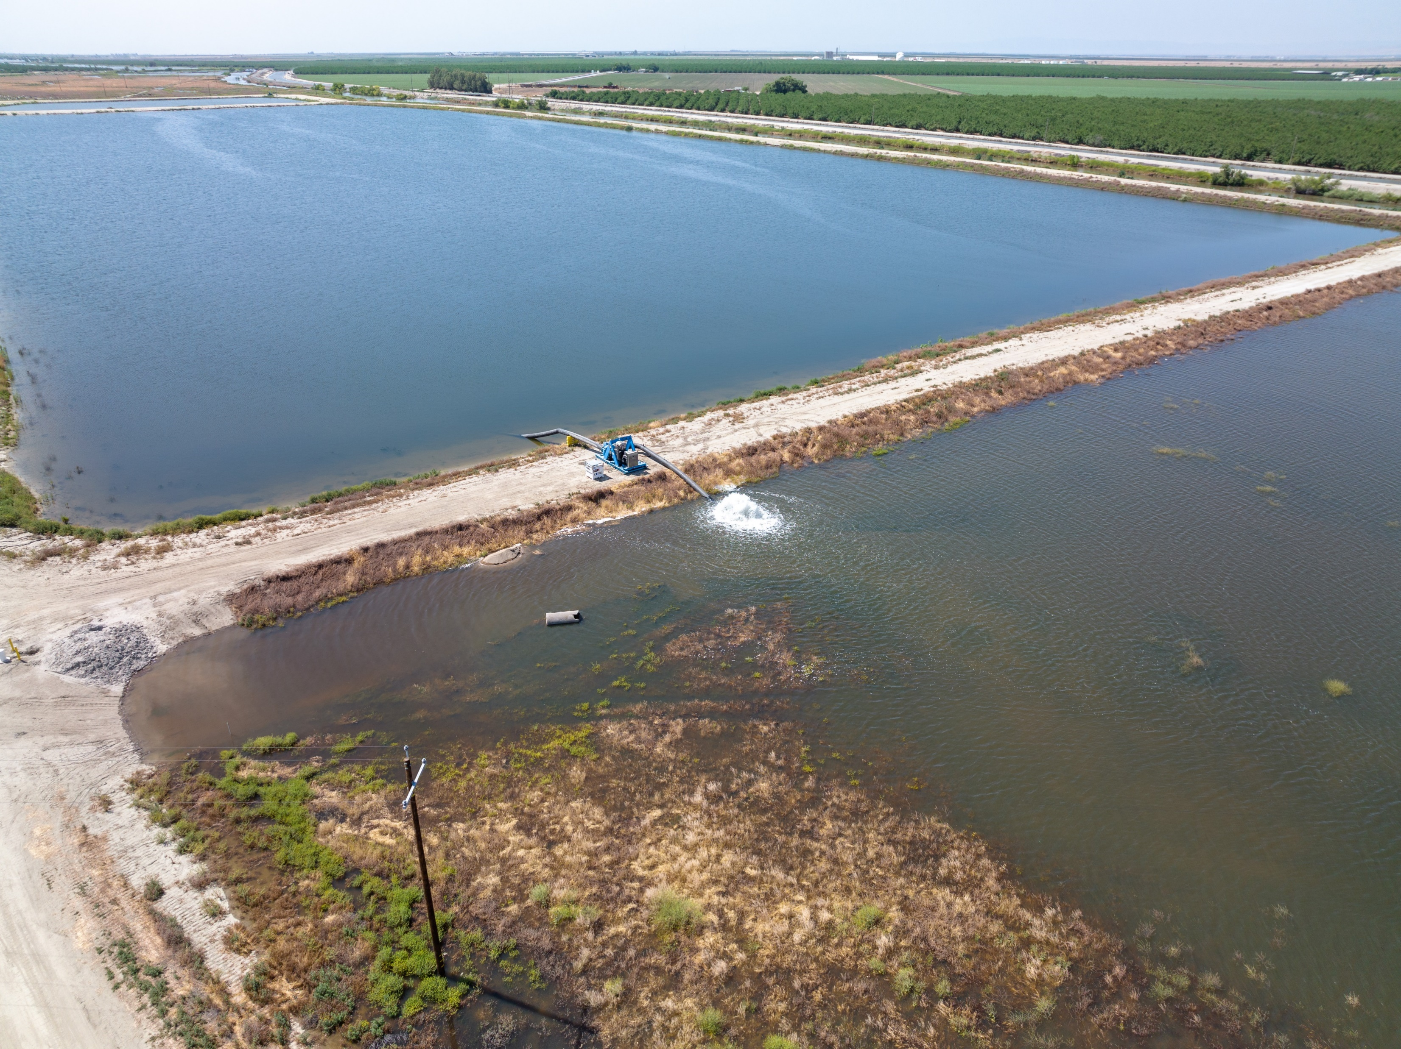
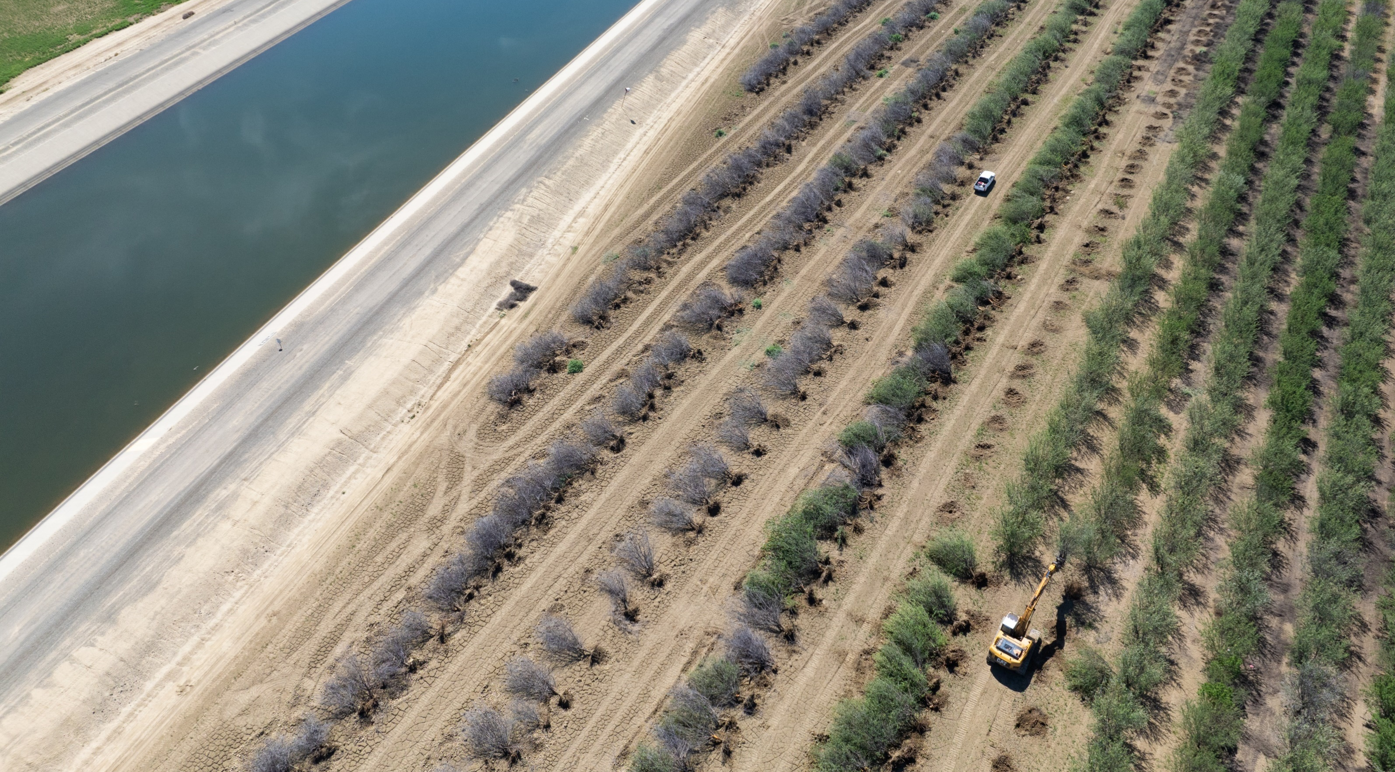
2023 Temporary Flood Diversion and Recharge Enhancement Initiative
Outreach to local agencies in response to Tulare Lake Flood Emergency
DWR assisted 6 local agencies by funding 30 temporary pumps and land clearing equipment to reduce flood risk and enhance groundwater recharge
Recharged 10-15 TAF and cleared 291 acres of land. Small percentage of all local flood diversion and recharge efforts

Slide 36
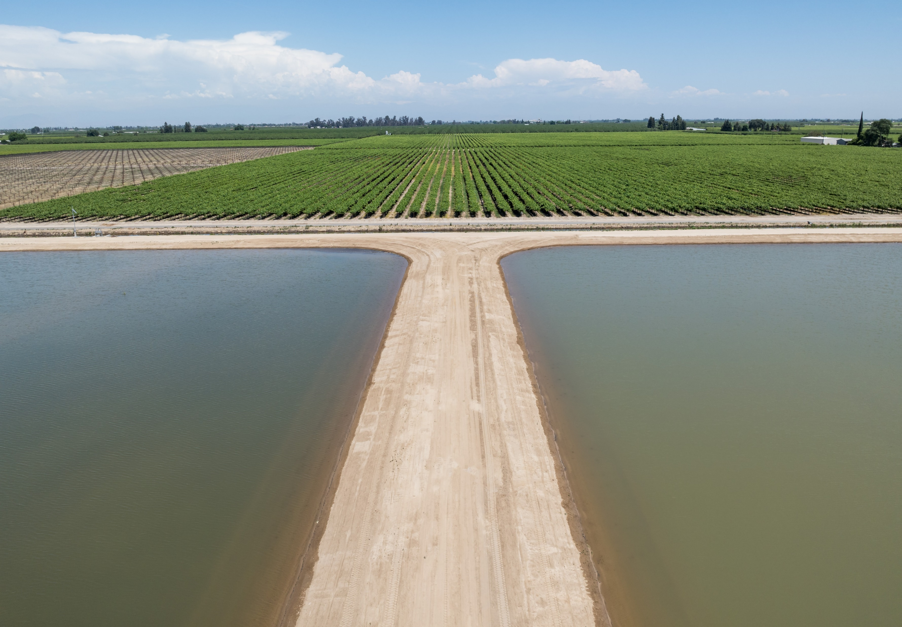
2024 Flood Diversion and Recharge Enhancement Initiative (FDRE)
Building on the success of the 2023 initiative, additional one-time funding was acquired for 2024 to provide similar assistance
Working with 14 local agencies
FDRE assistance includes:
  Temporary flood basins
  Temporary flood diversion equipment
    Pumps, siphons, and protective screens
  Conveyance improvements
  Land clearing

Slide 37
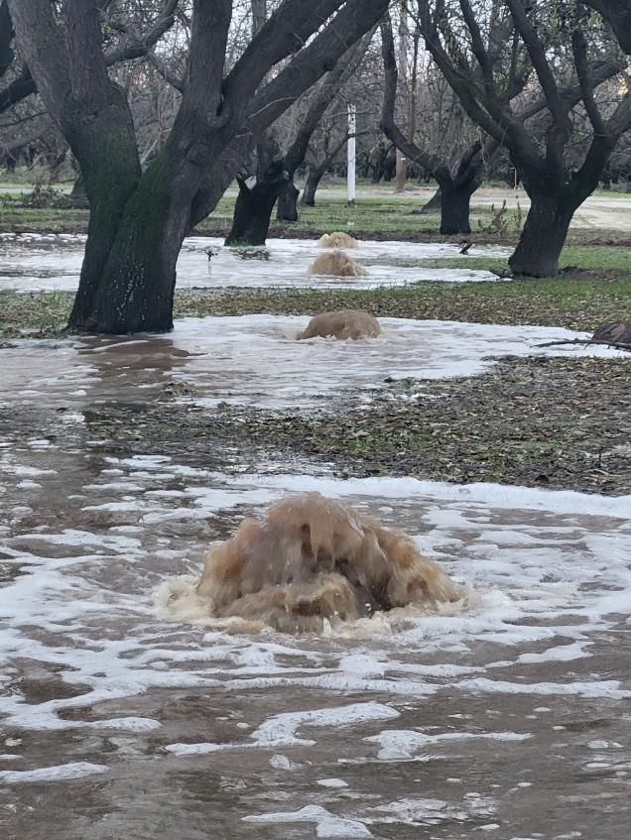
DWR Temporary Permit Technical Assistance
DWR provided technical assistance for 12 temporary permit applications for winters 2023-2025:
  Winter 2023: 2 applications
  Winter 2024: 7 applications
  Winter 2025: 3 applications
Assistance included:
  Technical analysis for water availability and downstream impacts
  Compilation of application and first year fees paid
  Support for other permit terms and conditions

Slide 38
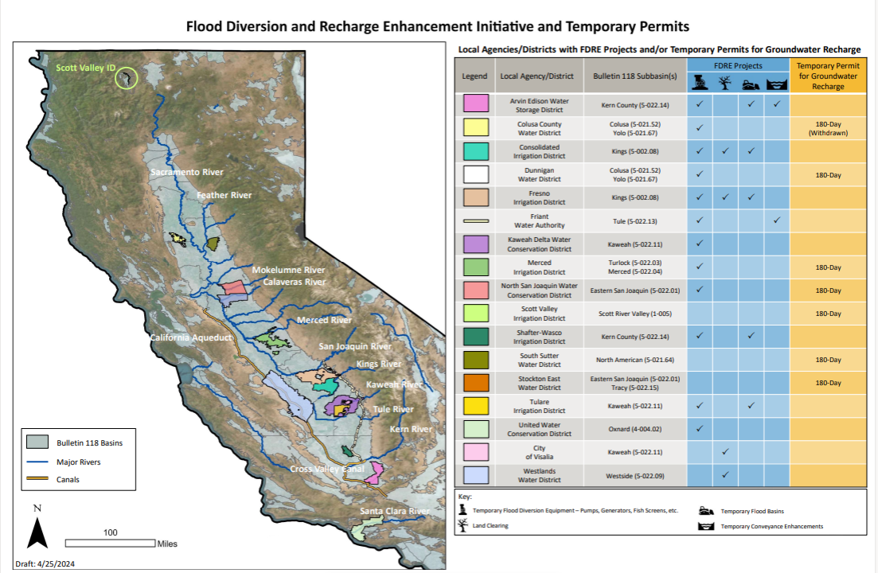

Slide 39
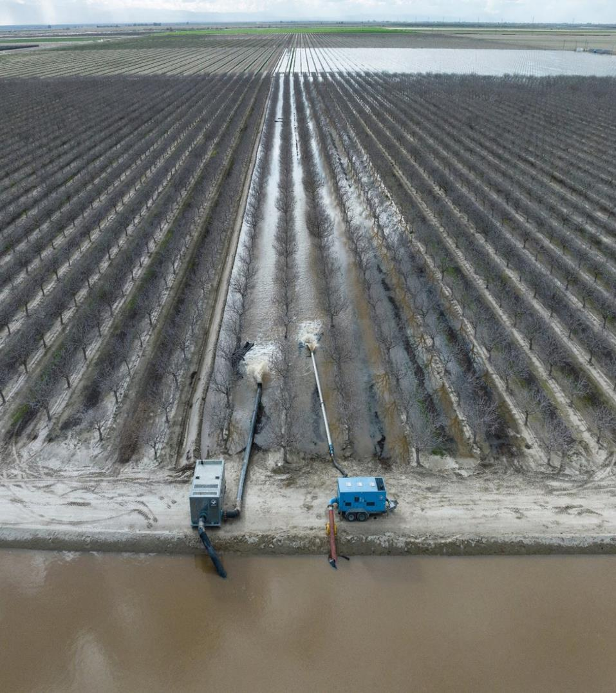
Key Takeaway
Funding for FDRE and permitting assistance are exhausted; however, the main key takeaway from these efforts: Early planning is crucial
Temporary pump diversions
  Takes time to establish a contract with pump vendors, early contact for predesign and quote of a system is best
  Costs are higher in an emergency setting, emergency rates often apply
  Pump inventories are limited, and demand is high in emergency events. Pumps are available on a first come, first served basis

Slide 40
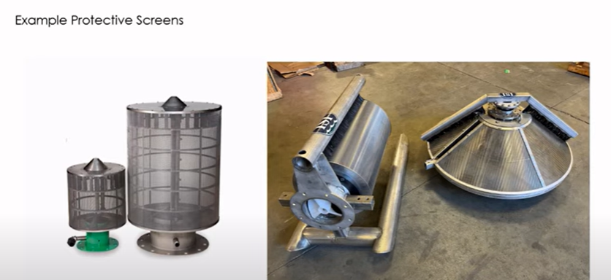
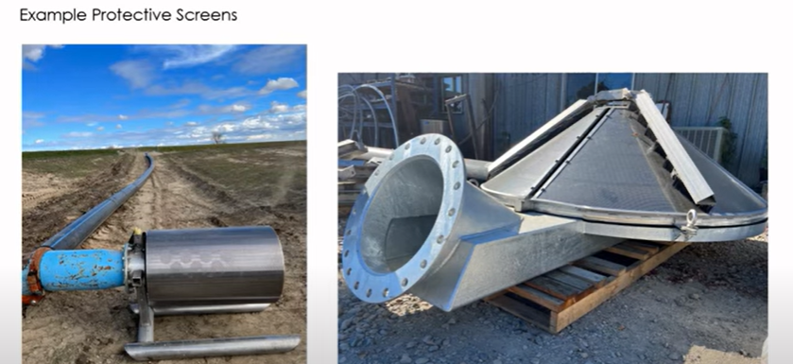
Key Takeaway (cont.)
Protective screens for temporary pumps
  Early consultation for protective screens is key
  Protective screen design can take several weeks and is very site specific
  Temporary pump vendors will often work with protective screen vendors to design a screen appropriate for the pump system and site location, and then include the protective screen costs in the temporary pump contract as a ‘sale’ item
  Some protective screen vendors work directly with agencies (and do not work with pump vendors)
Early coordination and project scoping with SWRCB and CDFW is encouraged
  Points of diversion
  Recharge lands
  Biological assessment
From CDFW SB 122 Screens Workshop: https://www.youtube.com/watch?v=1TqsZrzJ6nE

Slide 41
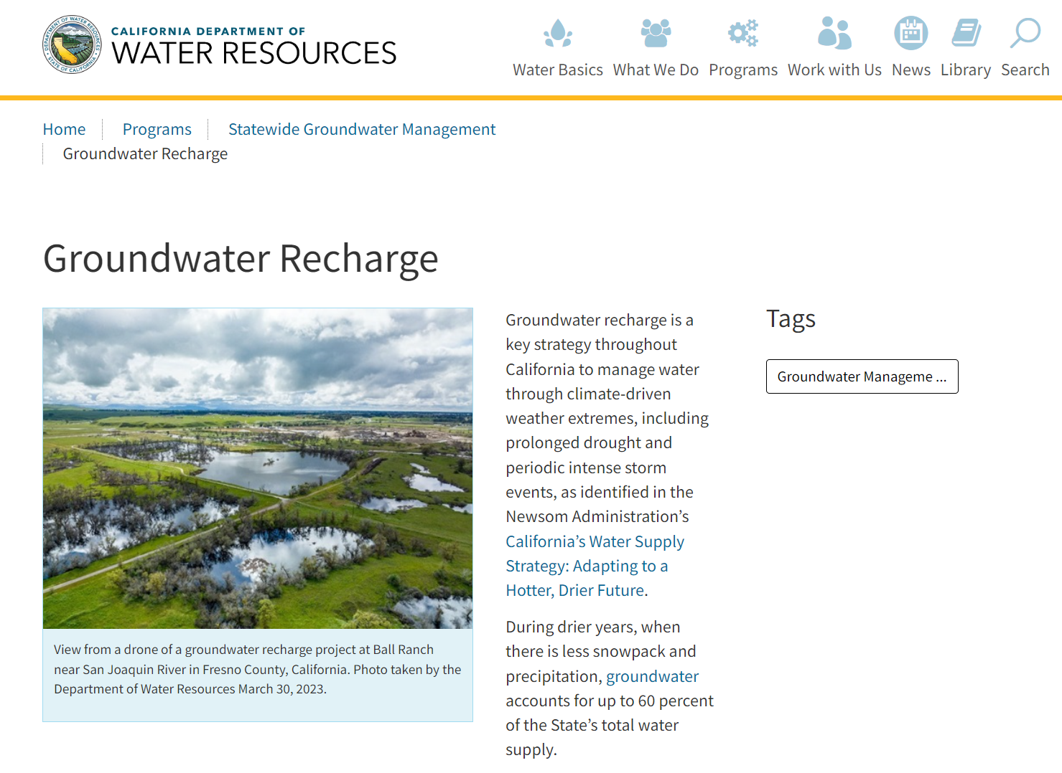
Resources and Coordination
Upcoming information about the protective screen design process for temporary pump locations
Additional information and resources can be found at DWR’s Groundwater Recharge webpage
  https://water.ca.gov/Programs/Groundwater-Management/Groundwater-Recharge
DWR Next Steps
  Continue to encourage partnerships between groundwater and flood managers at all levels
    For more information and/or questions, email: sgmps@water.ca.gov
  Preseason preparedness – FDRE integration with DWR’s Flood Management outreach efforts

Slide 42
Streamlined Pathway: https://www.waterboards.ca.gov/waterrights/water_issues/programs/applications/groundwater_recharge/streamlined_permits.html
eWRIMS: https://ciwqs.waterboards.ca.gov/ciwqs/ewrims/EWPublicTerms.jsp
WROF: https://public2.waterboards.ca.gov/mt/Home/Index
Pending Temporary Permits: https://www.waterboards.ca.gov/waterrights/water_issues/programs/applications/groundwater_recharge/pending_applications.html
Groundwater Recharge Homepage: https://www.waterboards.ca.gov/waterrights/water_issues/programs/applications/groundwater_recharge/
Groundwater Recharge FAQ: https://www.waterboards.ca.gov/waterrights/water_issues/programs/applications/groundwater_recharge/faqs.html
CDFW FAQs: https://nrm.dfg.ca.gov/FileHandler.ashx?DocumentID=215081&inline
DWR Groundwater Recharge: https://water.ca.gov/Programs/Groundwater-Management/Groundwater-Recharge

Slide 43
Questions
After the meeting you may submit your questions to Erica Thompson at Erica.Thompson@waterboards.ca.gov
Mike Conway – will answer questions from the chat

Slide 44
Thank you!

