Slide 1
California water fix
South Delta Water Agency Parties
Rebuttal Testimony, Part 1
THOMAS BURKE, P.E.
Principal, Hydrologic Systems
SDWA Exhibit 258

Slide 2
Impacts From The HORB Implemented In The PA
HORB Operations
Impacts To Stage
Impacts To WQ
SDWA Exhibit 258

Slide 3
Analysis of Impacts
DSM2 Model
  82 Year Period In The BA
  16 Year Period For Boundary Condition
  Enhanced Probability Analysis
Scenarios
  Preferred Alternative (PA)
  No Action Alternative (NAA)
  From The Biological Assessment
SDWA Exhibit 258

Slide 4
HORB Operations
SDWA Exhibit 258

Slide 5
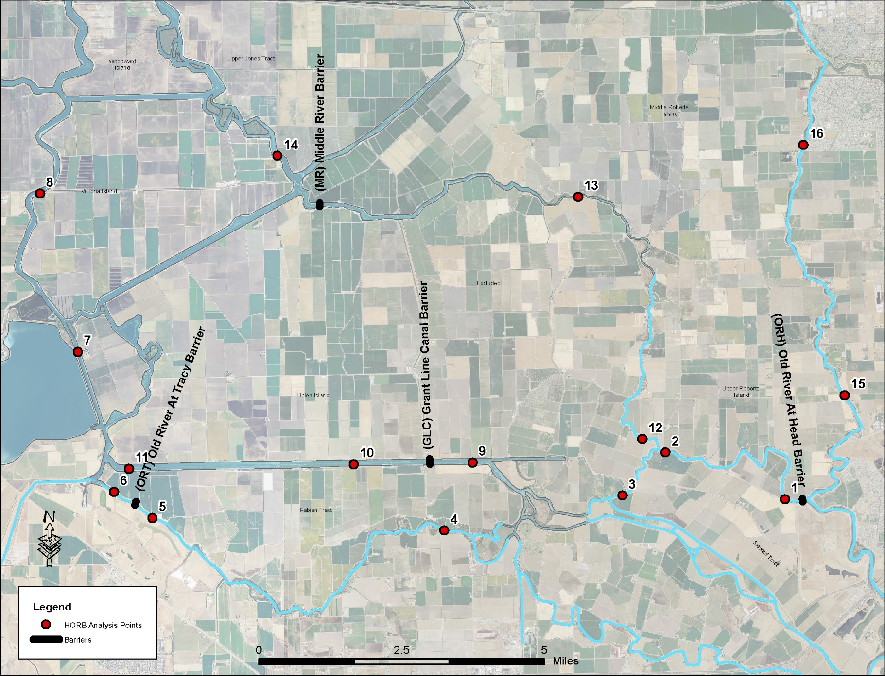
Analysis Points
SDWA Exhibit 258

Slide 6
Analysis of Stage Impacts
Comparison Of The PA To The NAA
SDWA Exhibit 258

Slide 7
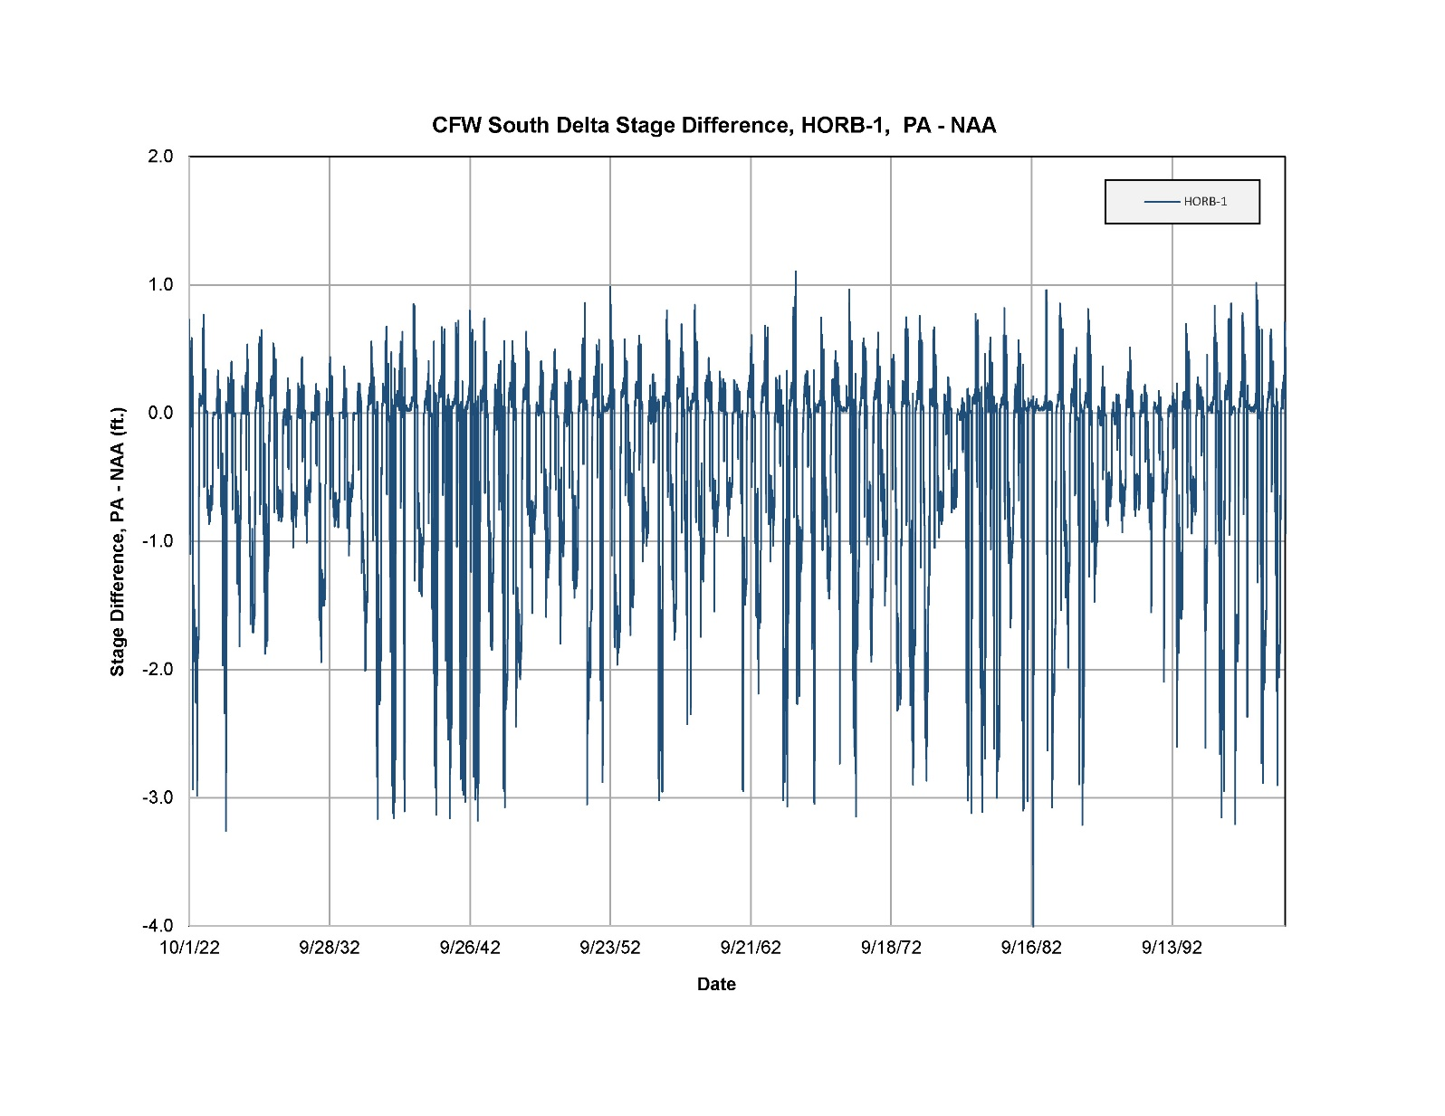
SDWA Exhibit 258

Slide 8
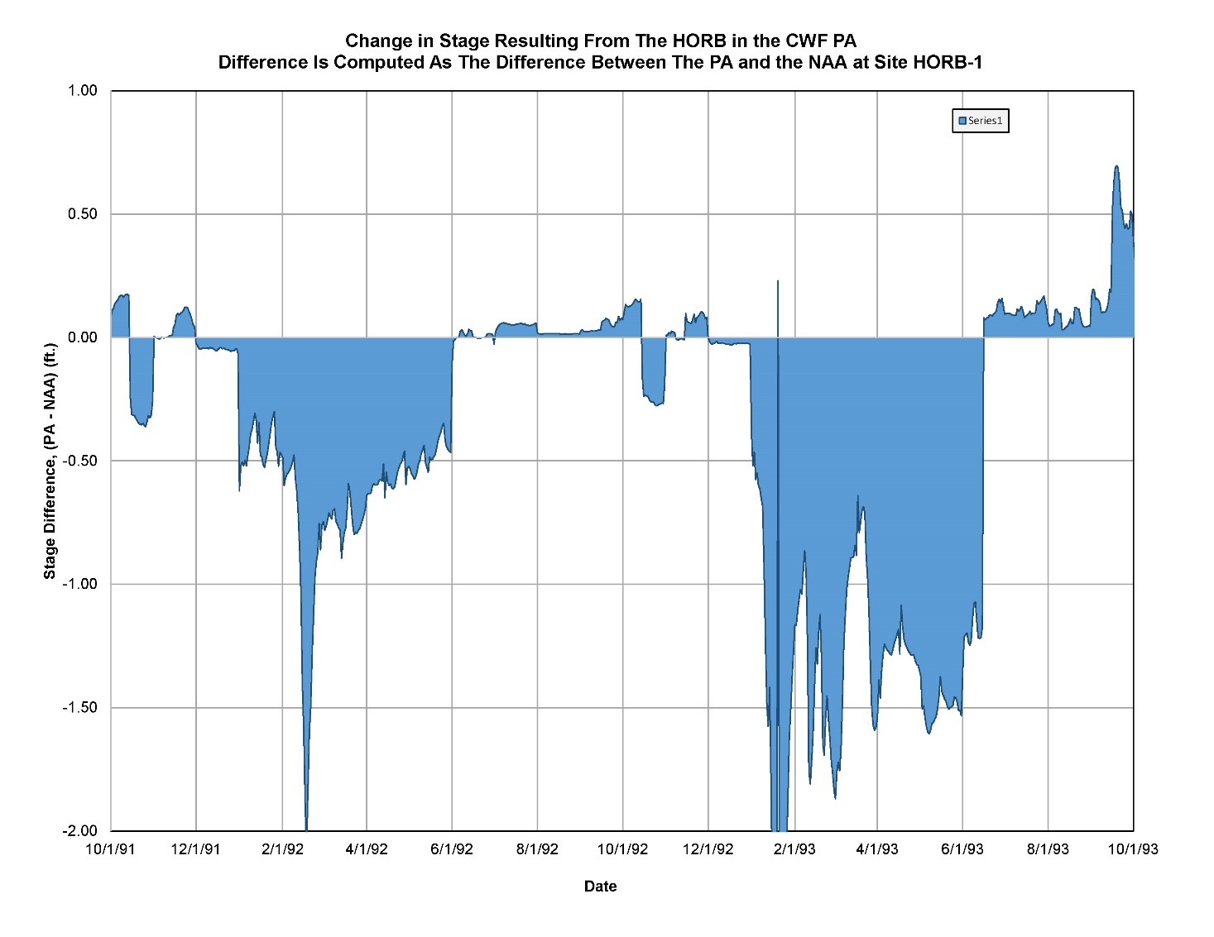
SDWA Exhibit 258

Slide 9
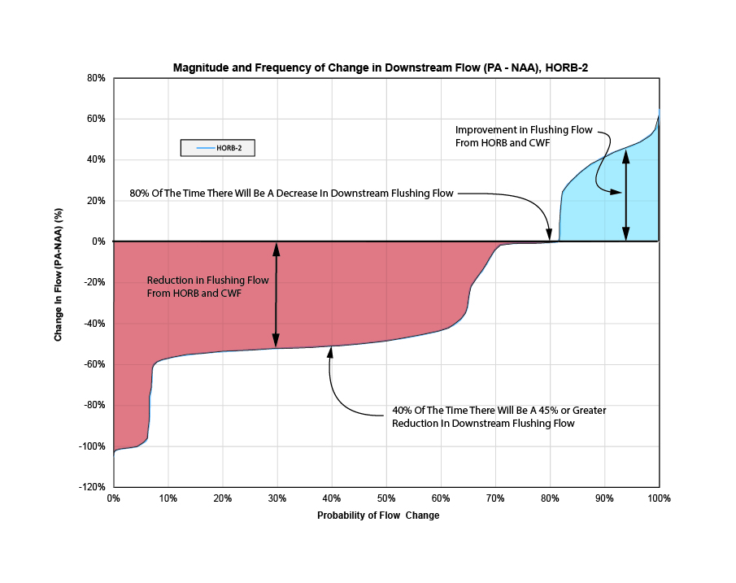
SDWA Exhibit 258

Slide 10
Change In River Stage
SDWA Exhibit 258

Slide 11
Existing Issues With Stage
Channel Siltation
DSM2 Channel Invert Accuracy
Ability To Irrigate
  Pumps
  Siphons
SDWA Exhibit 258

Slide 12
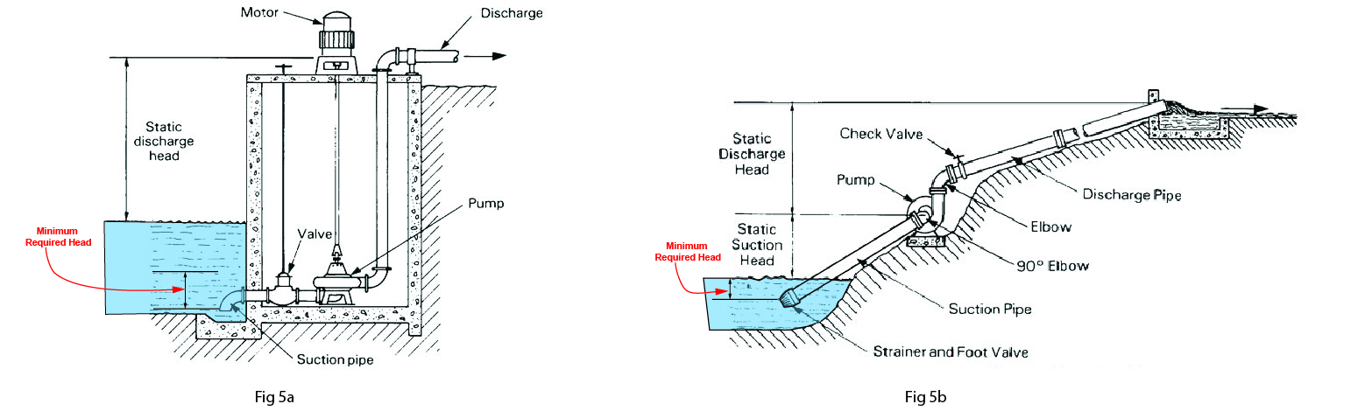
Water Depth Required For Pumping
SDWA Exhibit 258

Slide 13
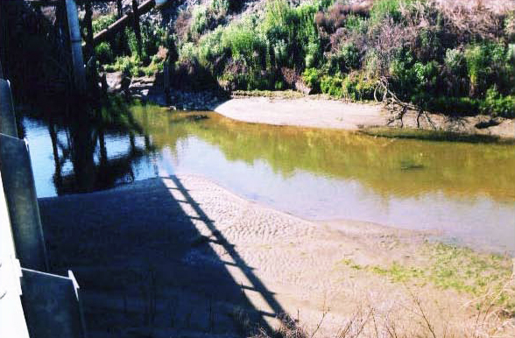
Middle River April 2007
SDWA Exhibit 258

Slide 14
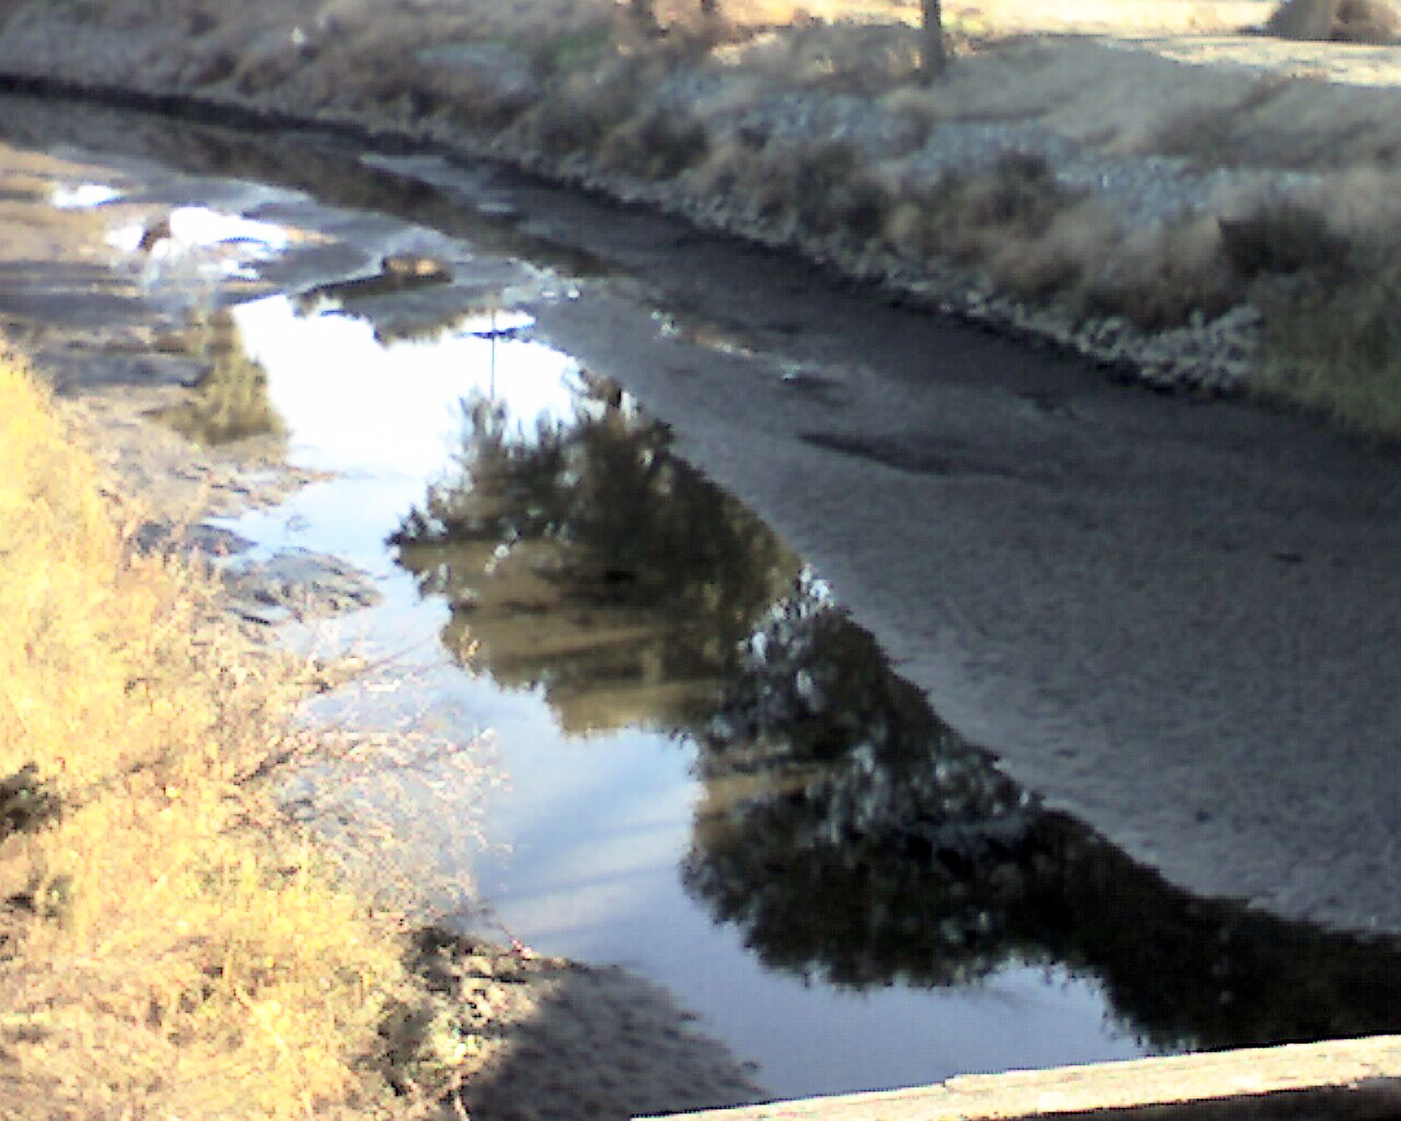
Middle River November 2007
SDWA Exhibit 258

Slide 15
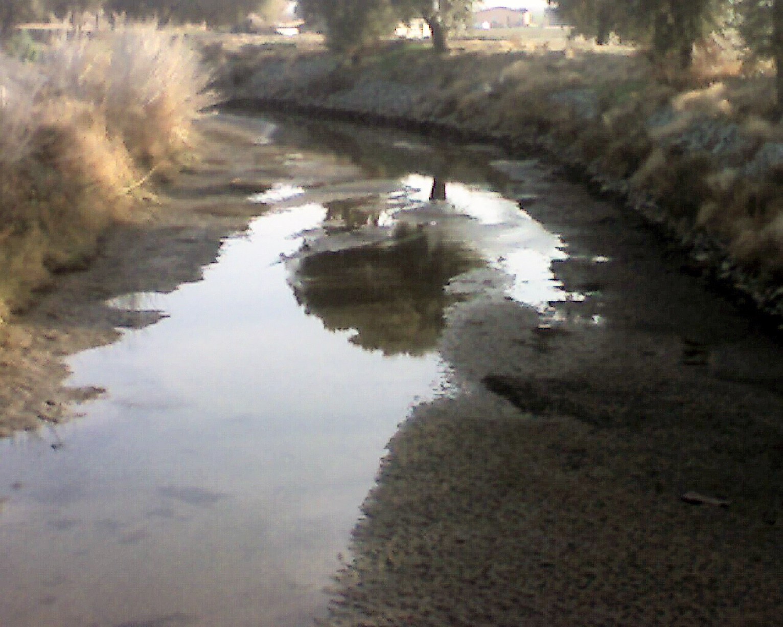
Middle River November 2007
SDWA Exhibit 258

Slide 16
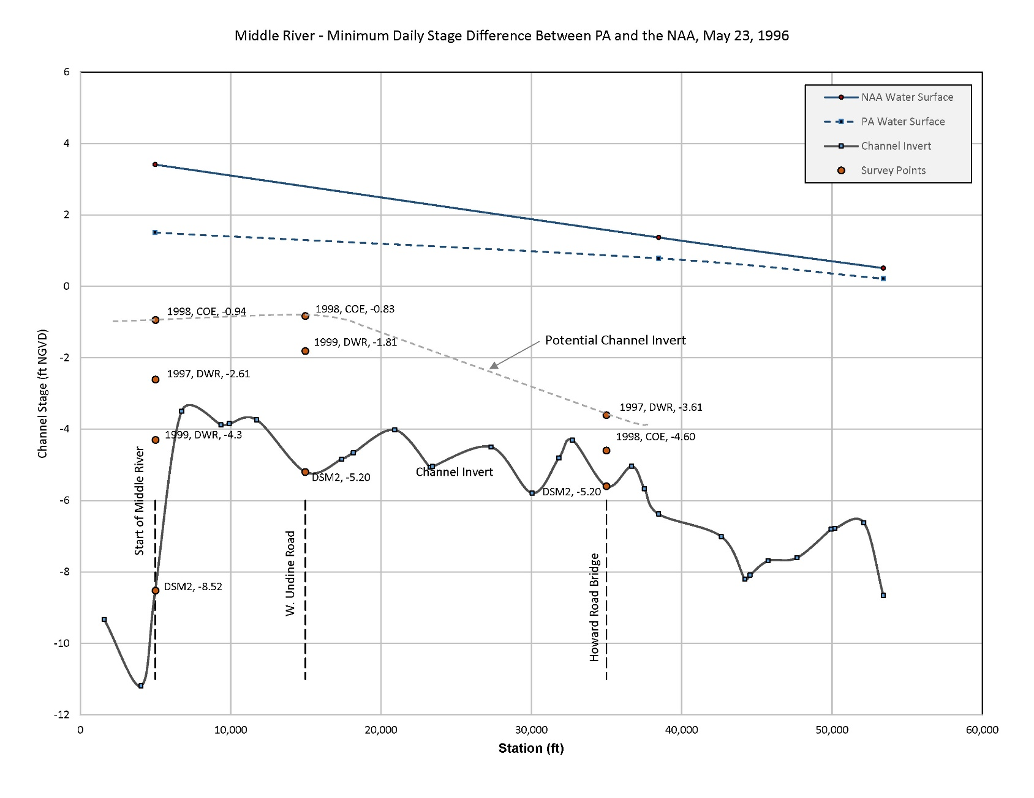
Middle River Stage Profile
SDWA Exhibit 258

Slide 17
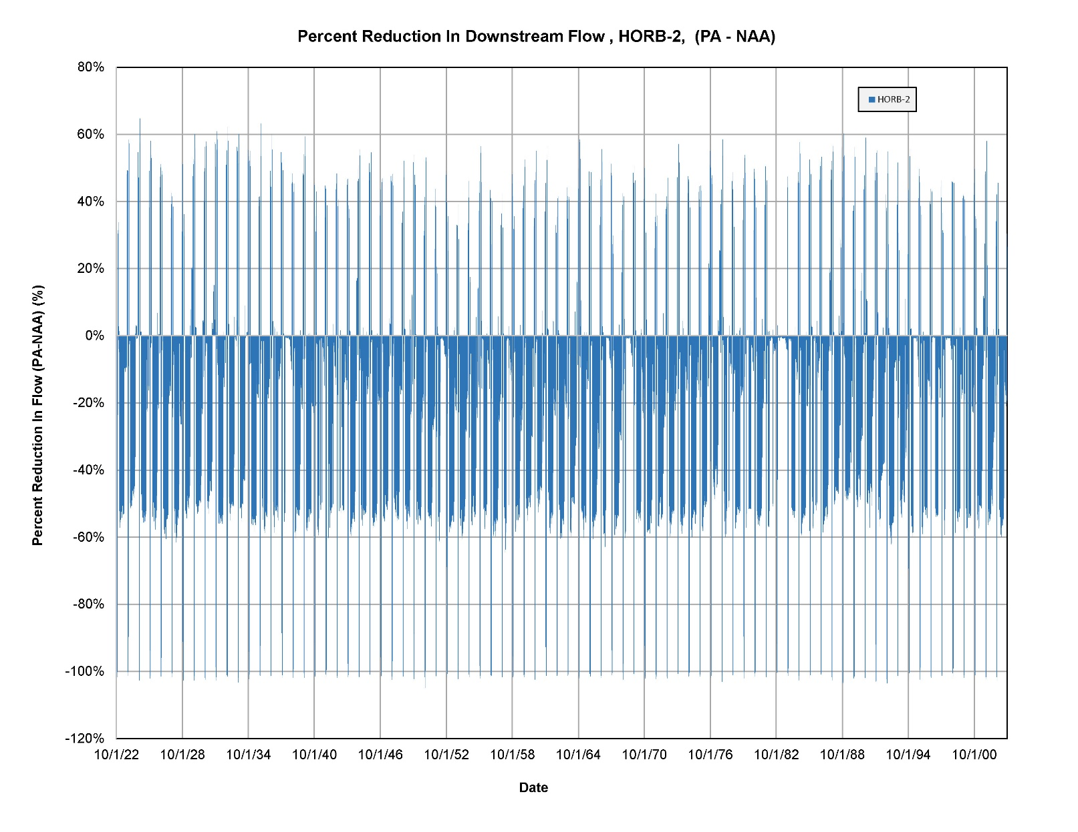
Reduction In Flushing Flow
SDWA Exhibit 258

Slide 18
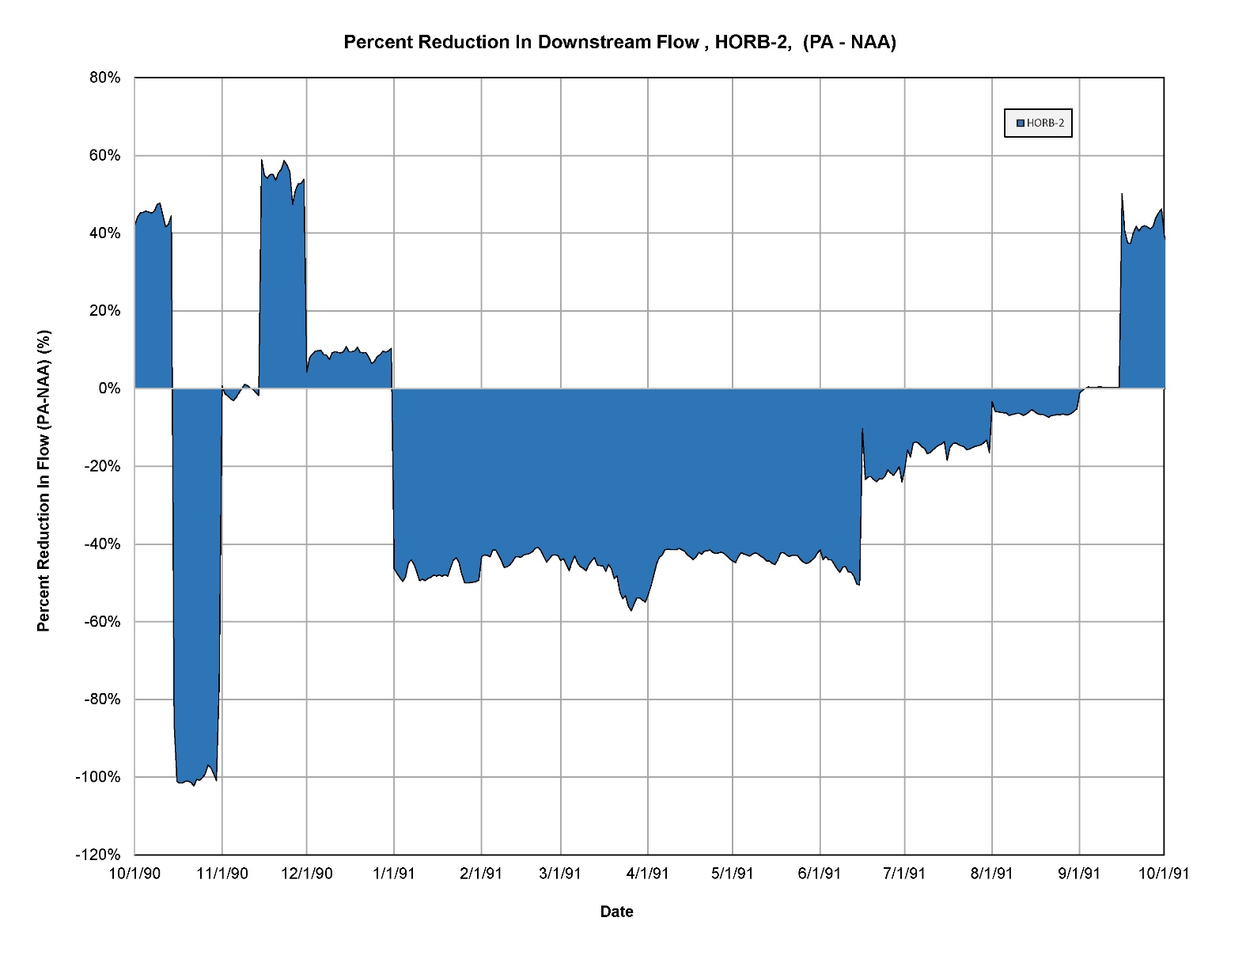
Reduction In Flushing Flow
SDWA Exhibit 258

Slide 19
Frequency of Downstream Flow Changes
SDWA Exhibit 258

Slide 20
Change In Downstream Flushing Flow
Percent Change In Flow Between The PA and the NAA (%)
 | Exceedance Value
Site | 10% | 20% | 50%
1 | -57% | -54% | -48%
2 | -57% | -54% | -48%
3 | -58% | -54% | -49%
4 | -83% | -57% | -46%
5 | -164% | -86% | -47%
6 | -163% | -86% | -47%
7 | -118% | -97% | -30%
8 | -122% | -98% | -30%
9 | -67% | -60% | -51%
10 | -68% | -60% | -51%
11 | -72% | -62% | -50%
12 | -64% | -54% | -34%
13 | -245% | -130% | -59%
14 | -114% | -90% | -26%
15 | -23% | 0.3% | 57%
16 | -23% | 0.3% | 58%
SDWA Exhibit 258

Slide 21
Summary
Stage Impacts
Model Representation of The Correct Channel Invert
Impacts To Flushing Flow
SDWA Exhibit 258

