Slide 1
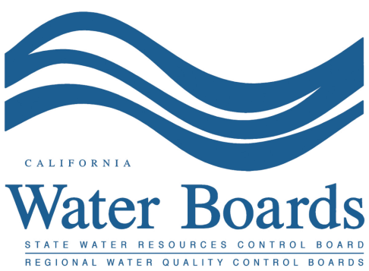
Phase 4 of Bay-Delta Effort: Overview & Background
Method to Develop Flow Criteria for Priority
Tributaries to the Bay-Delta Workshop
Erin Ragazzi
March 19, 2014

Slide 2
Presentation Outline
Definitions
General Background on State Water Board & Authority
Phase 4 Overview – Flow Objectives for Priority Tributaries (Sacramento River focus)
Next Steps
Resources

Slide 3
DEFINITIONS
Flow Criteria
Flow Objective
Public Trust
Beneficial Uses

Slide 4
Flow Criteria (focus of today’s workshop)
The range of instream flow needed to ensure the viability of aquatic dependent species, and to support geomorphic processes that create and maintain habitat
Provide the technical basis for the development of flow objectives
Do not consider competing uses of water
Do not have regulatory effect

Slide 5
Flow Objectives
The quantity of instream flow required to maintain ecologically sustainable watersheds, while concurrently balancing all beneficial uses of water
State Water Board determination that has regulatory effect
Tributary-specific flow objectives will be developed as a component of tributary-specific policies

Slide 6
Public Trust
The State Water Board is responsible for the protection of public trust uses, including commerce, navigation, recreation, and habitat for fish and wildlife, which are held in trust for the public.
The State Water Board must consider these responsibilities when planning and allocating water resources, and protect public trust uses whenever feasible.

Slide 7
Beneficial Uses of Water
Beneficial uses of water, pertaining to water rights include: domestic; irrigation; power; municipal; mining; industrial; fish and wildlife preservation and enhancement; aquaculture; recreational; stock watering; water quality; frost protection; and heat control.
California Code of Regulations (CCR) §659-672

Slide 8
Beneficial Uses of Water (con’t)
Water quality control plans (basin plans) also designate beneficial uses
Beneficial uses of waters of the state that “may be protected against quality degradation include, but are not limited to: domestic, municipal, agricultural and industrial supply; power generation; recreation; aesthetic enjoyment; navigation; and preservation and enhancement of fish, wildlife, and other aquatic resources or preserves” - Water Code §13050
Examples: water contact recreation, cold and warm freshwater habitat, cold and warm water spawning habitat, agricultural supply, commercial and sport fishing, etc.

Slide 9
State Water Board Background & Authority

Slide 10
State Water Board’s Mission
To preserve, enhance and restore the quality of California’s water resources, and ensure their proper allocation and efficient use for the benefit of
present and future generations

Slide 11
Authorities
Dual authorities (water allocation and water quality protection) to provide comprehensive protection of California’s waters
Protect and enforce water quality standards (beneficial uses + water quality objectives + antidegradation)
Protect public trust resources
Balancing role

Slide 12
Recent History
2009 Delta Reform Act (Senate Bill X7-1)
Water Code §§ 85086 & 85087

Slide 13
Water Code (Delta Reform Act)
§85086
§85087
“For the purpose of informing planning decisions for the Delta Plan and the Bay Delta Conservation Plan, the board shall, pursuant to its public trust obligations, develop new flow criteria for the Delta ecosystem necessary to protect public trust resources”
“The board […] shall submit to the Legislature a prioritized schedule and estimate of costs to complete instream flow studies for the Delta and for high priority rivers and streams in the Delta watershed […] and for all major rivers and streams outside the Sacramento River watershed […]”

Slide 14
History Continued
2010: State Water Board submittal to Legislature – Instream Flow Studies for the Protection of Public Trust Resources: A Prioritized Schedule and Estimate of Costs
Included 138 rivers and streams (28 Delta tributaries)
Determined which rivers and streams should be prioritized for instream flow studies
2010: State Water Board completed report: Development of Flow Criteria for the Sacramento-San Joaquin Delta Ecosystem
http://www.waterboards.ca.gov/publications_forms/publications/legislative/docs/2011/instream_flow2010.pdf

Slide 15
History Continued
2013: Delta Stewardship Council’s Final Delta Plan
Co-equal goals:
Provide a more reliable water supply for California
Protect, restore, and enhance the Delta ecosystem
Directs State Water Board “By June 2, 2018, adopt, and as soon as reasonably possible, implement flow objectives for high-priority tributaries in the Delta watershed that are necessary to achieve the coequal goals”

Slide 16
State Water Board Bay-Delta Activities
Phase 1: Bay-Delta Plan review and update of the San Joaquin River flow and southern Delta salinity objectives and program of implementation
Phase 2: Comprehensive review and update of other components of the Bay-Delta Plan and program of implementation
Phase 3: Amendment of water rights and other measures to implement changes to the Bay-Delta Plan resulting from Phases 1 and 2
Phase 4: Development and implementation of flow criteria and flow objectives for priority tributaries to the Sacramento-San Joaquin Delta watershed, with a focus on the Sacramento River watershed

Slide 17
Phase 4 Goal
Focus on Sacramento River watershed
Establish and implement flow objectives for a minimum of five priority tributaries in the Bay-Delta watershed by 2018 – as policies for water quality control
Work to continue on remaining priority tributaries thereafter
Consistent with Delta Stewardship Council’s Final Delta Plan

Slide 18
Phase 4 Objectives
Achieve characteristics of a natural hydrograph
Inter-annual variability
Intra-annual events
Restore natural fluvial processes
Inundate floodplains
Flush fines
Maintain channel habitat
Restore natural high flow recession rates
Prevent juvenile salmonid stranding
Promote riparian seed dispersal
Trigger natural species reproduction patterns

Slide 19
Phase 4 Objectives
Restore self-sustaining resilient populations of anadromous salmonids and other native species
Preserve existing beneficial uses of water to the maximum extent possible
Minimize impacts to water right holders

Slide 20
Phase 4 Process
Development of non-binding flow criteria (discussion of this workshop)
Development of flow objectives and implementation plans
Development of policies for water quality control
Implementation of policies through conditioning of water rights and other measures as appropriate

Slide 21
Policies for Water Quality Control (Water Code §§13140-13147)
Tributary-specific
Include flow objective(s), implementation plan, and adaptive management
Principles, guidelines, and requirements for maintaining instream flows and habitat connectivity to protect public trust resources, while minimizing impacts on other beneficial uses of water
Complement or enhance existing efforts to make significant positive progress towards protection of public trust resources and other beneficial uses of water

Slide 22
Flow Criteria Method Objectives
Leverage limited resources available to conduct needed studies over large geographic area
Applicable to bulk of each tributary’s watershed
Address multiple species or life stages and fluvial processes
Responsive to critical and time-sensitive need to address flow-related impacts contributing to the decline of threatened and endangered species

Slide 24
Major Tributaries in the Phase 4 Planning Area (in alphabetical order)
American River | Clear Creak | Mill Creek
Antelope Creek | Cosumnes River | Mokelumne River
Auburn Ravine | Cottonwood Creek | Paynes Creek
Battle Creek | Cow Creek | Sacramento River (below Keswick)
Bear River | Deer Creek | Stony Creek
Big Chico Creek | Dry Creek | Thomes Creek
Butte Creek | Feather River | Yuba River
Calaveras River | McClure Creek
Flow Objectives to be developed as part of Phase 1 Bay-Delta Plan Update
Merced River
San Joaquin River
Stanislaus River
Tuolumne River

Slide 25
Flow Criteria Development (to date)
July 2013: State Water Board submitted Request for Recommendation of Method to Develop Flow Criteria for Priority Tributaries to the Sacramento-San Joaquin Delta to the Delta Science Program
Scientifically Defensible
Cost-effective
Applicable to the bulk of each tributary’s watershed
Can be implemented in a timely fashion

Slide 26
Flow Criteria Development (to date)
February 2014: Delta Science Program transmitted the report developed by an independent review committee - Recommendations for Determining Regional Instream Flow Criteria for Priority Tributaries to the Sacramento-San Joaquin Delta

Slide 27
Phase 4 Next Steps
Public Comment Period ends at Noon (12:00 pm) on April 18, 2014
Staff will review comments received to develop a recommendation for the State Water Board regarding its process to develop instream flow criteria for priority tributaries as part of the Phase 4 process
Staff recommendation to be incorporated into Phase 4 Strategy document

Slide 28
Phase 4 Next Steps (con’t)
Develop Strategy for Establishing Flows for Tributaries to the Bay-Delta (Phase 4 Strategy); Anticipate Strategy will contain:
Goals and objectives of Phase 4 effort
Overview of process
Flow criteria methodology
Priority Tributaries
Timeframe: Draft Strategy anticipated for release for public comment in Fall 2014

Slide 29
Phase 4 Resources
Phase 4 Webpage:
http://www.waterboards.ca.gov/waterrights/water_issues/programs/bay_delta/flow_objectives/index.shtml
To receive email subscriptions:
http://www.waterboards.ca.gov/resources/email_subscriptions/
Select “State Water Resources Control Board”
Enter email address and full name
Under Categories, select “Water Rights Topics”
Select “Delta Watershed Flow Objectives (Phase 4 of Bay-Delta effort)”
Click “Subscribe” button at top

Slide 30
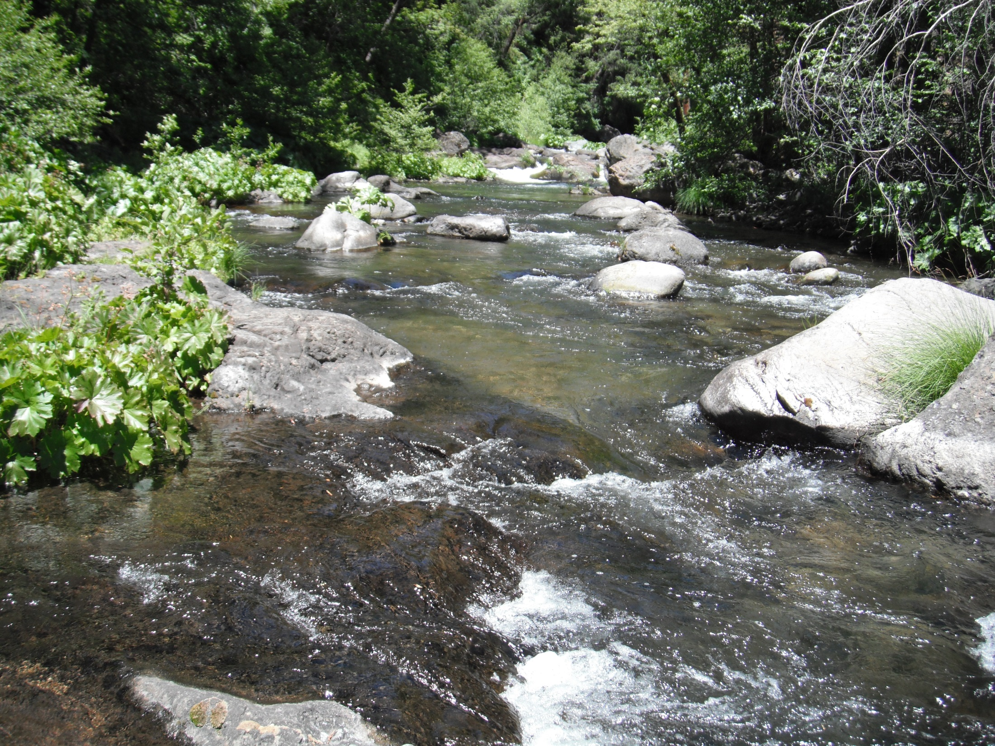
Method to Develop Flow Criteria for Priority
Tributaries to the Bay-Delta Workshop
March 19, 2014

