Slide 1

Evaluation of Carrying Capacity and Limiting Factors for Production of Salmon and Steelhead
in Stanshaw Creek

Slide 2
Evaluation Process
I first reviewed all available information on Stanshaw Creek in correspondence to Marble Mountain Ranch and in reports posted on the internet.
  I completed my report of findings on September 29
I subsequently surveyed Stanshaw Creek from the point of diversion to the Klamath River.
  I completed my report of findings on October 30

Slide 3
Stream Survey Assessments
Impediments to upstream passage
Suitable patches of spawning gravel
Rearing capacity for salmonids
Monitor depth and velocity changes
Notes:
I will not say more about the spawning gravel. I found no patches that desirable for spawning. I did find some that were marginal but were above water, or sloped laterally. All were likely to scour and be redeposited during high and low flows through the winter and spring.

Slide 4
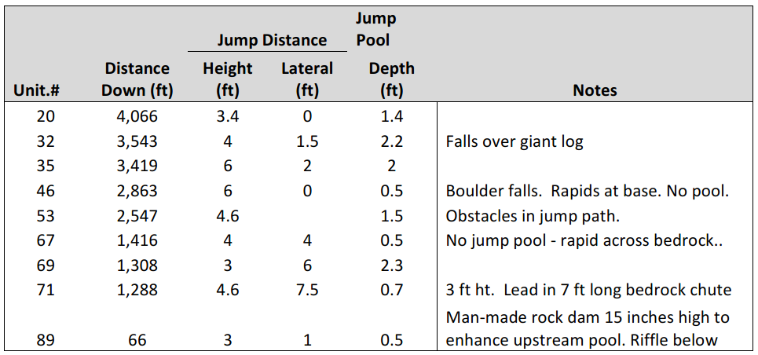
Stanshaw Creek
Potential Barriers to Upstream Passage
Notes:
a jump pool depth of ≥ 1.25 times the vertical height to be jumped. This ratio is also being used by the USFWS in their evaluation of potential passage barriers in the Battle Creek watershed (Early 2004).
Kalama River Falls, Washington, and concluded, “Our data suggest that steelhead do not begin to jump at the KFH barrier until the water temperatures reach 7 or 8°C, and successes occur at temperatures ≥ 10°C.” They also found that jumper success was negatively correlated to flow, i.e., success decreased as flows increased.
Lab tests show that turbulence, air entrainment, and shape of the plunge pool all have large effects on jumping ability
Controlled tests in a laboratory showed that juvnile coho 103 mm long – none passed 32 cm from a 30cm deep pool success was 34% at 12 cm, 20% at 20 cm and 2% at 26 cm.
None of the barriers achieved the 1.25 depth to jump ht ratio.

Slide 5
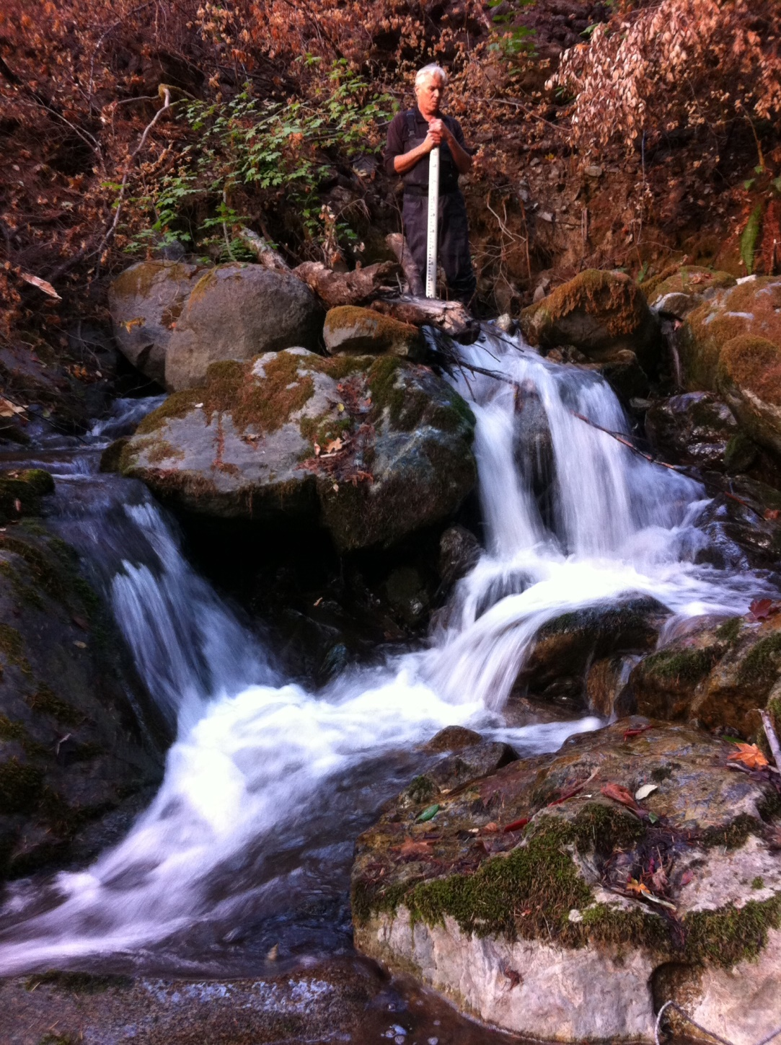
Stanshaw Creek
First natural barrier
40 ft above Hwy 96
4.6 ft vertical
7.5 ft lateral
Jump pool: 0.7 ft deep

Slide 6
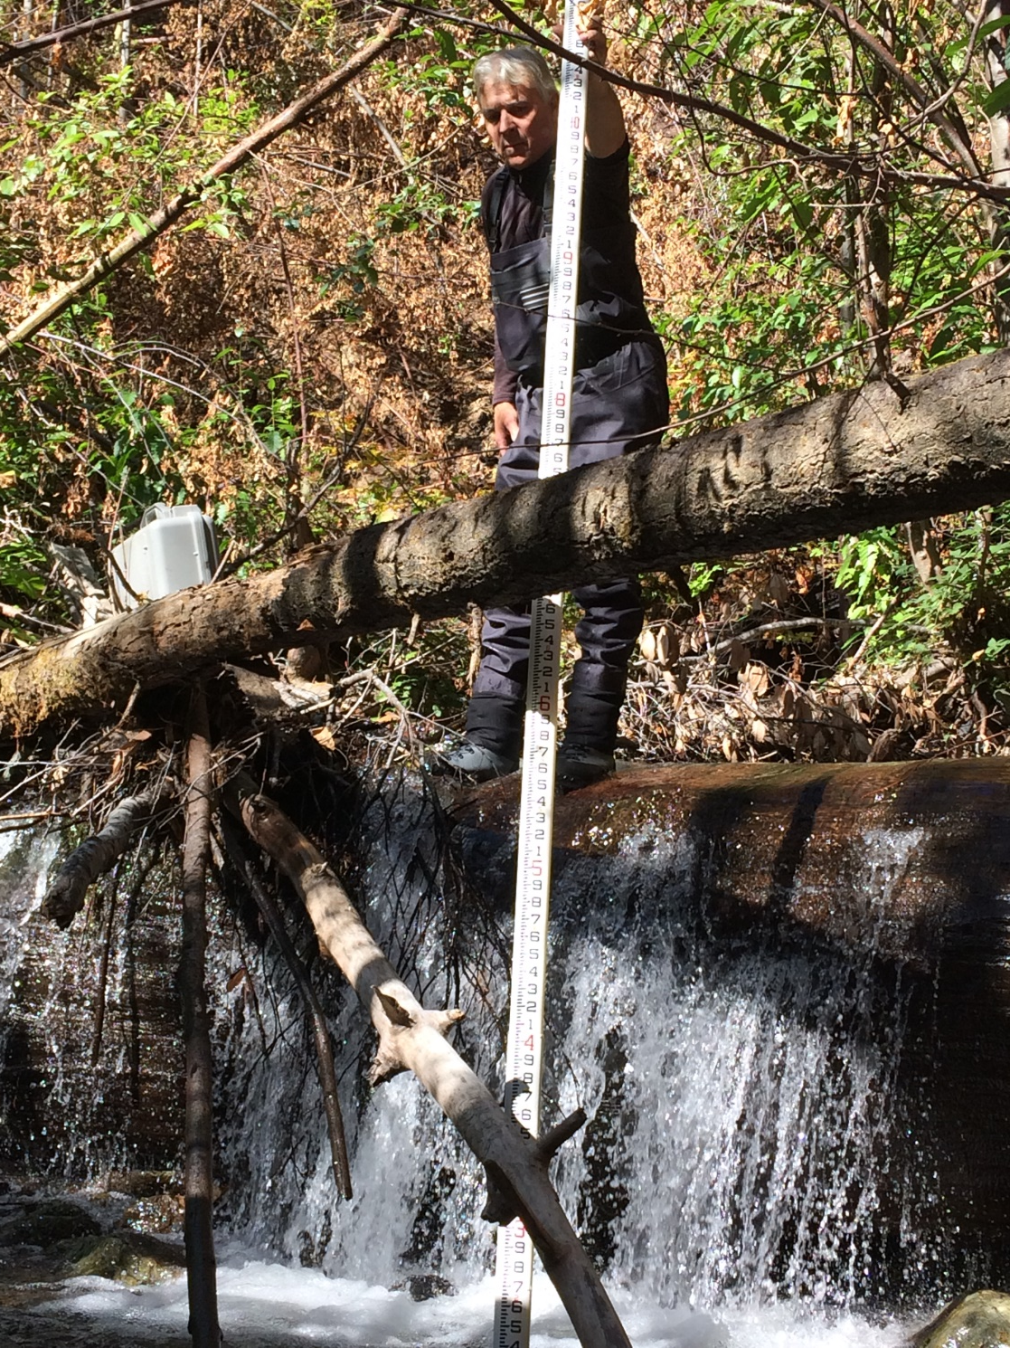
Stanshaw Creek
Barrier @ 2,547 ft
4.6 ft vertical
0.0 ft lateral
Jump Pool
2 ft deep

Slide 7
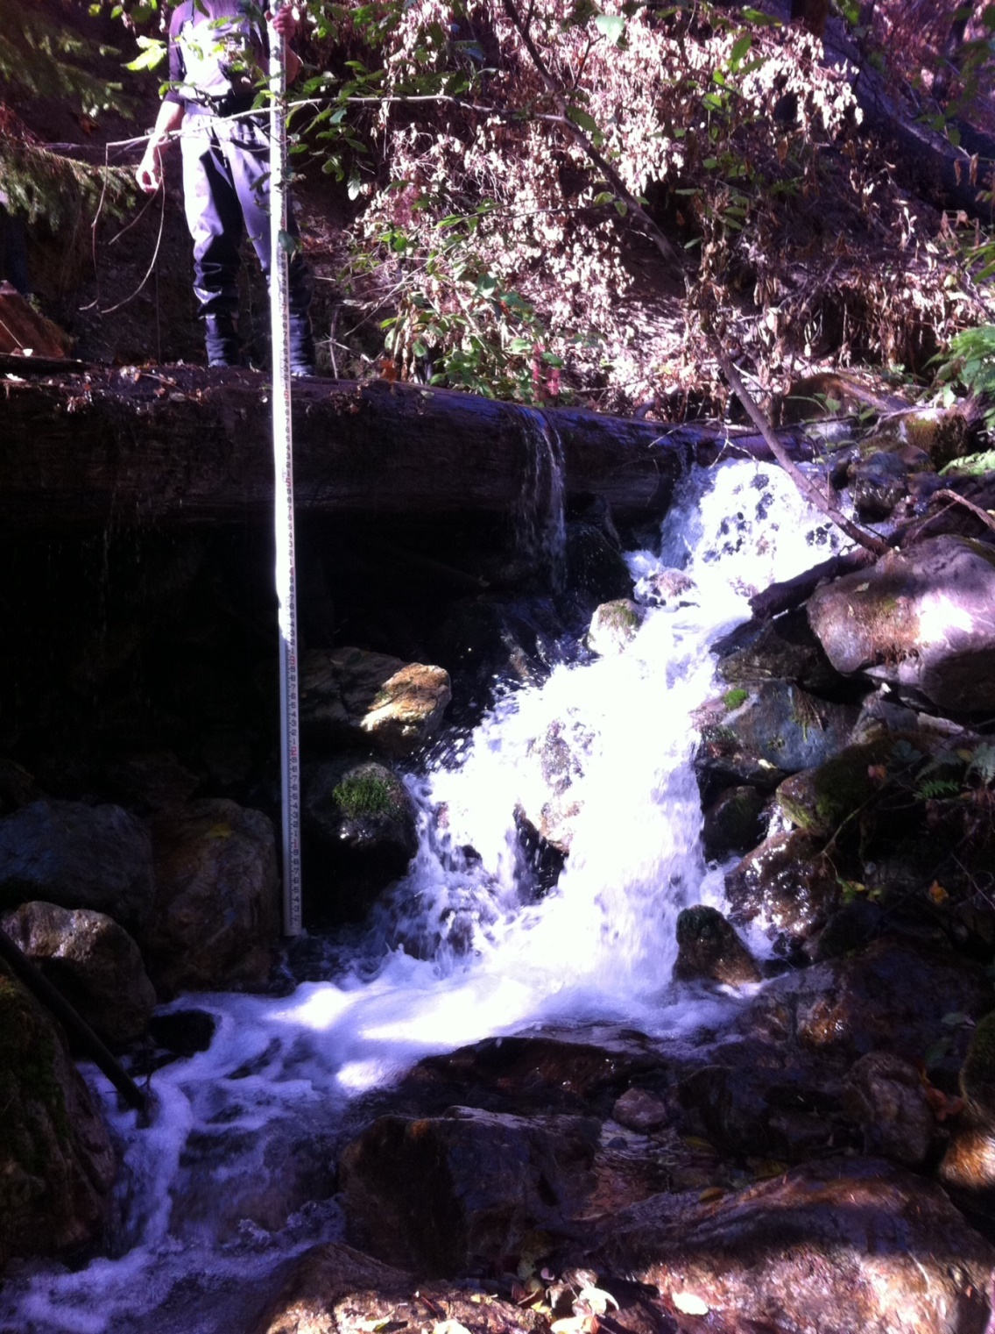
Stanshaw Creek
Barrier @ 3,419 ft
6 ft vertical
2 ft latteral
Jump pocket
2 ft deep

Slide 8
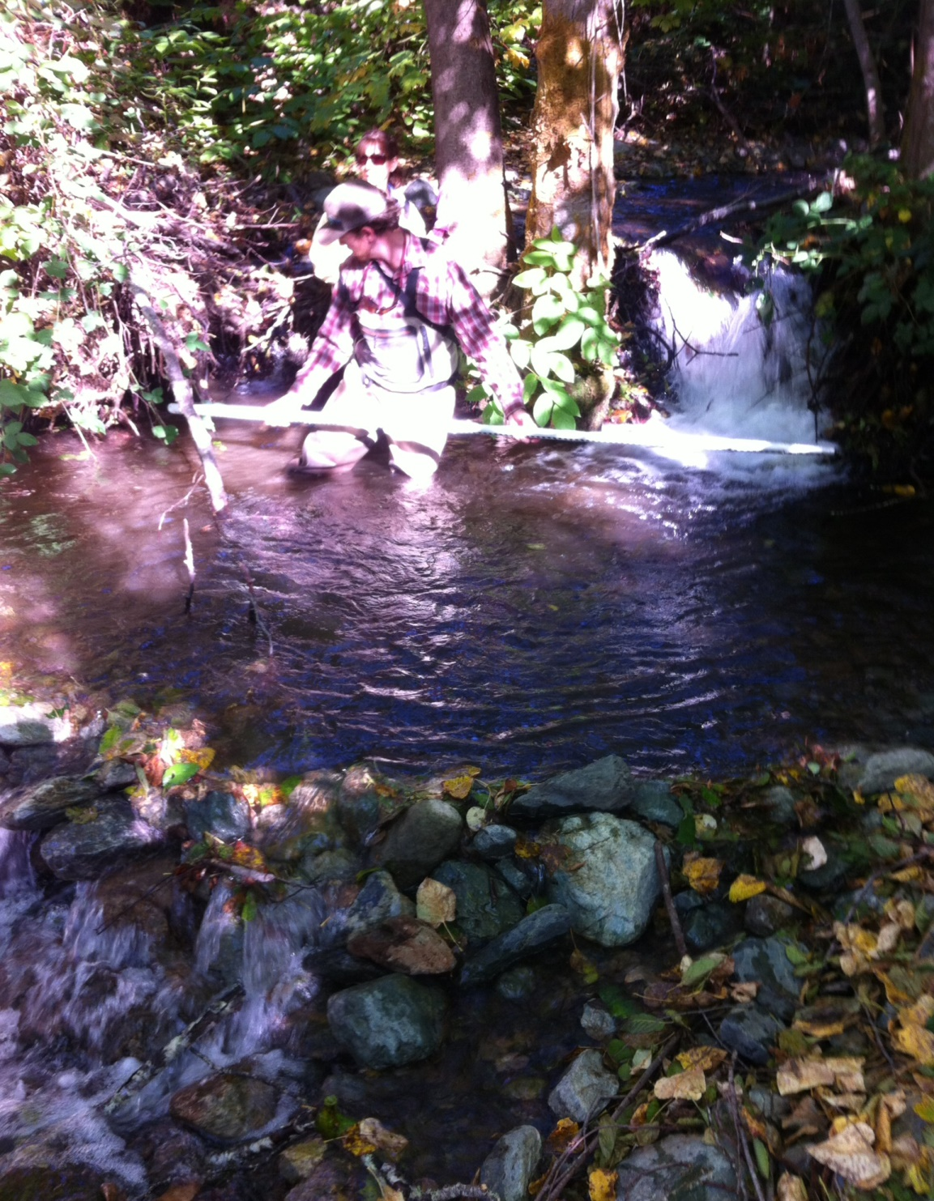
Man Made Pool
Lower Stanshaw Ck
@ 66 ft from floodplain
Jump Height at Base:
3ft up
1 ft lateral

Slide 9
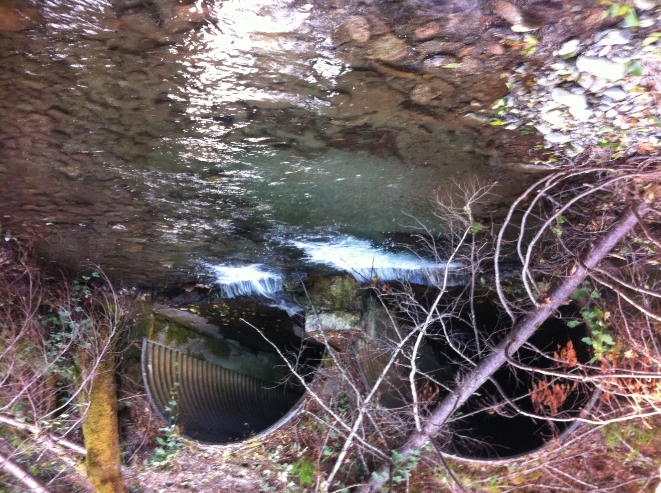
Stanshaw Creek
Hwy 96 outfall

Slide 10
Survey Results
Point of Diversion to floodplain is 4,284
  Note error in October 30 report – total in that report excluded the length below Hwy 96 (1,048 ft)
Channel Unit Composition below Hwy 96:
  12% Pools
  3% Riffles
  85% Complex fast-water stretches
Few marginal gravel patches
9 probable barriers to upstream migration

Slide 11
Expected Age 1+ Steelhead Densities by Channel Unit Type
Notes:
Change in surface area (width and length) and/or unit type

Slide 12
Notes:
Change in depth

Slide 13
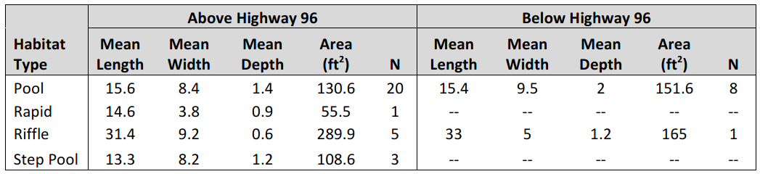
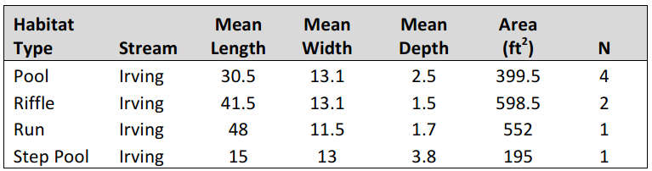
Stanshaw Creek
Irving Creek

Slide 14
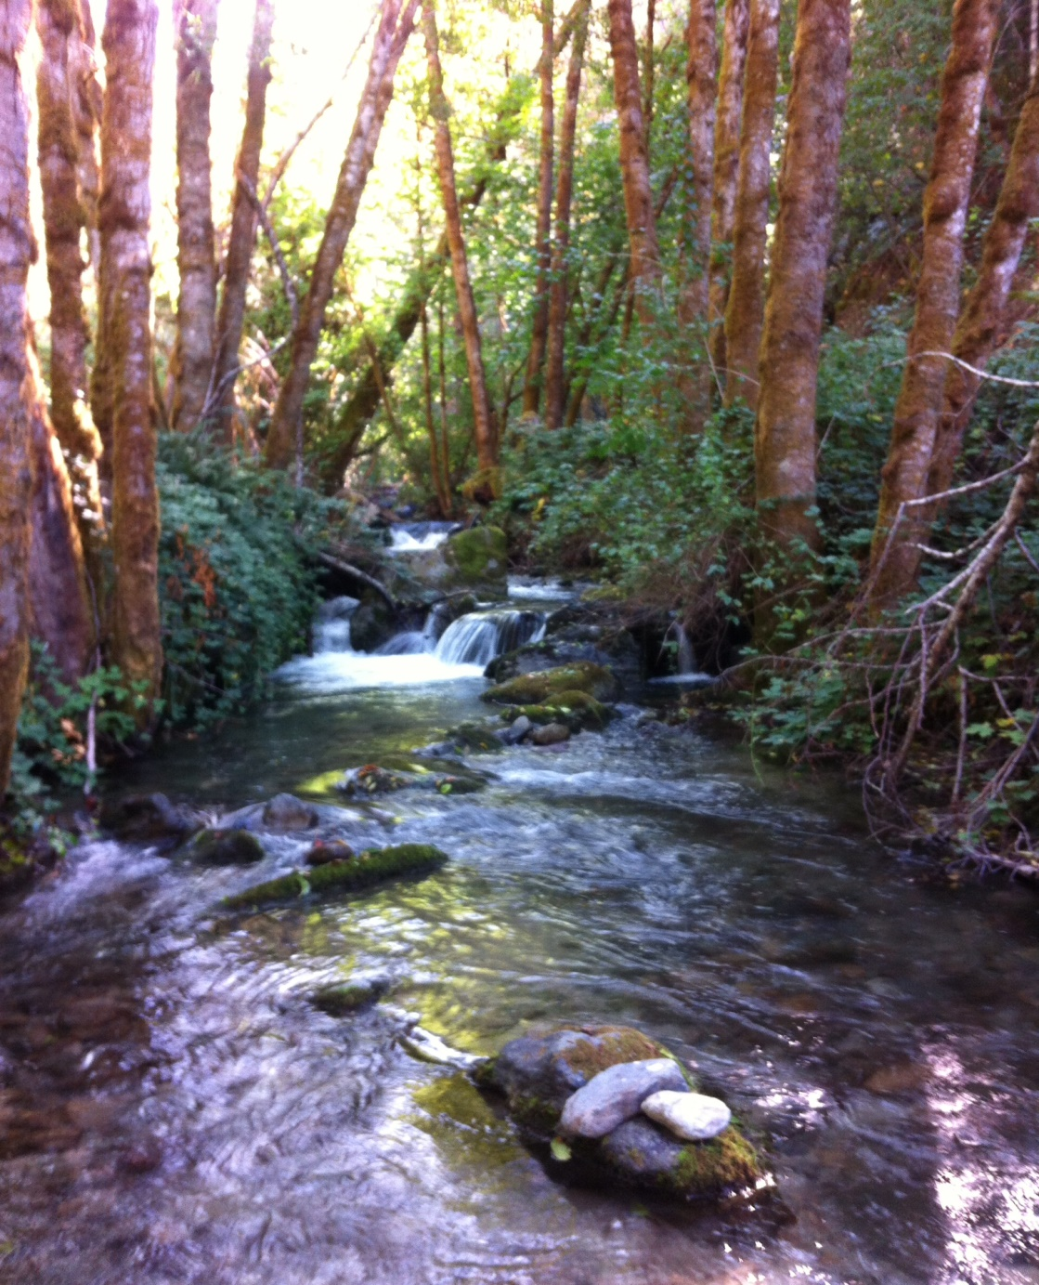
Irving Creek

Slide 15
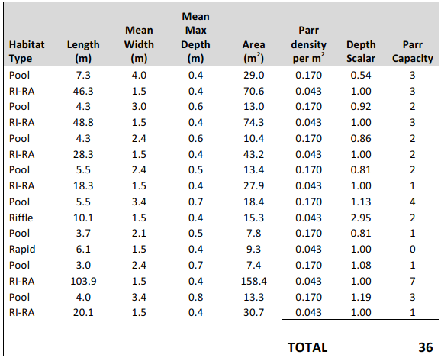
Steelhead Age 1+ Capacity
Stanshaw Creek below Hwy 96
Notes:
Note that pools have higher denisty.
I averaged densities across fish water units.
Explain depth scalar.
36 parr by 50% = 18 smolts x 10% = 1.8 adults at capacity in an above average year = not sustainable, could sustain small population of resident trout.

Slide 16
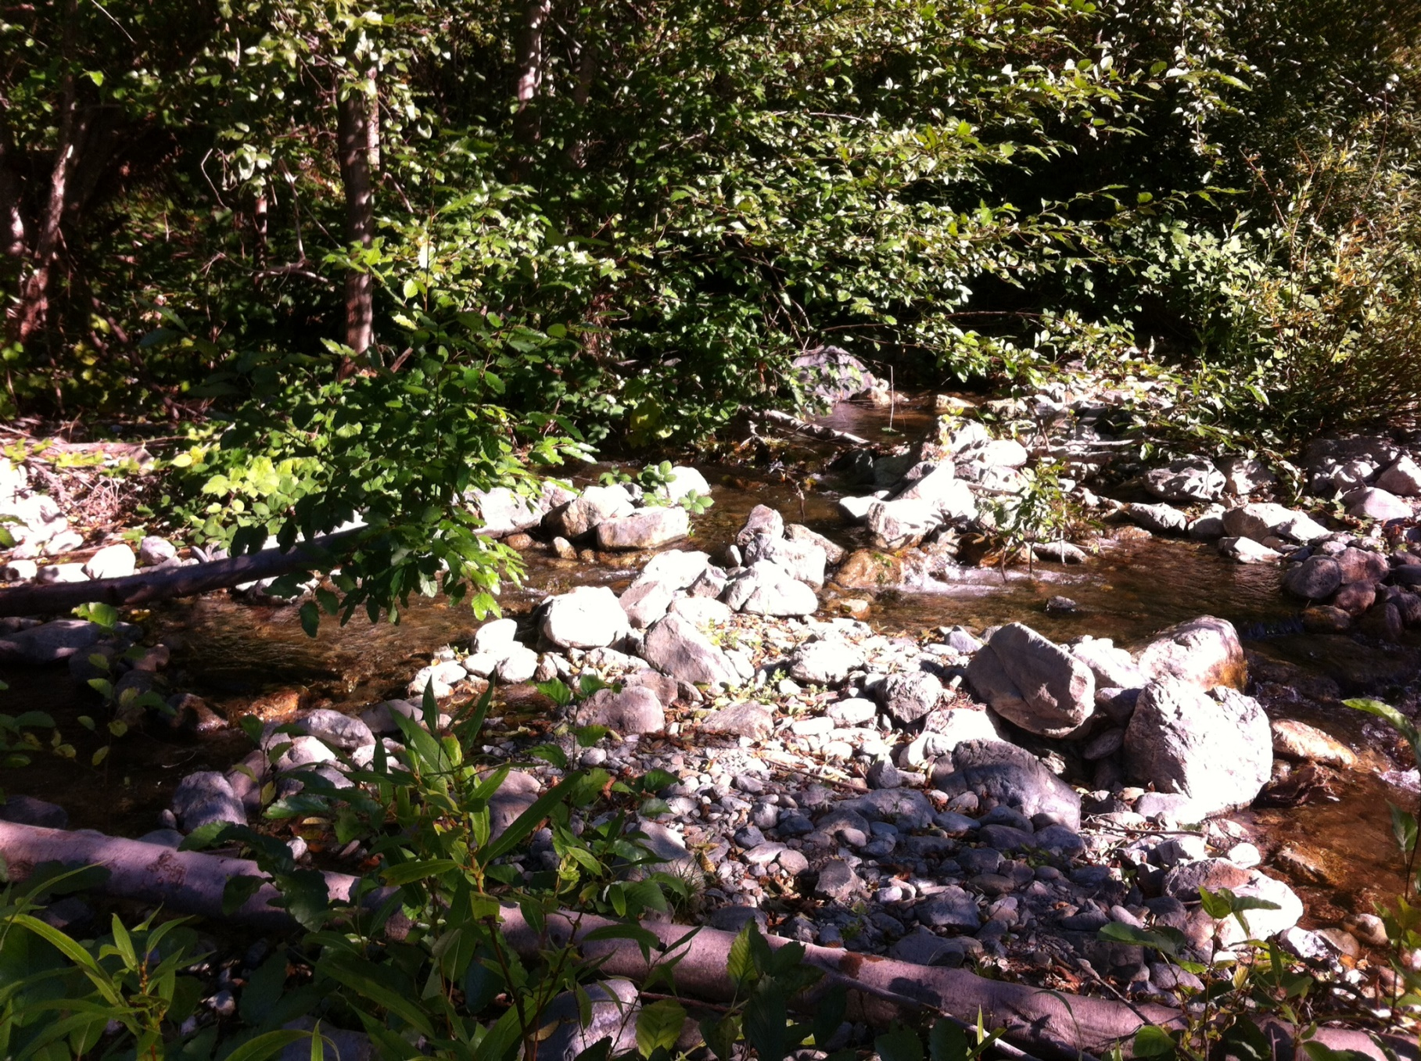
Notes:
The morphology of Stanshaw Creek changes dramatically as it enters onto the Klamath floodplain before reaching the floodplain pond. Right up to the edge of the floodplain, the channel is incised between confining hillslopes on both sides…The channel immediately becomes braided and spreads out on the floodplain. There are not trees and only occasional bushes.
Explain no trees is view to right where floodplain slopes down to river. Much of bush vegetation is alder.

Slide 17
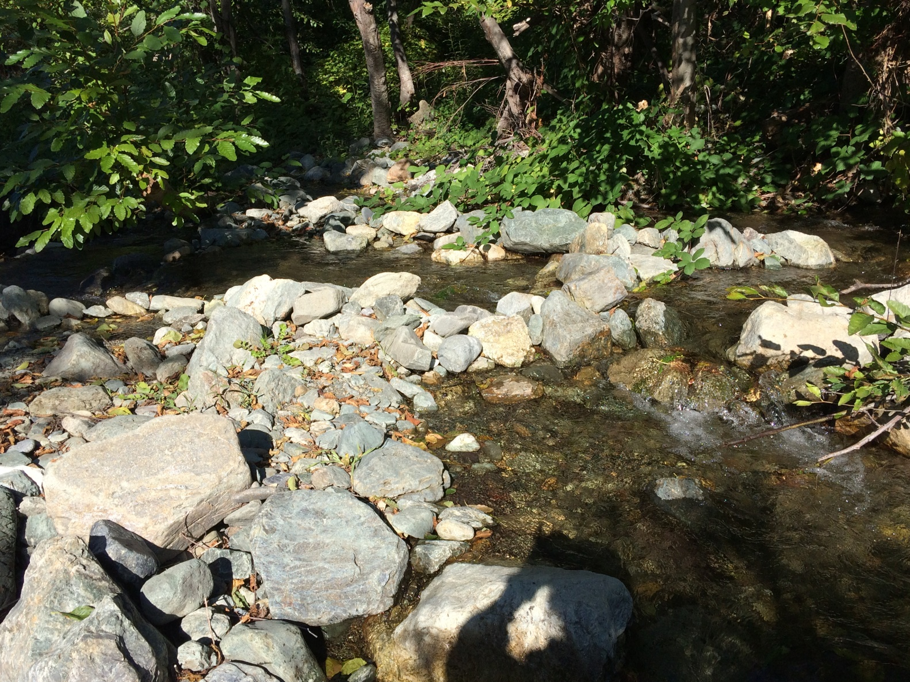
Notes:
Even with rock berms to direct flow, about 2/3 of flow goes downhill, acorss the floodplain directly into the Klamath River. Some here and some as leakage through berms
The confined channel of Stanshaw Creek is not directed at the pond, but is directed about 45º to the left looking downstream (to right in Photo 1 looking upstream). The velocity energy of the channel is toward the right in this picture, but rocks were hand-placed at the head of that channel to block its flow, and a continuing berm of. Thus, flow entering the Klamath floodplain must make a sharp right turn to reach the pond, which is located about 45 feet to the sharp right of the floodplain entry point.

Slide 18
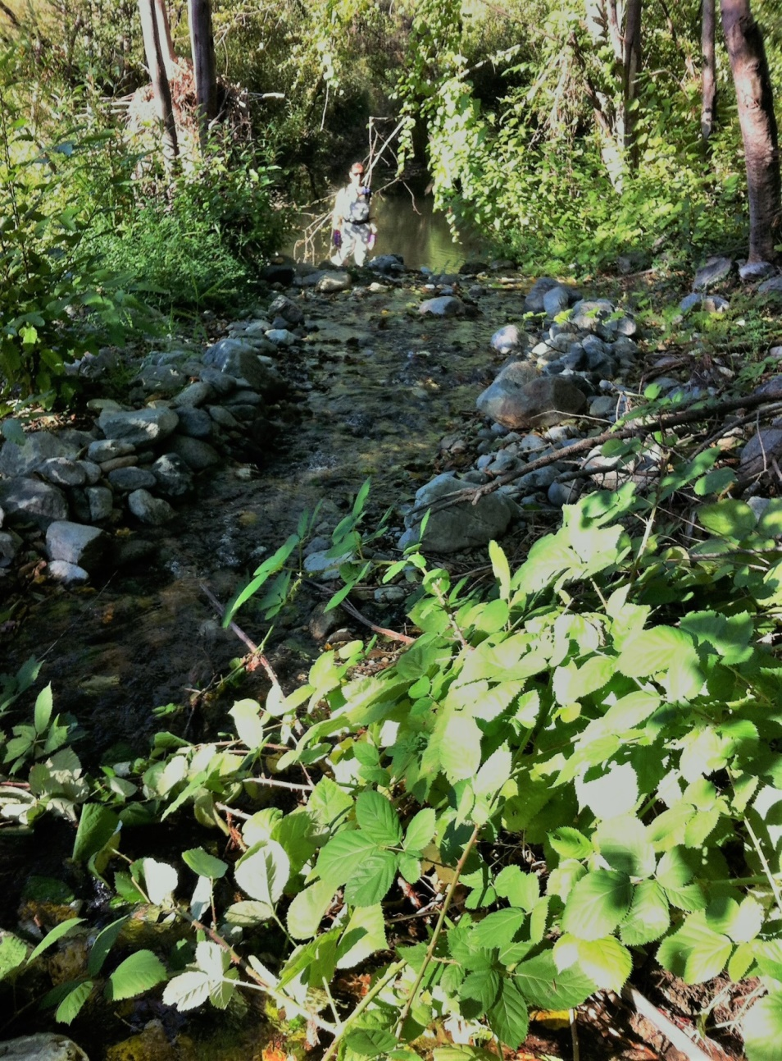
First bermed channel to Stanshaw Pond
Notes:
Note rock berms. 5 ft drop between camera and edge of pond. Distance is about 40 ft.

Slide 19
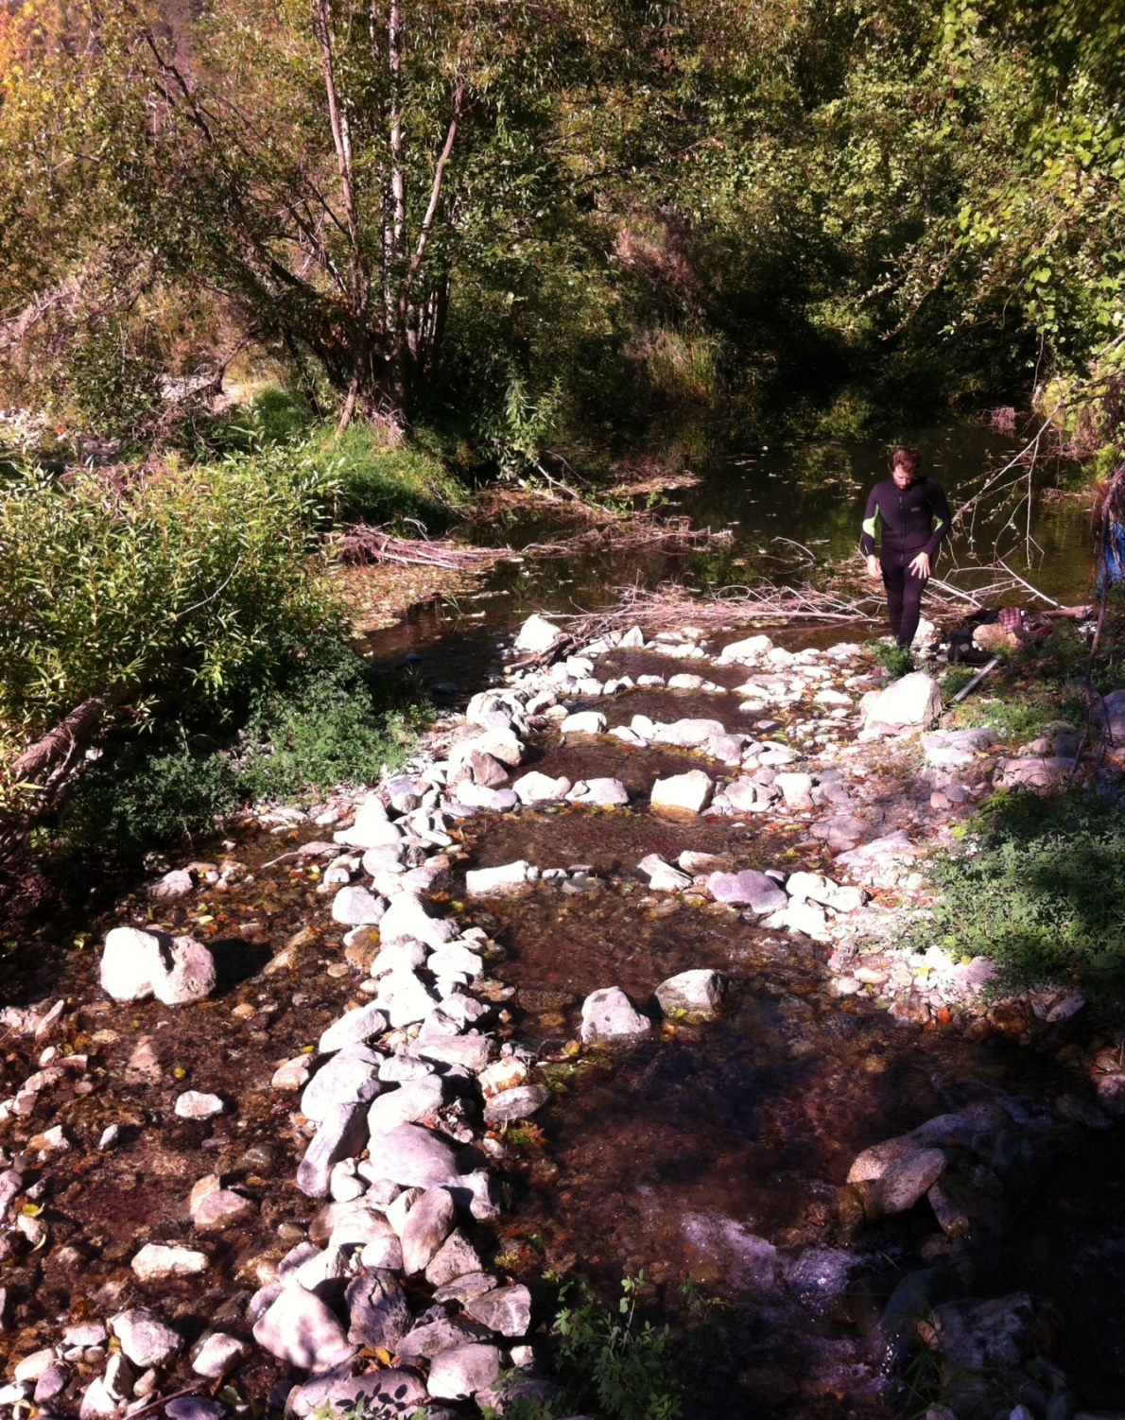
Second Bermed
Channel to
Stanshaw Pond
Steps apparently to aid upstream passage
There is no overflow from the pond to the river. All flow is passing through pores in rock berms.
Notes:
All flow that was entering the pond was artificially directed their by hand built rock berms that formed miniature levees leading water to the pond (Photos 1-3). This berm was no more than a few cobbles high, and would be completely washed away by high flows from Stanshaw Creek during fall through spring

Slide 20
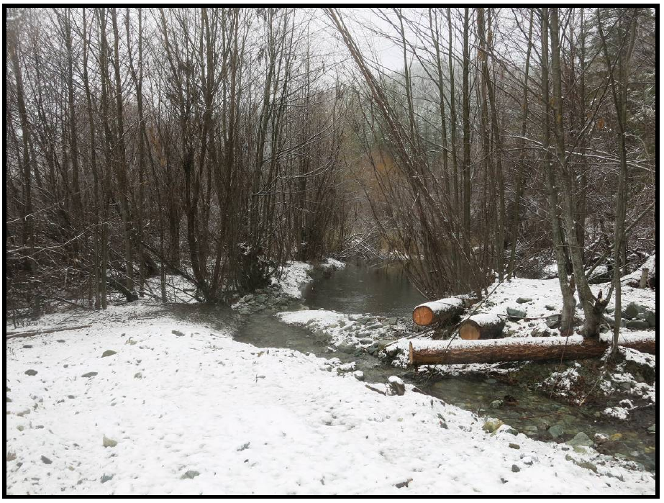
Stanshaw Pond, after Sept 2013 Enhancement
Notes:
Photo from WR-184 report on completion of Habitat Enhancement Project – Completed Sept 10-16, 2013.
Cannot see where the water exits in this picture. Outflow looks much different presently. Suggested constructed channel isn’t sustainable.
Photos show additions impair upstream passage far beyond natural.

Slide 21
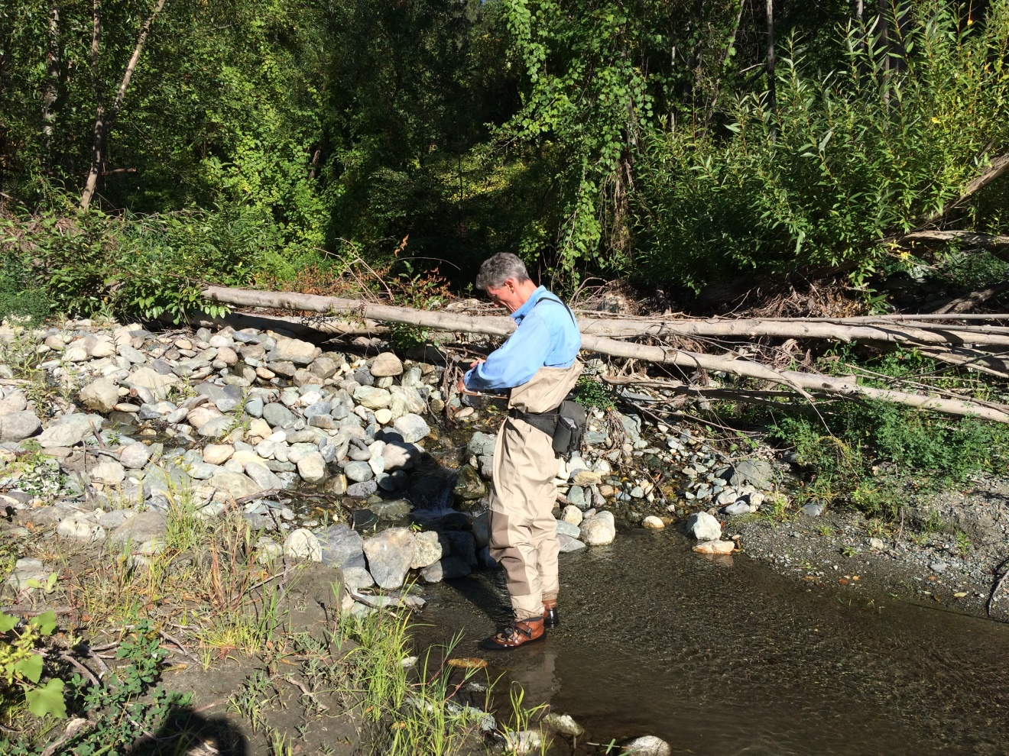
Rock Dam @ Stanshaw Pond Outfall
All Flow Passes Through the Dam
Notes:
There is no passage route up to the pond. None of the flow comes over the top, it all passes through pores in the rock. Flow is at least 6 cfs and much of that flow passes down the floodplain well to the right out of this picture.
, it appears that flow from Stanshaw Creek to the off-channel floodplain pool requires constant work by humans to redirect some of the low-season flow to the pool. Without the rock berms and the rock dam across the pond outlet, most or all of flow from Stashaw Creek would not have flowed to the pond. More flow will not cure this situation, but rather will tend to wash out or expand gaps in the man-made rock berms.
Absent the berms, fish access to the creek and pond would likely have been possible, although it is hard to determine what the pond and multi creek channels would look like without the extensive berms.

Slide 22
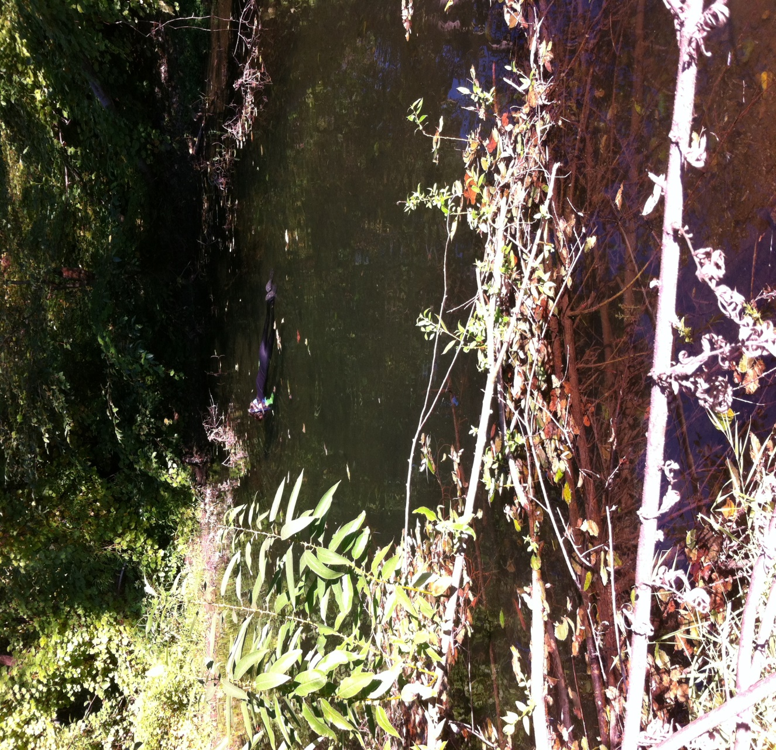
Snorkeler in West Half
Stanshaw Pond
Stream enters at right
1st Count:
9 St age 0+
2 Coho age 0+
2nd Count:
15 St age 0+
1 St age 1+
October 3, 2017
Notes:
159 x 91 and 1.5 to 4 ft deep
Less than 30 St and 5 coho
the Karuk tribe (methods not given) observed 156 juvenile Coho in the creek in 2005, 130 in 2008, and 55 in 2010. During 2005-2009 they also observed over 100 steelh each yr. Whitmore estimate 120 were present in the floodplain pond in 2012. and the enhancement report shows an estimated 105 coho in Feb 2014 (would emigrate in spring). All of those observations were made before hydro plant operations were diminished.
Krall (2014) estaimated 10 coho in summer 2014. We observed only 2 in 2017.
Yurok tribal report from 2011 on thermal refuge monitoring during summer cite examples of Red Cap and Elk creeks where natural change dramatically alter fish use between years.
Also, reported the heavy human visitation caused fish to leave the ponds on Horse Linto Creek and Indian Creek.
Further, reported in the hundreds and thousands of juveniles in 2010 and years prior, only chinook and steelhead were observed, no coho
When fish congregate in such refuges, it is not uncommon that some arrive with diseases and subsequently died in the refuge. I have observed such occurrences in tributaries to the Rogue River and the Willamette River that are used as cold water refuges.

Slide 23
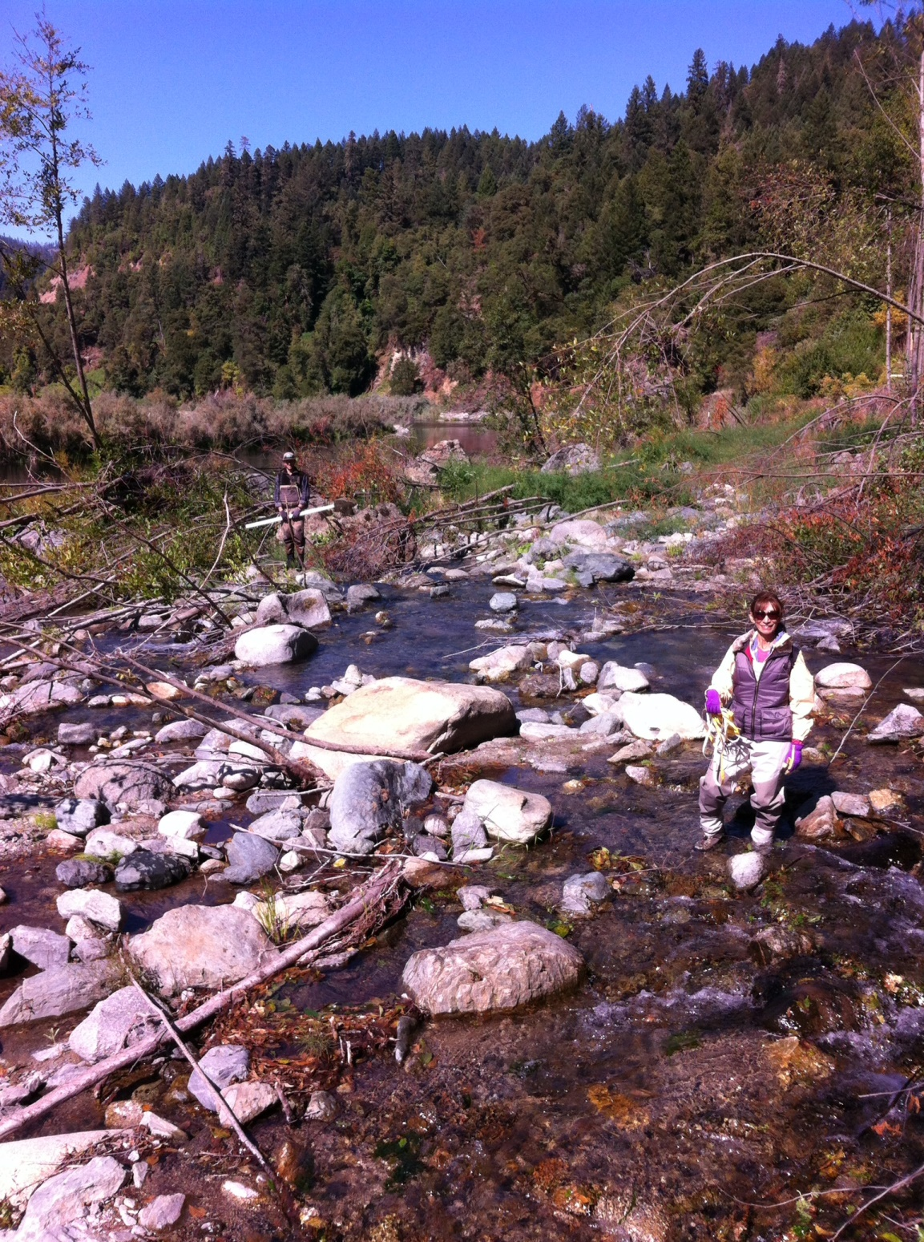
Irving Creek
Entry to Floodplain
Notes:
Although the stream braided into numerous channels upon entry to the floodplain, at least one of the small channels formed a small pond within a clump of rooted vegetation on the floodplain.
Within 30 ft onto the floodplain the flow had spread over braided channel already 120 ft wide

Slide 24
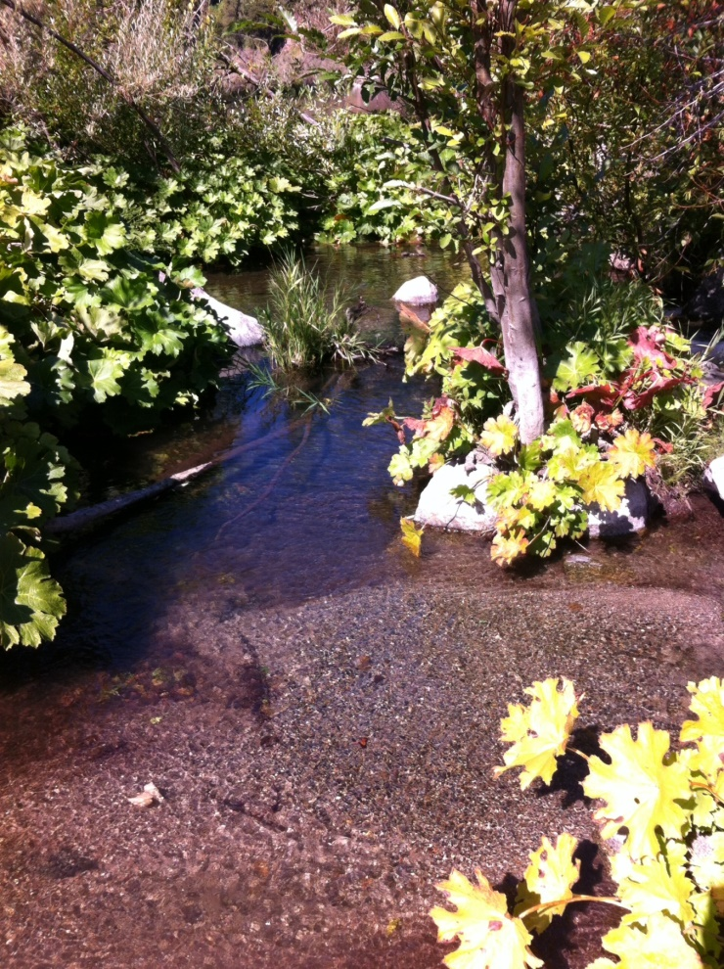
Irving Creek
Floodplain Pond
Fish were observed

Slide 25
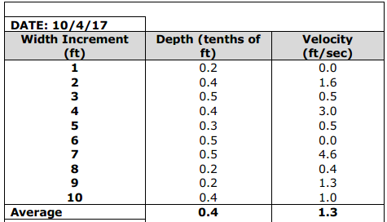
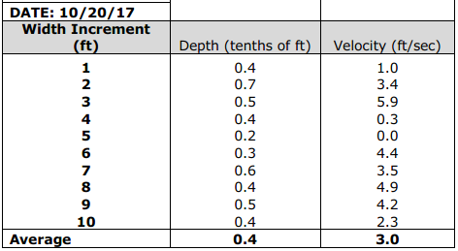
Stanshaw Creek
Riffle Crossection
5.3 cfs
14.2 cfs
Notes:
Swoofer model 2100 velocity meter
On October 20 at an estimated flow of 14.2 cfs, most of the riffle is less than 6 inches deep and velocities already reach 4 ft/sec or more across almost half the channel (Tables 7 and 8). These are shallower depths and faster velocities than preferred by juvenile salmonids. We chose this location because it was one of the few distinct riffles in stream, and riffle has slower velocity that either rapid or a cascade
these measurements indicate is that conditions for rearing juvenile salmonids are declining, rather than improving, as flows increase. Due to the effects of high gradient, velocities will increase quickly with further increases in flow, and Stanshaw Creek will become a very difficult environment for juvenile salmonids to survive in through the winter.

Slide 26
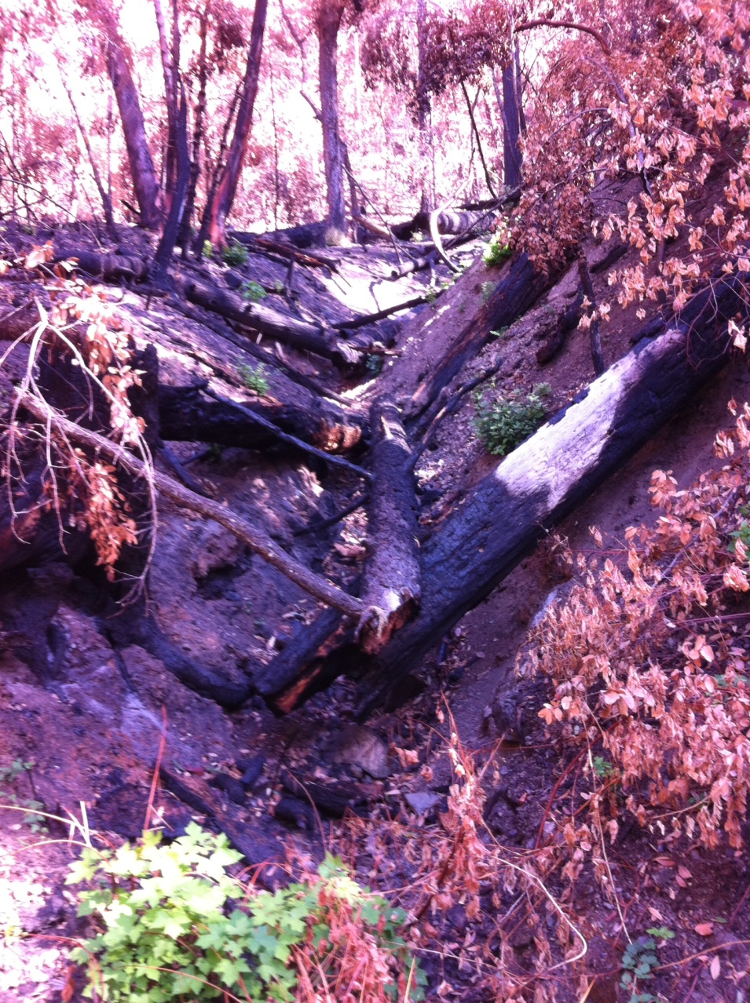
Gulley uphill from MMR canal

Slide 27
Conclusions
Stream morphology and habitat suitability for salmonids is low and primarily driven by the 9% to 11% stream gradient.
Upstream passage is blocked within 40 ft above the Hwy 96 crossing.
Habitat is not suitable for coho and capable of supporting less than 50 steelhead parr at moderate summer flows. Capacity likely declines as flows increase, due to increasing velocities.
The floodplain pond is capable of providing cool water refuge through the summer, and high flow refuge in winter-spring for juvenile salmonids, at least in some years.

Slide 28
Conclusions (2)
Man-made rock berms intended to direct flow and increase depth, also created substantial impediment to upstream access by juvenile salmonids to both the pond and stream.
Floodplains are dynamic, and the function of Stanshaw Pond as a refuge is likely to vary widely between years without annual human intervention.
Monitoring data indicate the Stanshaw Pond likely functioned more effectively as a refuge before the 2013 Habitat Enhancement Project than it has since.
Flows of 1 cfs into the pond should be more than adequate to maintain water quality during summer.

